Slide 1
Mindless Eating Research Experiment
Amanda Meszaros

Slide 2
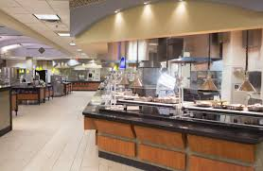
Describe the topic and methods of the mini research study.
I conducted a mini research experiment that was an observational study within Dorrill Dining Hall.
I went to the dining hall with five of my other friends and did not mention the observational study until after dinner.
I waited to see how many plates each individual collected in order to look at the average number of plates.

Slide 3
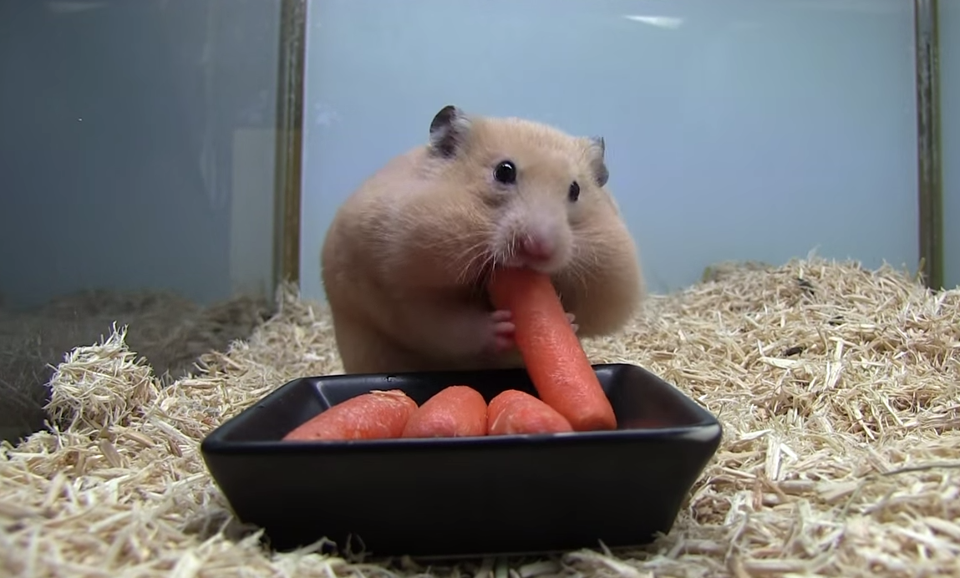
Why is researching this particular topic and research relevant to the general population?
I believe that this topic is crucial because I do not think that people realize that they do not have to eat until they feel so full that they are going to pop. This is primarily because people nowadays, especially college students, eat so quickly that the body has not had the time to process the influx of food so they keep eating and once the first plate of food hits the stomach, they realize they have had too much.

Slide 4
Who was studied?
Subject 1:
Female & college student
Subject 2:
Male, college student, & extremely active
Subject 3:
Male & college student
Subject 4:
Female, college student, & extremely active
Subject 5:
Female & college student
Subject Ages: 18-21

Slide 5
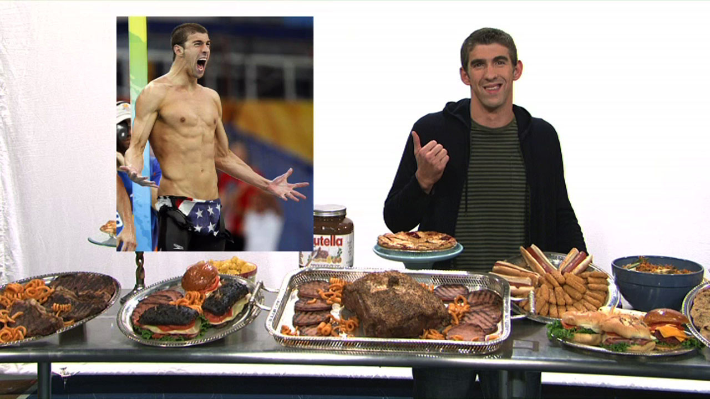
What was the hypothesis?
Hypothesis: If the student is active or eats quickly, they will collect more plates of food by the end of their meal

Slide 6
State the study’s methods.
I recorded how many plates of food five subjects consumed normally.
I recorded whether of not they were active individuals (preformed exercises on a daily basis).
I recorded ages and gender
I also observed how quickly each subject consumed their food

Slide 7
What were the findings of the research?
Subject 1: 1 plate & ate slowly
Subject 2: 3 plates + dessert & ate quickly
Subject 3: 2 plates & ate quickly
Subject 4: 2 plates & ate at a relatively normal speed
Subject 5: 1 plate & ate slowly

Slide 8
Were results similar throughout the subjects tested? Why or why not?
The results were not constant for each individual throughout the study.
This is primarily due to differing appetites and differing levels of activity throughout the day.
The speed in which the food was consumed is also a key component when it comes to the outcomes.

Slide 9
Did the findings match the hypothesis? Why or why not?
Hypothesis: If the student is active or eats quickly, they will collect more plates of food by the end of their meal
The findings did match the hypothesis because if the subject was extremely active or ate overly fast, the more plates accumulated on their behalf.

Slide 10
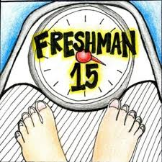
What observations/opinions can you make regarding the results and the Longwood University population?
The observations of the study definitely show that college student or the general population consume food far to quickly and end up eating more food than they actually need in order to consider themselves as full.

Slide 11
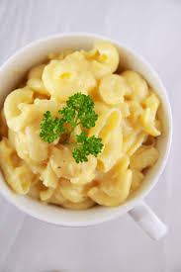
How can these results help to change “Mindless Eating?”
The results of this study may help change “Mindless Eating” by making individuals more aware of how quickly they may eat and if they slow down they may come to the realization that they can eat slowly and still fill up just the same.

