Slide 1
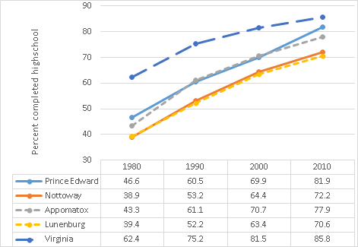
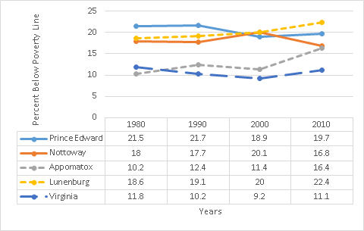
Educational Attainment & Poverty Levels in Southside Virginia, 1980-2010
Colin Dominick, Amanda Meszaros, Katrina Sexton, and Cole Roberts
HON 295 MATH-SOCL Interdisciplinary Link, Longwood University
Background Information
In the 1950s, Prince Edward County’s public school system closed in protest to the Brown v. Board of Education decision. While the effects of the closings have been studied by researchers during the time of the closings, little research has been addressed to how graduation rates have changed over time (Brown 2010, Hackman 2010, Losen 2004, Brookover 1993). In studies with educational attainment as a focal point, correlations between median education and poverty were made (Nitardy 2015). Researching the association between educational attainment and poverty rates is important due to the fact that previous studies have claimed that increased education can result in a raised income (Berry 1980). In order to observe how Prince Edward County is currently influenced by the public school closings, the graduation rates/educational attainment of students within Prince Edward County can be compared to surrounding counties and Virginia as a whole.
Results
Figure 1: Educational Attainment
Dashed Line - Schools Open
Virginia
Solid Line - Schools Closed
Figure 1 Results
Figure 1 represents the percentage of people in all four counties who have graduated high school or obtained a GED. The graph has a positive trend, showing that the percentage of students who have obtained a high school level of education has increased, and has begun to close the graduation rate gap within Virginia as a whole.
Objectives
Observe the change in educational attainment from the earliest attainable, comparable data 1980 to 2010.
Observe the change in poverty from the earliest attainable, comparable data 1980 to 2010.
Figure 2: Poverty Rates
Figure 2 Results
Figure 2 represents poverty rates. All of the counties have stayed about the same with minor fluctuations. However, if we look at the data, Virginia as a whole is lower. This could possibly be caused by the economic differences between Northern and Southern Virginia.
Methodology
Data for this study comes from the United States Census focusing on individuals 25 years of age and older. Counties for comparison in this study were chosen using the typology found in Brown (2010). This typology was created based on whether or not school closings occurred after the Brown V. Board of Education decision. The counties that closed their schools included: Prince Edward County and Nottoway County. The counties that were less resistant to integration included: Appomattox County and Lunenburg County. In addition to comparing counties, this study also makes the comparison with the state of Virginia to see trends in relation to the state. For this study, educational attainment is operationalized as obtaining a high school level education, this includes a GED. Poverty is defined by federal guidelines.
Conclusion
According to the data there is a clear increase in educational attainment at the high school level between 1980 and 2010 for all localities. However, we were surprised by Figure 2 since poverty levels remained somewhat consistent over time. This was unexpected because we thought the increase in educational attainment would result in poverty decreasing.
School closings initially had a negative impact on the percentage of people who attained a high school level education. As time has progressed, the damage has begun to reverse itself resulting in higher educational attainment in Prince Edward County and surrounding counties. Unfortunately, the earliest attainable data utilized in the study dates back to the 1980s due to differing federal calculations of poverty rates. Additional research on the poverty in these counties would be interesting because of the stagnation in spite of increasing educational attainment. One possible reason for the difference in poverty rates, between the state as a whole and the southern counties is the difference between the economies in Southern and Northern counties of Virginia. No evidence was found supporting the idea that there is a link between educational attainment and poverty rates.This could be because of a possible time lag between the increase in educational attainment and poverty rates. Future research could be done to find a possible link between educational attainment and poverty rates; by conducting a similar research project that compares these variables across different areas in the country.
Citations:
Berry, A. (1980). Education income productivity and urban poverty.
Brookover, W. B.. (1993). Education in Prince Edward County, Virginia, 1953-1993. The Journal of Negro Education, 62(2), 149–161. http://doi.org/10.2307/2295190
Brown, H. (2010). ‘They must be discontented’: racial threat, black mobilization and the passage of school closing policies. Ethnic and Racial Studies, 33(B), 1392-1411.
Censtats Database. (2010). Retrieved November 4, 2016, from http://censtats.census.gov/cgi-bin/usac/usatable.pl
Green, R. L., & Morgan, R. F.. (1969). The Effects of Resumed Schooling on the Measured Intelligence of Prince Edward County's Black Children. The Journal of Negro Education, 38(2), 147–155. http://doi.org/10.2307/2294274
Heckman, J. J., & LaFontaine, P. A. (2010). THE AMERICAN HIGH SCHOOL GRADUATION RATE: TRENDS AND LEVELS. The Review of Economics and Statistics, 92(2), 244–262. http://doi.org/10.1162/rest.2010.12366
Losen Daniel J., Orfield Gary, Wald Johanna, Swanson Christopher B. Losng our Future: How Minority Youth are being Left Behind by the Graduation Rate Crisis. Urban Institute; Advocates for Children of New York; New York: 2004.
Nitardy, C. M., Duke, N. N., Pettingell, S. L., & Borowsky, I. W. (2015). Racial and ethnic disparities in educational achievement and aspirations: findings from a statewide survey from 1998 to 2010. Maternal And Child Health Journal, 19(1), 58-66. doi:10.1007/s10995-014-1495-y

