Slide 1
App Review
Megan Mellenkamp

Slide 2
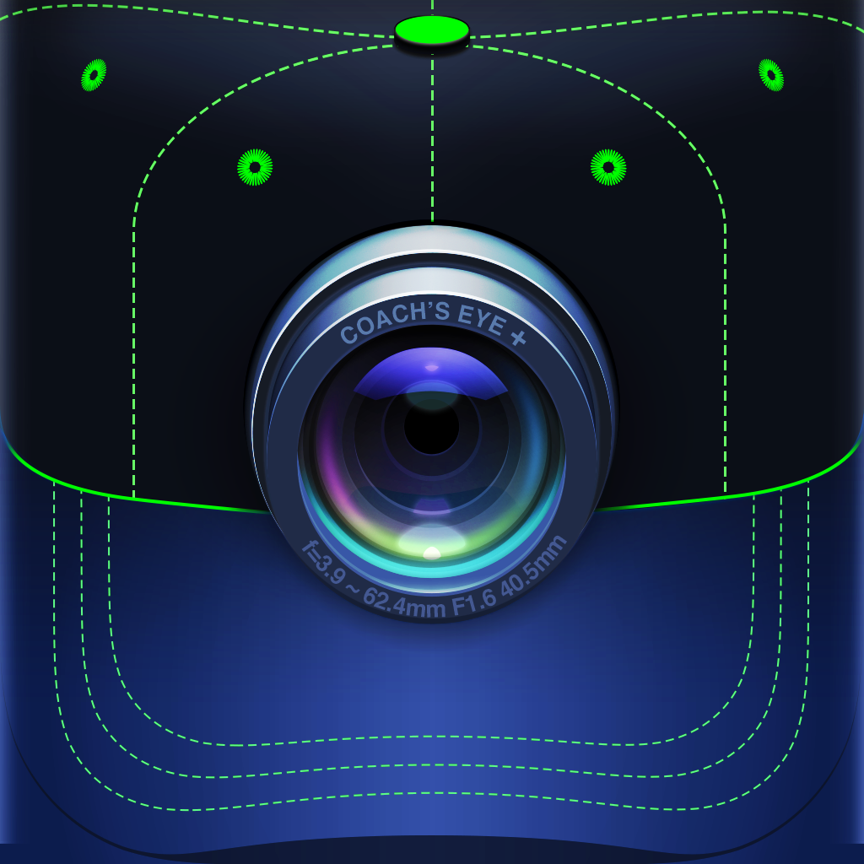
Coach’s Eye
This app is a video platform for coaches and athletes who need to review athletic technique.
Coach’s Eye delivers state of the art coaching and content management tools on any mobile device anytime, anywhere.

Slide 3
Application to Learning
Applying this app to a learning environment would help the students succeed more.
The reason they will be able to succeed more is because the app allows the teacher to record whatever skill or activity the students are doing, and then they are able to watch the footage back and analyze it.
Teachers will be able to analyze the film on the field or in the gym. They are able to play the video back in slow motion, allowing them to look at the video frame-by-frame. This is important because the teacher will be to help the student improve their technique with specific detail from the slow motion video.
They can also look at two videos side-by-side to see if there was any improvement from when they tried the skill or activity again.
This app is also helpful for the students to record themselves and be able to see by themselves where they need improvement, this is great for self-growth.

Slide 4
Teacher or Student App
This app is mostly for the teacher, but it can be a great tool for the students to use as well.
The students can record themselves, review the footage, and see where they need to make the most improvement.
However, the app is more of a teacher app so that the teachers can easily look at the students progress with great detail from the tools the app provides.

Slide 5
Ease of Use
This app is very easy to navigate. It has so many useful tools that make showing back footage easy to understand and highlight certain parts of the video.
It has tools in it that allow the teacher to draw on the video using lines, shapes and arrows to clearly illustrate their points and emphasize technique.
Other useful and easy tools the app has is the stopwatch to show elapsed time, a spotlight tool to highlight important details, and an angle tool to measure accuracy
Another fantastic part of this app that makes easy to use is that you can use it on any mobile device at anytime.

Slide 6
How to Utilize Coach’s Eye in Physical Education
This app could be utilized best in an elementary school physical education classroom.
The teacher can use Coach’s Eye to record the students while they learn and develop their locomotor skills. Then see where each student needs to improve on their skills by playing the video back and using all the special tools to analyze the footage.
This app can be utilized in a high school physical education classroom as well.
The teacher can use the app to analyze the students while they play the different activities that day. For example, they could be playing a 3 on 3 basketball game, the teacher can use the app to record the game and then go back, analyze the film, and show the students how to improve their form and skills for when they play another round.

Slide 7
Costs Involved in Coach’s Eye
The app has two packages with an annual fee
The Individual Package costs $120 a year
The Team Package costs $240 a year
These prices do seem a bit costly, however, these packages are advanced and suitable for a physical education class and can really bring out the best in the students and their physical activity skills

Slide 8
Overall Like and Dislikes of Coach’s Eye
Likes:
As a whole, I think the app is fantastic and has incredible tools that teachers can use when they need to assess and evaluate their students in their skills that they learn and develop in physical education.
My favorite tool featured in the app are the drawing tools for making lines, shapes and arrows to illustrate the points and technique. It’s very smart and very useful.
Dislikes:
My number one dislike of the app is how expensive it is for each package. Some schools may not want to fund it to help pay for the package. It’s unfortunate because this app is an extremely helpful and has useful tools within the app to help develop our students.

Slide 9
ImgPlay Pro
This app allows you to easily create GIFs or videos, using live photos, standard photos, burst photos, and videos.
For teachers, they will be able to use this to create GIFs to show students so they can learn new skills.

Slide 10
Application to Learning
This app would be extremely useful in a physical education classroom.
The teacher can create GIFs and/or video to show the students when they are learning a new skill or activity in the classroom that week.
These app is a great learning tool for the students because the will be able to replay the GIFs and video over and over as many times as they want until they fully understand the concept of what they’re learning that week.

Slide 11
Teacher or Student App
This app can be used by the teacher and the students.
The teacher can use it to create GIFs and videos to show the class so they can easily learn the new things that will be taught that week.
The app can also be used by the students, the teacher can create an assignment for the students to create a GIF or video of the skill or activity. They can share with the GIF or video with the teacher via email for a grade.

Slide 12
Ease of Use
This app is very easy to use for the teachers and the students.
The making of the GIFs and short videos in the app are very simple to create and just as easy to share.
The overall mechanics of the app are simple not hard to use at all for teachers and students.

Slide 13
Utilizing ImgPro Play in Physical Education
This app is an excellent tool to utilize in the gym.
The teachers can use it to create GIFs and videos to demonstrate different skills and activities for the students. Teachers can also make an assignment for the students by setting them up in groups and giving them a specific skill or activity to perform and then sharing it with the rest of the class.

Slide 14
Costs of ImgPro Play
This app costs $2.99, which is a very affordable price for schools.
The app also has a 4 ½ star rating that is compatible with iPhones and iPads.

Slide 15
Overall Likes and Dislikes of ImgPro Play
Likes:
I like the app as a whole. I really like that you can make these GIFs and videos and have the ability watch them over again as many times as you as you want.
The GIFs that you can create in this app are great tools for the students and teachers to utilize.
If the students were to use the app as an assignment to record themselves performing a skill or activity, then it promotes great self-growth in the physical education class.
Dislikes:
One dislike I have with app is that it could be free. It doesn’t have super advanced tools within it. It is simply an app to make video and GIFs.

Slide 16
References
https://www.coachseye.com/
https://www.appannie.com/en/apps/ios/app/imgplay-pro-animated-gif-maker/

