Slide 1
Gulf Coast jaguarundi Herpailurus yagouaroundi cacomitli
Megan Curry

Slide 2
Description
Two colors: blackish to brownish grey or reddish yellow to chestnut
Body is long and low with short legs
Small flattened head
Slightly larger than domestic cat
Looks more like a weasel or otter
Weasel like ears with a long tail

Slide 3
Darker animals found in dense forests
Lighter colors found in more open areas
Habitats include forests, areas with a lot of brush, dense thorny shrublands
Description cont.

Slide 4
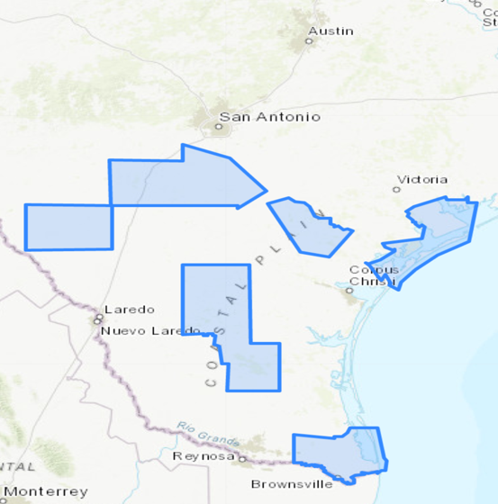
Status and Distribution
2
3
Status:
Endangered
Distribution in Texas counties:
Dimmit 2. Frio 3. Atascosa
Bee 5. Duval 6. Brooks
7. Cameron 8. Aransas 9. Calhoun
1
4
9
8
5
6
7

Slide 5
Natural History Information
Reach maturity around 2 and 3 years of age
Females have first estrus around 2 years old and repeat it every six months
Females gestation period lasts 70-75 days
Females give birth to 1-4 kittens and have two litters a year
Mating seasons are dependent on location: can be year-round or in November and December

Slide 6
Natural History Cont.
Are solitary except during mating seasons or raising kittens
Typically don’t migrate
They are diurnal which takes part in their diets
Carnivorous diet: birds, mammals, reptiles, frogs, fish, rodents
Can live 10-15 years in the wild or 16-22 years in captivity

Slide 7
Values of the Species
Commercially valuable through trapping and hunting
Economically valuable through aiding in the control of populations of rabbits, mice, and rats
Not very ecologically valuable due to small numbers and secluded nature
Not very aesthetically valuable because they are rarely seen by humans

Slide 8
Treats/Reasons for Decline
Mortality from collisions with vehicles
Border security activities
Habitat destruction
Degradation
Fragmentation associated with agriculture and urbanization

Slide 9
Treats/Reasons cont.
Increases and decreases in precipitation
Climate change
Competition with bobcats

Slide 10
Recovery/Conservation Actions
Assessing, protecting, reconnecting, and restoring habitat
Monitoring existing habitat
Investigate relationships with other carnivorous animals
Reduce the effects of human impact
Reduce road mortality

Slide 11
Recovery cont.
Evaluating reintroduction
Adaptive management
Develop more effective surveys
Assure long-term viability of conservation through:
partnerships
landowner incentives
application of regulations
education and outreach

Slide 12
Conclusion
Human interference is the main reason for decline
They don’t have a lot of support or values
There are very productive measures being taken
Based on current recovery actions delisting of the Gulf Coast jaguarundi could be initiated by 2050

Slide 13
Citations
https://ecos.fws.gov/docs/recovery_plan/FINAL%20Gulf%20Coast%20Jaguarundi%20Recovery%20Plan.pdf
https://ecos.fws.gov/ecp0/profile/speciesProfile?spcode=A05H
https://bigcatrescue.org/jaguarundi-facts/
http://www.belizezoo.org/mammals/jaguarundi.html
https://www.lamar.edu/arts-sciences/biology/jungle-critters/jungle-critters-2/jaguarundi.html

