Slide 1
Largemouth Bass
Micropterus salmoides
By: Christina Bell, Caroline Carter, Megan Curry, and Connor Marshall
Notes:
INTRO: (3-6 Slides)
Broad overview of species
Classification
Distribution
Commercial Use
Significance
Morphology
Conservation Status
Habitat

Slide 2
Taxonomy
Bernard Germain de Lacépède, 1802
French Naturalist
Order: Perciformes
Family: Centrarchidae
Genus: Micropterus
Species: salmoides
(Near et al., 2003) (ITIS, 2018)
Notes:
The Largemouth Bass (Micropterus salmoides) was first described in 1802 by Bernard Germain de Lacépède, a French naturalist who was an early evolutionary thinker. Lacépède wrote almost 20 works centering on naturalist thought in the late 18th and early 19th century (ITIS, 2018) (Schmitt, 2010). M. salmoides belongs to the family Centrarchidae, related to other sunfish species, with several sub species (Near et al., 2003). Its closest species is the Micropterus floridanus, or the Florida Largemouth Bass when assessed along mitochondrial lineages that speciated 2.5 million years ago (Near et al., 2003).

Slide 3
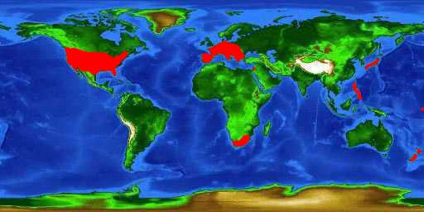
Distribution
(Bridges and Bester, 2018)
Notes:
The M. salmoides is native to the Eastern coast of the United States, but was introduced across the country as a game fish (Fuller, and Neilson, 2015). This species has been noted globally in other countries including South Africa, Europe, Guam, Japan, Lebanon, New Zealand, the Philippines, and Puerto Rico (Bridges and Bester, 2018) (ITIS, 2018) (Beamish, Booth, and Deacon, 2005) (Lorenzoni et al., 2002)(Tsukada and Yamamoto, 2010). The global distribution is likely due to the introduction of the species to new places where it acts as an invasive species.

Slide 4
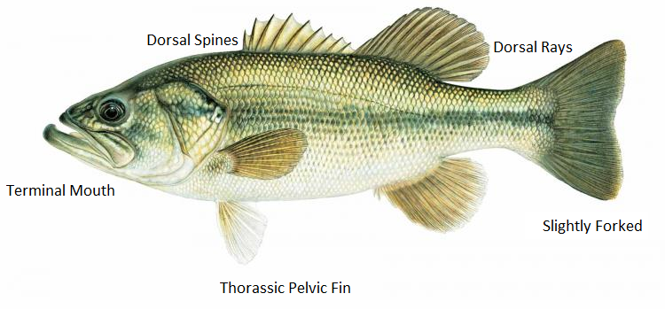
Morphology

Slide 5
Conservation Status
No known large-scale threats
Maintained populations for commercial use
(IUCN Red List, 2018)

Slide 6
Virginia Species
Notes:
In Virginia, there are both natural and introduced populations of largemouth bass (Fuller and Neilson, 2015) (NatureServe), that state fisheries monitor for game fishing and for monitoring the health and wellbeing of the system.

Slide 7
Objectives
In this study, we aimed to understand the life history of the Largemouth Bass in Virginia through morphometric and meristic analysis of 12 captured and preserved specimen. By studying these fish, we can further understand the health of the fish populations in the system, and the health of the system overall.

Slide 8
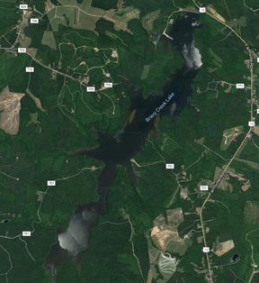
Collection Site
Briery Creek Lake
Notes:
METHODS: (3-4 Slides)
Field Collections
Meristic analysis
Morphometric Analysis
Electrofishing at Briery Creek Lake on Sep 21st

Slide 9
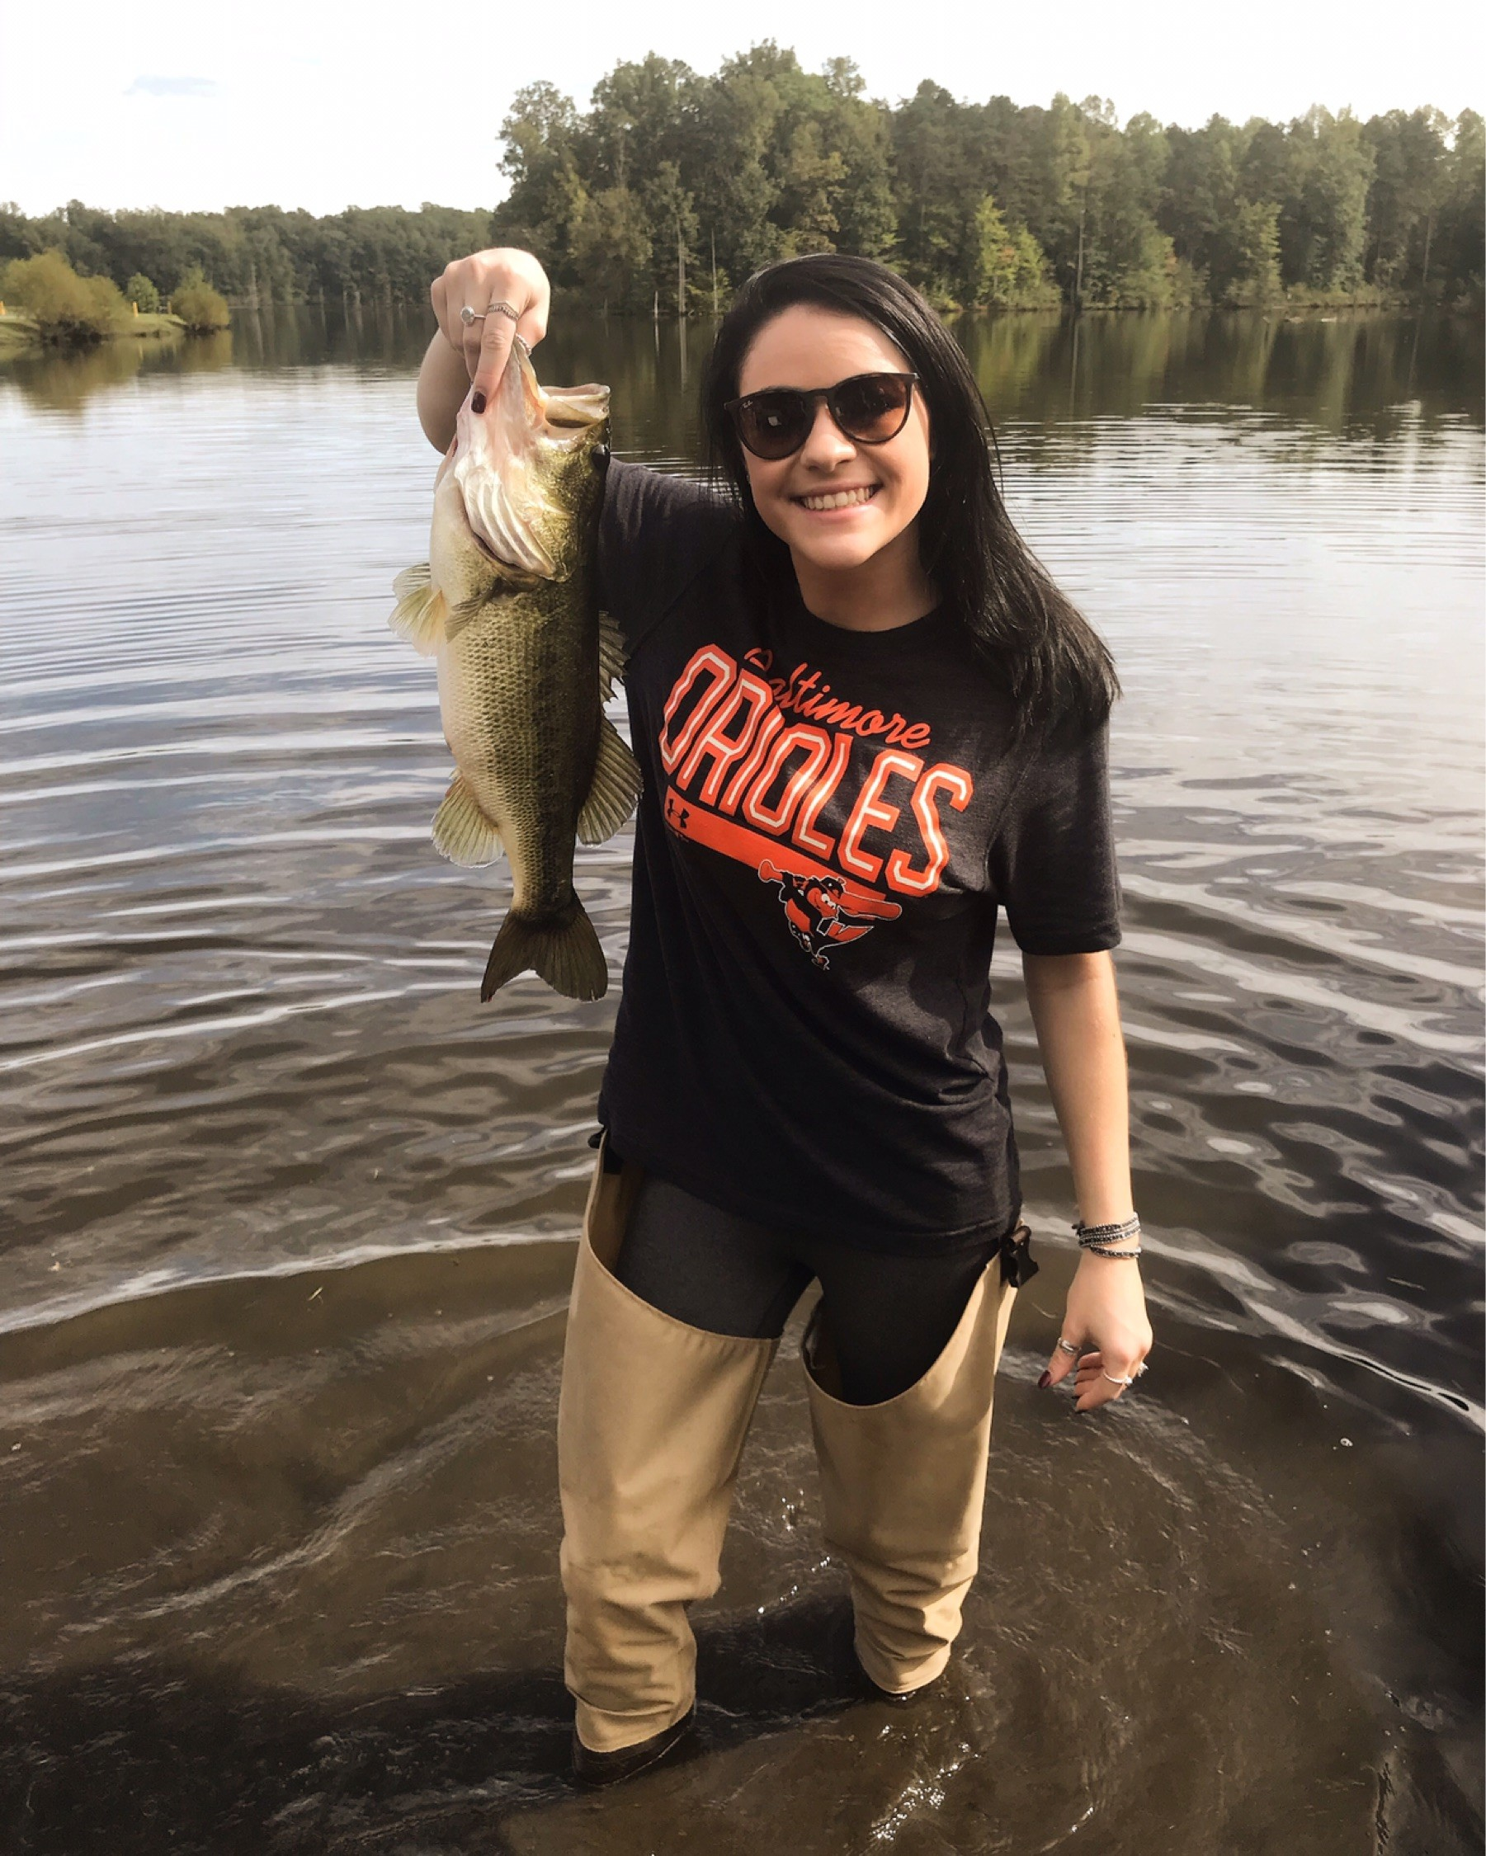
Field Collection
Notes:
Field Collection
Fish were caught in nets and put into a storage area
Larger specimens were kept and the smaller were thrown back in
Specimens were euthanized using MS-222 and stored in ethanol

Slide 10
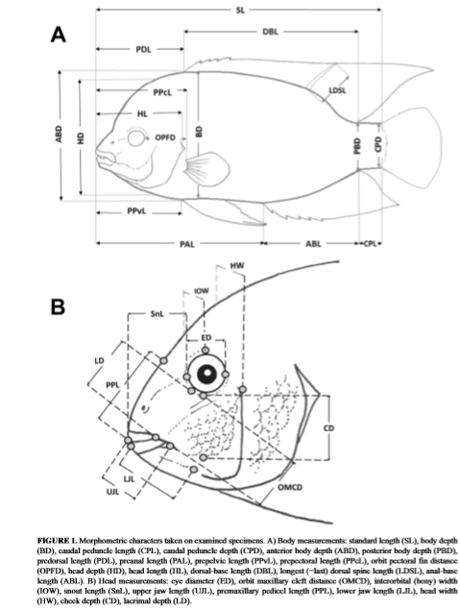
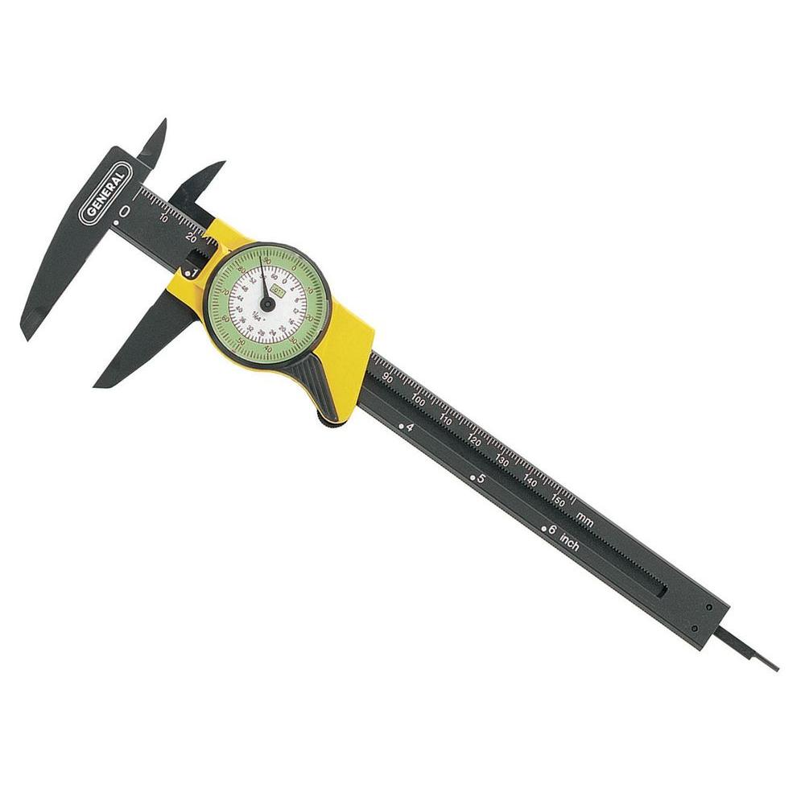
Methods (Cont.)
Meristic and morphometric data was taken for each fish
Measurements were done with a ruler and caliper

Slide 11
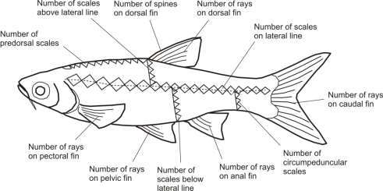
Methods (cont.)
https://www.researchgate.net/figure/Common-meristic-data-collected-by-taxonomists-Source-Adapted-from-Rainboth-1996-and_fig13_318816871

Slide 12
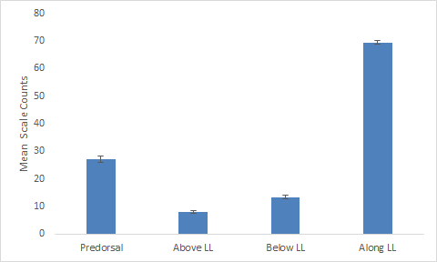
Results
Figure 1: Scale counts for Largemouth Bass (Micropterus salmoides). Predorsal mean scale counts were 27.2, while above, below and along the Lateral line were: 8, 13.25, and 69.4 respectively. Error bars represent standard error.
Notes:
Results: (4-6 Slides)
Weight
Total Length
Standard Length
Meristics
Morphometrics

Slide 13
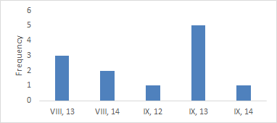
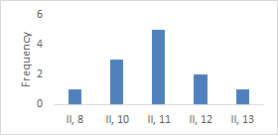
Results cont.
Figure 2: Dorsal spine and ray count combination frequencies for Largemouth Bass (Micropterus salmoides). Roman numerals are used to denote spine counts and Arabic numerals indicate ray counts.
Figure 3: Anal spine and ray count combination frequencies for Largemouth Bass (Micropterus salmoides). Roman numerals denote spine counts while Arabic numerals are used to indicate ray counts.

Slide 14
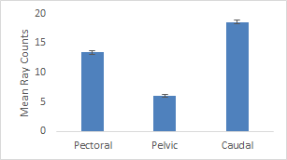
Results cont.
Figure 4: Mean pectoral, pelvic, and caudal fin ray counts for Largemouth Bass (Micropterus salmoides). Pectoral mean ray counts were 13.4, while pelvic and caudal were 6 and 18.6 respectively. Error bars represent standard error.
Notes:
Figure 4: Mean pectoral, pelvic, and caudal fin ray counts for Largemouth Bass (Micropterus salmoides). Pectoral mean ray counts were 13.4, while pelvic and caudal were 6 and 18.6 respectively. Error bars represent standard error.

Slide 15
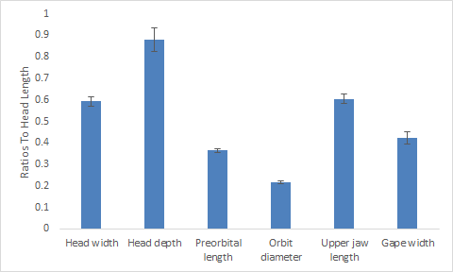
Results cont.
Figure 5: Mean ratio to head length measurements for Largemouth bass (Micropterus salmoides). Error bars represent standard error.
Notes:
Figure 5: Mean ratio to head length measurements for Largemouth bass (Micropterus salmoides). Error bars represent standard error.
Table 1: Mean and standard error values for ratios of various head measurements to head length of Largemouth Bass (Micropterus salmoides).

Slide 16
Results cont.
 | Head width | Head depth | Preorbital length
Mean | 0.593847 | 0.879884 | 0.364492
SE | 0.022089 | 0.055835 | 0.009347
 | Orbit diameter | Upper jaw length | Gape width
Mean | 0.217824 | 0.603926 | 0.421829
SE | 0.006106 | 0.021601 | 0.028787
Table 1: Mean and standard error values for ratios of various head measurements to head length of Largemouth Bass (Micropterus salmoides).

Slide 17
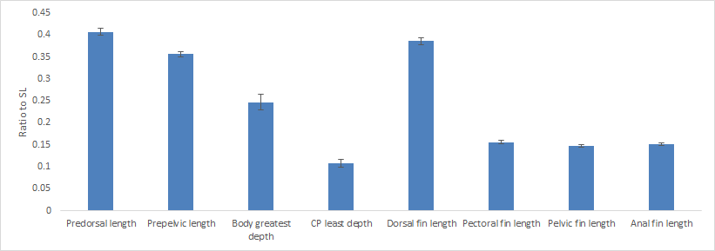
Results cont.
Figure 6: Mean length ratio to standard length of Largemouth Bass (Micropterus salmoides). Error bars are used to represent standard error.
Notes:
Figure 6: Mean length ratio to standard length of Largemouth Bass (Micropterus salmoides). Error bars are used to represent standard error.

Slide 18
Results cont.
 | Predorsal length | Pre-pelvic length | Body greatest depth | CP least depth
Mean | 0.407274535 | 0.356186828 | 0.246870533 | 0.108085792
SE | 0.008032802 | 0.006611602 | 0.017630886 | 0.008546857
 | Dorsal fin length | Pectoral fin length | Pelvic fin length | Anal fin length
Mean | 0.385946559 | 0.156167903 | 0.147682926 | 0.151340623
SE | 0.007302245 | 0.003652773 | 0.003284127 | 0.003264816
Table 2: Mean and standard error values for ratios of various body measurements to standard length of Largemouth Bass (Micropterus salmoides).
Notes:
Table 2: Mean and standard error values for ratios of various body measurements to standard length of Largemouth Bass (Micropterus salmoides).

Slide 19
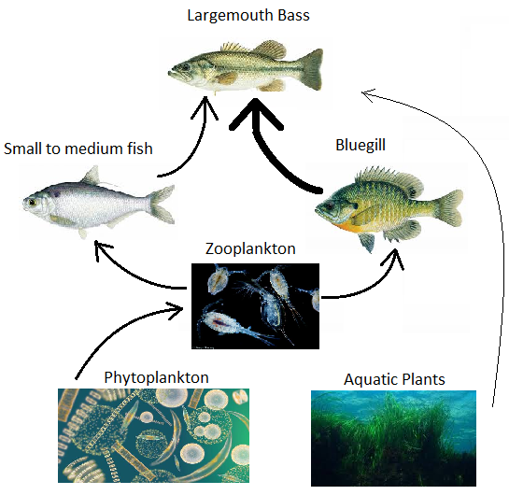
Food
Piscivorous
6 species of fish
Mostly the Bluegill
55% solely ate vertebrates
37% had some plants and invertebrates

Slide 20
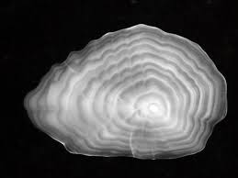
Age
Age
6-9 years
Females live longer
Most common age found in nature
2-3 years
Mature by age 2

Slide 21
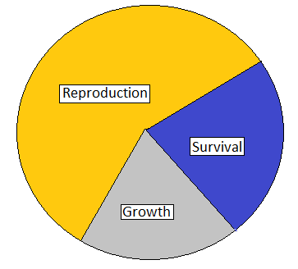
Growth
Eggs hatch between 1-5 weeks
Fastest growing bass
Eutrophic vs. oligotrophic
Females grow slower
Males can mature faster

Slide 22
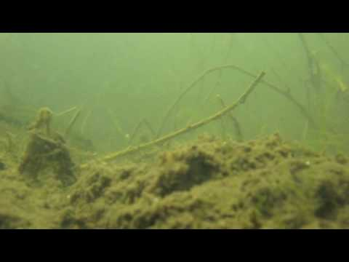
Reproduction
Can mature as early as a year old
Maturity can be size dependent
Iteroparous
150,000 eggs released
Nest Builders
Males guard nest
Mate one time per year
Notes:
a. Breder, C. M. (1936). The reproductive habits of the North American sunfishes (family Centrarchidae). New York Zoological Society, the Zoological Park.
a. Heidinger, R. C. (1975). Life history and biology of the largemouth bass. Black bass biology and management.
a. Bridges, A. and C. Bester. 2018. Discover Fishes: Micropterus salmoides. Florida Museum, Florida. Availible from www.floridamuseum.ufl.edu (accessed November 2018)

Slide 23
Connection to the Ecosystem
Largemouth Bass are predators that have been shown to prefer larger individuals
Feed on fishes that are smaller than them
Prefer adults to maximize energy
Travel in schools as large as 1000
Schools found within or close to aquatic vegetation
Piscivory by Largemouth Bass causes resource partitioning in of smaller species in the ecosystem
Notes:
iii. Bettoli, P. W., Maceina, M. J., Noble, R. L., & Betsill, R. K. (1992). Piscivory in largemouth bass as a function of aquatic vegetation abundance. North American Journal of Fisheries Management, 12(3), 509-516.
iv. Gilinsky, E. (1984). The role of fish predation and spatial heterogeneity in determining benthic community structure. Ecology, 65(2), 455-468.

Slide 24
Concluding Remarks
The sex, age, and diet of these fish could not be determined due to poor preservation.
Largemouth Bass are fish that can be detrimental to an ecosystem.
Catching these fish for commercial use will decrease school size and limit resource partitioning.
Further studies are needed to compare the life history of all species found in Briery Creek Lake.
Notes:
Here is what is going in my discussion
i Grows faster in eutrophic, warm waters of the south the most quickly (Rawls, 1979), therefore we would expect the bass in this study to be larger and younger than they would be in other habitats.
ii. Had we extracted the gonads and done a sex analysis of fish size, we would expect the female fish to be on average older and smaller than the male fish in the system because of the reproductive effort that female fish expend limits the growth of the fish (Beamish, Booth, and Deacon, 2005).
c. Connect to established morphometric
b. Problems with the study
d. Connect to how it grows by its diet
e. Connect to competition
f. Connect to ecological structure as a whole
So ideas to throw in here. Trends we can talk about while we are doing the figures.
Then I think maybe we can move into why the morphology is the way it is because of: diet, competition, etc.
Then we move it to HERE IS HOW IT CONNECTS TO THE ECOSYSTEM AS A WHOLE and bring it home. How does that sound, Tina?

Slide 25
Acknowledgements
Thank You to Dan and Dan for assisting us in the collection of our specimens.

Slide 26
References
Bettoli, P. W., Maceina, M. J., Noble, R. L., & Betsill, R. K. (1992). Piscivory in largemouth bass as a function of aquatic vegetation abundance. North American Journal of Fisheries Management, 12(3), 509-516.
Beamish, C.A., A.J. Booth, and N. Deacon. 2005. Age, growth, and reproduction of largemouth bass Micropterus salmoides, in Lake Manyame, Zimbabwe. African Zoology. 40: 63-69.
Gilinsky, E. (1984). The role of fish predation and spatial heterogeneity in determining benthic community structure. Ecology, 65(2), 455-468.
ITIS. 2018. Micropterus salmoides (Lacepede, 1802). ITIS Report, Washington D.C. Available at www.itis.gov (accessed November 2018).
IUCN. 2018. The IUCN Red List of Threatened Species. Version 2018-2. IUCN, Switzerland. http://www.iucnredlist.org (Accessed November 2018).
Near, T. J., T. W. Kassler, J. B. Koppelman, C. B. Dillman, and D. P. Philipp. 2003. Speciation in North American black basses, Micropterus (Actinopterygii: Centrarchidae). Evolution, 57(7): 1610-1621.

