Slide 1
Global Mammal Extinctions
Jacob Jennings
Megan Curry
Garrett Ramsey

Slide 2
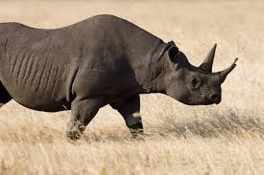
Introduction
Warm-blooded vertebrate
Distinguished by possession of fur or hair and the ability to produce milk
There are 5,416 known mammal species.
Approximately 80 have gone extinct since 1500.
637 mammal species are endangered.

Slide 3
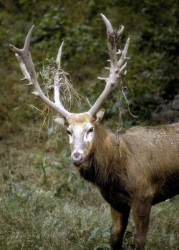
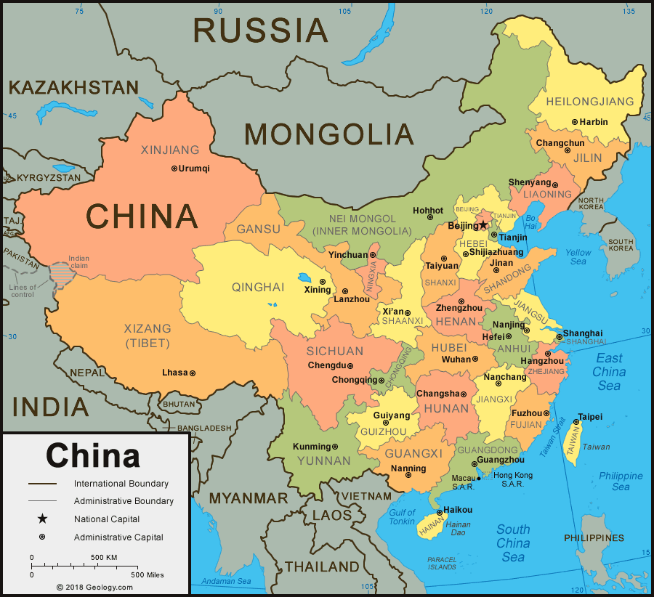
Père David's Deer
Elaphurus davidianus
Former range: endemic to China
Date of extinction: 1939
Causes of extinction: Residential and commercial development, agriculture and aquaculture, and biological resource use (hunting and trapping)

Slide 4
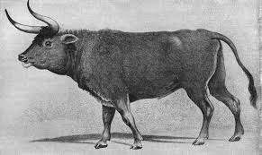
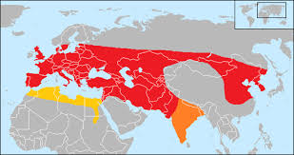
Aurochs
Bos primigenius
Former Range: Poland, Lithuania, Moldova, Transylvania, East Prussia.
Date of Extinction: 1627.
Causes of Extinction: Hunting and competition of feeding grounds with domesticated cattle.

Slide 5
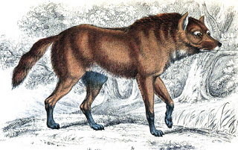
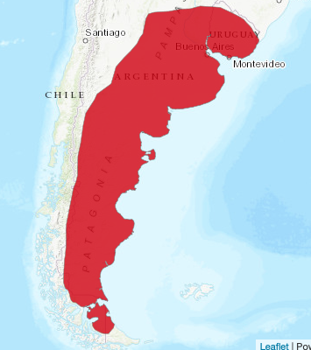
Extinct Fox/Wolf
Dusicyon avus
Former Range: South America
Date of Extinction: 1636
Causes of Extinction: Hunting and Trapping, Disease, and Habitat Shifting/Climate Change

Slide 6
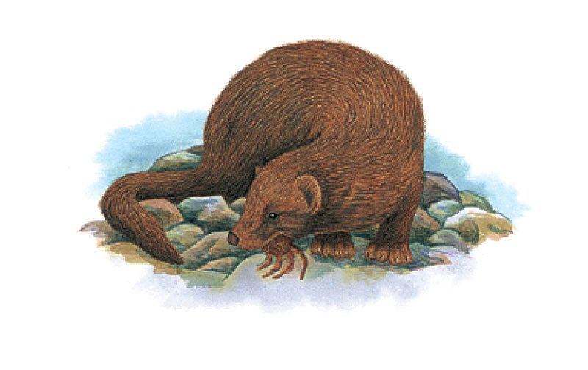
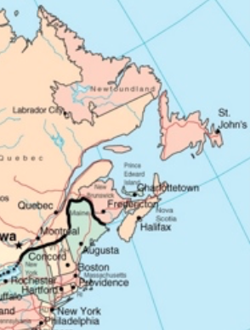
Sea Mink
Neovision macrodon
Former Range: Canada and United States
Date of Extinction: 1860
Causes of Extinction: Hunting and trapping

Slide 7
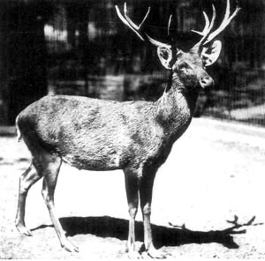
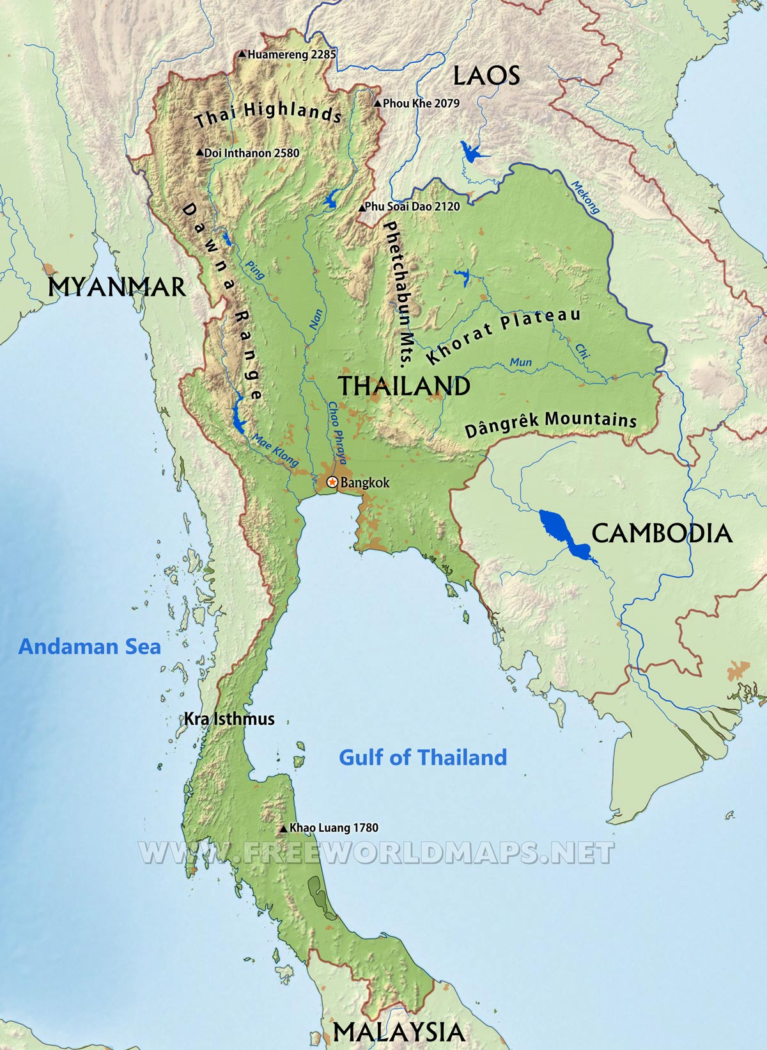
Schomburgk’s Deer
Rucervus schomburgki
Former Range: Endemic to Thailand
Date of Extinction: 1938
Causes of Extinction: Agriculture/Aquaculture and Hunting

Slide 8
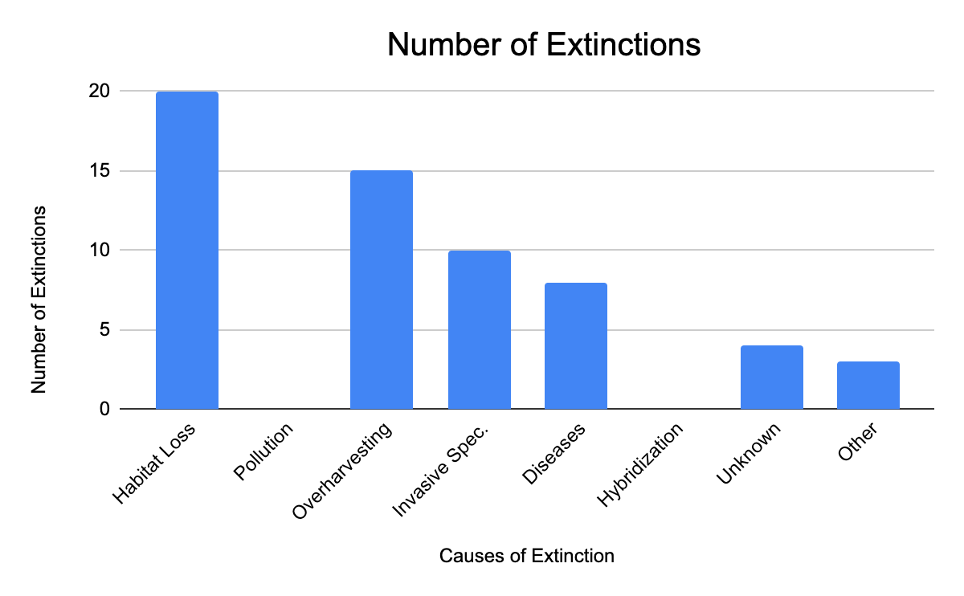

Slide 9
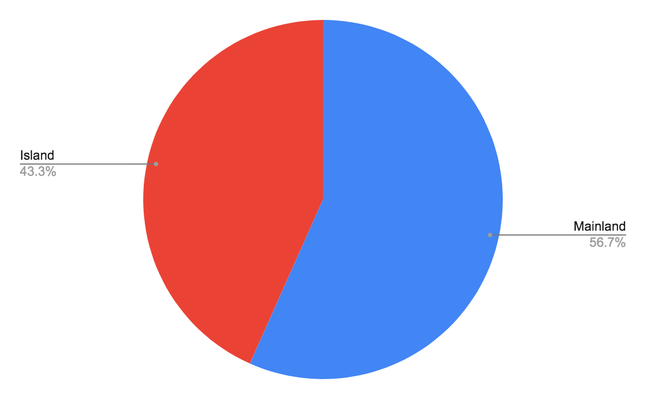
Island vs. Mainland Extinctions

Slide 10
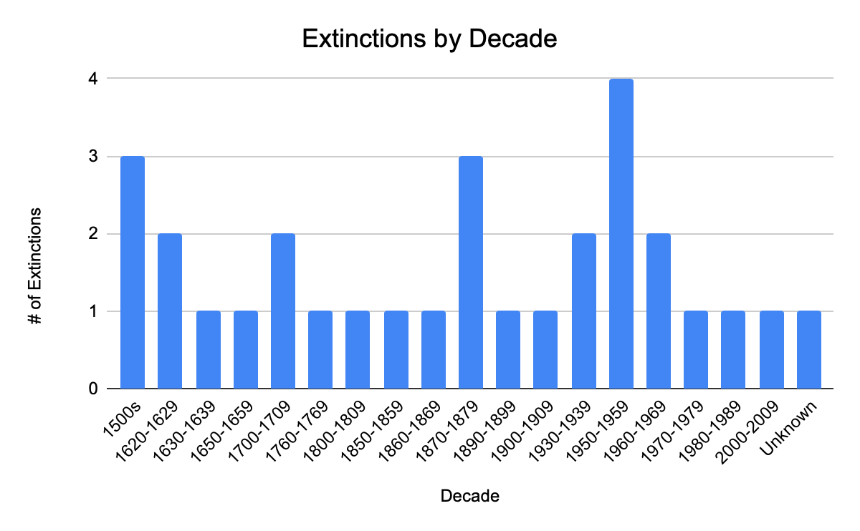

Slide 11
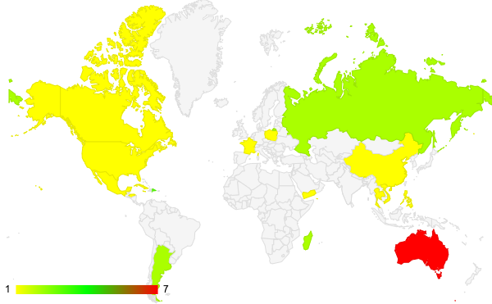
Extinction Heat Map

Slide 12
Conclusion
Largest extinction cause was due to habitat loss (agriculture, deforestation, urbanization)
56.7% of extinctions were mainland
Largest decade of extinctions during 1950-1959 (smog issues, nuclear weapon/test issues, first views on global warming)
Most extinctions charted in Australia (nuclear testing, soil erosion/salinity, land clearing)
Data collected corresponds with the extinction causes

Slide 13
Sources
Wikipedia
IUCN List

