Slide 1
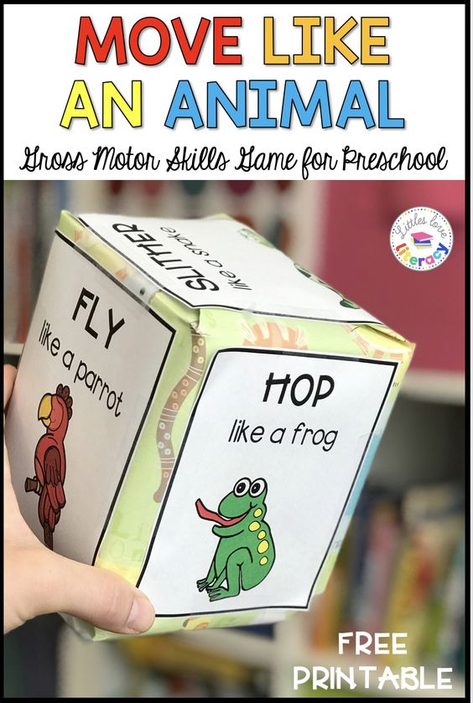
Animal Dice Game Activity

Slide 2
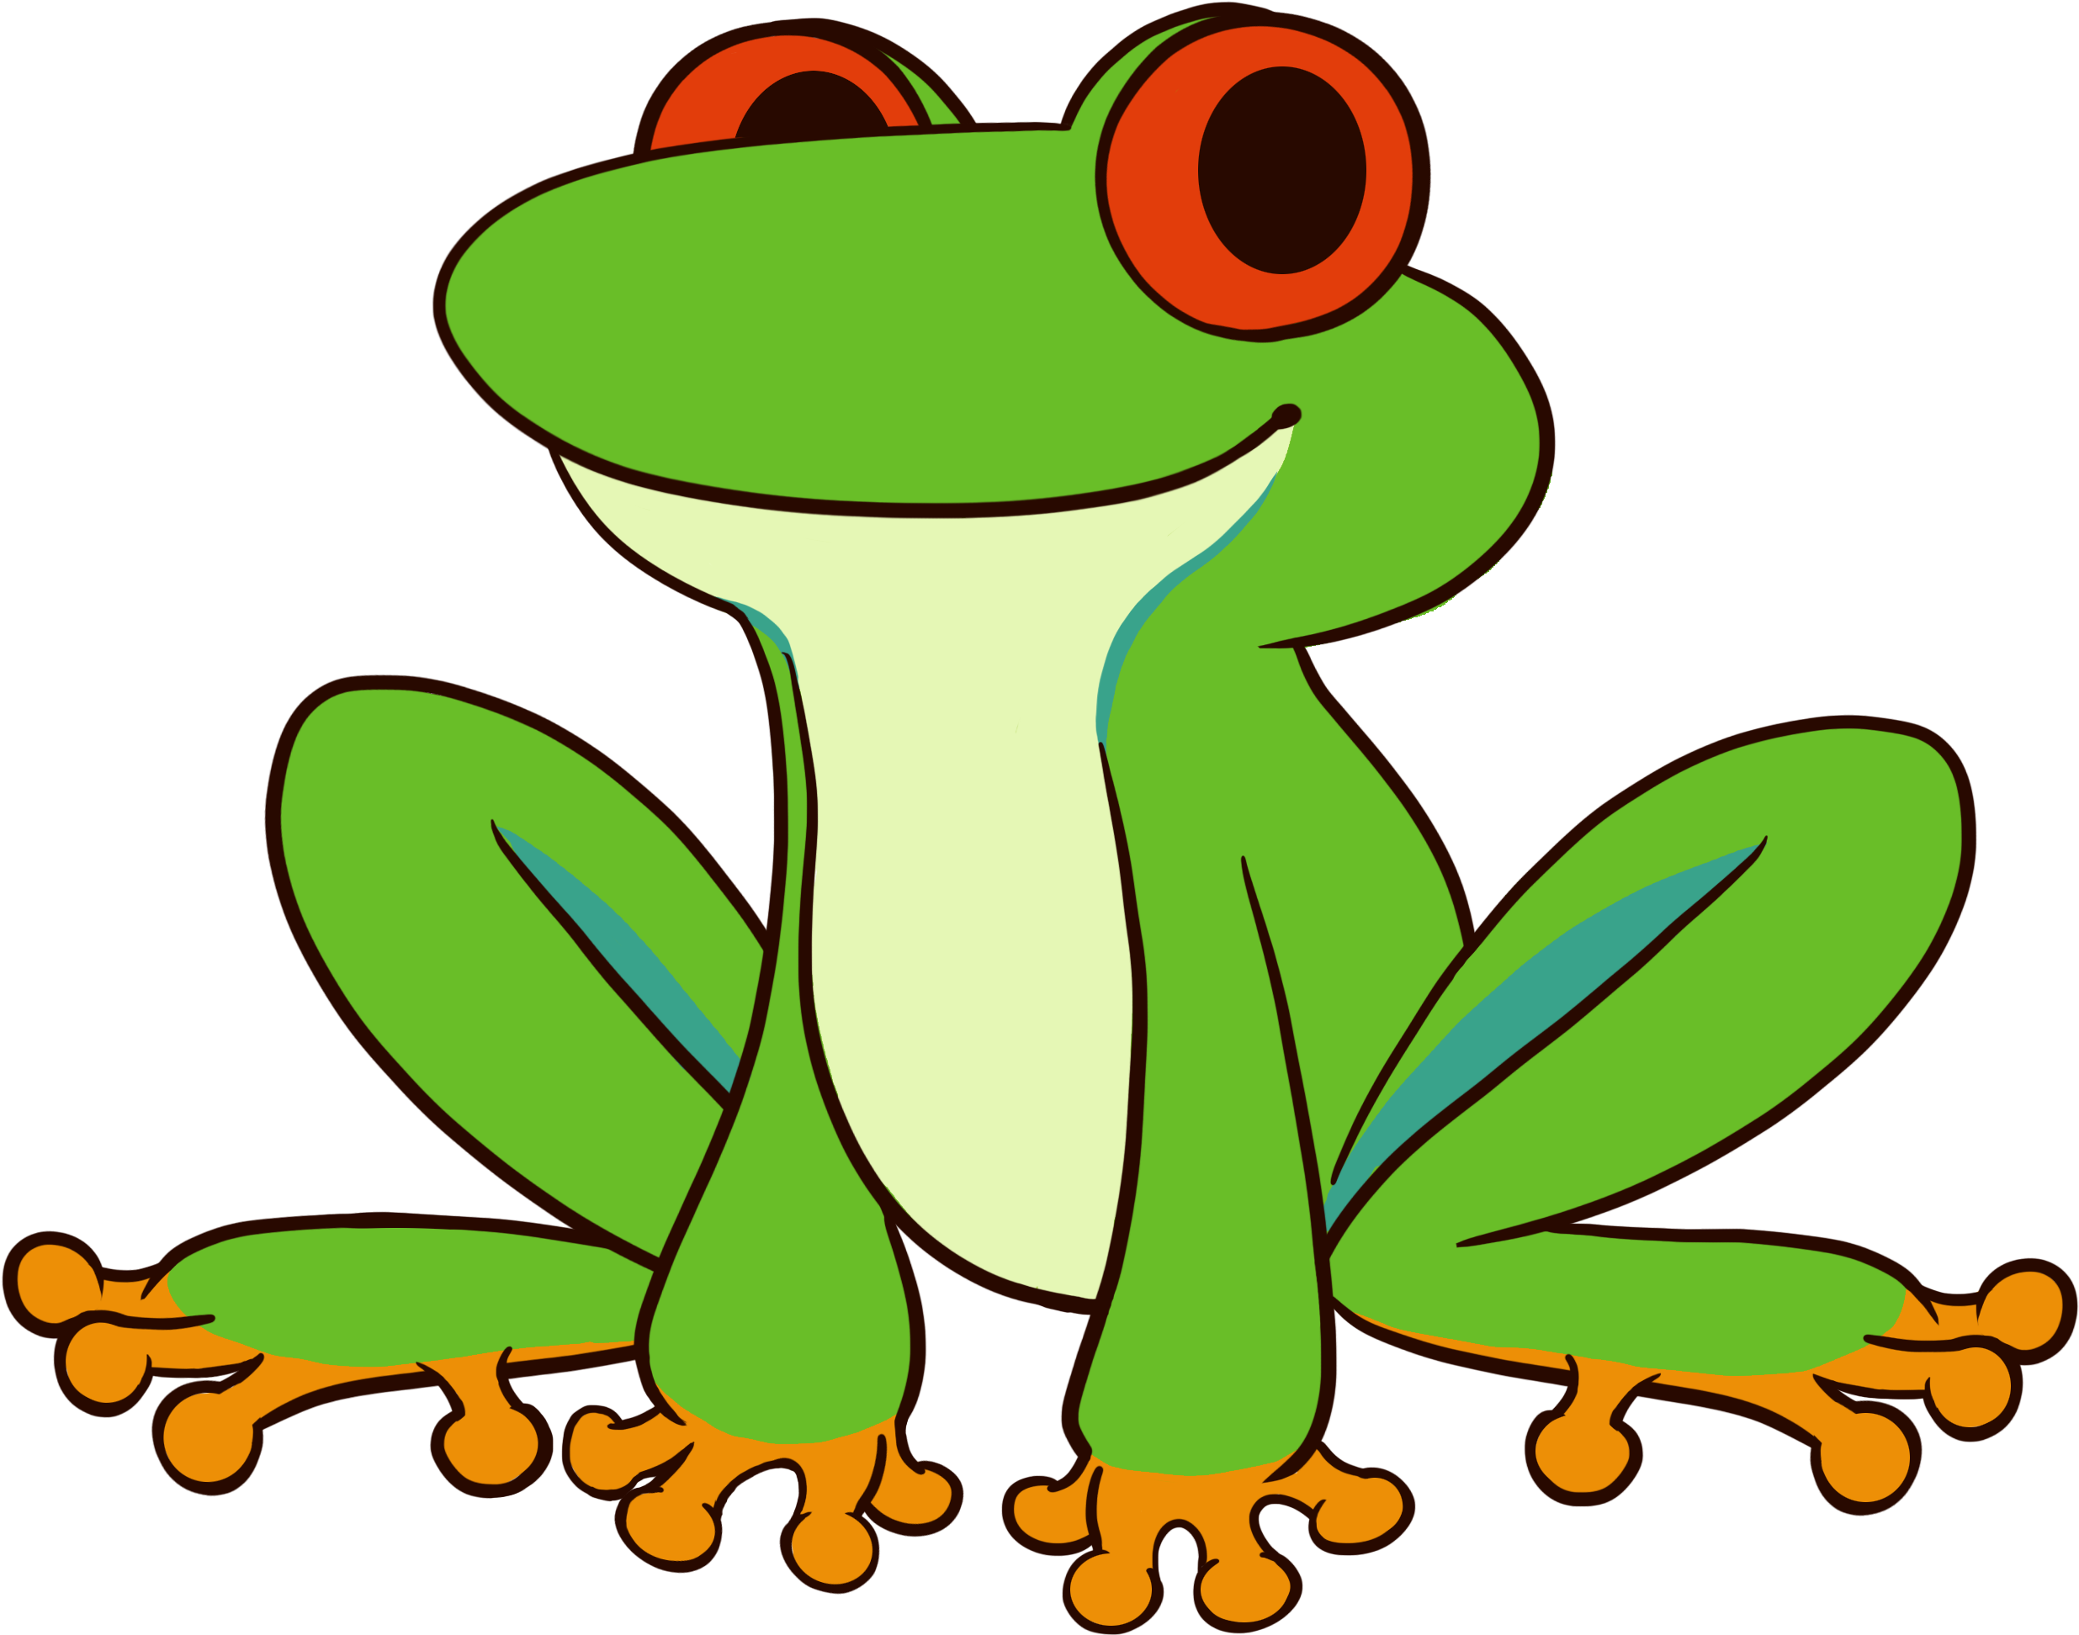
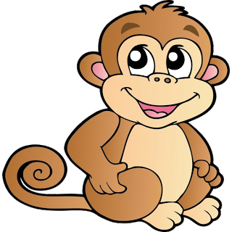
Instructions & Sides of Dice
Within this game, you and your child will practice identifying different animals and learn their associated action and/or sound. Remember to be silly and have fun!
Within the tissue box, you will find 6 pictures of animals clipped together
Remove them from the tissue box and unclip them
You and your child will glue each animal picture to the sides of the tissue box
Once all the pictures are secure, you and your child will take turns rolling the tissue box as if it were a big dice.
Corresponding to the side that is facing up after the dice has been rolled, assist your child to identify the animal pictured.
Next demonstrate the action labeled on the picture
Repeat the action with your child until they are confident with the action
Repeat steps 4-7
Hop like a frog
Moo like a cow
Dance like a monkey
Make elephant noise
Chirp like a bird
Waddle like a penguin

Slide 3
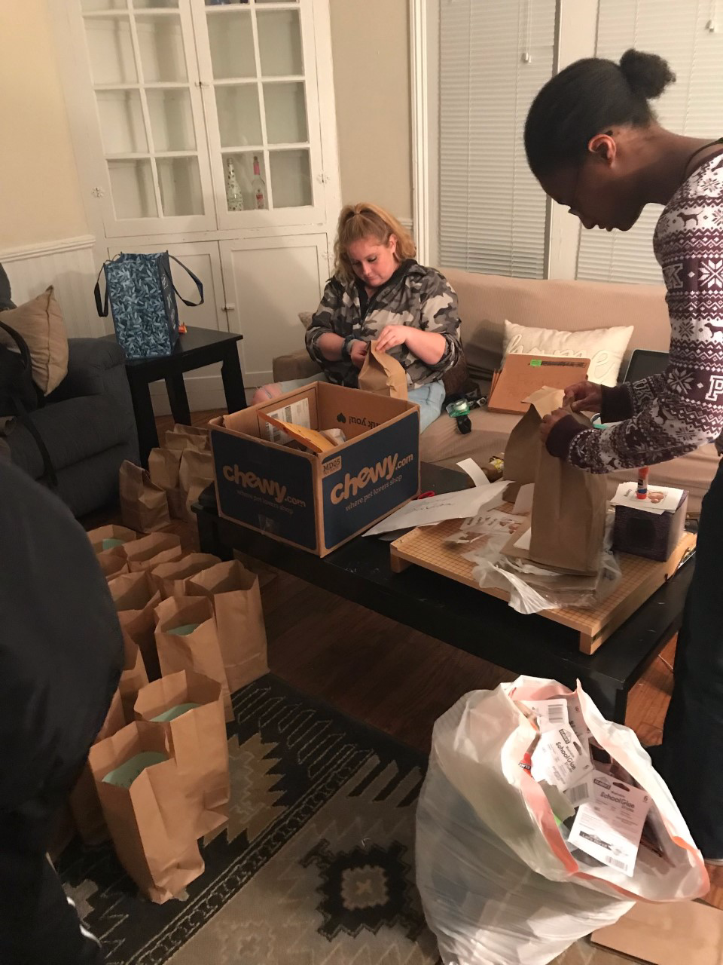
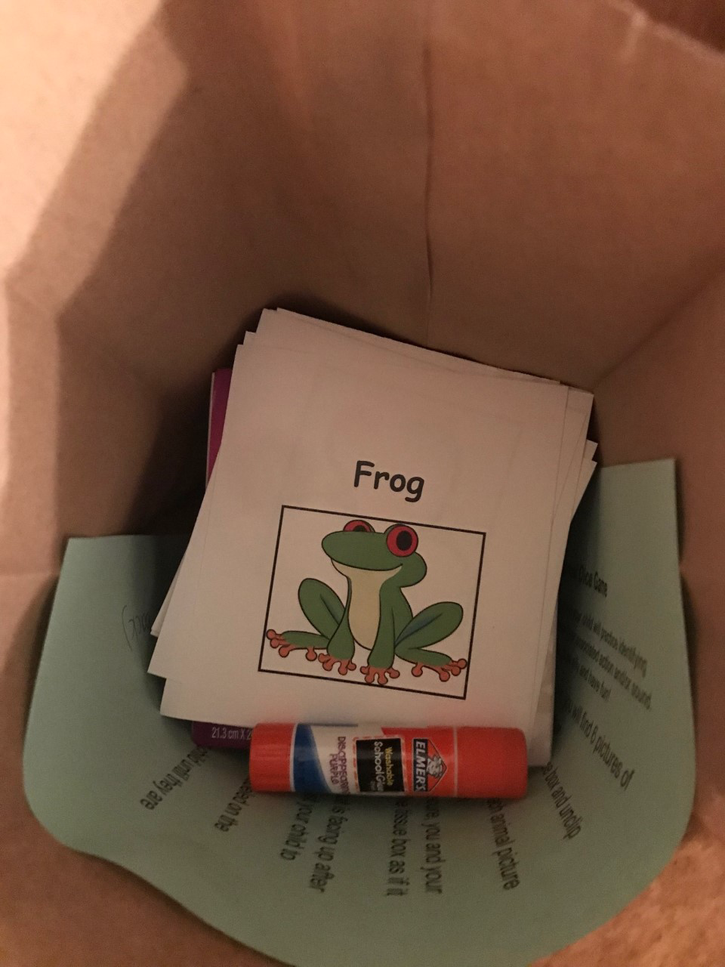
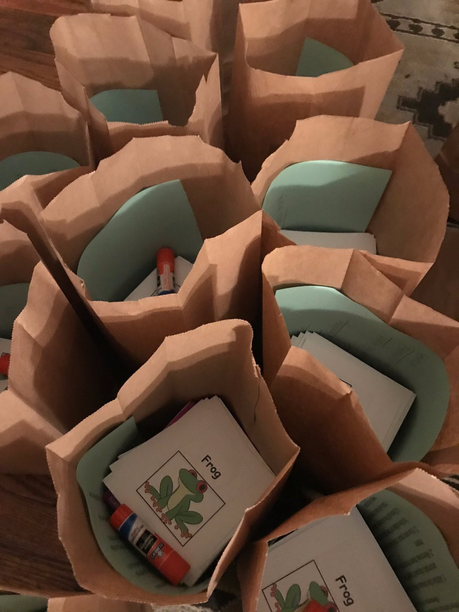
Animal Dice Game Activity SMART Objectives
Within 30 minutes, the child will be able to accurately (4 out of 6 options) act out the action or sound
presented to them in order to increase their cognitive development through memory and word
association, gross motor development through moving their major body parts (arms and legs),
and parental engagement.
Notes:
This game is created to help with a child cognitive development process. This game can help with a child’s memory with trying to memorize what kind of animals are on the dice and what the movement and or sound might be. It has been said that it isn’t “until the age of 3 that children can reliably do this, although they remain better at recognition than recall, and they do not show ability to spontaneously use mnemonic strategies to assist remembering for a number of years”(Anthony). Playing this game can help a child remember that animal by what they look as well as what actions that they may do. This game is about memorizing the animals and then having to act a certain way to describe the animal. Having the dice helps with children having to repeat an action which can help with the memorization process. “Children tend to use routines to define understanding of events, and to recall sequence” (Anthony). Cognitive development is very important during this age range and is important to work with a child in their learning process. This game will help with a child cognitive development with the memorization process but is also a physical attribute because the child will be running around and be using their bodies to act out the animal as well as to roll and get the dice.

