Slide 1
Three Ages of Development
Emily McGuire

Slide 2
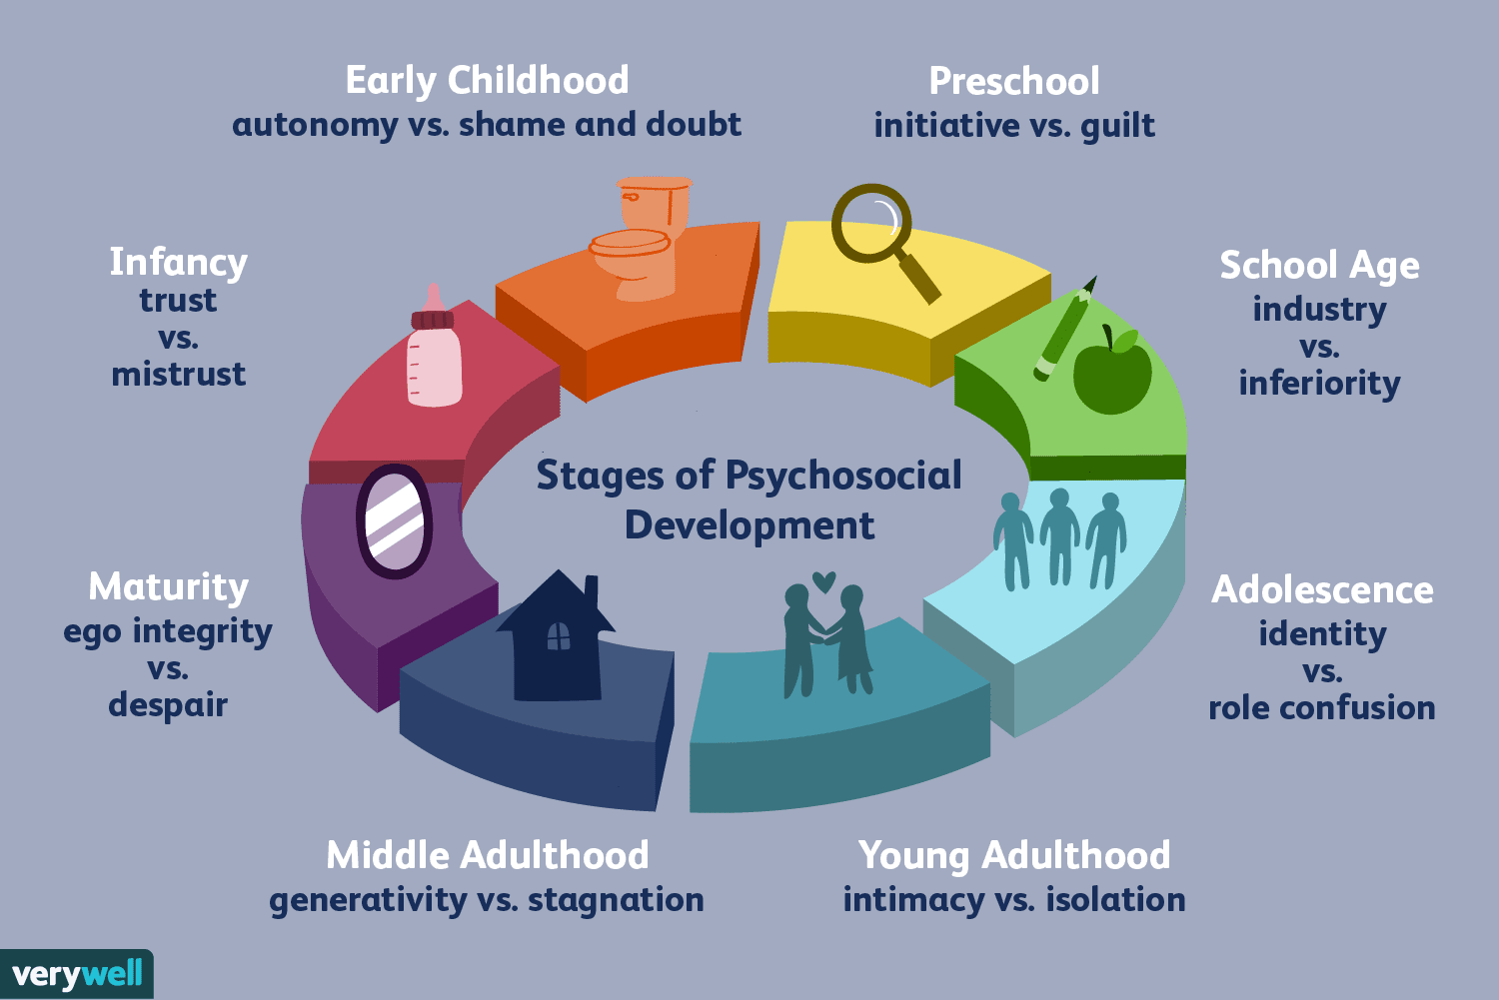
Psychosocial Theory
- Erik Erikson
- 8 Stages
- Each stage builds on the previous stage and affects all future stages

Slide 3
Interviews
Moni
Age 6
First grade
Met on mission trip
AB
Age 13
Eighth grade
Cousin
EE
Age 18
College freshman
Friend

Slide 4
Moni
- Trust versus Mistrust
- Initiative versus Guilt
- Industry versus Inferiority

Slide 5
AB
- Industry versus Inferiority
- Identity versus Role Confusion
- Intimacy versus Isolation

Slide 6
EE
- Identity versus Role Confusion
- Intimacy versus Isolation
- Generativity versus Stagnation

Slide 7
Helpful Questions
- Do you get rewarded when you do well in school?
- What do you want to be when you grow up?
- Do you have a crush or a boyfriend/girlfriend?
- Do you have a large friend group, or do you mainly stay by yourself and sometimes a few other people?

Slide 8
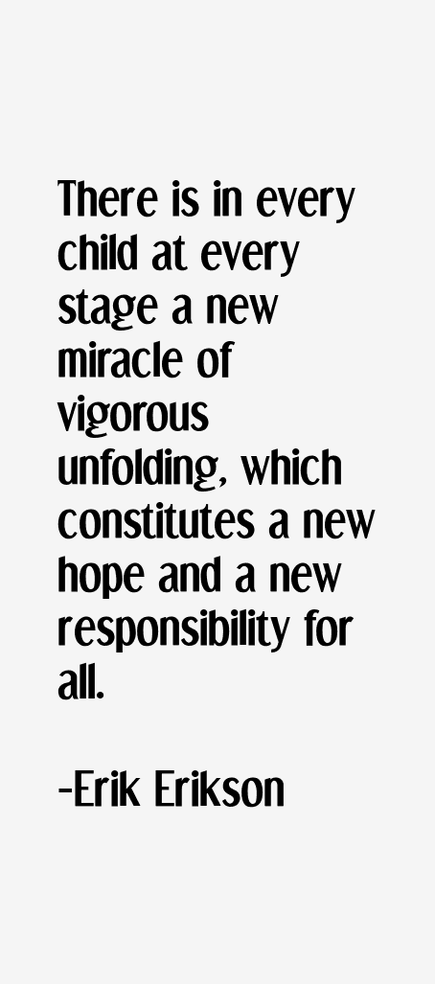
Final Discussion
- One of several theories
- Future layout
- Recommendation
- Large Impact

Slide 9
Questions or Comments

Slide 10
References
- Cherry, Kendra. “Understanding Erikson's Stages of Psychosocial Development.” Verywell Mind, Verywell Mind, 5 Sept. 2019, https://www.verywellmind.com/erik-eriksons-stages-of-psychosocial-development-2795740.
- Levine, L. E., & Munsch, J. (2017). Child Development: An Active Learning Approach(3rded.). California: Sage.

