Slide 1
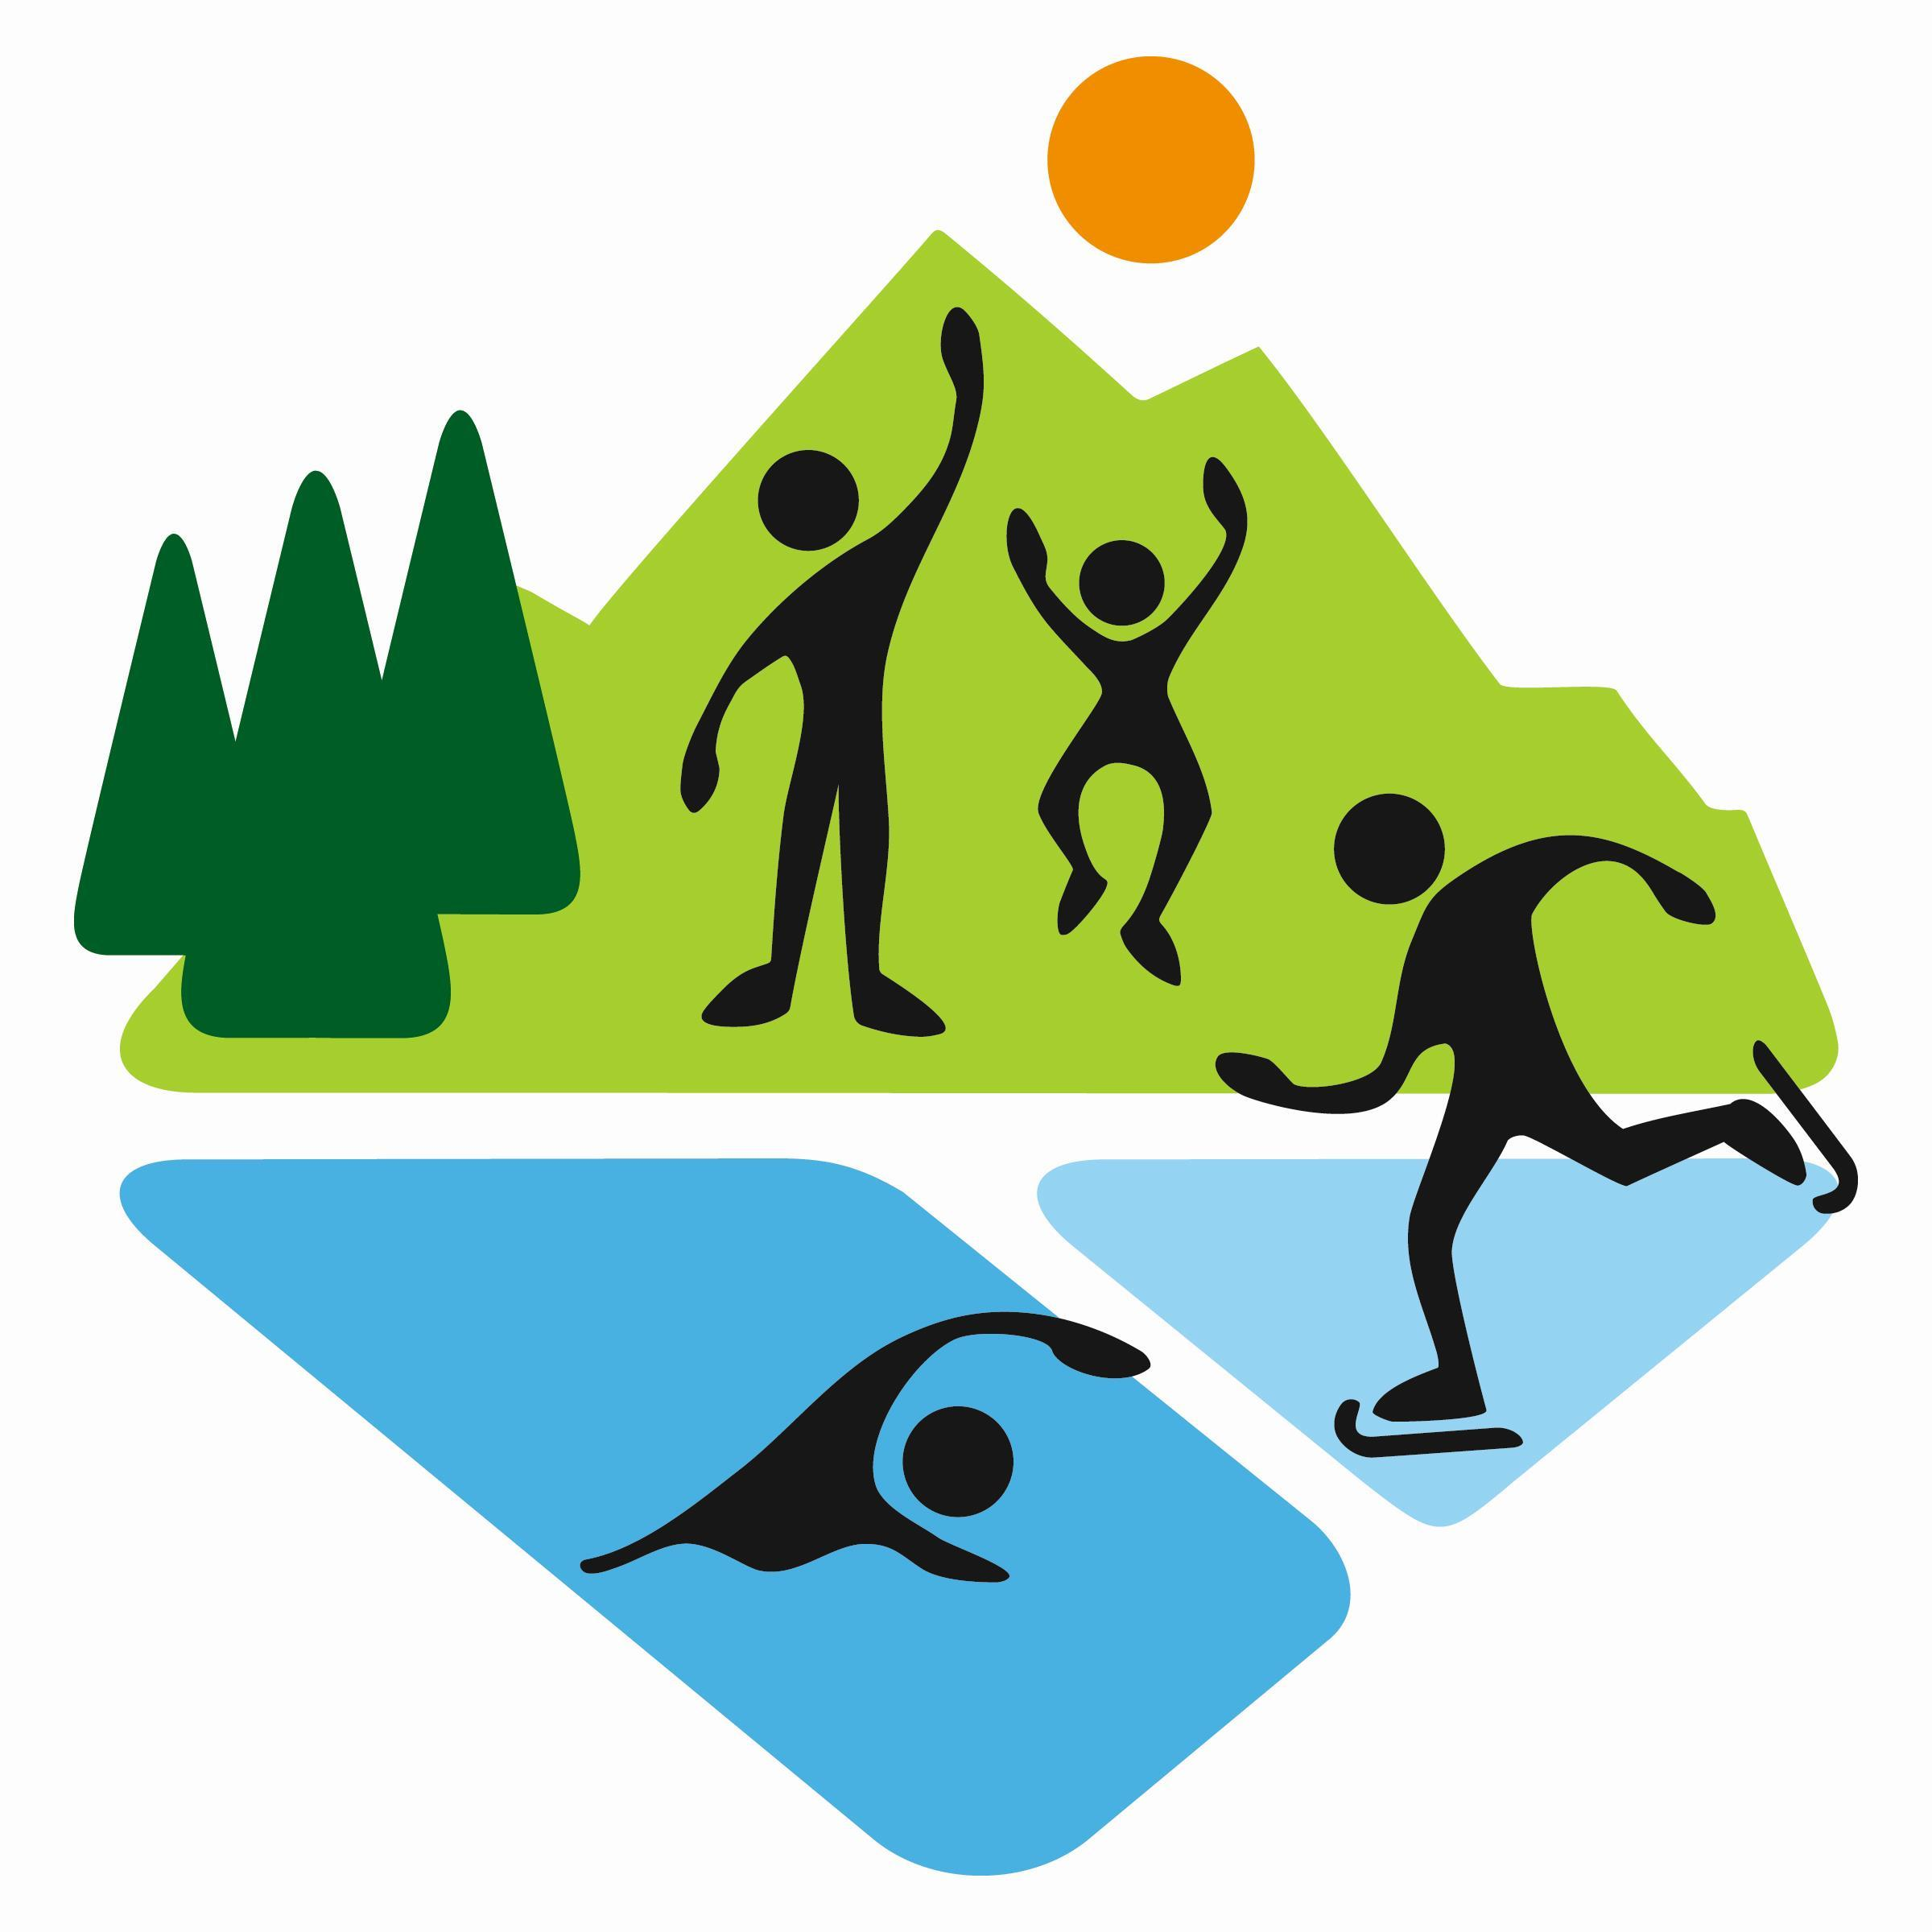
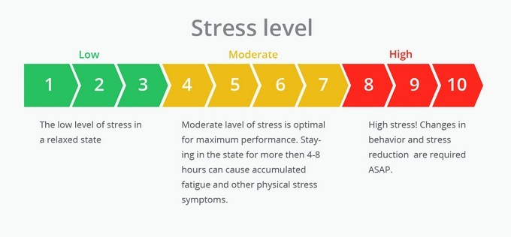
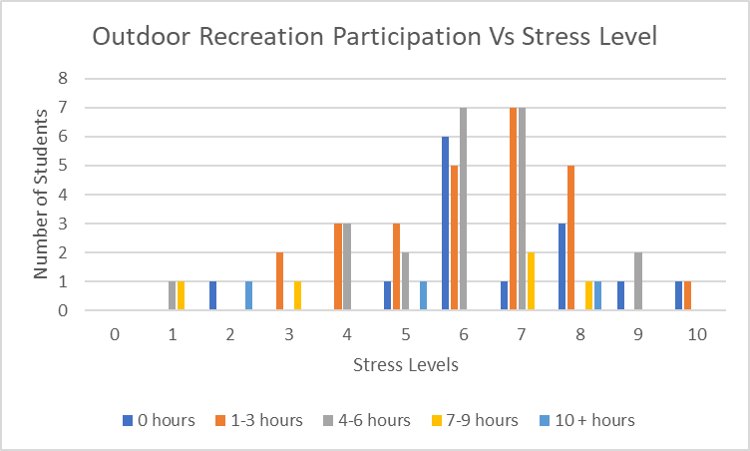
The Effects of Outdoor Recreation on College Students
Abbey Mays
Cormier Honors College for Citizen Scholars
EDU-376-50: Intro to Residential Learning
Introduction
Results
Outdoor Recreation is defined as an activity taking place in nature. A few of these activities include walking, hiking, canoeing, kayaking, and camping. These activities have many health benefits on people, including college students based on different studies (Outdoor Recreation FAQs). Often colleges offer an outdoor club where students can go on such trips. Colleges often cut funding in the recreational area. According to Flourishing through Resilience: The Impact of a College Outdoor Education Program, this can be detrimental to college students because outdoor recreation can play a big role in the student’s stress and anxiety levels, academic success, mental and physical health, better/more social connections, and more (Shellman and Hill 10). With the other’s research in mind a survey was created to test if the population at Longwood University follows the trend that Outdoor Recreation can reduce stress.
Low stress was considered 1-3 on the scale, which was only 10% of the participants. Moderate stress was considered 4-7 on the scale, which was 69% of the participants. High stress was considered 8-10 on the scale, which was 21% of the participants. The mean stress level was 6.11, which is considered within optimal range for maximum performance. 1-3 hours of outdoor recreation participation was the highest percentage at 37% with 4-6 hours at 32%, 0 hours at 20%, 7-9 hours at 7%, and 10+ hours at 4%
The correlation between outdoor recreation participation and stress levels is -0.1774. This means that hours of recreation is weakly correlated with stress levels, so as hourly recreation goes up stress levels go down. When a Mann-Whitney Test was preformed between each hourly group and the control group of no recreation participation it rejected the null hypothesis that they have same stress levels. This means that those who participate in recreation less tend to have a higher stress level.
In addition, most Longwood students have hiking as their primary outdoor recreation method at 50%, with sport participation being the second at 36%. 98% of those who took the survey believe that outdoor recreation can help manage stress.
Method
Discussion and Future Studies
Participants were 70 ( 61% Women, 37% Men, and 2% Nonbinary) students at Longwood University in Farmville, Virginia who completed a survey. Participants were classified as Freshman (14%), Sophomores (46% ), Juniors (23%), Seniors (14%), Fifth Years (1%), or Graduate Student (2%). Participation in this study was on a voluntary basis.
The questions were:
On a scale from 1-10, What is your stress level?
What types of Outdoor Recreation do you participate in?
How many hours do you participate in some form of Outdoor Recreation per week?
Do you believe that Outdoor Recreation can help manage stress?
Outdoor recreation can be an avenue for some to alleviate everyday stress. It is seen as an escape for a regular routine. In a college student’s life is can be a way to relax and distract for the stresses of classes, essays, and/ or homework, but it is important to keep it within moderation. Too much outdoor recreation can take away from time that should be spent studying and cause more stress due to over involvement. It should also be considered that there are other methods to destress and many students do not enjoy outdoor recreation.
The data presented only gives a small insight into the effects of outdoor recreation in college students at Longwood University. In future studies it would be effective to gather more surveys from a wider population of Longwood University. With more information the tester would be able to better assess the population. This was barrier because of limited access to all Longwood students, as evidenced by the higher number of Sophomores who took the survey. The participation was also on a voluntary basis, which meant that those who are interested in Outdoor Recreation were more likely to fill out the survey.
References
-“Outdoor Recreation FAQs.” The Wilderness Society, https://www.wilderness.org/articles/article/outdoor-recreation-faqs.
-Shellman, Amy, and Eddie Hill. “Flourishing through Resilience: The Impact of a College Outdoor Education Program.” Journal of Parks & Recreation Administration, vol. 35, no. 4, Dec. 2017.
-

