Slide 1
The Benefits of Practicing Mindfulness
April
2020
Abbey Mays
https://youtu.be/T6srj2iCzdg

Slide 2
Mindfulness
A mental state achieved by allowing one’s self to be fully aware in the present moment.
This can be done through meditation and can help people acknowledge thoughts, feelings, and can be used as a therapeutic technique in psychotherapy.

Slide 3
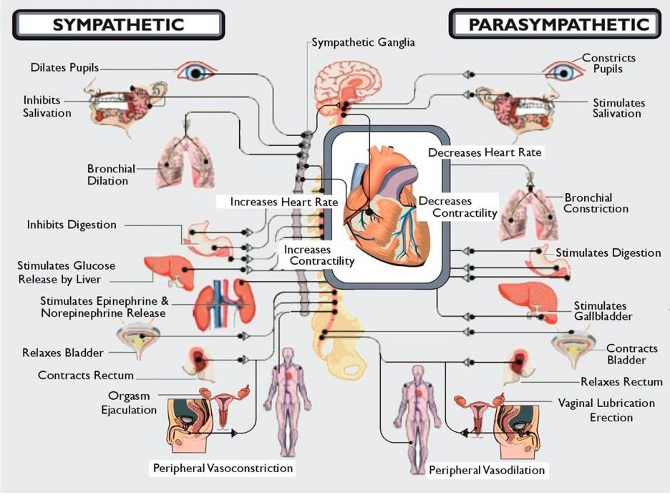
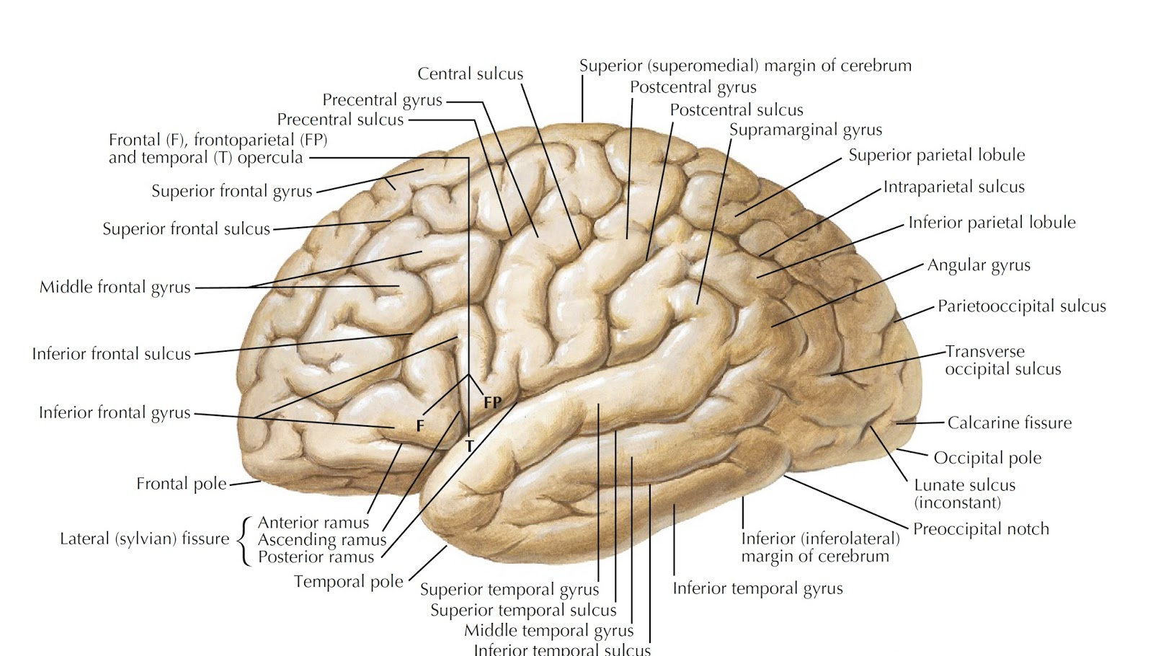
How it effects the body
This system is responsible for restoring the body.
Lowering heart rate
Blood pressure
Muscle tension
It also alters brain patterns consistently during practice.
Frontopolar Cortex
Sensory Cortices
Hippocampus
Orbitofrontal Cortex
Corpus Callosum
It can induce a relaxation response, which engages the parasympathetic nervous system.

Slide 4
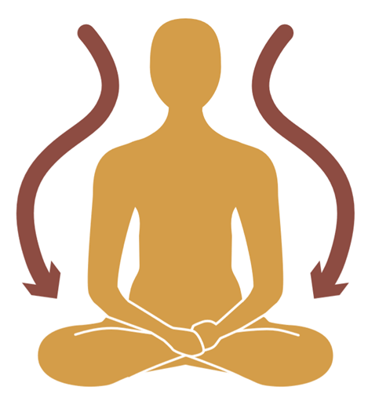
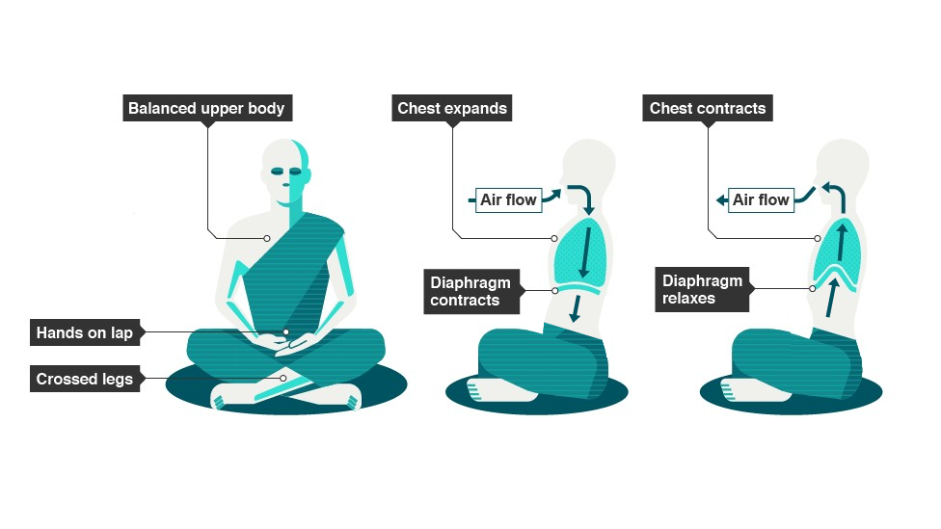
Types of Meditation
Breathing
Body Scan

Slide 5
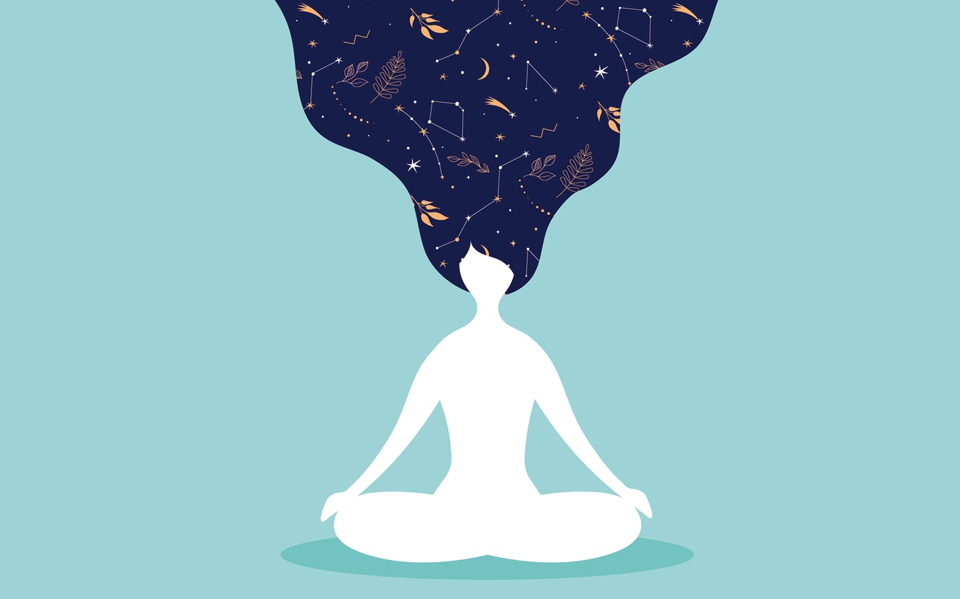
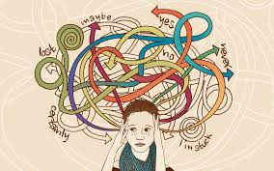
Types of Meditation
Loving-kindness
Observing-though

Slide 6
Other ways to practice
Mindfulness walks and runs

Slide 7
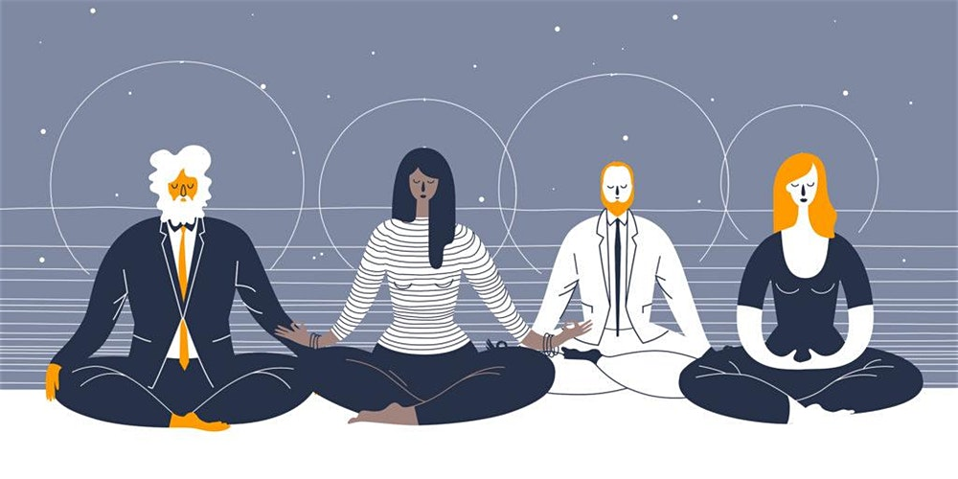
Other ways to practice
Yoga

Slide 8
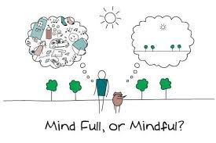
Remember

Slide 9
Work Cited
“How Does Mindfulness Work?” Taking Charge of Your Health & Wellbeing, University of Minnesota, www.takingcharge.csh.umn.edu/how-does-mindfulness-work.
Newman, Kira M., et al. “How to Choose a Type of Mindfulness Meditation.” Mindful, 5 June 2018, www.mindful.org/choose-type-mindfulness-meditation/.
Owl, and Admin. “From Mindful Movement to ‘AH-HA!" Moments: 4 Steps to Getting Answers to Life’s Biggest Questions.” Mindful Running, 24 Jan. 2015, www.mindfulrunning.org/mindful- movement-leads-ah-ha-moments/.
Schreiner, Istvan, and James P. Malcolm. “The Benefits of Mindfulness Meditation: Changes in Emotional States of Depression, Anxiety, and Stress.” Behaviour Change, vol. 25, no. 3, Jan. 2008, pp. 156–168., doi:10.1375/bech.25.3.156.

