Slide 1
Management Plan Grades 3-6
Maria Giarrusso

Slide 2

Management Philosophy
Students should be seen as equals, not lesser. They should be taught self-control and self-management strategies. The classroom should be a democratic space in which students should have some autonomy and voice.
As a teacher I should be a facilitator who manages my students, instead of controlling them. I should foster individual thinking and allow for creativity.
Classroom management should be a way to teach students to manage and supervise themselves
Glassers Choice Theory resonates with me, as I believe in providing basic needs for my students, as well as providing opportunities for choice in the classroom. This build a students trust and engagement in the classroom,

Slide 3
Learning environment
Classroom Layout.docx
Desks in groups of 4
  Desk group size could change depending on size of the class
Kidney table in the back of the room for small group
A reading section with comfy chairs/ pillows.
  Fosters reading but could also be used as a “cool off zone”
Complaints Box: A way for students to share complaints anonymously
  Complains can be about another student, and issue about the classroom
  We will discuss how to respectfully leave a complaint
Walls decorated with:
  Student work
  Motivational Posters/ Quotes
  Anchor Charts
  Compliment Wall
    A space for people to post nice things to about each other

Slide 4

Trust and Community
Establish a good rapport with student early on using active listening
Be open to student ideas
Give positive and specific praise to everyone everyday
Use mistakes as a learning moment, do not shame
Provide the power of choice when possible
Complaints Box
  Allows students to know they have a voice in the classroom, and they have an opportunity to bring up a problem if they see one.
Be Proactive in student interaction expectations
  Treat each other kindly
  Bullying is not tolerated

Slide 5

Rules and Procedures
Make a class rules list on the first day
  Have students come up with the rules
  Have everyone sign on the bottom and post up on the wall
On the first day of school explain and model procedures
  Make it interactive by having students demonstrate with you
  Have students practice several times during the first week
  If a transition or procedure is not working as expected, be flexible and adjust it so that it is smooth
  Take students feedback or suggestions
Be consistent and fair when implementing rules and procedures

Slide 6

Teaching Elements
Engage students in material that is relevant
Provide extension activities for students who complete tasks early
Use open ended questions to provoke deeper thinking
  If students are using deeper thinking, instead of completing a worksheet, they are less likely to act out because thy will be engaged
  Make sure the question is at an appropriate level, because if the question is too difficult students will become frustrated
Power of Choice
  Allow students to chose for themselves during lessons
    Which problems to finish
    What extension activity they want to do
    Who they work with

Slide 7
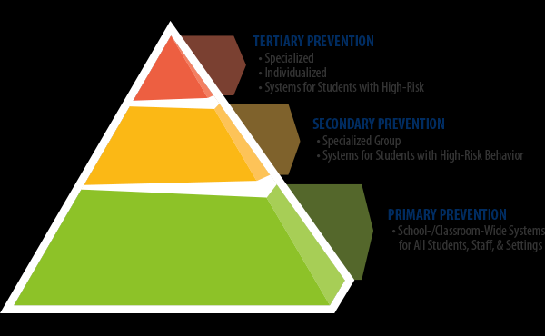
Tiered Response to intervention
Start collecting data on the student during class
Take note of any environmental or social triggers, try to fix them
Communicate and create plans with other personnel and staff that interact with the student
Provide small group supports for tier two students.
  A time to talk about issues, why they are happening and how they can be fixed
For Tier 3 students use a problem solving approach
  Identify the problem and what causes it
  Come up with a coaching plan to assist student combat behavior issues

Slide 8
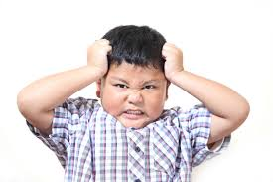
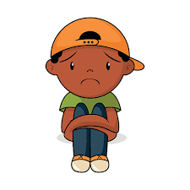
Internal and External factors on misbehavior
When a student is constantly put in a stressful or traumatic situation, their brain begins to slow down in development, this can effect how a child behaves or reacts to normal situations
Internal Factors
  Lacking self confidence
  Being socially and/or emotionally unaware
  Emotional Behavioral Disorders
External Factors
  Trauma in the home
  Trauma at school
  ACEs (Adverse Childhood Experiences)
  Feeling rejected or put down

Slide 9
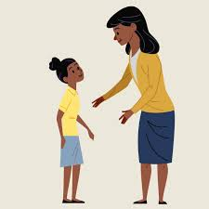
Responding to misbehavior
Deescalate the situation first
Provide a cool down time if necessary
Treat students with respect, by talking with them about he situation, not down at them
Provide warnings, explaining and reminding the student the consequences for their actions
If needed, deliver the consequence in a fair manner, then explain why the student got the consequence, finally talk out a solution with the student
Use “I need” statements
Do not embarrass the student, or belittle them!

Slide 10

Social and emotional development
Model respect by speaking respectfully to all students and staff
Establish a process in which students come up with solution to their problems together
  Not fair for the teacher to act as judge, jury, and executioner
  Establishes a democratic classroom, and democratic skills
Model and practice 5 primary skills for Social Emotional Learning
  Self-Awareness
  Self-Management
  Social Awareness
  Relationship Skills
  Responsible Decision making

Slide 11

Solving problems with peers
Hold an open conversation with students involved that creates a solution to the problem
Provide cool off time for students, so that conversation in productive
As the teacher do not domineer the conversation, let students lead and find a solution
Follow the three Rs and H
  Relate the solution to the problem
  Respect each other in conversation
  Reasonable punishment for actions
  The solution should be Helpful to all involved

Slide 12


Home-school connections
To start a positive relationship with parents or guardians I will call or email a positive note home about their student
Ensure homework is appropriate, and give parents tools to help their child
Make sure to send student home with positive messages
  Encourage students daily, multiple times a day
  Provide support in a safe and caring environment
Offer open communication lines
  Find out a mode of communication that works best for parents
  Provide resources for parents and guardians when needed
  Be available to meet with parents or guardians

Slide 13
References
Nelsen, J., Lott, L., & Glenn, S. (2013). Positive Discipline in the Classroom (4th ed.). Three Rivers Press.
Smith, S. W., & Yell, M. L. (2013). A Teachers Guide to Preventing Behavior Problems in the Elementary Classroom. Pearson.
Zeeman, R. D. (2006). Glasser’s Choice Theory and Purkey’s Invitational Education-Allied Approaches to Counseling and Schooling. Journal of Invitational Theory & Practice, 12, 46–51. Retrieved from http://search.ebscohost.com/login.aspx?direct=true&db=ehh&AN=24003911&site=ehost-live&scope=site

