Slide 1
Gendercide
Meg Lowman

Slide 2
It’s a Girl Trailer
https://www.youtube.com/watch?v=ISme5-9orR0

Slide 3
What is Gendercide?
Gendercide is defined as the “systematic, mass extermination of a particular gender”
Mary Anne Warren’s Definition: “I use the term “gendercide” to refer to those wrongful forms of sexual discrimination which reduce the relative number of females, whether through direct killing or in more indirect ways”

Slide 4
Mary Anne Warren
Author of Gendercide: The Implications of Sex Selection
Feminist author who first used the term “Gendercide” in 1985

Slide 5
Where does gendercide occur?
Directly- India and China
Indirectly- In virtually every country through violence against women

Slide 6
Women are not equal to males
In many countries and to different extents, women are not equivalent to males in economic, cultural, and political aspects.
Warren says “the degree to which parents in a given society tend to value sons more than daughters provides a measure of the extent to which women’s rights are denied opportunities which they will later enjoy”.

Slide 7
Domestic Abuse
Includes physical, mental, sexual and emotional abuse.
35% of women worldwide have experienced either intimate partner violence or non-partner sexual violence in their lifetime and globally, as many as 38% of murders of women are committed by an intimate partner.

Slide 8
Physical Abuse
The physical assault, battery, and sexual assault used as part of a systematic pattern of power and control perpetrated by one intimate partner against another.
1 in 3 women and 1 in 4 men is a victim of some form of physical violence by an intimate partner during their lifetimes.
40% of female murder victims are killed by intimate partners.

Slide 9
Psychological Abuse
The trauma to the victim caused by verbal abuse, acts, threats of acts, or coercive tactics
48.4% of women and 48.8% of men have experienced at least one psychologically aggressive behavior by an intimate partner.

Slide 10
Sexual Abuse
Any sort of non-consensual sexual act.
1 in 5 women will be raped in her lifetime… women who are sexually abused by intimate partners report more risk factors for intimate partner homicides than non-sexually abused women… women who are sexually abused by intimate partner suffer severe and long-lasting physical and mental health problems, similar to those of other rape victims.

Slide 11
Genital Mutilation
Involves the complete excision of the clitoris, labia majora and labia minora-all of the external genitalia.
Performed on girls 8-12.
Often unsanitary, anesthetics usually not used.
Prevents a woman from experiencing sexual pleasure and therefore deters the woman from cheating on her husband.

Slide 14
Sexual Violence
In many countries, it is the belief that women are not allowed to deny their husbands or even other men sexual intercourse.
According to Warren, “This sexual enslavement, which is often combined with the deliberate suppression of existing means of contraception and medically safe abortion, has probably caused the deaths of more adult women than any other form of gendercide”

Slide 16
Honor Killings
Form of punishment used on women who have been accused of dishonoring the family.
Usually this is committed through unmarried, un-consensual sexual relations.
Even when a woman is raped, she is still guilty of having sex unmarried and is therefore dishonoring her family.
Methods of honor killings include stoning, burning, beating, hanging beheading, acid attacks, strangulation etc.

Slide 17
Why are male offspring preferred?
Warren says “the lower women’s social, legal and economic status, the stronger will be the tendency of both women and men to prefer sons”
However, many believe the preference for sons originates because of patriarchal societies.
In a patriarchal society, men are authoritative over women. Men carry on family name and are given dowry.

Slide 18
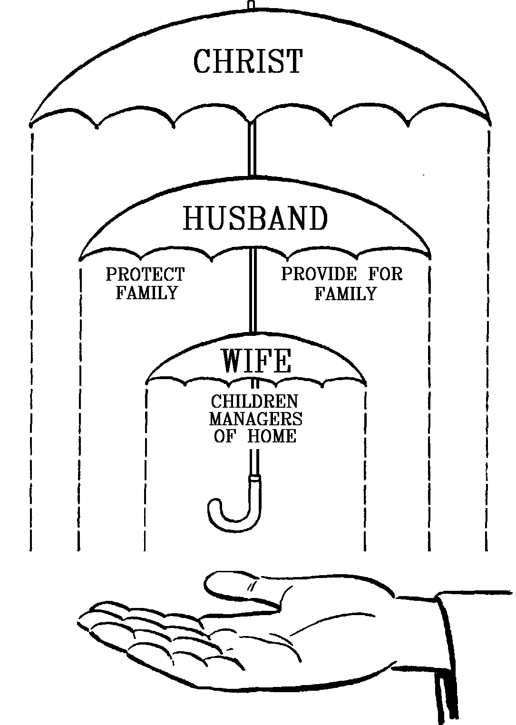

Slide 19
Gendercide in China: Statistics
In 2012, there were over 18 million more boys than girls under the age of 15 in China.
In 2012, the national government estimated that China has 40 million more males than females.
By 2020, the Chinese government estimates that there will be at least 30 million men of marriageable age that may be unable to find a spouse

Slide 21
Causes of Gendercide in China
“One-child policy”: was created in 1979 to control Chinas rapidly growing population. It only allows couples in China to have one child .
Sons are preferred as they carry on the family name and are eventually able to care for their parents in old age.
Therefore, many families abort female daughters or kill/neglect them after birth.

Slide 22
Consequences of gender imbalance in China
Men are having challenges finding wives. Unmarried men in China are not viewed highly by society and are called “bare branches” or floaters”. These men are desperate so they begin marrying younger brides.
Males are inherently more violent than females, therefore the crime rate in China has doubled over the past 20 years.
Because women are so desirable, there has been an increase in the sex trafficking industry.

Slide 23
Causes of Gendercide in India
High price of traditional Indian weddings and extensive dowry cost
In order to avoid these financial burdens, many parents decide to abort their female daughters or kill them soon, if not immediately, after birth.
If the daughter is not killed after birth, she may spend her whole life working for her parents doing housework in order to bring about some economic gain to her family.

Slide 24
Dowry Deaths
In India, when a daughter is married and the dowry given to her husband is not deemed adequate enough, the bride and her family are subject to acid throwing by her in-laws.
An estimated 5,000 women are burnt to death each year in ‘kitchen accidents’ because their dowry was seen as being too modest.

Slide 26
What is being done to stop violence against women?
Non-profit organizations: World Health Organization, The National Resource Center on Domestic Violence, National Organization for Women, and The Association of Women’s Rights in Development.

Slide 27
What is being done to stop gendercide?
Non-profit organizations: Invisible Girl Project, Gender Awareness Project, Woman’s Rights Without Frontiers, All Girls Allowed, Save A Girl Campaign, and the Global Gendercide Advocacy and Awareness Project.
Chinas “two-child policy”

Slide 28
Ms.Nourry
“Terracotta Daughters”
116 terracotta sculptures of young girls inspired by the thousands of terra cotta soldiers placed in the tomb of Chinese emperor, Qin Shi Huangdi.

Slide 29
Terracotta Daughters

Slide 30
Ms.Nourry
“Holy Daughters”
Ms.Nourry combined the image of a young girl with a cow.

Slide 31
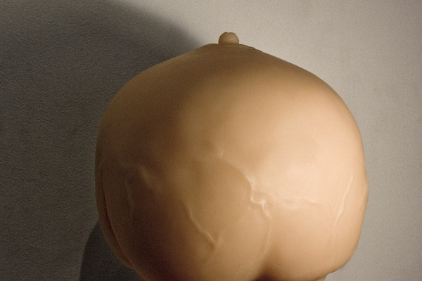
Holy Daughters

