Slide 1
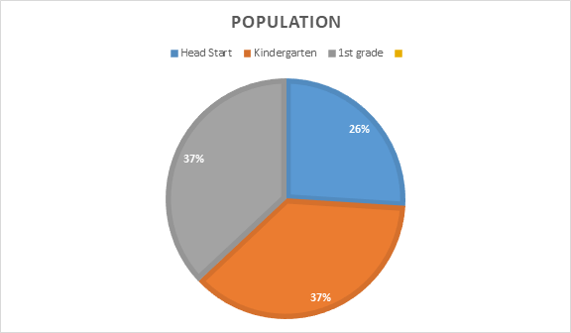
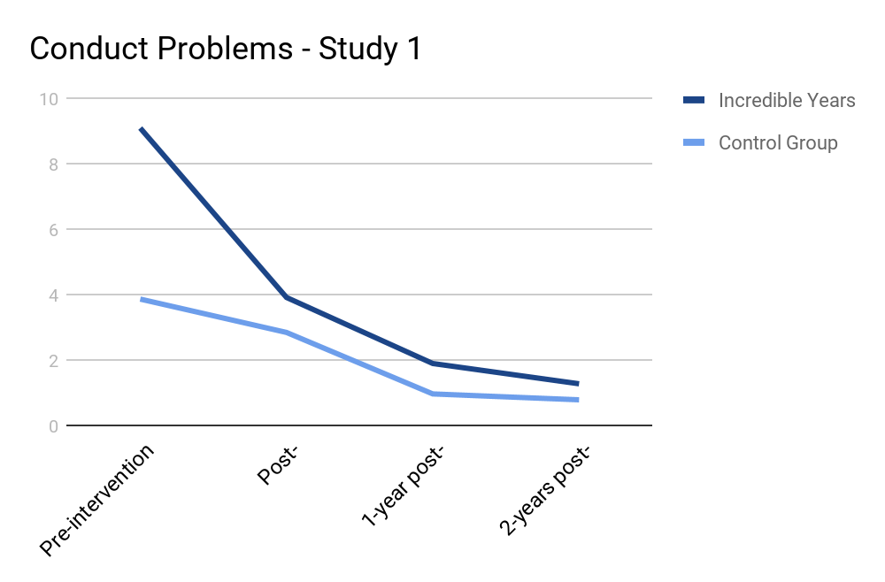
The Effectiveness of The Incredible Years for Students with Emotional or Behavioral Disorders
Dr. Khan - SPED 389
Study #1: Sustained Effects of Incredible Years as a Preventive Intervention in Preschool Children with Conduct Problems
This study looked at 72 parents of preschool aged children with severe conduct problems. Some families received The Incredible Years program training and other families, the control group, received care “as usual”, meaning they could treat the child any way they wanted. The focus of this study was to use The Incredible Years to decrease conduct problems in children as well as help parents discipline their kids. The researchers completed a 1 and 2-year follow up after the intervention to assess it’s effectiveness on improving parenting and conduct problems in children. At the 2-year follow up, it was found that there were significant improvements in conduct problems in children after the Incredible Years. While the control group showed decreases in conduct problems too, the Incredible Years group showed a larger decrease overall. It was noted that there were also improvements in parenting-skills in the families. According to the researchers in this study, the “Incredible Years parent program [is] a promising intervention for the prevention of conduct disorders” (Posthumus, Raaijmakers, Maassen, Engeland, & Matthys, 2011, p. 498).
Miranda Barringer and Mary Anderson
Study #3:Classroom behaviour management strategies in response to problematic behaviours of primary school children with special educational needs: views of special educational needs coordinators
This study implemented IY by six SENcos in primary schools in South West England to identify if it was an appropriate strategy for teachers to implement for students with behavioral problems that identified as special needs. The study showed that IY was successful, however, there were times when the teacher had to step back from the method for the safety of the student, so the students with severe disabilities may find IY to be less effective because they need special one-on-one attention for implementation and maintaining. The appropriateness of this program is hard because the “qualitative design does not allow for any conclusions to be made about the effectiveness of the IY TCM Programme for children identified with SEN in mainstream schools” .
Abstract:
The Incredible Years program was predicted to be successful in effectively helping students with emotional behavioral disorders because it involved the teacher, the parent, as well as the child. The program is structured with the goal of aiding students with social competence and appropriate behavior within a set setting that is culturally accepted. After further research the effectiveness of the program has been supported through studies showing that students improved behavior over time, and teachers are willing to implement it because of the positive outcomes it presented within their classroom.
The Incredible Years(IY) is an evidence-based practice which includes different training programs that work to improve social competence and reduce behavioral problems in children at-risk for EBD. The objective of this program is to help parents and teachers provide their children with a solid emotional, social, and academic foundation to reduce the development of further development of future problems such as emotional or behavioral disorders.
Study #2: Treating Children With Early-Onset Conduct Problems: Intervention Outcomes for Parent, Child, and Teacher Training
This study focused on 159 families with children between the ages of 4-8 that had oppositional defiant disorder (ODD). Families were randomly assigned to different groups including “parent training; parent plus teacher training; child training; child plus teacher training; parent, child, plus teacher training; or a waiting list control [group] (Webster-Stratton, Reid, & Hammond, 2004, p.105). After 6 months, it was observed that there was a significant drop in conduct problems across all of the groups compared to the control group. It was also noted that there was an increase in prosocial behaviors when interacting with peers. The study also found improvements in parenting behaviors and behavior management skills among the teachers involved in the study. Teachers also reported a decrease in behavior problems in the classroom. The Incredible Years was effective at improving conduct problems in students with ODD and also at improving teacher and parent behavior management skills when dealing with those types of students.
Study #4: Preventing conduct problems and improving school readiness: evaluation of the Incredible Years Teacher and Child Training Programs in high-risk schools
This study looked at 153 teachers and 1,768 students and the observations recorded for the outcome of the study was done in the beginning and end of thee year by “blinded observers.” The observers noticed that the classes that used the IY program “showed more social competence and emotional self-regulation and fewer conduct problems than control teachers and students”. The teachers also were very happy with the program because it fostered more and better interactions between the teacher and parents, and the study also showed that the students behavior was improved in the classroom setting as well as at home.
Emotional or behavioral disorder is defined by IDEA as an “emotional disturbance that adversely affects a child’s education performance.” Students portray poor interpersonal relationships while underachieving in academics that is not due to lack of intelligence. The behaviors are continuous and extreme while be inappropriate according to social setting and cultural expectations. EBD has been categorized by ether internalizing or externalizing behaviors. Internalizing, more common in females, is portrayed by social withdrawal and isolation while externalizing, more common in males, is through physical acts such as aggression and defiance. Students with EBD makeup approximately 7% of students receiving special education services.

