Slide 1
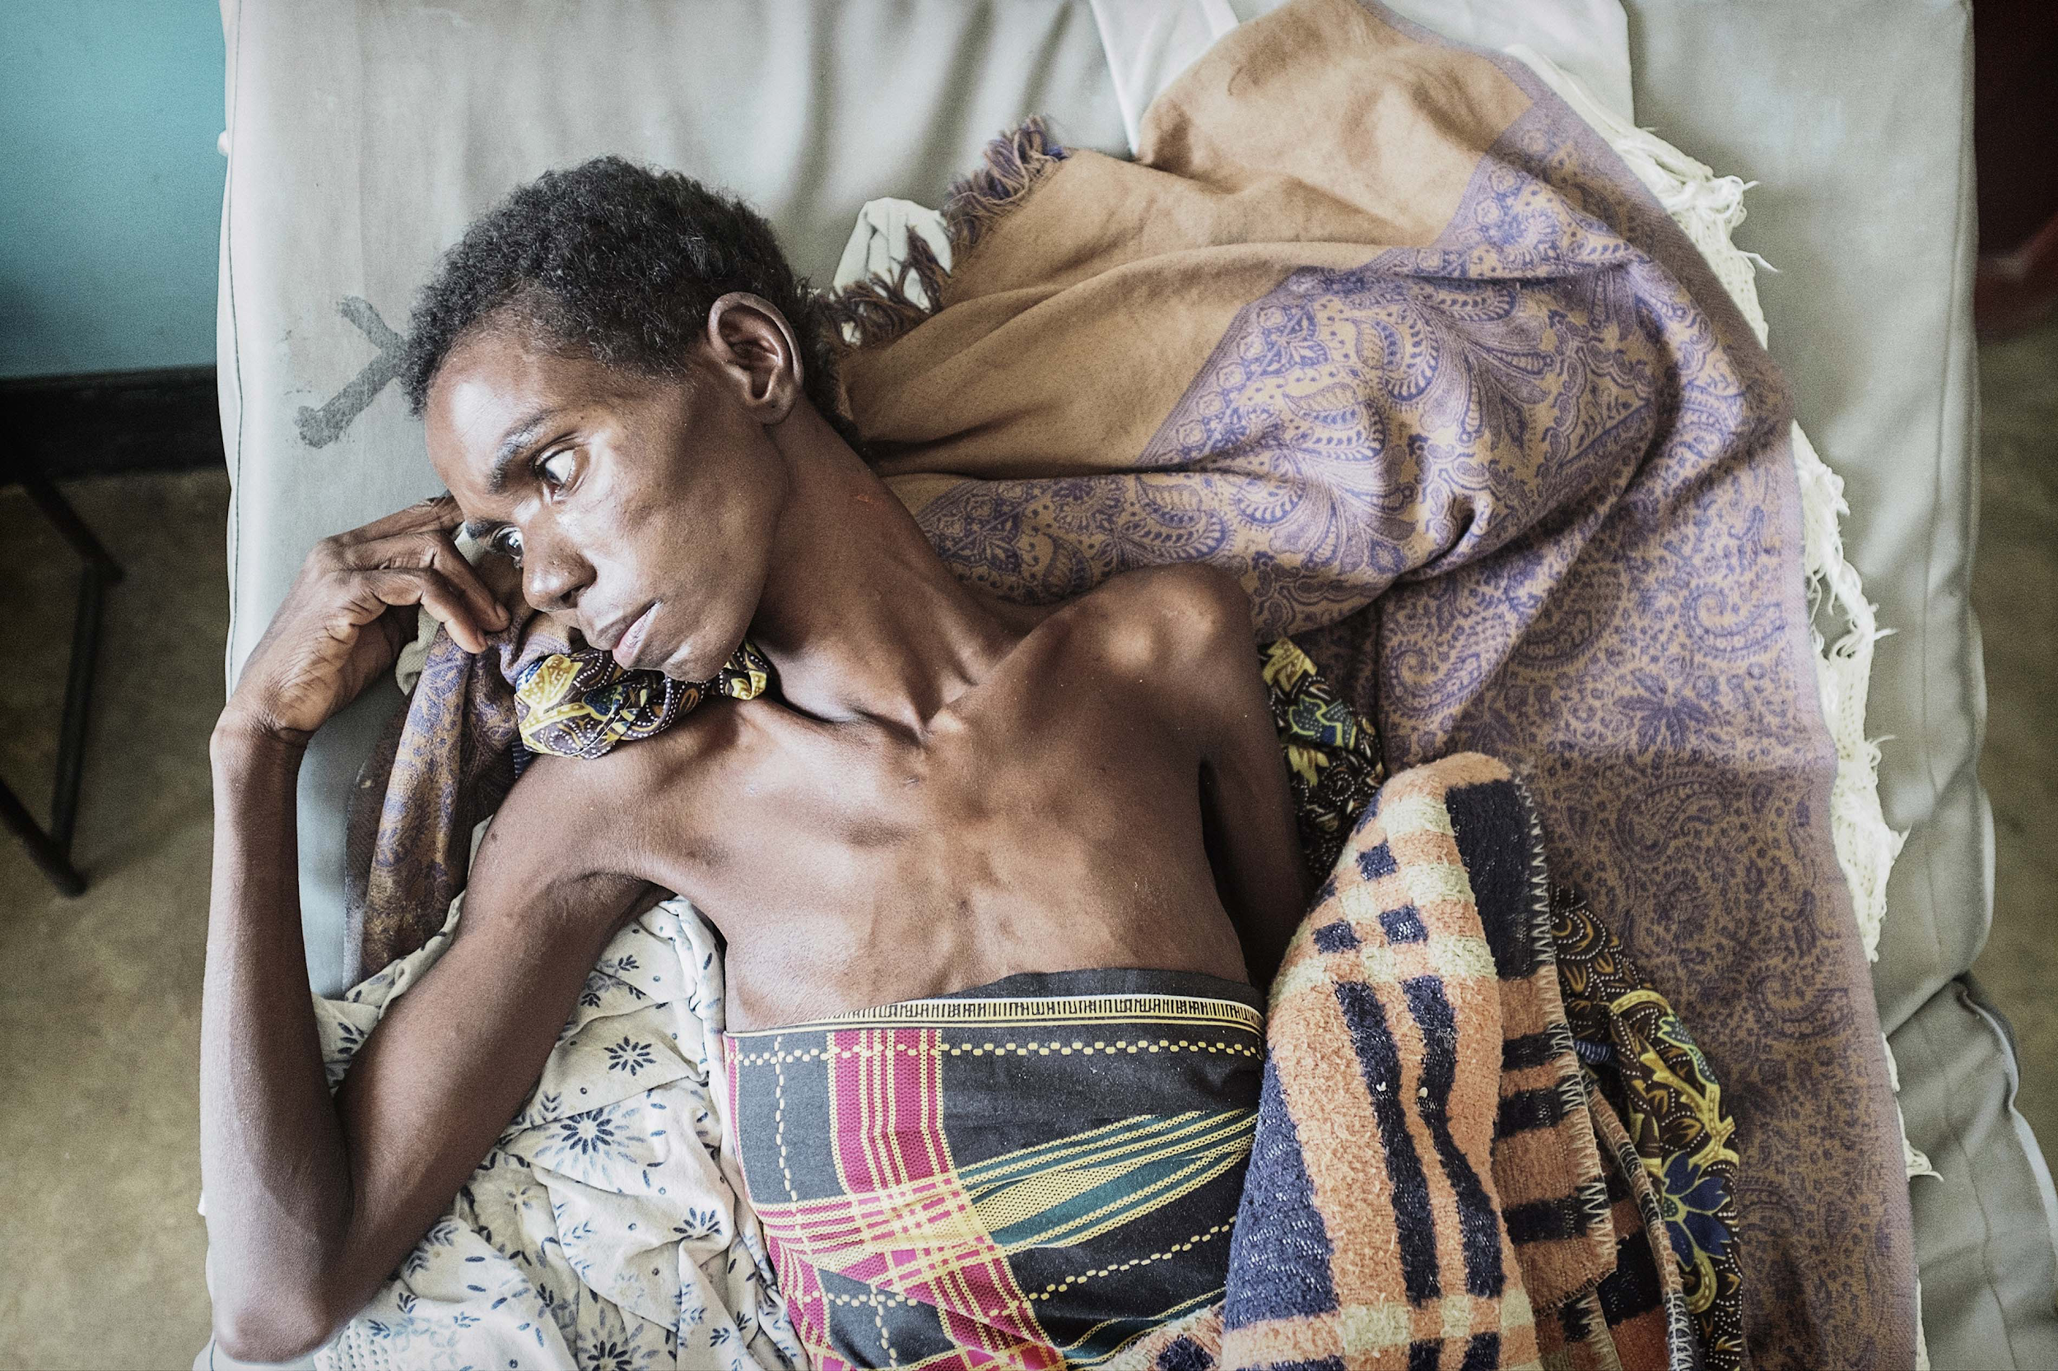
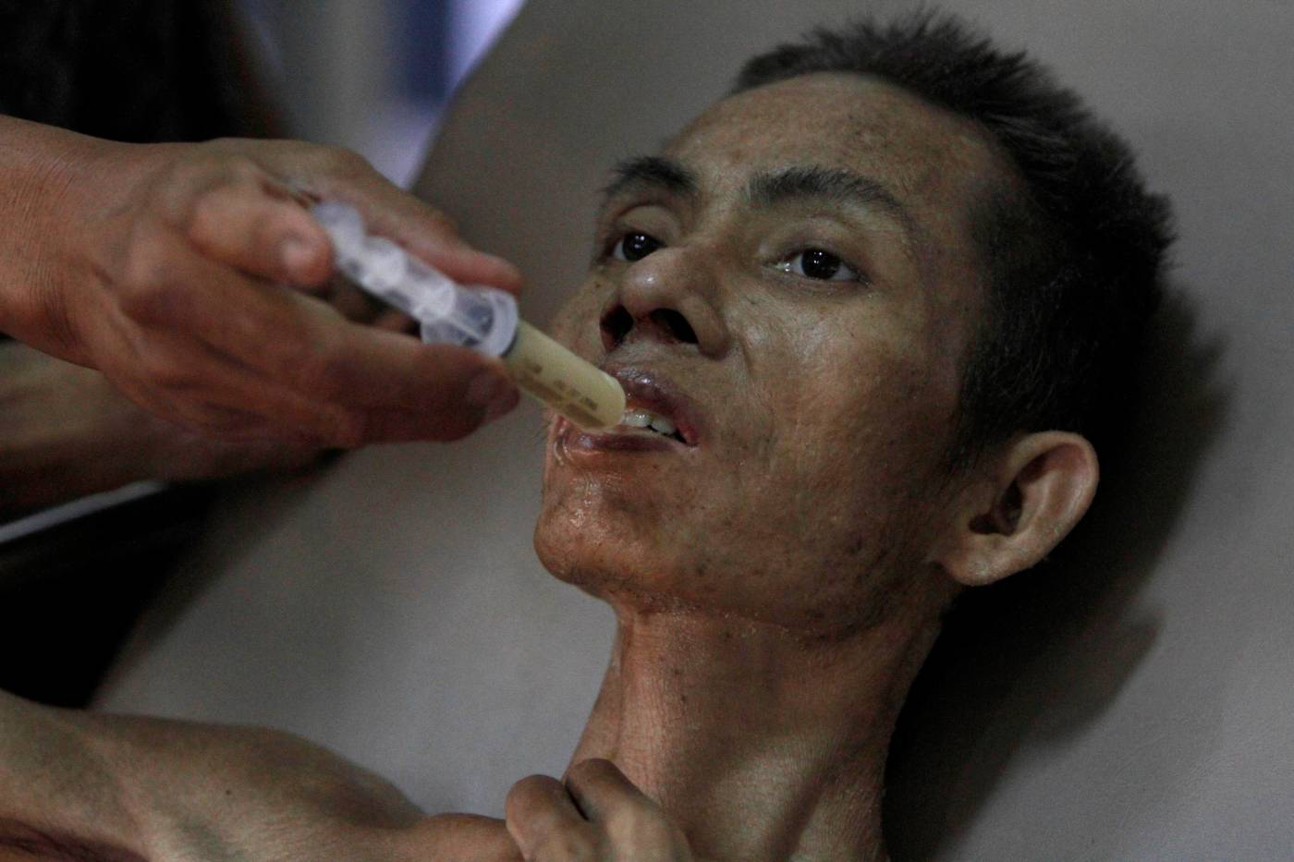
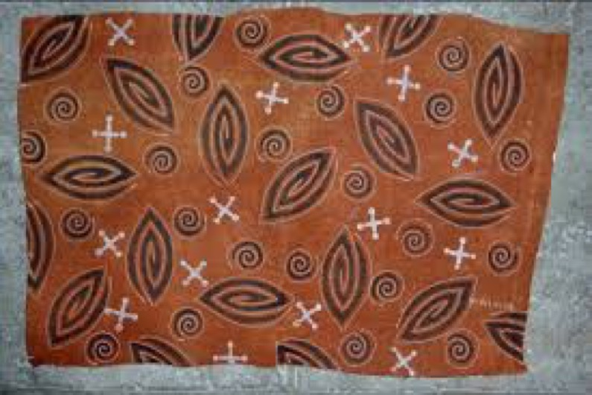
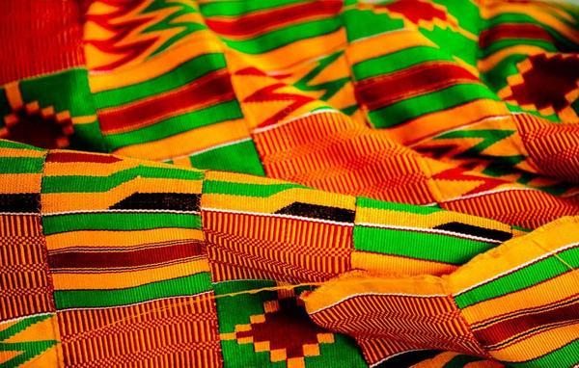
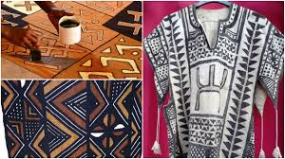
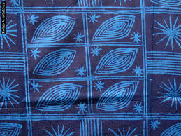
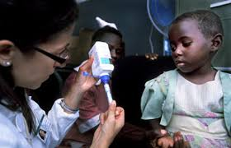
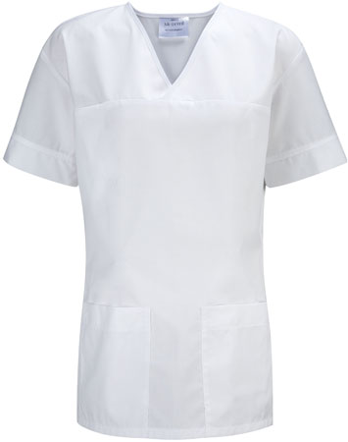
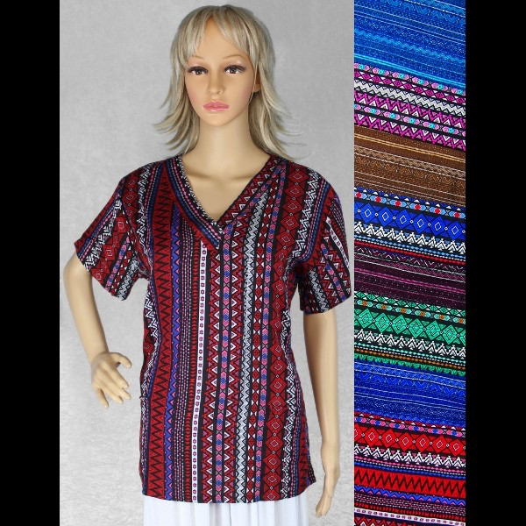
‘Scrubs Gives Back’ Can Change The Way We Treat HIV and AIDS In Developing Countries
Abby Johnson, Clayton Hoffmeister, Molly Mancini
Cormier Honors College, Longwood University, Farmville, Virginia
ABSTRACT
Feasibility, Sustainability, Originality
CONCLUSIONS
At the end of 2016, 36.7 million people worldwide were living with HIV/AIDS. Since this tends to be a major problem in developing countries, we want to provide a solution that will not only prevent the disease, but also give back to the local tribes and communities. To make this happen, we want to partner with these developing countries by having them create scrub tops out of their local fabric in return for medications and treatment for HIV/AIDS. We plan to send the appropriate medications back to those countries to help provide sufferers with more substantial treatment.
Feasibility
We don’t need a large amount of money to start off, so we can easily make a profit from selling the tops to hospitals, doctors offices, and other medical setting in the United States and the Netherlands.
Sustainability
This product is self-supporting because everyone in the process (those with HIV/AIDS and those who distribute scrub tops and medicines) will benefit.
Since this epidemic will not go away over night, we believe people will continue to fight HIV/AIDS until it can be more easily prevented.
INTRODUCTION
Challenges
160,000 children in Sub-Saharan Africa were affected by mother’s with HIV/AIDS during pregnancy.
In 2016, 1 million people died of AIDS.
Since 1970 (beginning of epidemic in Africa only), 35 million people have died from this disease.
AIDS/HIV is a Sexually Transmitted Disease/Infection
No direct cure
Symptoms: fever, headache, joint pain, skin rashes/bumps, weight loss
Treatments: ART (antiretroviral therapy) therapy (three drugs from two classes- NNRTI, NRTI, PI, Fusion Inhibitors, Integrase Inhibitors)
Most common population: children and orphans (280,000, 58% on treatment).
We won’t be able to directly communicate with our target population.
Sourcing fabrics from impoverished tribes may be difficult
Possible potential for medication to not be used appropriately (i.e. misuse, overdose etc.)
Originality
Most doctors and nurses wear plain scrub tops- either white or blue.
There are not many unique and patterned styles available for sale.
Our idea is different from other organizations working towards the same cause because we give something back to our ’sponsors’ in exchange for these life-saving medications.
Impact
By introducing a line of scrub tops that will allow healthcare professions from all over the world to help developing countries in need, we will be able to fund the medication and treatments needed in these developing countries so we can fight HIV/AIDS.
Types of Fabric
FUTURE WORK
Barkcloth from Uganda
Kente from Ghana
Bologan from Mali
WE ARE ASKING FOR $50,000 FOR 8% OF THE COMPANY.
Our next steps are…
Build relationships with those in need.
Connect and partner with hospitals to sell scrub tops in bulk.
If we are successful, we want to expand our target population to groups in need on six continents (excluding Antarctica).
Kitenge from Kenya
Adire from Nigeria
METHODS
Implementation
Collect scrub tops made from fabrics indigenous to foreign countries to sell in the United States and the Netherlands
With our profit, we want to send the appropriate medications developed in our countries, to the countries that provided scrub tops to help treat HIV (Human Immunodeficiency Virus) and AIDS (Acquired Immunodeficiency Syndrome).
Our profit will also cover shipping and distribution fees.
Acknowledgments
We want to acknowledge Mrs. Jessi Znosko as being our wonderful professor and leading us to solve a worldwide problem through out social innovation. We also want to acknowledge two other members of our team from the Netherlands, Tijs Berkenbosch and Nikki Froentjes.js
References Cited
https://www.hiv.gov/hiv-basics/overview/data-and-trends/global-statistics
http://blog.swaliafrica.com/6-colourful-african-fabric-used-around-the-world/https://moguldom.com/66437/10-popular-african-textiles-and-fabrics/6
/https://www.ietravel.com/blog/traditional-textiles-peru-what-look-cuscohttps://www.medindia.net/news/healthinfocus/how-accessible-is-healthcare-to-the-rich-and-poor-in-india-151803-1.ht
https://idpc.net/policy-advocacy/regional-work/sub-saharan-africa

