Slide 1
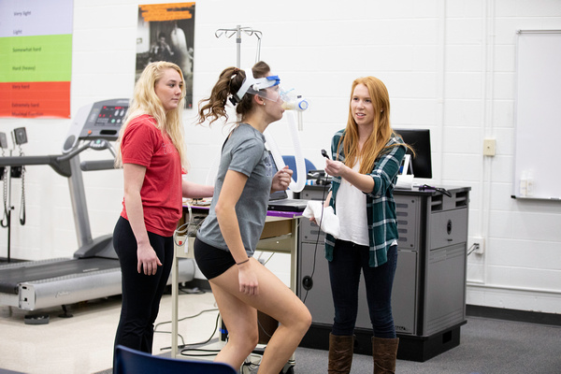
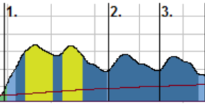
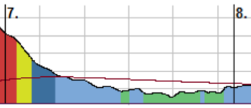
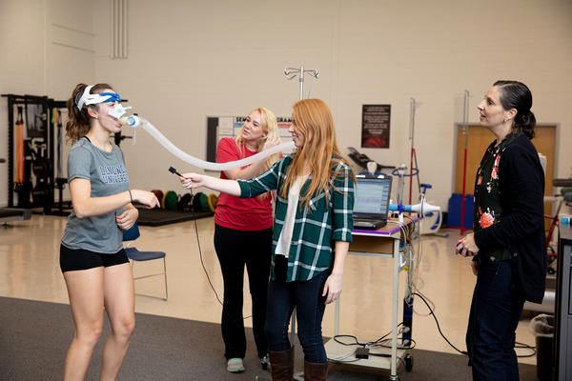
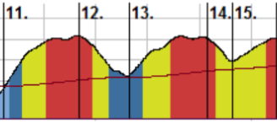
Analyzing Heart Rate and VO₂ Data in Recreational Hard and Soft Shoe Irish Dancers
Madison Cutten, Madison Trebour & Dr. Jo Morrison, KINS 480 – Advanced Exercise Testing
Overview
Results
The purpose of this study was to gain experience using heart rate and VO₂ testing equipment to characterize the cardiorespiratory demands of female, recreational Irish dancers. Several female dancers volunteered for HR monitoring and VO₂ testing while wearing both hard and soft shoes. The data gathered suggest that Irish dance classes are moderate intensity activities with vigorous intensity intervals and are physiologically demanding with both aerobic and anaerobic contributions. Through using this data, exercise physiologists can look at the cardiorespiratory response to dance and prescribe more effective training programs to enhance performance.
Dark blue zones indicate aerobic training of moderate intensity. During this training session, the subject was performing a warm-up during this segment of data.
Light green zones indicate areas where the subject is in recovery. During this training session, the subject was standing and listening to the instructor during this segment of data.
Background
Heart rate is defined as the number of times the heart beats per minute ^{[1]}
Several factors can affect heart rate including temperature, body size, posture, emotions, and medications ^{[1]}
VO_{2max} is defined as the highest volume of oxygen the body can consume ^{[2]}
VO_{2max} is used as an indicator of aerobic fitness and endurance exercise performance. A higher VO_{2max} indicates a greater capacity to create ATP to supply the energy required to support higher intensity exercise ^{[2]}
Irish Step Dance is a form of dance characterized by maintaining an upright posture and moving primarily through the lower extremities with two different shoe styles. Soft shoe dance requires light and delicate movements, while hard shoe dance requires forceful and powerful movements. Irish dance competition pieces can last anywhere from 30-60 seconds, and performance pieces can last up to 10 minutes.
Dark red zones indicate periods of high intensity training where the subject is at or is close to maximum heart rate. During this training session, the subject was performing Ceili dances during this segment of data.
Methods
Conclusion
Seven female dancers volunteered for HR monitoring during three separate 45-minute classes.
Classes consisted of a mixture of hard shoe and soft shoe dancing.
Three female dancers volunteered for VO₂ testing.
Dancers completed a three-minute reel and treble reel dances while wearing soft and hard shoes.
Steady-state data were analyzed from the last 30 seconds of the three-minute dance test.
The order of testing was randomized, and the same piece of music was used for all dances.
The class data suggest that Irish dance classes are moderate intensity activities with vigorous intensity intervals. Hard shoe and soft shoe Irish dances are physiologically demanding aerobic activities with anaerobic contribution. Despite differences in dance style these data suggest that there is no difference between the metabolic demands of hard and soft shoe Irish dancing.
References
All About Heart Rate. (2018). American Heart Association. Retrieved from, http://www.heart.org/en/health-topics/high-blood-pressure/the-facts-about-high-blood-pressure/all-about-heart-rate-pulse.
Magyari, P., Lite, R., Kilatrick, M., & Schoffstall, J. (2018). Resources for the Exercise Physiologist. Philadelphia, PA: Lippincott Willians & Wilkins.

