Slide 1
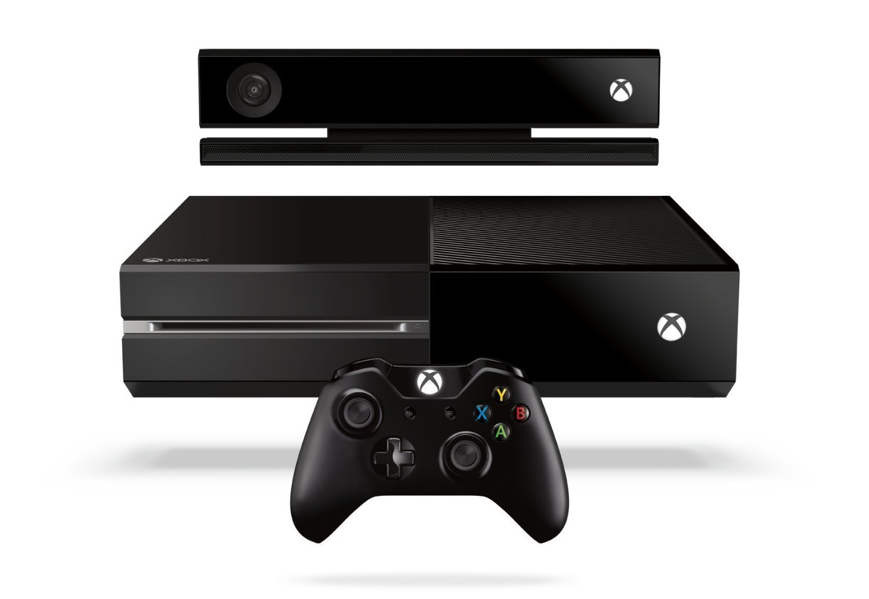
Xbox Kinect
By Andy Lucas

Slide 2
Why is this interesting?
Video games can incorporate technology into a physical education through dance and sports in a competitive and fun manner.
Active video games can be used to help ease kids away from sedentary lifestyles to more active ones

Slide 3
What does it do?
The Kinect camera senses where the player is in space and tracks their movements.
In some games, points are awarded with how closely the player matches the movements of the game
Sports games require you to mimic as if you were really playing the sport

Slide 4
Features?
Body recognition
Voice commands
Eliminates the need for controllers
Skype capability

Slide 5
How does this fit into PE/Health
This can be used to get kids up and active through the allure of video games
Skype feature can be used during health to have class listen to a dietitian, health professional, etc.
Certain games are designed to get the players up and moving, rather than just sitting and twiddling their thumbs.

Slide 6
Cost?
These pieces of equipment can be expensive, and the Kinect does cost extra
Xbox One with Kinect will cost you around $350 per console, and fitness games range from $15 - $40
Xbox 360 with Kinect costs about $200-250 (varies in stores), and fitness games vary from $10 – $25

Slide 7
References
http://www.walmart.com/cp/Xbox-One/1224908
http://www.xbox.com/en-US/xbox-one/accessories/kinect-for-xbox-one

