Slide 2
What Is School-Wide PBIS?
School wide PBIS is a set of proactive strategies that define and support appropriate students behaviors throughout the school. It is a way to monitor and reward positive behaviors while managing and redirecting the less favorable one.

Slide 3
What Is School-Wide PBIS?
It is based on a 3-tier system:
Tier 1
Universal: applies to the entire student body
Tier 2
Targets Groups: applies to groups in most need
Tier 3
Targets Individuals: interventions to help support and motivate frequently identified individuals

Slide 4
Why Teach Positive Behaviors?
Research supports the “reinforcing positive social behaviors as an important step of a student’s educational experience” (PBIS.org). Furthermore, research all demonstrates that continuous use of punishment is ineffective. PBIS is a proactive way to cut-off misbehavior before it occurs by rewarding positive ones, creating a climate of appropriate behavior norms.

Slide 5
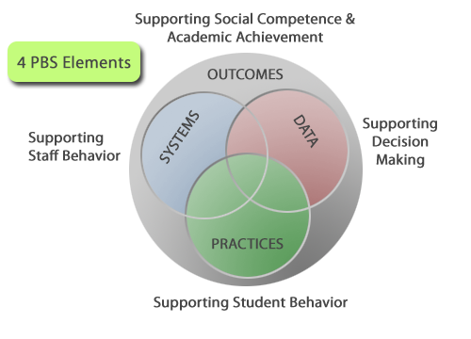
The Systems Approach

Slide 6
A Systems Approach
Outcomes
Academic and behavior targets are endorsed and emphasized by students, families, and educators. These are agreed upon and shared cultural values.
Practices
The practice and use of evidence based strategies that are proven effective in deterring unfavorable behaviors and help the school and students achieve their identified goals.
Data
Data is assessed regularly to determine what is working and what isn’t across the school, across targeted groups, and with individuals.
Systems
Enable support systems that are accurate and sustainable over time.

