Slide 1
Good Morning class!
Where is Miss. Lucas today?

Slide 2
Hmm Where is miss. Lucas today?
Well class teachers have to learn too, so today I will be at a conference where I get to meet others teachers and learn fun ways to teach all of you!
Now I know you all are probably so sad about not having a teacher today, right?
Well…
HAVE NO FEAR…
THE SUBSTITUTE IS HERE!!

Slide 3
Endangered species
Today we will continue to talk about our unit on endangered species, but this time we will be doing it through…
POETRY!
We will be going over three different types of poems: I wish poems, color poems, and I am poems.
After we go over each type of poem everyone will pick their favorite one and write a poem as if you were one of the endangered species.

Slide 4
Warm up
In your journals, write about what you know about endangered species and what you would like to know, and what you know about each of the three poems or what you think they are.
Discuss what you wrote in your journal with your tablemates then each table will share with the class what they talked about.

Slide 5
I am poems
Remember class when the substitute is teaching we need to give our full attention with listening ears on and eyes up front, she should be treated with respect and politeness treat her as if I was there.
I am poems start with “I am” on the first line and end with “I am” on the last time, but every line in between does not have to start with “I am” it only has to start with “I”.
Ex:
I am Ben Rogers
I am a first grader
I am a baseball player
I am a brother
I saved my dog from the pound
I was with my friend Zack yesterday
I am nice

Slide 6
Lets try it
Use the worksheet (on the next slide) to create an I am poem for yourself.
Once everyone is done you will share your poem with your tablemates and one person from each table will present one poem from their table to the class.

Slide 7
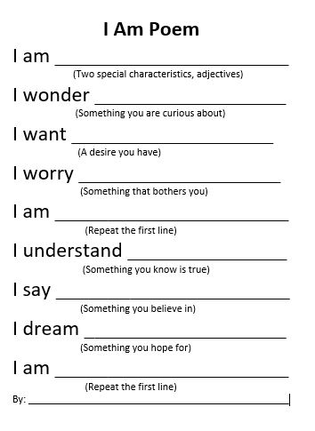
I am poem worksheet
The student who has the assigned job of passing out papers this week should pass out this worksheet to everyone, the worksheets are in a stack on my desk with a pink sticky note that says “I Am Poems”

Slide 8
Color poems
What are color poems? Does anyone have any ideas?
Color poems start each line with a color, they can be different colors or all the same colors.
Now lets try to make one on our own, once completed everyone will share with their groups.
Example:
Blue is the sky
Blue is the ocean
Blue is the color of my new shoes
Blue is my fish
Blue is my Gatorade

Slide 9
I wish poems
I wish poems begin each line with “I wish” and then complete the line with a wish.
Now lets try to make one on our own and once completed share with your tablemates.
Ex.
I wish I had a new phone
I wish I had a dog
I wish mac n cheese is for lunch
I wish for a new Barbie
I wish I had a truck
I wish I were a magician
I wish it was snowing

Slide 10
Your turn
Now that we know how to write each type of poem, pick your favorite type of poem and write as if you were an endangered species.
Some helpful ideas: what they struggle with, what they are like, where they live, or how they need help. Don’t be afraid to get creative!
Once completed, everyone will go around the room and share their poem to the class.
At the end of class turn in each of your three poems and endangered species poems with your name at the top and place it in your classwork bins.

