Slide 1
App Review
By: Kyle Weston

Slide 2
Sworkit-Kids
Sworkit-Kids is a simple and easy student app for kids of all ages to use. This is a great way to introduce kids to new and a variety of ways to work out without much instruction from the teacher.
Exercises includes:
1.) Agility
2.) Strength
3.) Flexibility
4.) Balance

Slide 3
Sworkit-Kids
The positives of this app:
The app is super customizable with what workouts kids want to do and can be set to any difficulty of their choice.
It has resources to show video clips to minimize error correction in the exercises. This makes it easy for students to learn and follow along.
This app is centered to help get kids moving and being able to freely choose what workouts they would like to participate in.
It’s FREE!

Slide 4
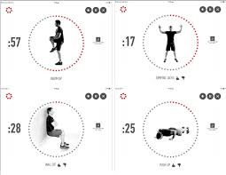
J & J Official 7 minute workout
This app is considered one of the popular apps for physical education classes. This app is for both students and teachers to use in their warm-ups or for getting the heart rate up. It’s a 7 minute, non-stop, high intensity workout that focuses on getting the students heart pumping and moving!

Slide 5
J & J Official 7 minute workout
The positives of this app:
The app is customizable with a variety of workout options and each exercise is 30 seconds. The teacher can choose the number of circuits, rest periods and the level of difficulty they desire.
It requires no equipment!
It’s a great app to use for warm ups and getting the heart pumping for activities.
It’s FREE!

