Slide 1
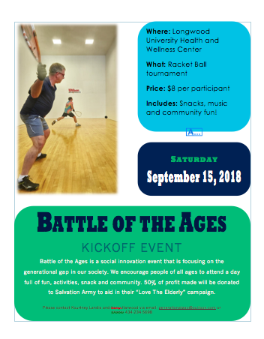
Battle of the Ages
Karly Harwood, Kourtney Landis, Emma Peeters and Ella Grit
Our Event:
Different sport like activities​
Bring two generations together​
Start on college campus' during family weekend
Held once a month
Cost is $8 per participant
Goal is to bring the two different generations together and help them to create a life-long bond
Create an event that people will look forward to attending
Salvation Army:
For our event, we will be partnering with salvation army and donating 50% of our proceeds to their “Love the Elderly” Campaign. Salvation Army focuses on finding residences for elderly individuals as well as hosting meals and different activities to help the elderly feel less alone. We want to do our part by helping the Salvation Army finically and as volunteers.
Overview:
We have created a social innovation event that is focused on the older and teenager/young adult generations. Our event will include sport like games as well as food, music and drinks. We want to create an atmosphere where these two different generations will come together and converse with one another to help solve the problem of loneliness in both generations.
How it’s a social innovation:
Our event is sustainable because it will be held monthly at every college campus that hosts our events
We will create flyers and social media pages to gain people’s attention
Our event is feasible because we are holding our event’s on college campus’, which already have gyms or fields that could be used for our activities
Our event should be low in price to host it
Our event is original because there are no other social innovations similar to our idea
Our main focus is to create a bond between the two generations
The Problem:
40% of people over 50 feel lonely (Netherlands)​
43% of seniors report feeling lonely (U.S.A)​
Recent research has proven that younger people under 25 experience even more loneliness than elderly
Both Generations are dealing with issues of loneliness/depression due to lack of social contact​

