Slide 1
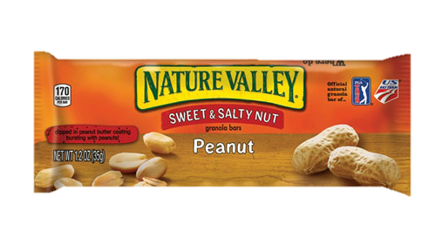
Nature Valley Peanut Bar
Food label

Slide 2
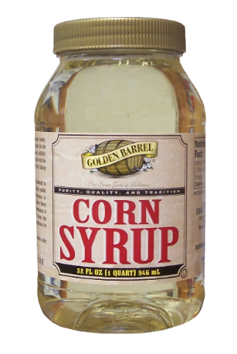
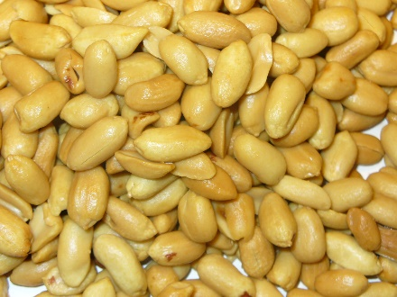
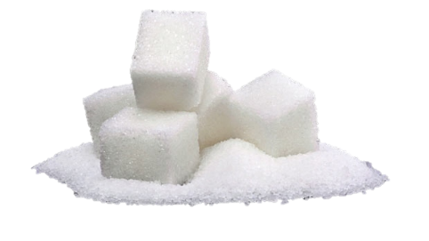
Top 3 Ingredients of the Peanut Bar
Roasted Peanuts
Corn Syrup
Sugar

Slide 3
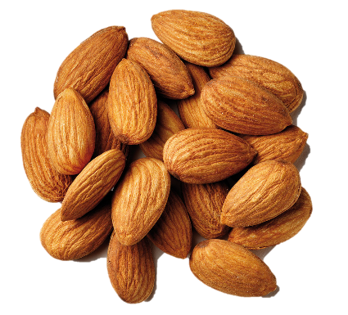
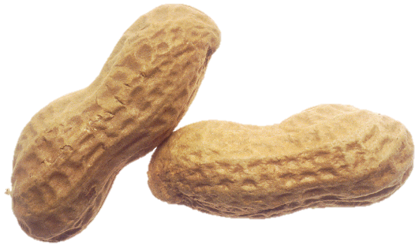
Top 3 Healthy Ingredients
1) Almonds – the oval nutlike seed (kernel) of the almond tree, growing in a woody shell, widely used as food
2) Peanuts – the oval seed of a South American plant, widely roasted and salted and eaten as a snack
3) Partially Defatted Peanut Flour – made from partially defatted peanuts and is used to enhance flavor

Slide 4
Why are these healthy?
1) Almonds – reduce risk of heart attack, lower “bad” cholesterol, protect artery walls, help maintain blood sugar levels, and nourish the nervous system
2) Peanuts – keep you heart healthy, high in vitamins and minerals, high in vitamin E, and lower risk of weight gain
3) Partially Defatted Peanut Flour – low in saturated fat and cholesterol, good source of dietary fiber, thiamin, folate, potassium and zinc, and a very good source of protein, niacin, magnesium, phosphorus, copper and manganese

Slide 5
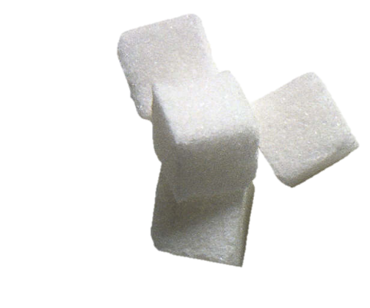
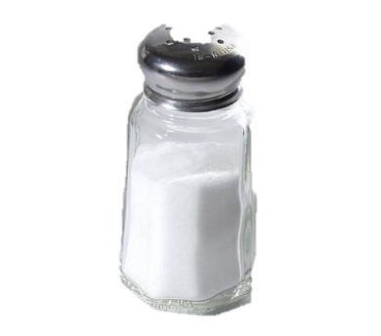
Top 3 Unhealthy Ingredients
1) Sugar – a sweet crystalline substance obtained from various plants, especially sugar cane and sugar beet, consisting essentially of sucrose, and used as a sweetener in food and drink
2) Corn Syrup – syrup made from cornstarch, consisting of dextrose, maltose, and dextrins
3) Salt – a white crystalline substance that gives seawater its characteristic taste and is used for seasoning or preserving food

Slide 6
Why are these unhealthy?
1) Sugar – bad for your teeth, can overload your liver, can lead to metabolic syndrome and type 2 diabetes, can lead to cancer, has fat-promoting effects, can lead to obesity, and can lead to heart disease
2) Corn Syrup – many of the same negative health effects as sugar; obesity, heart disease, etc.
3) Salt – can lead to high blood pressure, stroke, heart disease, cancer, obesity, kidney disease, etc.

Slide 7
Product as a Whole
Unhealthy
2 out of the top 3 most prevalent ingredients in the product are on my unhealthy list
Too many health risks
Short-term consequences – stomach ache due to high amounts of sugar or an allergic reaction if you are allergic to peanuts
Long-term consequences – heart disease, liver disease, kidney disease, high blood pressure, and cancer

Slide 8
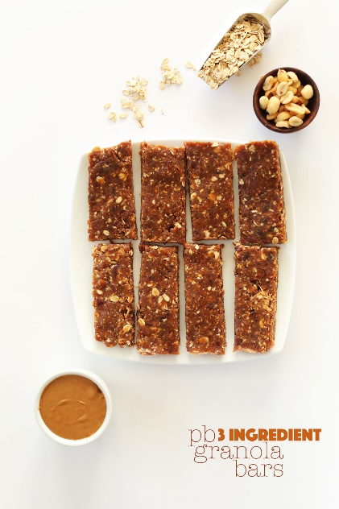
Healthier Alternatives
Eat peanuts or almonds by themselves
Make a peanut butter and jelly sandwich (use peanut butter that contains 1 or 2 ingredients)
Make your own peanut bars at home (use peanut butter that contains 1 or 2 ingredients)

Slide 9
Nature Valley Commercial

