Slide 1
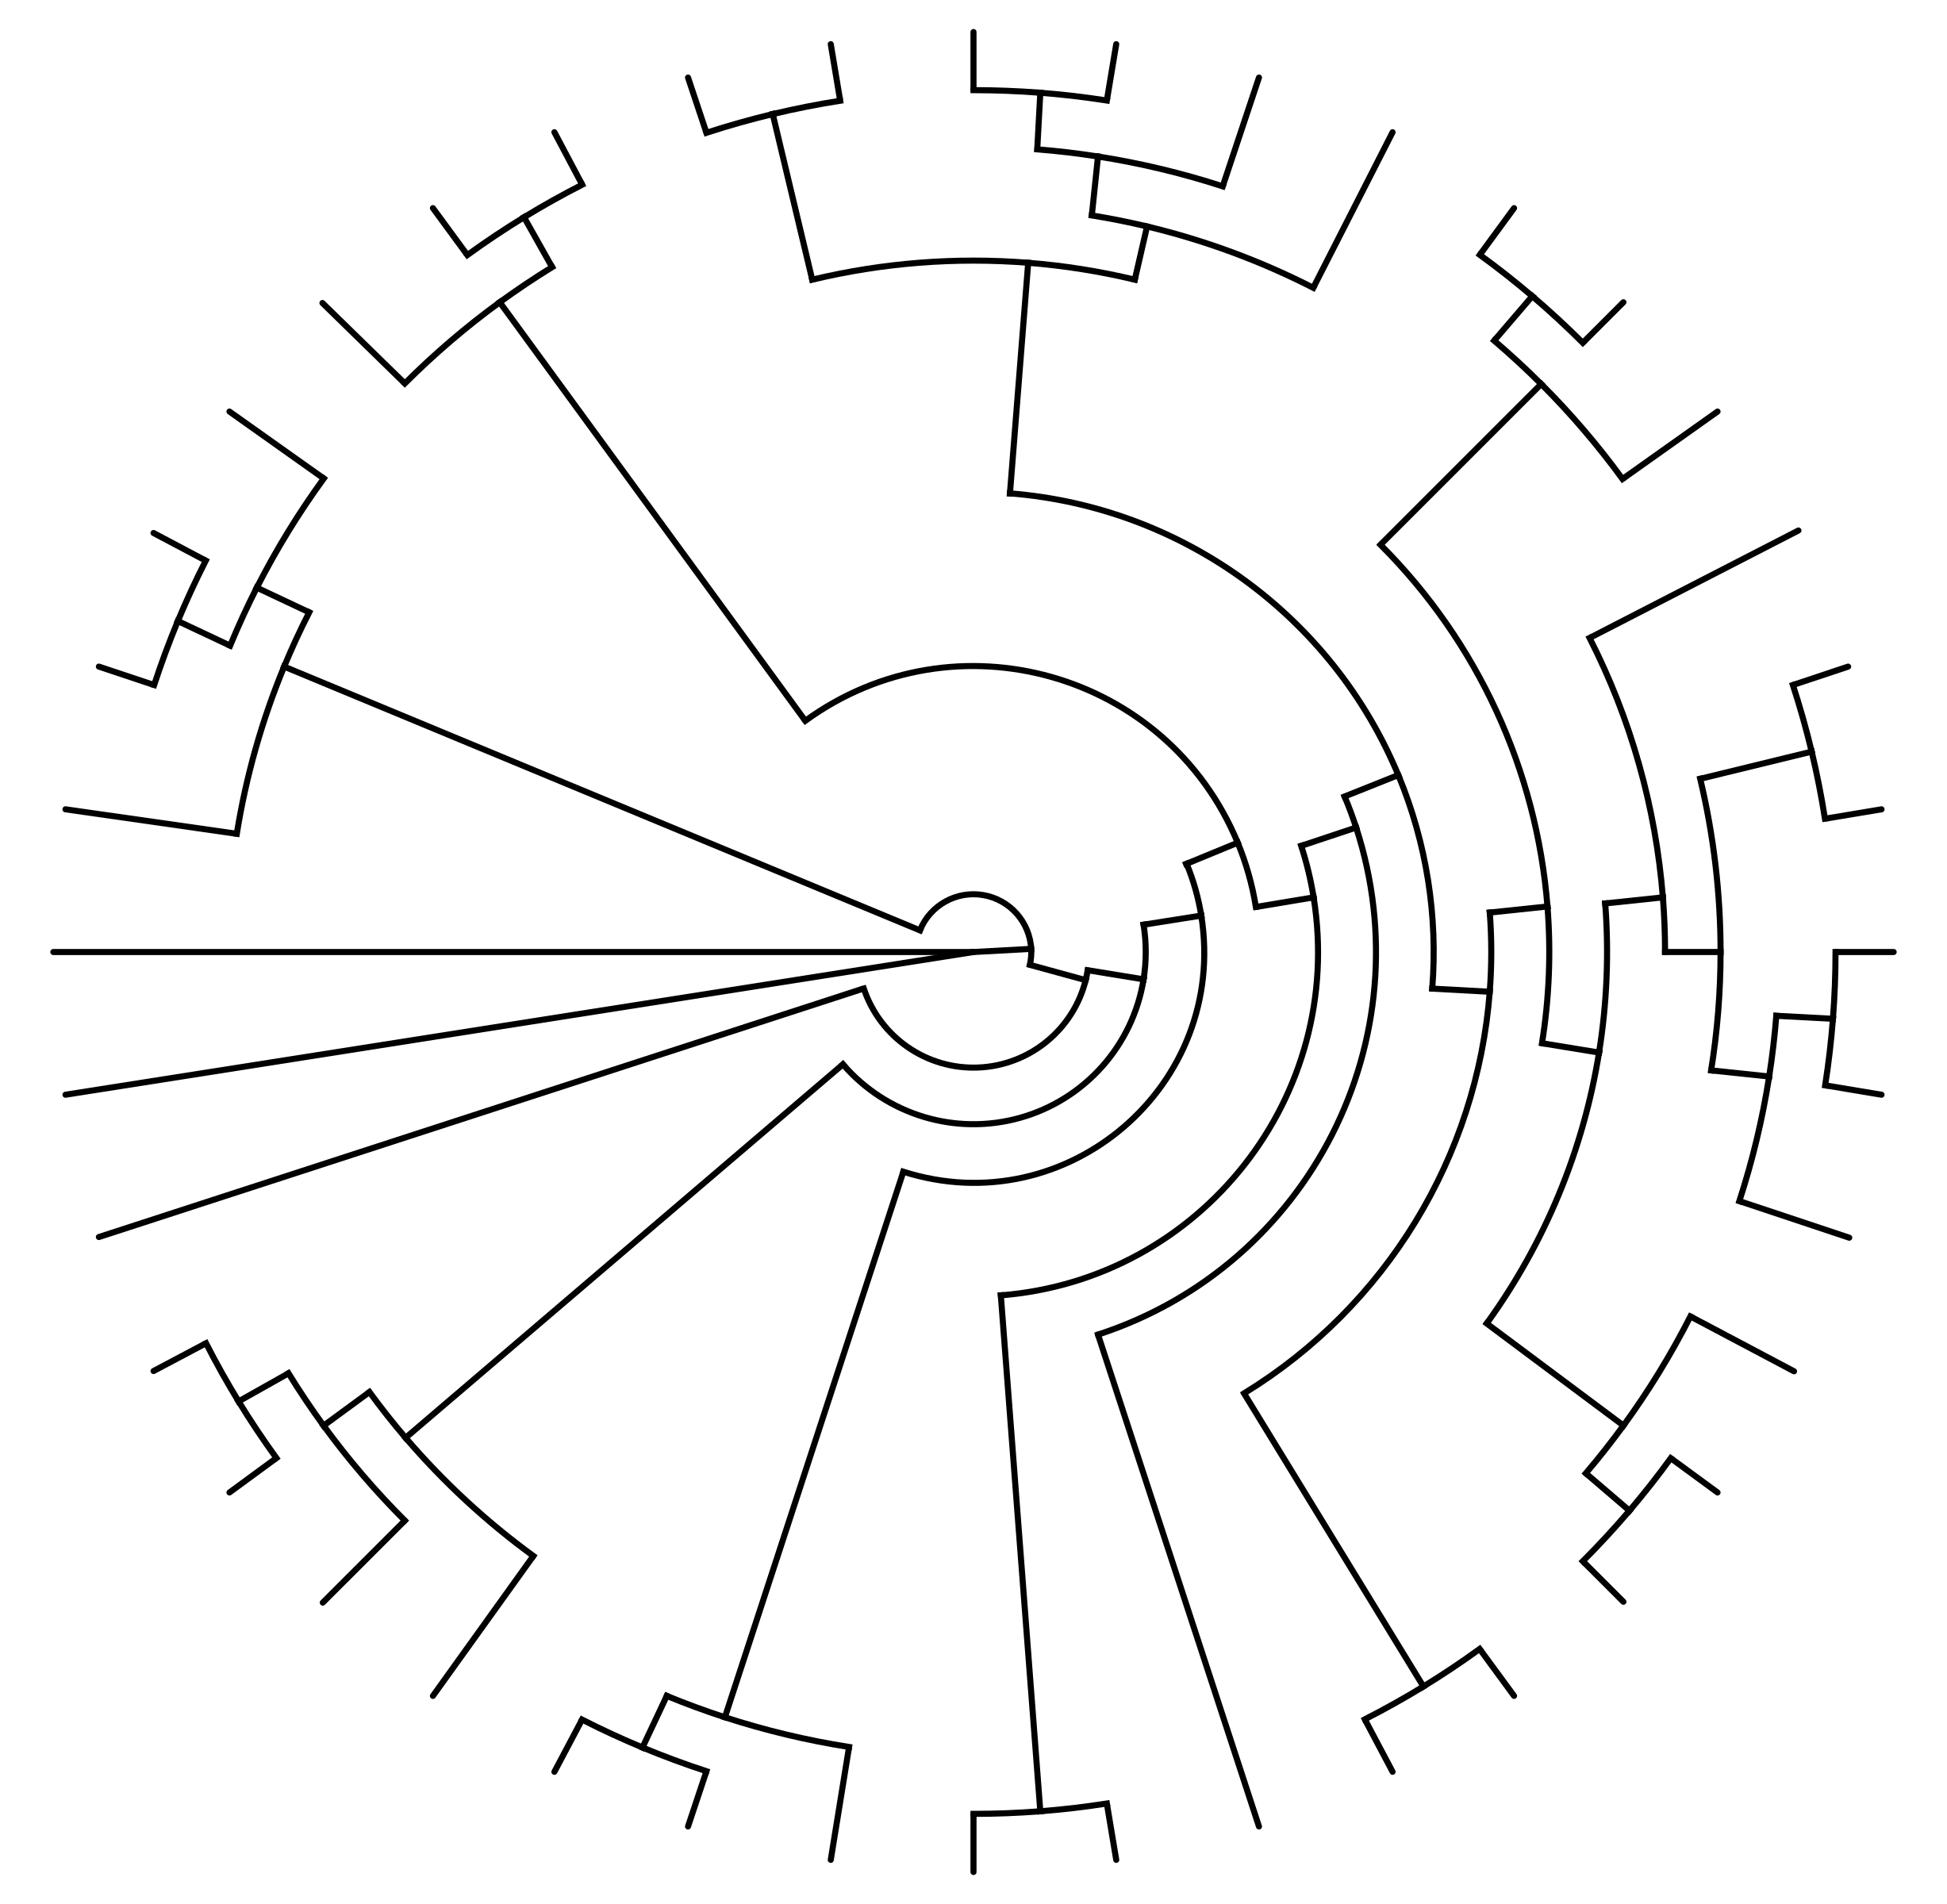
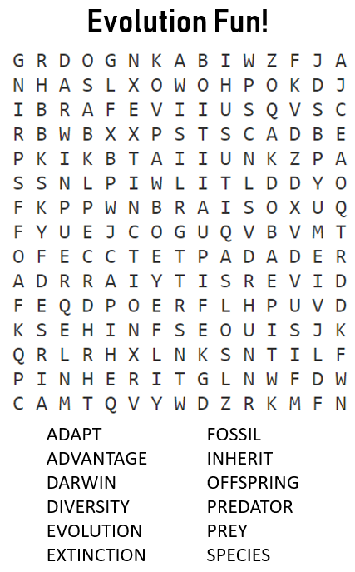
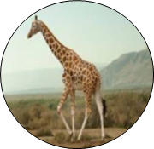
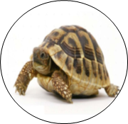
Evolution Day Workshop
Hailey Coleman, Juli Gordon, Katy Kosiorek, Kelly Tarmon
Biology 399-01, Dr. Franssen
Introduction
Importance of Community Outreach in Schools
Audience: Third grade students in Prince Edward County Public Schools
Plan: Crossword puzzle and Matching Activity
Goal: To have students understand general evolutionary concepts and how different animals relate with certain characteristics
May help to influence the next wave of scientists
Benefit of hands on/kinesthetic learning
Potential to build relationships between the university and the public school system
Crossword Puzzle
Matching Activity
Traits
Stripes
Claws
Whiskers
Mane
Hump
Long Legs
Extended Neck
Shell
No Legs
Scales
Hooves
Relevance of Activity to Evolution
Moving Forward
Children’s beliefs are heavily influenced, get them believing in evolution while they’re young and still finding their beliefs
Teaching and learning about evolution have immense practical value that extends beyond understanding our world. The principles of evolution underlie improvements in crops, livestock, and farming methods.
To assess the success of this workshop, we will hold a discussion after the activities are completed and conduct a verbal survey to gauge whether or not the students enjoyed and understood the importance of each activity.
Sample questions for the survey will include:
“On a scale of 1 to 5, how much did you have fun with these activities?”
“What is one thing you learned from both activities?”

