Slide 1
Discussion Team Round 1
Maddy Rea, Kelly Tarmon, and Maya Young

Slide 2
European Shags Paper
Purpose:
Wanted to provide baseline data for microplastics in European shags
Plastic abundance in the stomach may be useful to monitor historical contamination in a large area since ingested debris are retained in the stomach over a large period of time
Using pellets for database
Findings:
Presence of microplastics in pellets of shags
Monitoring programs based on the analysis of microplastics in pellets could help identify geographic patterns
and temporal trends in marine pollution, could also find differences in pollution levels in the marine environment
The presence of microplastics was higher in pellets containing remains of benthic fishes
Discussion:
Shags can indirectly ingest plastic fibers consumed by fish prey and/or confuse microplastic fibers with prey. Which do you think happens more often and why?
Why do some plastics sink to bottom and some stay at the top?
wheelofnames.com/f5r-vav
Notes:
Benthic fishes-bottom feeders

Slide 3
Microplastics in Seafood Paper
Purpose:
Provided evidence regarding human exposure to microplastics via seafood
Recommended mitigation and adaptation strategies targeting the life cycle of microplastics
Recommended future research to assess impacts of microplastics on humans
Explained the importance of addressing these research gaps due to the nutritional importance of seafood consumption
Major concerns:
Plastic polymers → non-toxic
Microplastics can persist and translocate from the intestinal tract to the circulatory system or surrounding tissue
Direct exposure to organic pollutants and other chemicals found in microplastics may affect biological systems
Ingested microplastics may cause inflammation in tissue, cellular proliferation, and necrosis and may compromise immune cells
Notes:
Non-toxic because generally cannot easily transport across biological membranes due to their size

Slide 4
Microplastics in Seafood Paper
What can be done:
Control environmental conditions in aquaculture—by raising animals in ponds, tanks, or selected water bodies—and animals generally have shorter lifespans in aquaculture than in the wild, which could provide less opportunities and time for microplastic exposure and uptake
Material reuse and recycling
Beach cleanup programs
Data gaps:
Insufficient information to assess the true amount of microplastics humans may be exposed to via food
Further work is required to estimate the dose of chemicals to humans from microplastics in seafood
Related effects, including studies of seafood intake, chemical characterization in seafood, and kinetic studies

Slide 5
Microplastics in Seafood Paper
Findings:
Humans ingest microplastics and nanoplastics
Shellfish and other marine life with intact GI tracts pose concern because they retain microplastics the best
Microplastics, chemical toxicity, and chronic exposure to microplastics may pose risk to human health, especially with increasing direct exposure to plastic and localized chemicals
Many key research needs to further research of microplastics and their effect on human health
Discussion question:
Why do nutritional authorities advise Americans to double their seafood consumption
wheelofnames.com/f5r-vav
Notes:
Answer: Because seafood provides many health benefits

Slide 6
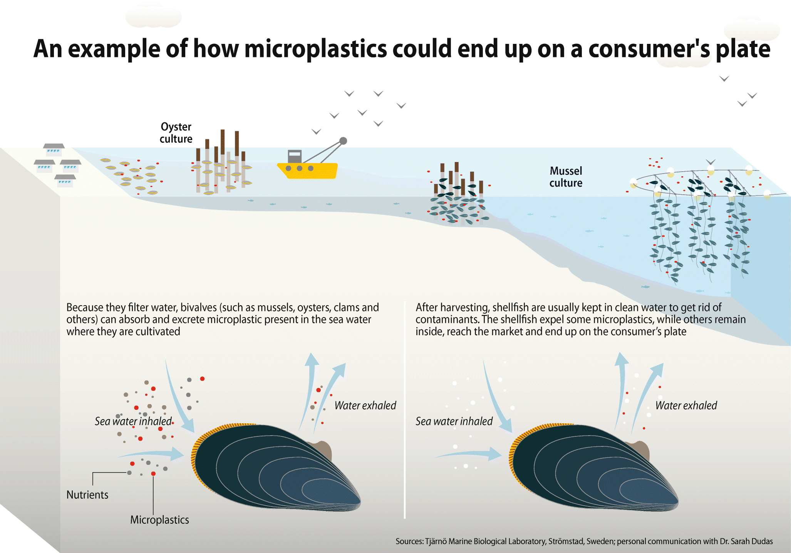
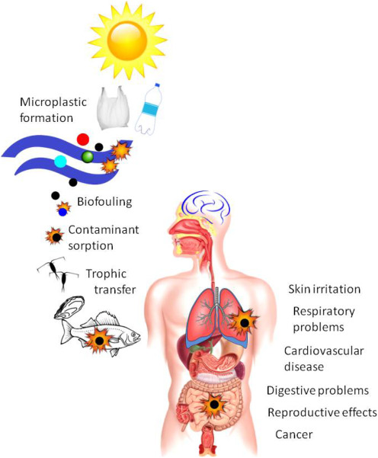
How do these two articles relate to each other?
How would mussel farming contribute to microplastics? wheelofnames.com/f5r-vav

Slide 7
Teams for Discussion
Please go sit with the following people/ groups
William, Saveya, Hartley
Matthew, Aryana, Jessica
Adrianna, Kristen, Tabitha, Rayven
Assign roles
Manager- Facilitate good discussion and time management
Writer- Write all ideas
Speaker- Talk about all ideas

Slide 8
Team discussion break off 10 and 10
Pellets team- William, Saveya, Hartley,
Why are pellets produced and how did the researchers use the pellets to find out what fish were eaten?
What else could pellets be used for and what are future studies with them?
Plastic pollution team- Matthew, Aryana, Jessica
What is the problem that remains even if humans halted plastic production and prevented plastic waste dumping?
List several ways we could help/mitigate the plastic pollution problem?
Human body and Microplastics team- Adrianna, Kristen, Tabitha, Rayven
What factors and chemicals from microplastics may affect biological systems and pose specific threats to humans?
The discussion paper lists several ways research is still needed to test microplastics and their effects on human health, choose which method or methods you think would be the most useful and why

Slide 9
Questions?

