Slide 1
Cri Du Chat
Kelly Tarmon and Jessica Knox

Slide 2
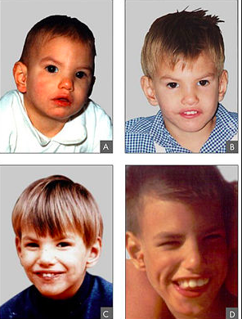
Phenotypes
Dental malocclusion (open bite)
Horizontal palpebral fissures
Frequent divergent strabismus
Small hands and feet
Prematurely grey hair
Severe psychomotor disability
Severe mental disability
Cat-like cry
Malformations of the cranial base
Low weight
Long and narrow face
Prominent supra-orbital arch
Short philtrum
Full lower lip
Notes:
8mo
2yr
4yr
9yr

Slide 3
Video
https://www.youtube.com/watch?v=TYQrzFABQHQ

Slide 4
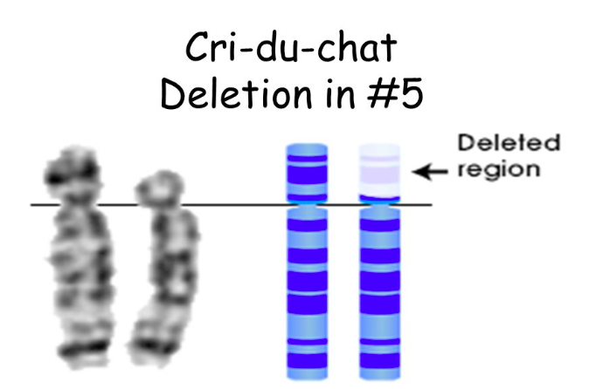
Gene affected
Deletion of the end of the short arm of chromosome 5
Size of the deletion varies-studies suggest that larger deletions tend to result in more severe intellectual disability and developmental delay than smaller deletions.
Signs and symptoms of cri du chat syndrome are probably related to the loss of multiple genes.

Slide 5
Inheritance Pattern
Most cases not inherited
Normal life expectancy
Rare: 1 in 20,000 to 1 in 50,000 newborns
If inherited-chromosome abnormality comes from an unaffected parent.
Children who inherit an unbalanced translocation have a chromosomal rearrangement with extra or missing genetic material.
Notes:
The deletion occurs as a random event during the formation of reproductive cells or in early fetal development. Most affected individuals do not have a history of the disorder in their family.
Children who inherit an unbalanced translocation can have a chromosomal rearrangement with extra or missing genetic material. Individuals with cri du chat syndrome who inherit an unbalanced translocation are missing genetic material from the short arm of chromosome 5.
In these cases, the parent carries a chromosomal rearrangement called a balanced translocation, in which no genetic material is gained or lost.

Slide 6
Alleles
TERT gene
Zhang’s research-2003
Notes:
localized to the distal portion of chromosome 5p and is the rate-limiting component for telomerase activity, which is essential for telomere length maintenance and sustained cell proliferation
showed that a deletion of the TERT allele had occurred in all 10 patients with cri-du-chat syndrome whom they examined. Induction of TERT mRNA in proliferating lymphocytes derived from 5 of 7 patients was lower than that in unaffected control individuals.

Slide 7
Screening Methods
Molecular-cytogenetic analysis
Chromosome CGH
Microarray CGH
SNP-based tests
Skeletal radiology
MRIs
Echocardiography
Swallowing study
Developmental testing.

Slide 8
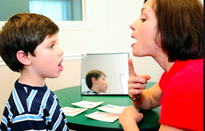
Treatment Options
Currently no cure
Treatment aims to stimulate child and help them reach their full potential
May include: physiotherapy to improve poor muscle tone and speech therapy.

Slide 9
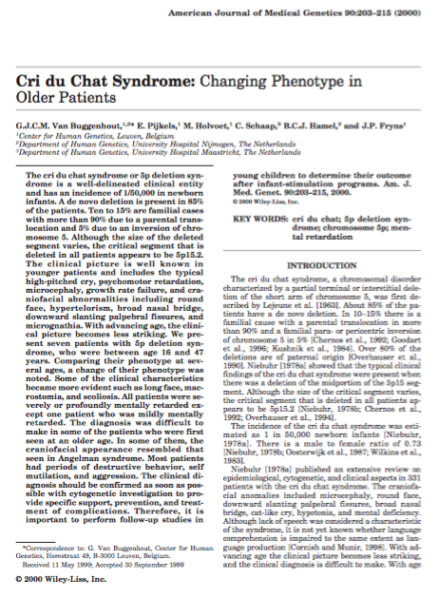
Cri du Chat Syndrome: Changing Phenotype in Older Patients

Slide 10
Research Question, Hypothesis, and Significance:
There are epidemiological, cytogenetic, and clinical aspects to patients diagnosed with the Cri du Chat syndrome and the researchers are questioning whether they change into adulthood.
The researchers hypothesized that into adulthood the phenotype from the disease changes to become coarser in appearance.
Understanding the changes in phenotype in this disease could potentially result in prevention and treatment where there are complications at a much younger age of the patient’s life. Supporting the idea about how important it is to have follow up studies in children to determine ultimately if childhood programs are working for the patient’s or not.

Slide 11
Study Design and Methods
They studied 7 different patients with the disease and identified each by their family background, their birth credentials- how many months, weight and length, and the phenotypic outcome in result to having the disease. There are pictures that depict each patient (1-7) when they are young infants into adulthood in order to compare how coarse the phenotypic changes were over time.

Slide 12
Major Results
The patients sex, age, birth weight, mental retardation level, behavioural problems, appearances, how well they pronounced sounds or words and deletion played an important role in determining how the phenotype from individuals with the syndrome changed with age.

Slide 13
Patient | M or F | Age | Birth weight | Mental Retardation Level | Behavioural Problems | Appearances | Deletion | Word Pronunciation
1 | M | 47 | 1500 g | Profound | Periodic: Head banging and destroying his own clothes | Gray hair, small forehead, flat midface, thin lips and simply formed ears | 46 XY del (5) | No speech, just sounds
2 | F | 45 | 2500 g | Severe | Periodic: Head banging and scratching | Premature gray hair, flat midface, coarse nose, simple ears | 46 XX del (5) | Speaks few words
3 | M | 44 | 3700 g | Profound | Specific: Jumping-happy Biting- frustrated | Long coarse face, gray hair, normal eyes, nose and ears | 46 XY del (5) | Few words wih a hoarse voice

Slide 14
4 | M | 43 | Not specified | Severe | Behavioural Problems | Long coarse face, prematurely grayed hair, full lips and an open mouth | 46 XY del (5) | Pronounced mostly sounds
5 | F | 25 | 3350 g | Severe | Periodic: Biting and scratching | Long face, large mouth with thin lips | 46 XX del (5) | Can’t pronounce words, only sounds
6 | M | 16 | 3100 g | Severe | Periodic: Head banging, biting other children | Long face, long neck, high nose bridge | 46 XY del (5) | Speaks only a few words
7 | F | 18 | 2050 g | Mild | Periodic: Nail biting and disobiendance | Long face, thin lips and flat midface | 46 XX del (5) | Could not speak words, just high pitched noises

Slide 15
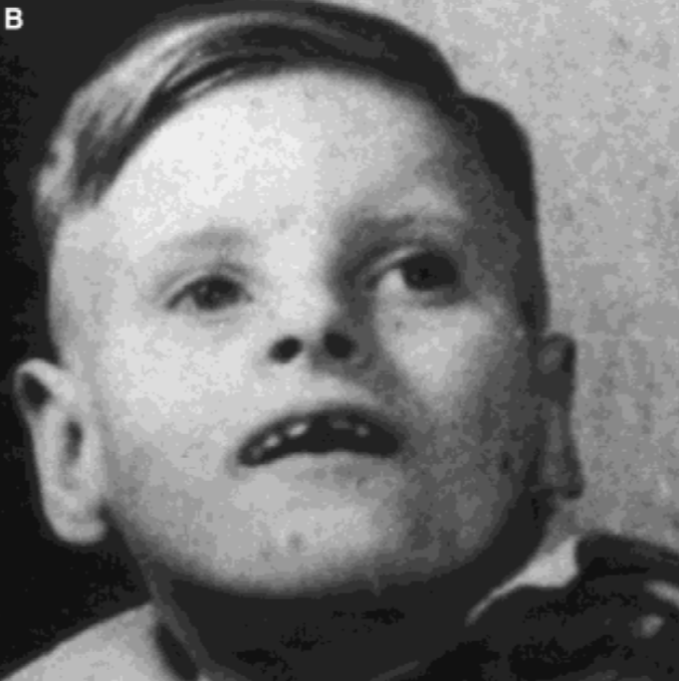
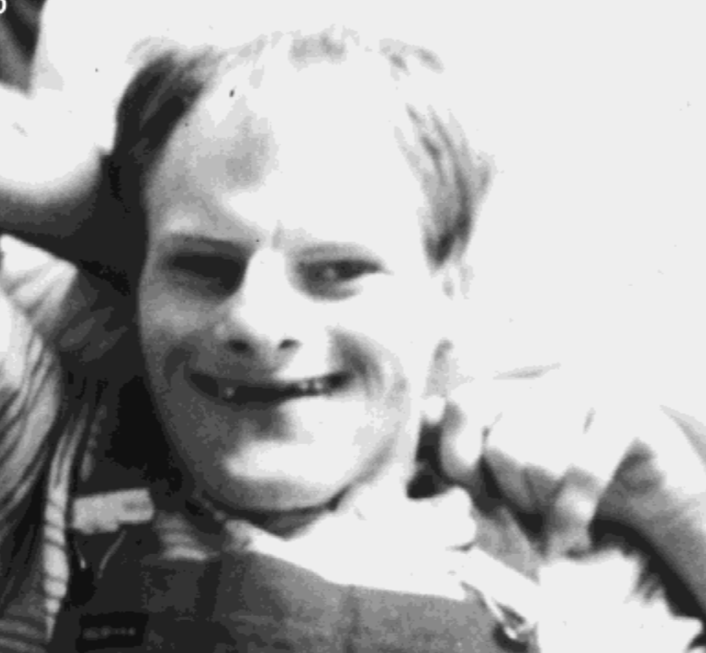
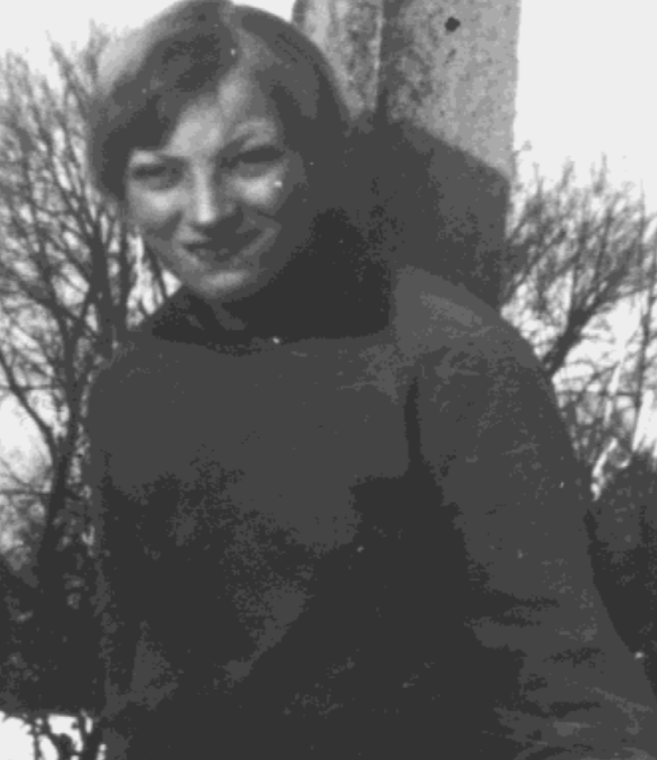
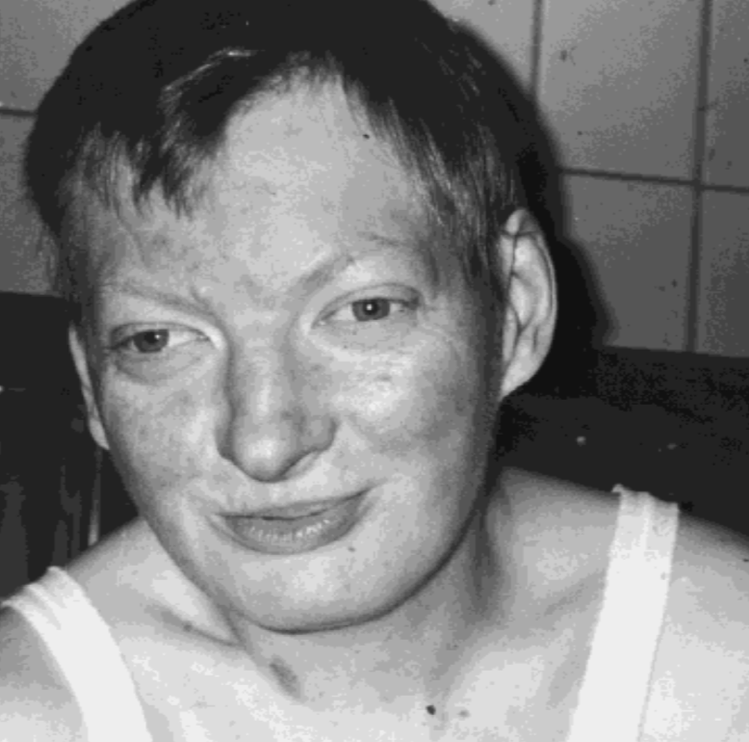
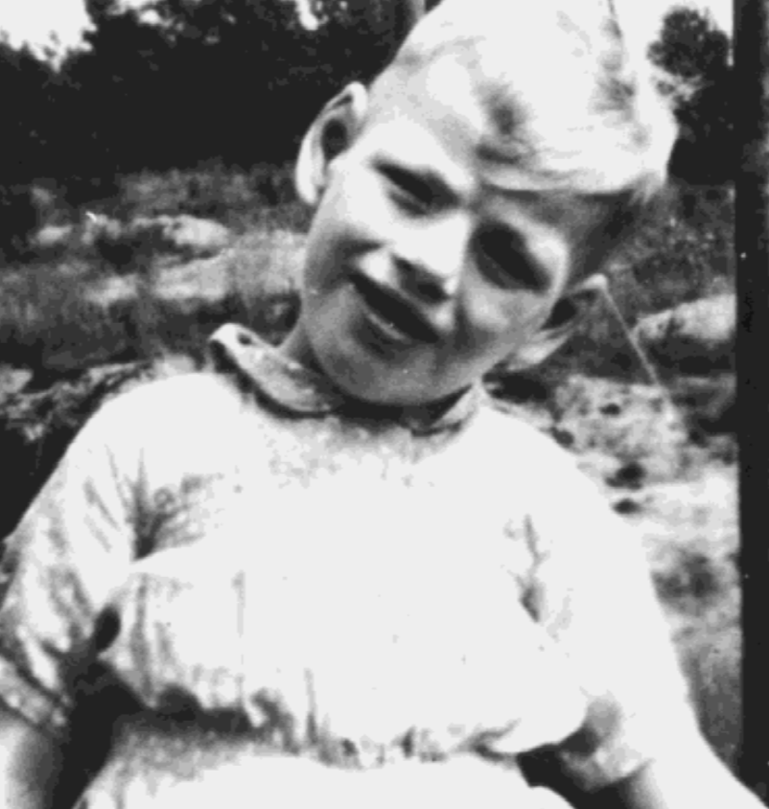
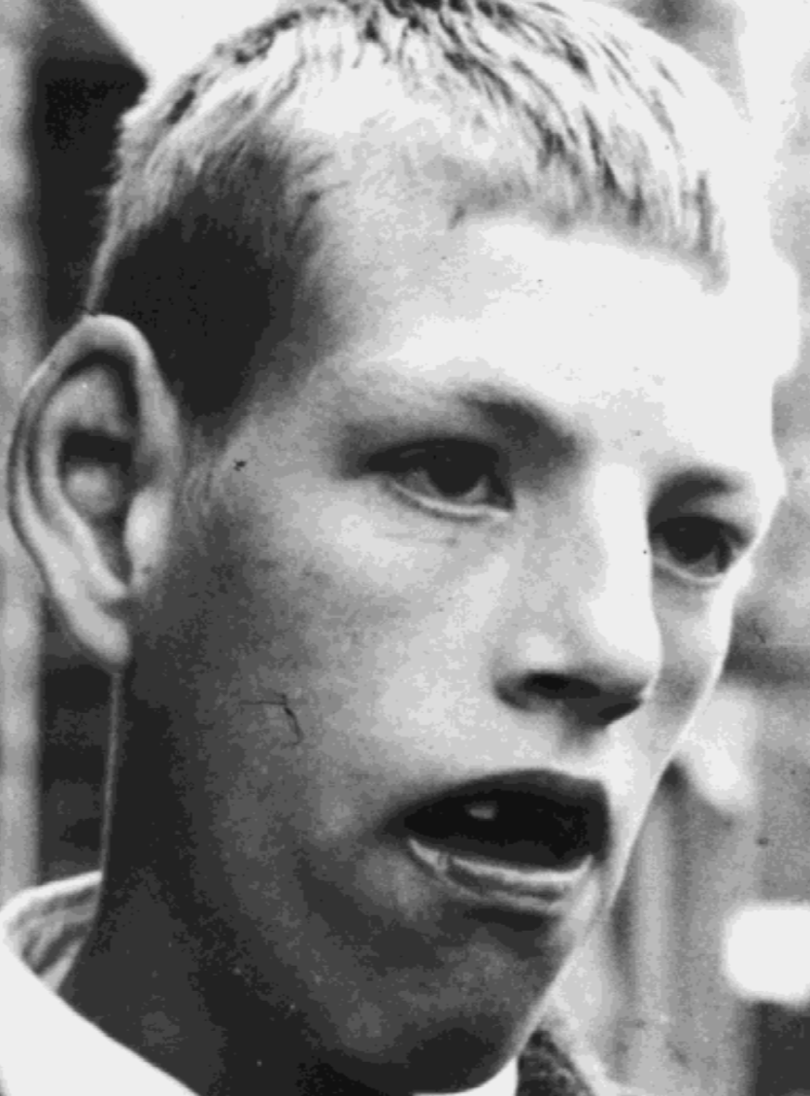
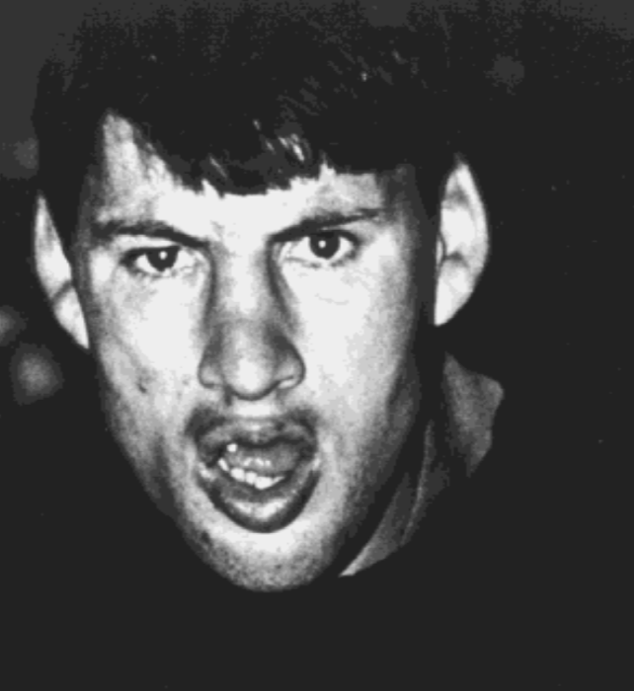

Slide 16
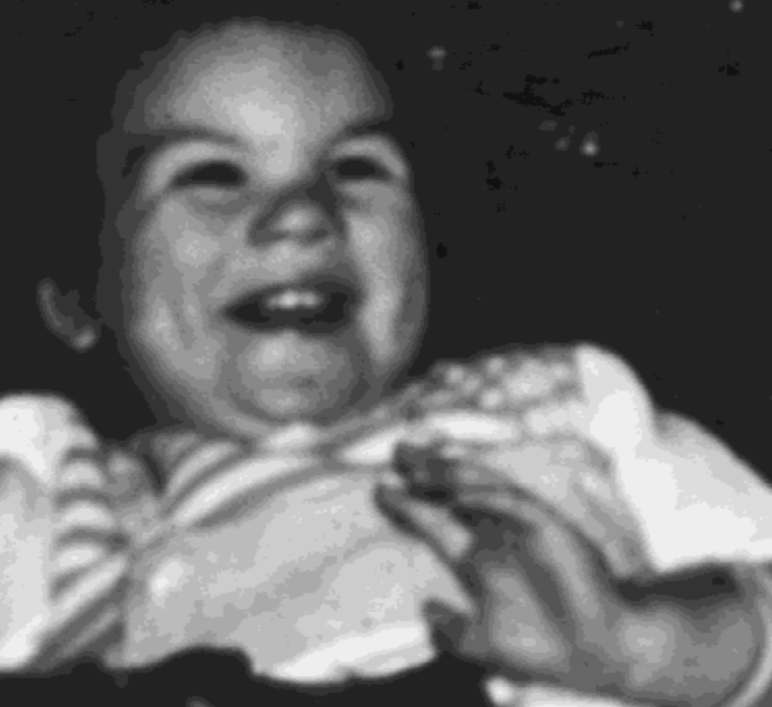
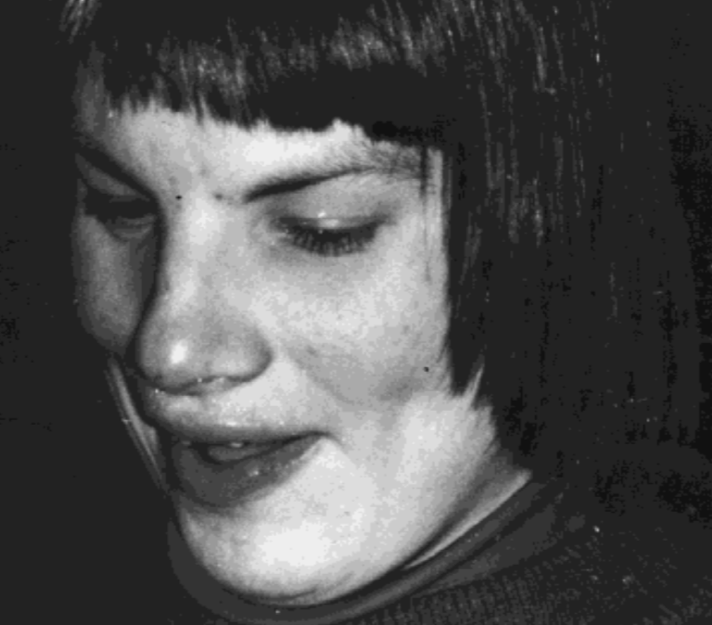
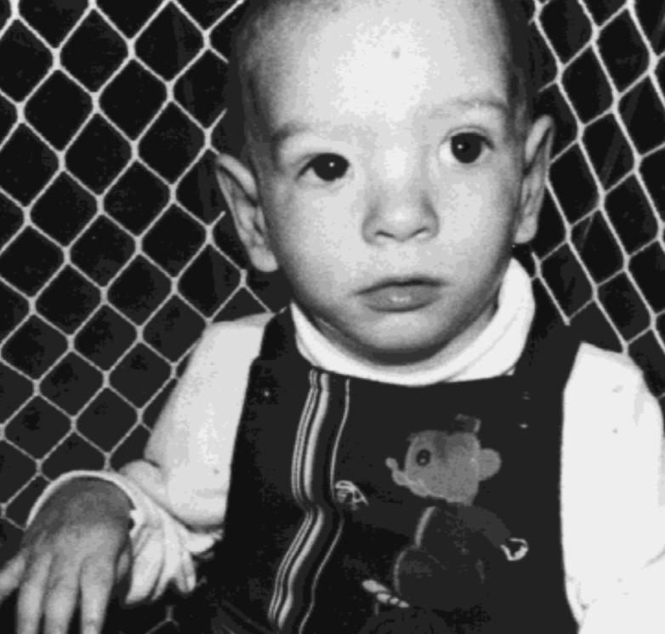
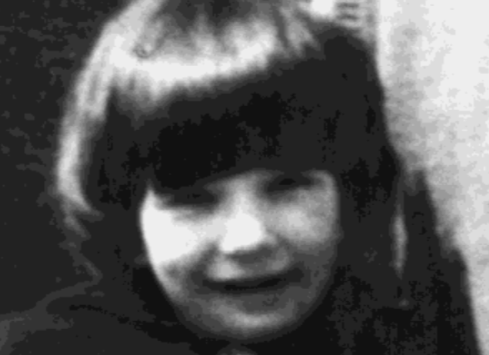
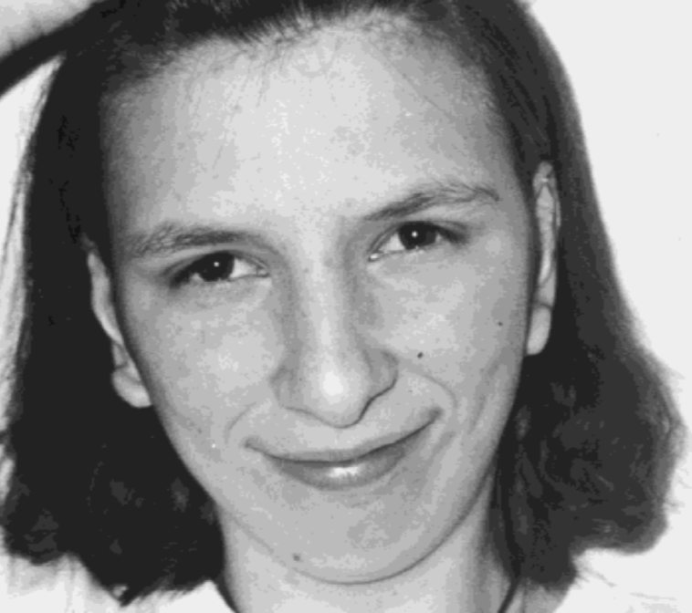
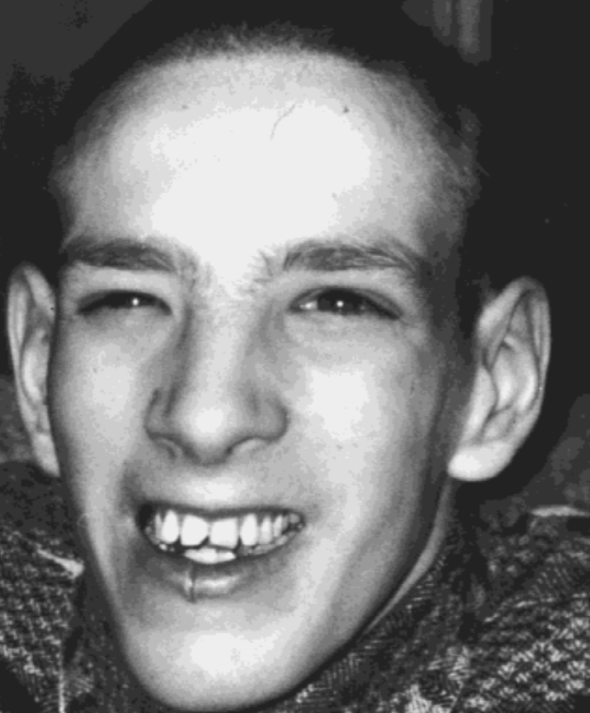

Slide 17
Major Conclusions
The phenotype from birth into adulthood is relatively the same, patients who had feeding difficulties carried those same difficulties into adulthood. However, pertaining to appearance in some cases patients began to be coarser with long faces and flat mid faces as well. Their behavior into adulthood changed due to the fact that at a young age more children cannot express the way in which they are feelings, however the aggression is limited at older ages in these 7 patients. It was concluded in their work that stimulation programs should include different programs for communication for the prevention of self-mutilation and any to all behavioral problems. Most importantly the size of deletion does not correlation with the rate of mental retardation.

Slide 18
Limitations
They only conducted this experiment on 7 patients, in order to produce more accurate results another experiment with more patients should be conducted. Also, 4 out of the 7 patients were around the same age, however that is not the case with 3. In order to make the experiment more accurate in relation to what is being measured age should remain the same throughout.

Slide 19
Future Directions
Going into the future with the Cri Du Chat syndrome, the pronunciation of words is very difficult for patients with the disease. Using the information that is taken away from this article it would be beneficial to conduct programs that help aid in the speak problems of individuals affected by this disease. Behavioral issues as well as communication problems should also be address in programs for children with the disease to go through while they are young, so that the disease does not continue to affect those parts of their lives when they are older as well.

Slide 20
Sources
Research:
Buggenhout, G.J.C.M. Van, et al. “Cri Du Chat Syndrome: Changing Phenotype in Older Patients.” American Journal of Medical Genetics, Wiley-Blackwell, 9 Mar. 2000, onlinelibrary.wiley.com/doi/10.1002/(SICI)1096-8628(20000131)90:33.0.CO;2-A/abstract.
Zhang, X. “High-Resolution Mapping of Genotype-Phenotype Relationships in Cri Du Chat Syndrome Using Array Comparative Genomic Hybridization.” The American Journal of Human Genetics, Cell Press, 9 Jan. 2008, www.sciencedirect.com/science/article/pii/S0002929707625828.
Pictures:
https://ghr.nlm.nih.gov/
Chromosome 5
http://slideplayer.com/slide/6261982/
TERT gene
https://ghr.nlm.nih.gov/gene/TERT
Phenotype
https://en.wikipedia.org/wiki/Cri_du_chat_syndrome
Physiotherapy
https://www.cosmotreeclinic.com/physiotherapy-treatment-in-delhi-india/
Speech Therapy
http://www.windbercare.org/therapy_speech.asp

