Slide 1
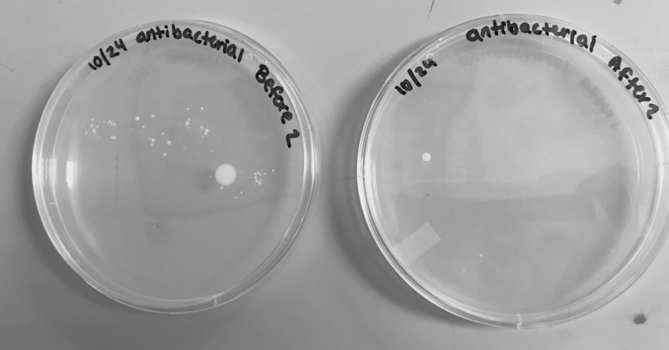
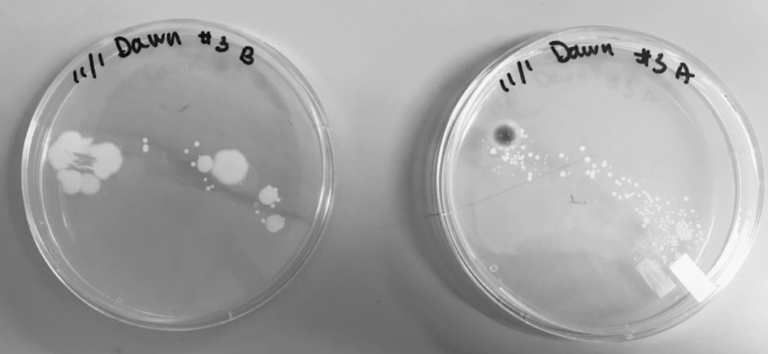
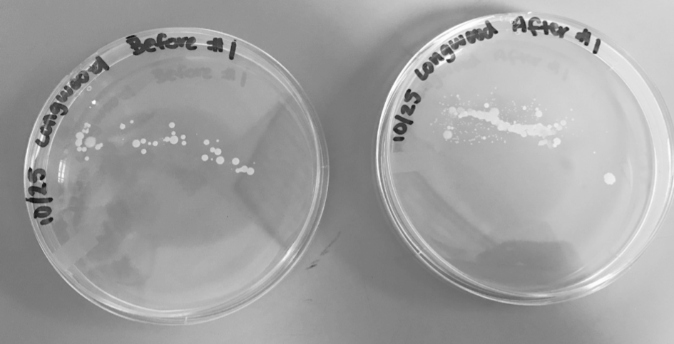
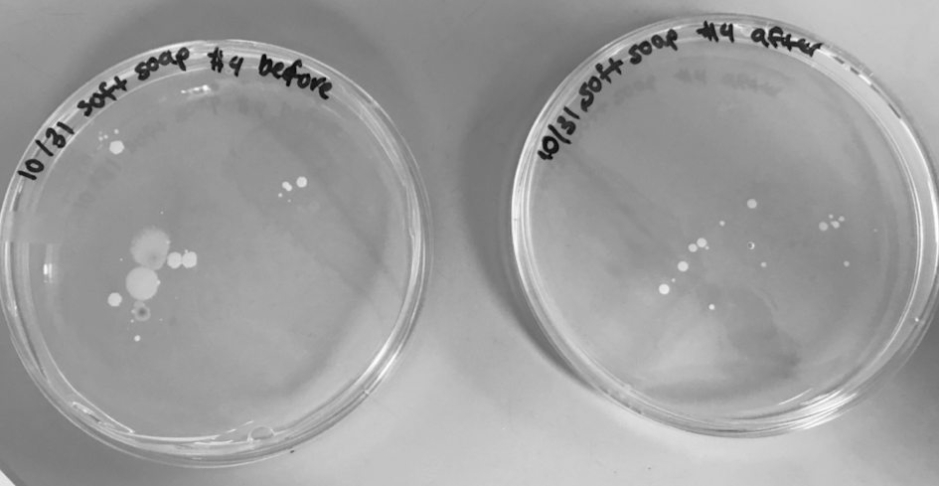
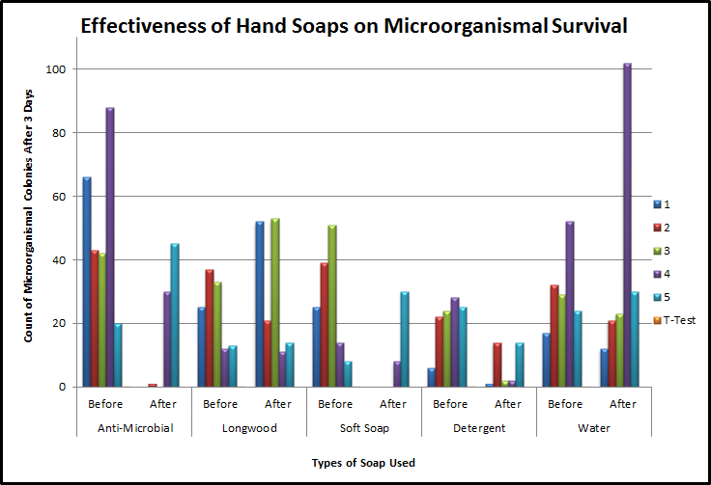
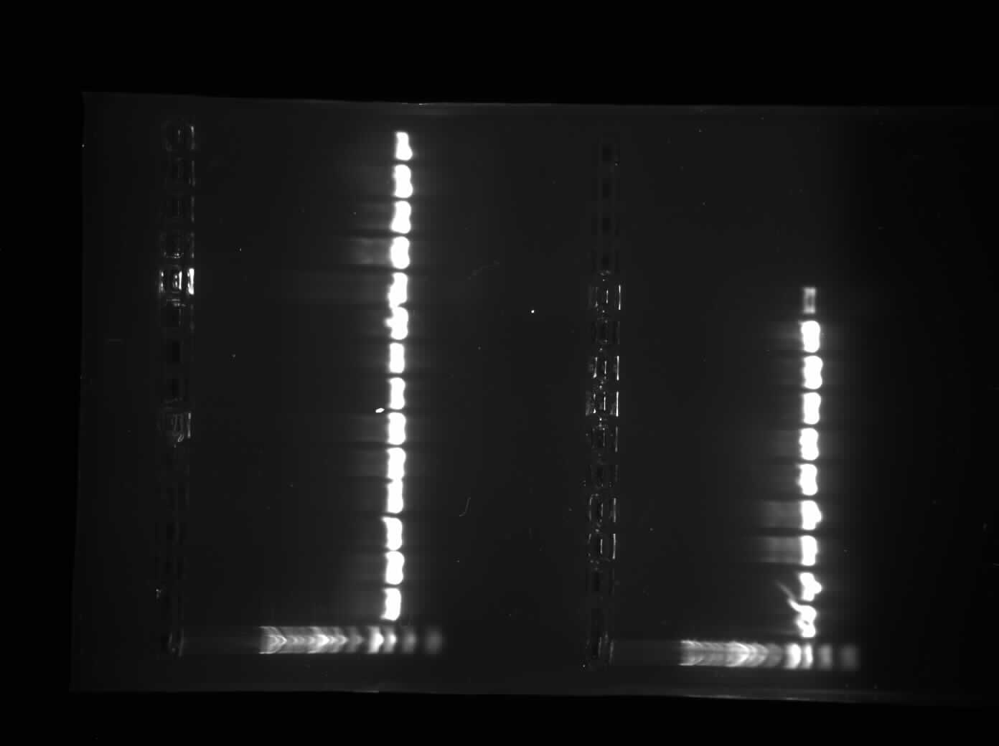
Effectiveness of Different Hand Soaps on Survival of Microorganisms
Morgan Karnes, Teresa Fruchterman, Morgan Perkins, Devin Teachey and Denis Trubitsyn
Department of Biological and Environmental Sciences, Longwood University
Introduction
Goals
Thousands of bacterial diseases can be prevented by proper hygiene such as washing hands using soap and water (1).
It has been confirmed in many studies that handwashing is an efficient method in preventing disease (2).
Soaps are effective cleansers because they cause the removal of lipid and adhering dirt, soil, and various organic substances from the hands, including loose transient bacteria (1).
There have been a number of studies that have compared different hand hygiene methods in hospital settings.
In contrast, there have been relatively few studies that test the effectiveness of common household soaps in a non-hospital setting (3).
Find the best hand soap brand that is commonly used at removing bacterial colonies
Run a PCR and analyze ribosomal 16s sequences to identify specific species
Hypothesis
If we place the palm of our dominant hands on nutrient agar plates before and after washing our hands with one pump of the chosen soap for twenty seconds, then the anti-microbial soap will have the least bacterial growth after.
Methods
Place palm of dominant hand on petri dish before washing
Apply one mL of soap on hands and wash for 20 seconds
On a new petri dish, place the same palm on plate after washing
Observe and count plates 72 hours after incubation at room temperature
Run a Polymerase Chain Reaction (PCR) to amplify 16s RNA
Perform DNA Gel Electrophoresis to visualize fragment size
Purify with NanoDrop and send for sequencing
Microoganismal Counts
Figure 1: Antimicrobial Soap Subject #2
White Colony
Figure 2: Dawn Soap Subject #3
Red Colony
Figure 3: Softsoap Subject #4
Green Colony
Figure 4: Longwood Soap Subject #1
Orange Colony
Table 1: The number of recorded colonies on each plate.
Figure 5: The number of colonies after 3 days of growth. The most effective soap is the Dawn Ultra Hand Soap (T-test p-value <0.01**) and the Anti-Microbial Hand Soap (T-Test p-value <0.05*). The least effective soap is the Soft’s Hand Soap (T-test p-value <0.30) and the Longwood University’s Hand Soap (T-Test p-value <0.30).
Results
Table 2: NanoDrop results of Nucleic Acid Concentration of purified PCR samples.
After Sample | ProMega 1 kb Purity | Nucleic Acid Concentration (ng/µl) | Bacterial Sequencing | Ideal %
Antibacterial Subject 2 | 1.92 | 41.4 | Bacillus sp. | 99%
Dawn Subject 3 | 1.94 | 63.2 | Staphylococcus pasteuri | 100%
Softsoap Subject 4 | 1.91 | 65.1 | Microbacterium paraoxydans | 100%
Longwood Subject 1 | 1.99 | 31.5 | Demacoccus sp. | 100%
Figure 6: Gel Electrophoresis compared to ProMega 1kb. Sample numbers 5-8.
Future Experiments
Acknowledgements
References
Have more replicates
Have more subjects
Increase soap samples
Analyze soap ingredients
Thank you to Dr. Trubitsyn for all the help and extra time he put into our project and a big thank you to Connor Perry for being a subject in our research project.
1. WHO Guidelines on Hand Hygiene in Health Care. WHO; Geneva, Switzerland: 2009.
2. Aiello A. et al., Effect of Hand Hygiene on Infectious Disease Risk in the Community Setting: A Meta-Analysis. Am J Public Health. 2008; 98(8): 1372–1381.
3. Burton et al., The Effect of Handwashing with Water or Soap on Bacterial Contamination of Hands. Int J Environ Res Public Health. 2011; 8(1): 97–104

