Slide 1
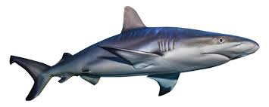
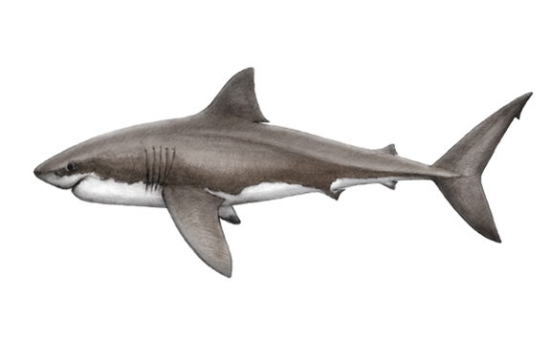
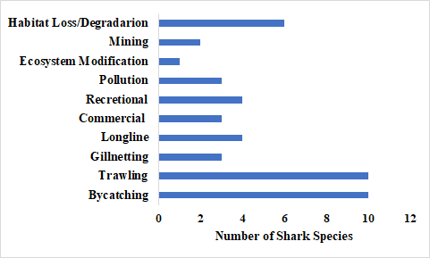
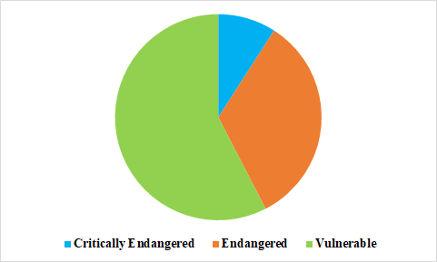
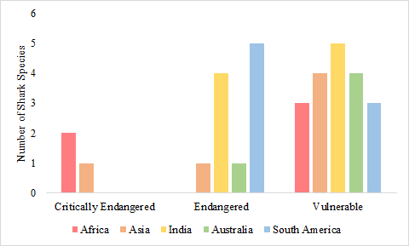
A Quantification of Risk Factors on Oceanic Sharks
Morgan Karnes and Elizabeth Hayden
Department of Biological and Environmental Sciences, Longwood University
Introduction
Results Continued
There are over 465 known shark species in the ocean.
Sharks are dispersed throughout the food web, making them very valuable to the oceanic ecosystems (Cortés 1999).
Have broad ranges: some inhabit cold water, others warm; some can live in both salt and freshwater, others only salt (Alfaro et al. 2014).
Sharks are now facing additional threats which are causing declines (Bornatowski et al 2014.)
Fishing, habitat degradation, pollution, and climate change.
Fishing occurs worldwide both commercially and recreationally (Stevens et al. 2000).
Pollution and climate change are both leading to habitat loss and degradation (Calderia and Wickett 2005).
Bycatch affected 10 species
Trawling affected 10 species
Gillnetting affected 3 species
Longline affected 4 species
Commercial fishing affected 3 species
Recreational fishing affected 4 species
Pollution affected 3 species
Ecosystem modifications affected 1 species
Mining affected 2 species
Habitat loss/ degradation affected 6 species
Figure 3. A graph of the number of shark species affected by each threat. The threats for each shark were recorded using IUCN Red List data.
India had the highest overall and numerical risk
Africa and Australia had the highest order risk
Australia had the highest threat risk
India and Australia had the highest fishing risk
Table 1. The table below shows the quantification of each region for the chosen risk factors
 | Asia | Africa | India | South America | Australia
Overall risk | 1.86 | 1.71 | 2.57 | 2.14 | 2.29
Numerical Risk | 3 | 3 | 5 | 3 | 4
Order Risk | 1 | 2 | 1 | 1 | 2
Threat risk | 3 | 2 | 4 | 3 | 5
Fishing risk | 2 | 2 | 3 | 2 | 3
Research Question/ Hypothesis
What are the threats that sharks face today?
What is the extent of each threat on sharks and which region of the world has the highest risk?
If a regional quantification of threats on oceanic sharks is performed, then the regions located in the Asia-pacific area will have the highest scores.
Discussion
Methods
Asia had one of the lowest overall risk, while India had the highest.
Bycatch fishing was the biggest threat to all species (Crowder et al. 2004)
occurs in trawling, gillnetting, longline, and commercial fishing
Large decline in a lot of shark species throughout the oceanic food web.
Major threat to sharks that stay along the bottom (Boyce 1996).
Increase in human population has led to an increase in byproducts, leading to more runoff and pollution and is causing degradation to aquatic habitats (Calderia and Wickett 2005, Chin et al. 2010).
Declines in shark populations is causing an imbalance in the oceanic food web (Baum et al. 2007).
A list of all critically endangered, endangered, and vulnerable species was created (non-oceanic species were excluded)
Species were separated based on regional range, including Africa, Asia, India, Australia, South America, North America, and Europe
Species without a specific range were excluded and a final list was created
Threats for each species were recorded and research for threats for each region was performed
Five risk factors were studied, including quantification of overall risk, order risk, numerical risk, threat risk, and fishing risk
A quantification scale based on a 0-5 point scale was created and risk factors for each region were quantified using the scale
Results
Acknowledgements
A special thanks to the IUCN Red List and all the people who make take time to research and input this data for others to use. Also we would like to thank Longwood University and especially Dr. Fink for guiding us and allowing us to participate in this wonderful opportunity.
There were a total of 33 species
3 critically endangered
11 endangered
19 vulnerable
References
Figure 1. A status composition of shark species. The pie chart above shows a composition of critically endangered, endangered, and vulnerable shark species from IUCN Red List data.
Alfaro M. E., F. Santini, L. Sorenson. 2014. The effect of habitat on modern shark diversification. Journal of Evolutionary Biology 27: 1536-1548.
Baum, J. K., R. A. Myers, C. H. Peterson, S. P. Powers, and T. D. Sheperd. 2007. Cascading Effects of the Loss of Apex Predatory Sharks from a Coastal Ocean. Science 315:1846-1850.
Bornatowskia H., R. R. Bragaa, J. R. S. Vitule. 2014.Threats to sharks in a developing country: The need for effective and simple conservation measures. Brazilian Journal of Nature Conservation 12:11-18.
Caldeira, K. and M. E. Wickett. 2005. Ocean Model Predictions of Chemistry Changes from Carbon Dioxide Emissions to the Atmosphere and Ocean. Journal Of Geophysical Research 110:1-12.
Chin A., P. M. Kyne, R. B. McAuley, T. I. Walker. 2010. An integrated risk assessment for climate change: analysing the vulnerability of sharks and rays on Australia's Great Barrier Reef. Global Change Biology 16: 1936-1953.
Crowder L. B., S. A. Freeman, R. L. Lewison, A. J. Read. 2004. Understanding impacts of fisheries bycatch on marine megafauna. Trends in Ecology and Evolution 19:598-604.
Cortés E. 1999. Standardized diet compositions and trophic levels of sharks. ICES Journal of Marine Sciences 56:707-717.
Stevens, J. D., Bonfil, R., Dulvy, N. K., and Walker, P. A. 2000. The effects of fishing on sharks, rays, and chimaeras (chondrichthyans), and the implications for marine
ecosystems. ICES Journal of Marine Science 57: 476–494.
Africa: 2 critically endangered and 3 vulnerable
Asia: 1 critically endangered, 1 endangered, and 4 vulnerable
Australia: 1 endangered and 4 vulnerable
South America: 5 endangered and 3 vulnerable
India: 4 endangered and 5 vulnerable
Figure 2. A graph of the number of critically endangered, endangered, and vulnerable shark species. The graph above shows the number of shark species per status category for each region using IUCN Red List data.

