Slide 1
Opioid Safe Injection Facilities: An Ethical Case Study
Joshua Walker
PHIL 308

Slide 2
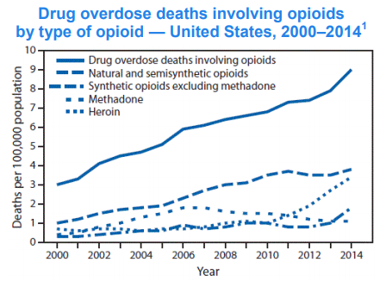
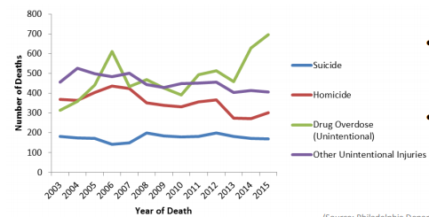
Background
Deaths in Philadelphia from 2003 to 2015
(Philadelphia)

Slide 3
Background
What are safe injection facilities?
Locations where opioid addicts come to use opioids under medical supervision
The addicts use pre-obtained drugs under nurse supervision
They are provided sterile injection equipment
They receive emergency overdose response as needed
They are given referrals to internal and external programs
(Kerr et al.)

Slide 4
Ethical Questions This Case Raises
Is it ethical to assist opioid addicts in getting help even though they commit actions that are considered morally wrong?
Is it ethical to have only safe injection facilities for opioids opposed to other drugs or substances?
Is it ethical to have safe injection facilities for opioid addicts?

Slide 5
Salient Answers to My Focal Question
Having safe injection facilities for opioid addicts is unethical.
Having safe injection facilities for opioid addicts is ethical.
My personal bias is towards Answer 2.

Slide 6
A Deontological Argument for Answer 1
A person has a moral obligation not to encourage the use illegal drugs.
Having locations where the use of opioids is under medical supervision results to encouraging people to use illegal drugs.
It is morally wrong for there to be a location where opioid addicts can use drugs under medical supervision.

Slide 7
Problem With This Argument
Locations that allow use of opioids under medical supervision is not encouraging them to use opioids, it allows for opioid addicts know that there is a way to help their problem and be safe at the same time.
The health professionals at the location would not promote the use of opioids but would direct the addicts in the right direction and help with rehabilitation.

Slide 8
A Consequentialist Argument for Answer 1
Either there can be safe injection facilities for opioid addicts or there can be no safe injection facilities for opioid addicts.
Safe injection sites would result in using taxpayer’s money for someone’s poor decisions.
No safe injection sites would result in not having to pay more taxes on people for their poor decisions.
Not having to pay more taxes for someone’s poor decisions is better than having to pay taxes for someone’s poor decisions.
People should act as to bring about the best overall consequences.
There should be no safe injection sites for opioid addicts.

Slide 9
Problem With This Argument
There are already programs funded by taxes that focus on drug rehabilitation.
Just because somebody doesn’t make a great decision doesn’t mean that they shouldn’t be able to get help.

Slide 10
A Consequentialist Argument for Answer 2
Either there are safe injection sites for opioid addicts or there are not.
Having safe injection sites for opioid addicts would reduce the mortality rate tied to drug abuse, but would cost more taxes.
Not having safe injection would leave the mortality rate for opioid users the same or would increase, but it would not cost more taxes.
Reducing the mortality rate of opioid users is better than leaving the mortality rate the same or having it increase.
People should act as to bring out the best overall consequences.
There should be safe injection sites for opioid addicts.

Slide 11
Objections to this Argument
Objection: People don’t want to pay more for people’s poor decisions.
Reason not to accept this objection: People are already paying taxes on programs like this and saving people’s lives are more important than paying more money.

Slide 12
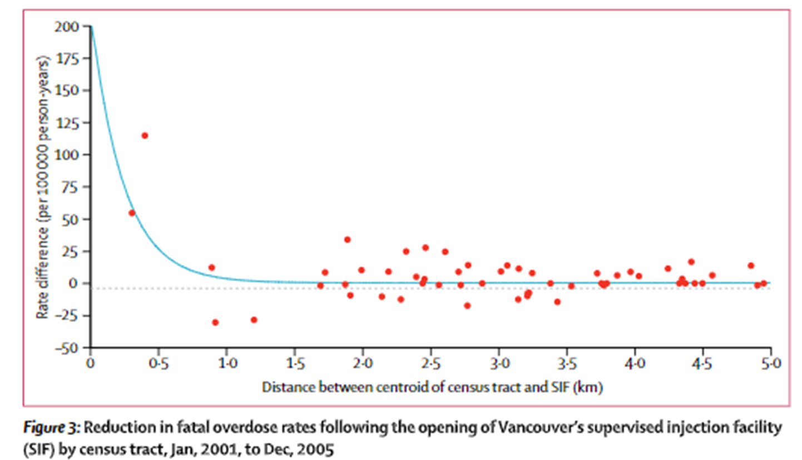
Conclusion
The last consequentialist argument is the strongest to my knowledge and supports that safe injection sites are ethical.
I was initially toward this belief.
I will keep my mind open to new information and arguments to avoid confirmation bias.
(Marshall et al.)

Slide 13
Resources Used
Kerr, Thomas, et al. “Supervised Injection Facilities in Canada: Past, Present, and Future.” Harm Reduction Journal, vol. 14, May 2017, p. 28. BioMed Central, doi:10.1186/s12954-017-0154-1.
Marshall, Brandon D. L., et al. “Reduction in Overdose Mortality after the Opening of North America’s First Medically Supervised Safer Injecting Facility: A Retrospective Population-Based Study.” Lancet (London, England), vol. 377, no. 9775, Apr. 2011, pp. 1429–37. PubMed, doi:10.1016/S0140- 6736(10)62353-7.
Philadelphia Department of Public Health. “2016 Overdoses from Opioids in Philadelphia.” CHART, vol. 2, no. 7, 2017, pp. 1–3

