Slide 1
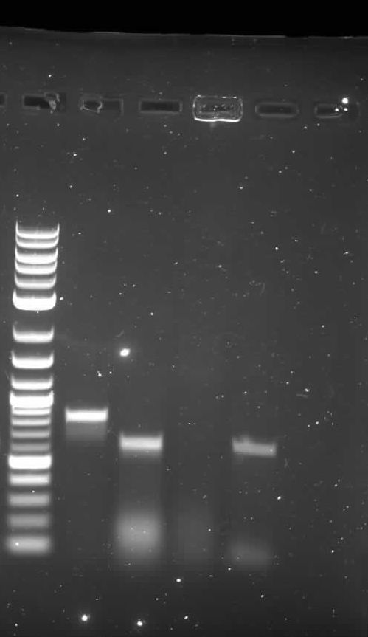

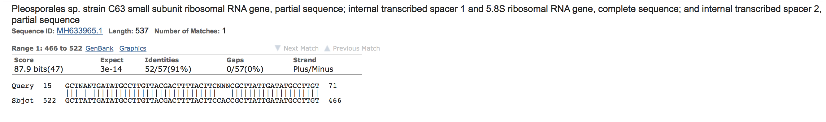
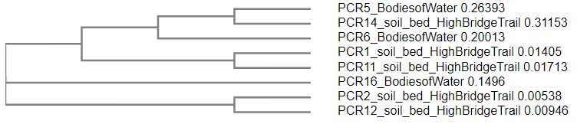
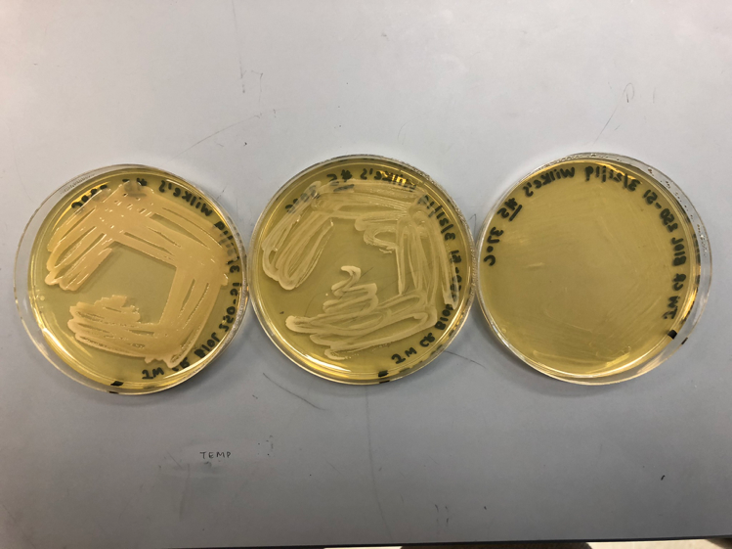
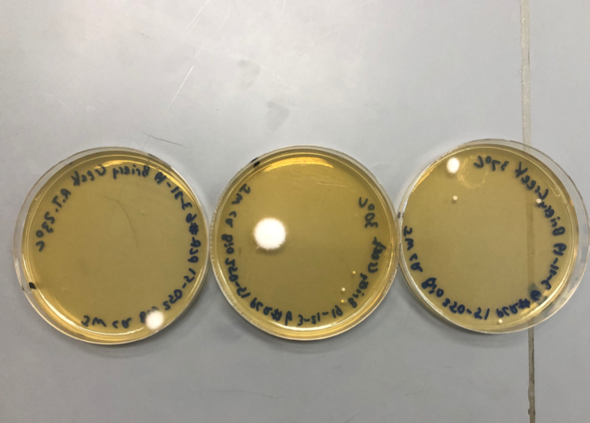
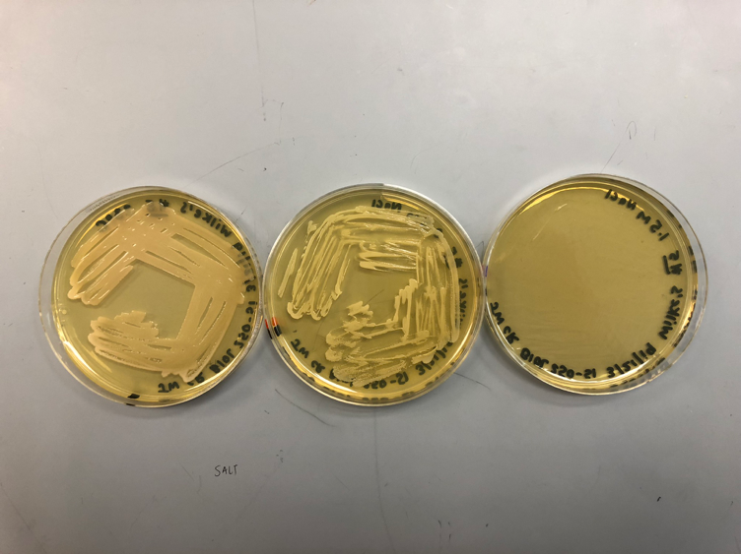
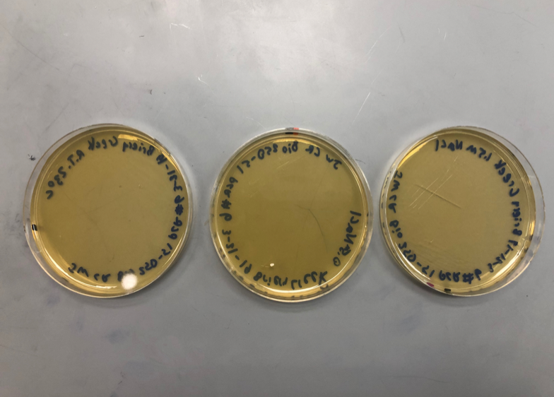
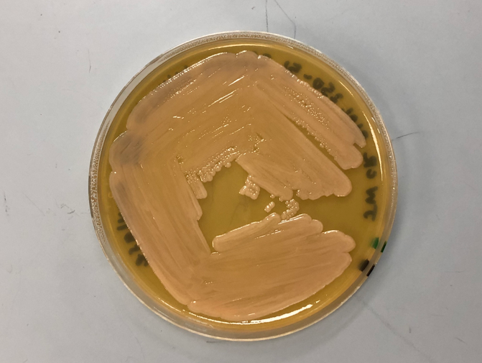
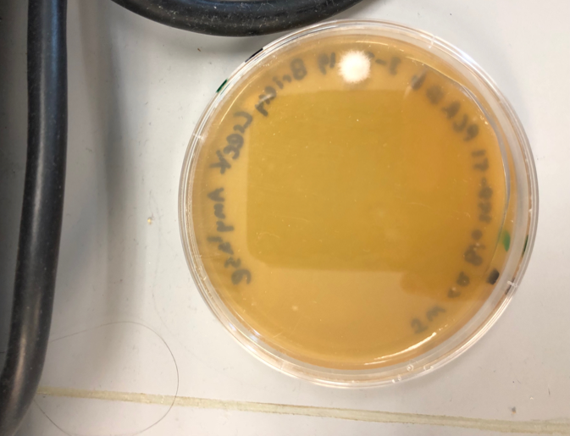
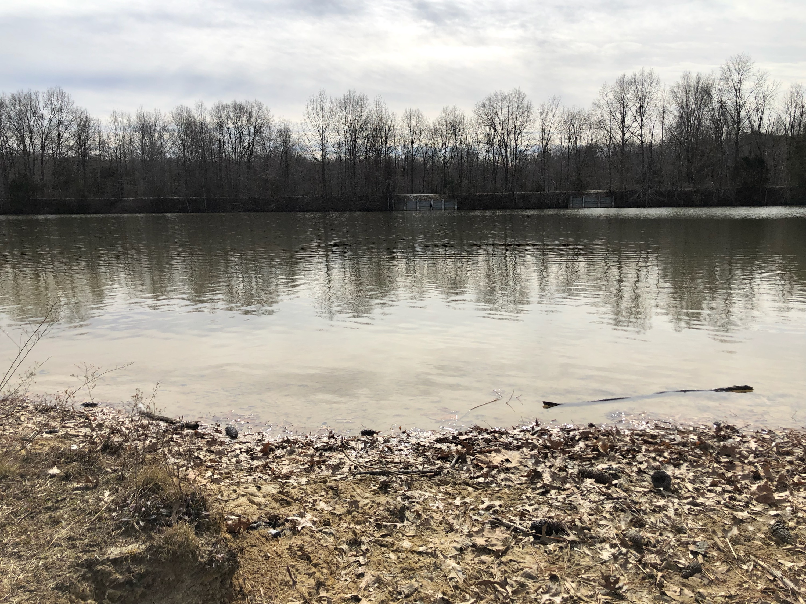
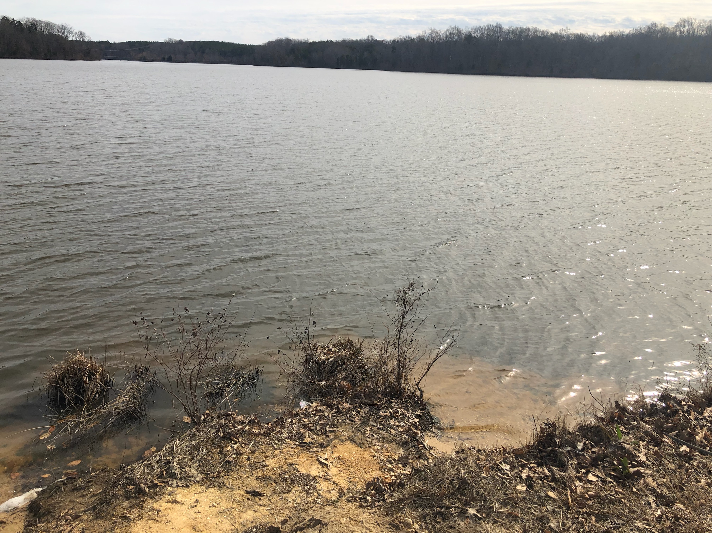
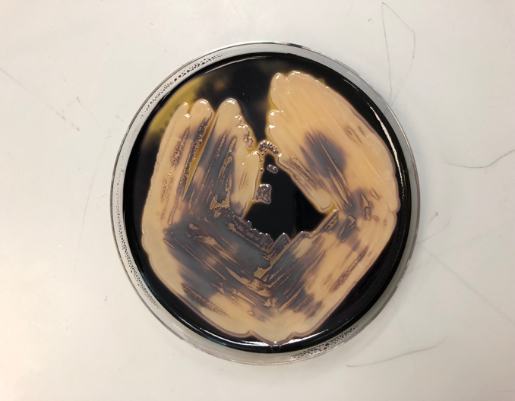
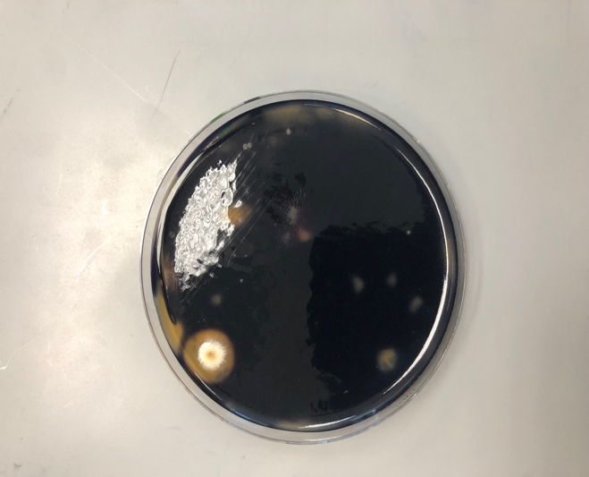
Comparing yeast occurrence and diversity in Prince Edward County public waters
Josh Walker and Carrie Reaver, BIOL 250
Introduction
Public waters serve multiple purposes from both a health and ecological standpoint.
Important to access the quality of public water in order to address any risks of waterborne diseases (Van Wyk, 2012).
More focus on using yeast species as a method for observing water pollution levels and aquatic microbial populations (More, et al., 2010).
Discussion
The results supported the hypothesis by showing that our yeasts are morphologically, genetically, and biochemically distinct from each other.
Comparing the adaptations of the yeasts present in different bodies of water can provide insight into the selective pressures occurring in each habitat (Gadanho & Sampaio, 2005). I
It is important to access the quality of water in public areas in order to address risks involving disease or pollution, (Van Wyk, 2012).
Continued sampling of aquatic provides us with a better understanding of long-term ecological process taking place in public waters and ultimately helps us make more informed decisions about water treatment/ intervention and public health.
Results
Morphology
Gel Electrophoresis
1
2
3
Hypothesis: Since each water source is subject to different human and environmental impacts, it is expected that the composition of yeast biodiversity will differ between each water source.
Figure 1. View of one yeast colony from each plate under light microscope. Left: Wilke’s Lake sample; right: Briery Creek sample.
1000 bp
500 bp
BLAST Analysis
Quick-Load 2-Log DNA Ladder
DNA Primer Residue
Briery Creek Lake DNA Fragment
Methods
A
Study Area & Sampling
Study areas: Wilke's Lake & Briery Creek in Prince Edwards County
Sampling: obtained water sample from surface of each body of water
Morphological Characterization
Serial Dilutions and plate streaking for isolation
Identify size, shape, color, and margins
Genetic Sequencing
PCR reaction
Biochemical Assays
Temperature: 23°C , 30°C , and 37°C
Salinity: 0.5 M and 1.5 M NaCl
Amylase
Gel Electrophoresis
BLAST analysis
Phylogenic Tree
B
C
Biochemical Assays
Figure 2. (A) Top DNA alignment of Briery Creek yeast based on the FASTA of known Trametes versicolor species and the Briery Creek’s isolated yeast specie’s FASTA. (B) Top DNA alignment of Wilke’s Lake yeast based on the FASTA of known Pleosporales yeast species and the Wilke’s Lake isolated yeast specie’s FASTA. (C) Phylogenic relationship all yeasts isolated from water and soil during this project. PCR 5 and PCR 6
A
C
Figure 5. Phylogenic relationship between all yeasts isolated from water and soil during this project. PCR 5 is Wilke’s Lake and PCR 6 is Briery Creek Lake. PCR 16 is the campus duck pond and all soil samples are from High Bridge Trail.
B
D
Acknowledgements
Thank you to the Department of Biological and Environmental Sciences at Longwood University and Dr. Consuelo Alvarez for supporting this project
A
C
Figure 3. Results of temperature and salinity assays. (A) Temperature assay for Wilke’s lake, (B) Salinity assay for Wilke’s lake, (C) Temperature assay for Briery Creek, (D) Salinity assay for Briery Creek.
References
Gadanho, M. and Sampaio, J.P. 2005. Occurrence and Diversity of Yeasts in the Mid- Atlantic Ridge Hydrothermal Fields Near the Azores Archipelago. Microbial Ecology, 50(3): 408-417.
Jankowiak,R., Ciach,M., Bilanski,P. and Linnakoski,R. 2017. Wood- inhabiting fungal communities of woodpeckers' cavities in temperate forests are dominated by microascalean and basidiomycetous fungi. GenBank: MF782818.1
Medeiros, A.O., Kohler, L.M, Hamdan, J.S., Missagia, B.S., Barbosa, F.A., Rosa, C.A. 2008. Diversity and antifungal susceptibility of yeasts from tropical freshwater environments in Southeastern Brazil. Water Research, 42(14); 3921-3929. GenBank: MH633965.1
Pereira,E. 2018. Fungal endophytes from roots of Festuca rubra subsp. Pruinosa. GenBank: MH633965.1
Van Wyk, D.A.B., Bezuidenhout, C.C. and Rhode, O.H.J. 2012. Diversity and characteristics of yeasts from water sources in the North West Province, South Africa. Water Science & Technology: Water Supply, 12(4): 422-430.
B
D
Figure 4. Results of amylase assay. (A) Wilke’s Lake yeast before amylase test (B) Wilke’s Lake yeast after amylase assay (C) Briery Creek yeast before amylase test (D) Briery Creek yeast after amylase test
Wilke’s Lake
Briery Creek Lake

