Slide 1
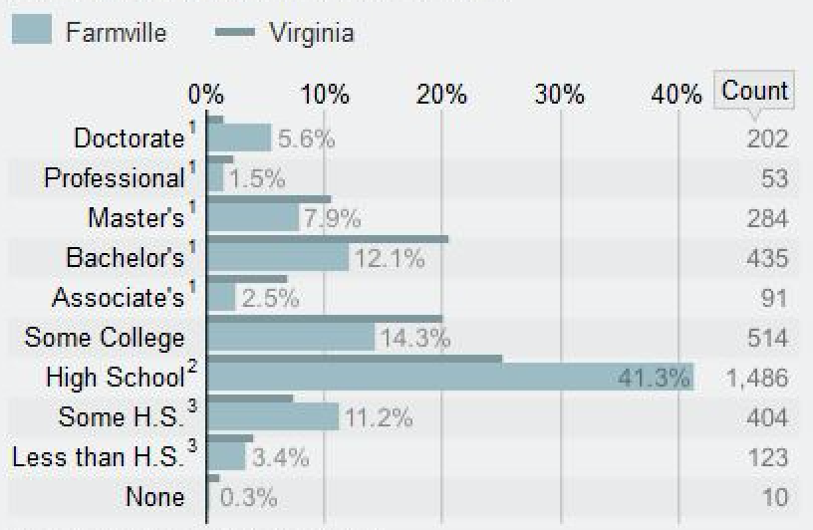
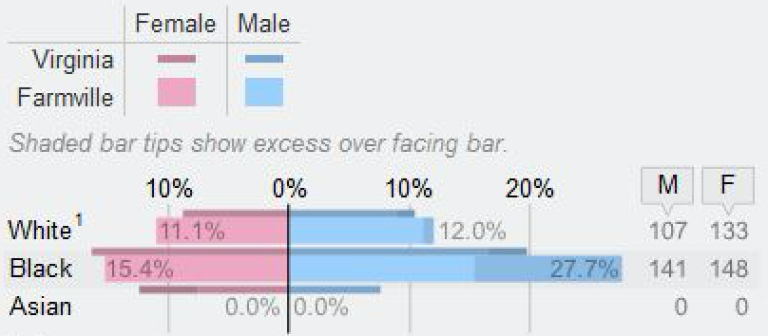
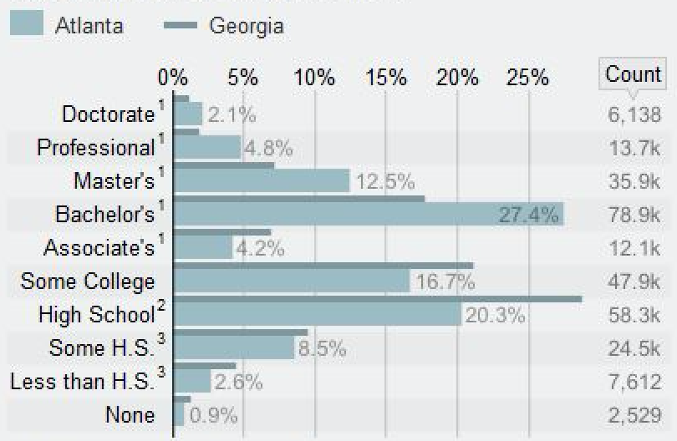
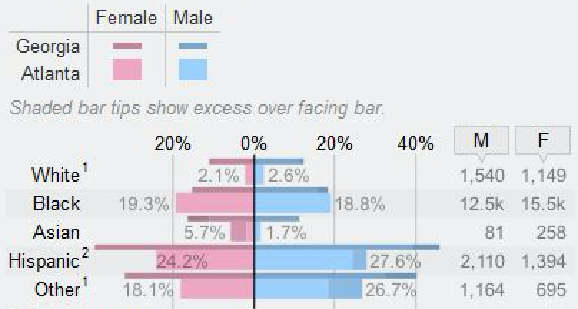
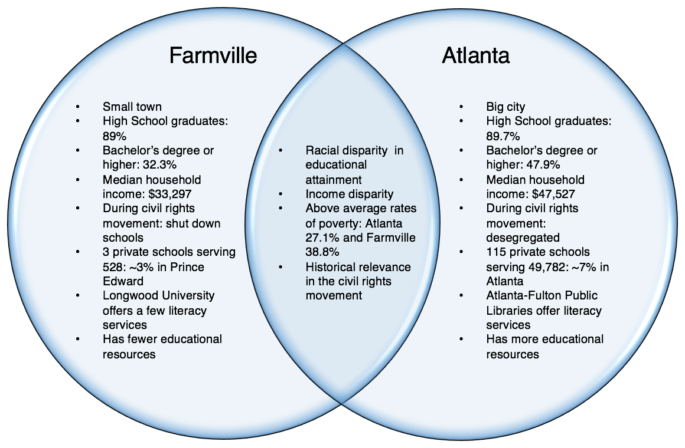
Educational Justice in Farmville, Virginia Vs. Atlanta, Georgia
Mackenzie Tabler and Derek Holmberg
Cormier Honors College, Longwood University
Main Objective: There is a wide variety of social justice issues in education. These issues range from lack of resources, racial discrimination, income disparity, and many others.
Social Justices Issues in Education
Statistics
Resources
Inequalities
Literacy
Different language
Bullying
LGBTQ
Opportunity
Racial Justice
Wealth
Unequal discipline
How can school systems overcome these inequalities when there are some many?
Do these inequalities differ based on the size of the area? Small town vs. big city?
Before travelling to Atlanta we hypothesized that: If the illiteracy and education disparities in Farmville are similar to those in Atlanta, then both cities will face similar problems. If these issues are resolved, then both areas will have more equal opportunity.
Detailed Educational Attainment:
Lacking High School Diploma By Race:
Virginia Children’s Book Festival
Past vs. Present
Compare and Contrast
Impacts
Farmville and Atlanta face similar issues stemming from a lack in literacy/education.
Consequences:
Higher rates of poverty
Higher crime/incarceration rates due to lack of discipline in schools
Higher unemployment
Lower opportunity
Farmville Population: 8,519
Atlanta Population: 432,589
Though Atlanta is 50 times larger that Farmville, they still face similar educational disparities, just on a smaller scale.
Segregation Responses:
Civil Rights History
Next Steps
Illiteracy and education affect all areas of life. Because lack of education seems to be directly proportional to other issues, working to better our education system could resolve other matters.
Acknowledgements: 1.

