Slide 1
Ecology and Evolution Proposal Presentation
By Matt Jones, Raquel Perez, Coleman Behne, and Brian White

Slide 2
Background
Terrestrial macroinvertebrates are organisms that are large enough to be seen by the naked eye and lack a spinal cord. This includes land-living animals such as insects, worms, arachnids, and some crustaceans.
Riparian Zones- zones of land adjacent to a body of water
The studies about macroinvertebrates have mostly consisted on abundance and diversity in their habitats however it has mostly consisted of soil habitat or ground habitats such as decaying wood or litter.

Slide 3
What we are trying to accomplish
We want to determine which kinds of macroinvertebrates prefer it closest to the water (I.E. Insects, worms, arachnids, crustaceans etc.)
Secondary objective: find what sorts of adaptations arise from increased proximity to the water.

Slide 4
Hypothesis
Invertebrates like crustaceans and specialized insects will be found closer to the water than worms or arachnids
Invertebrates found closer to the water will be more adapted for sub-aquatic living conditions than those that are further away.

Slide 5
Material list
A white cloth
Net
Plastic bags
Plots
Microscope
Trowel

Slide 6
Methods
Our proposed methods of extracting data will be to use a white cloth, lay on the ground next to a bush and shake the bush vigorously on to the cloth. This should capture most insects that resided on the bush.
We will go to one site located at Wilck's Lake Park from there we will pick a couple areas to represent as the different riparian zones and will survey each zone for its invertebrates.
A trowel will also be used for collecting burrowing invertebrates.

Slide 7
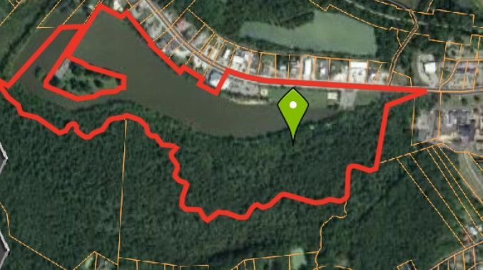
Areas that we will be visiting

Slide 8
Timeline
9-25-18 We will collect the insects at Wilck lake park for 1 hour and analyze the data for 1 hour
10-2-18 We will collect the insects at Wilck lake park for 1 hour and analyze the data for 1 hour
10-9-18 We will collect the insects at Wilck lake park for 1 hour and analyze the data for 1 hour

Slide 9
Factors that may skew results
Wilks lake is a social hub for many birds like geese, wood ducks, mallards, black ducks, teal, coots, great blue heron, green heron, kingfisher, osprey, hooded mergansers, wild turkey, redwing blackbirds, cardinals and various other songbirds. It is likely that insects will be very heavily hunted. We may see less insects in areas where there are less trees.
Other factors may be the variability of vegetation
Atmospheric conditions
Specialist invertebrates like pillbugs that do not represent the bulk of their group

Slide 10
References
Callaham, M.A., Richter D.D., Coleman, D.C., and Hofmockel, M. 2006. Long-term land-use effects on soil invertebrate communities in Southern Piedmont soils, USA. European Journal of Soil Biology 42:S150–S156.
King, J.R., Warren, R.J., and Bradford, M.A. 2013. Social insects dominate Eastern US Temperate hardwood forest macroinvertebrate communities in warmer regions. PLoS ONE 8:1-11.
Kula, E., and Lazorik, M. 2016. Centipedes, millipedes, terrestrial isopods and their relationships to physical and chemical properties of forest soils. Entomologica Fennica 27:33-51
Moody, EK, and Sabo JL. 2017. Dissimilarity in the riparian arthropod communities along surface water permanence gradients in aridland streams. Ecohydrology 10:4

