Slide 1
Terrestrial Microfauna
Emily Douglass, Jonah Hottinger, Zach Sergi, and Maya Young

Slide 2
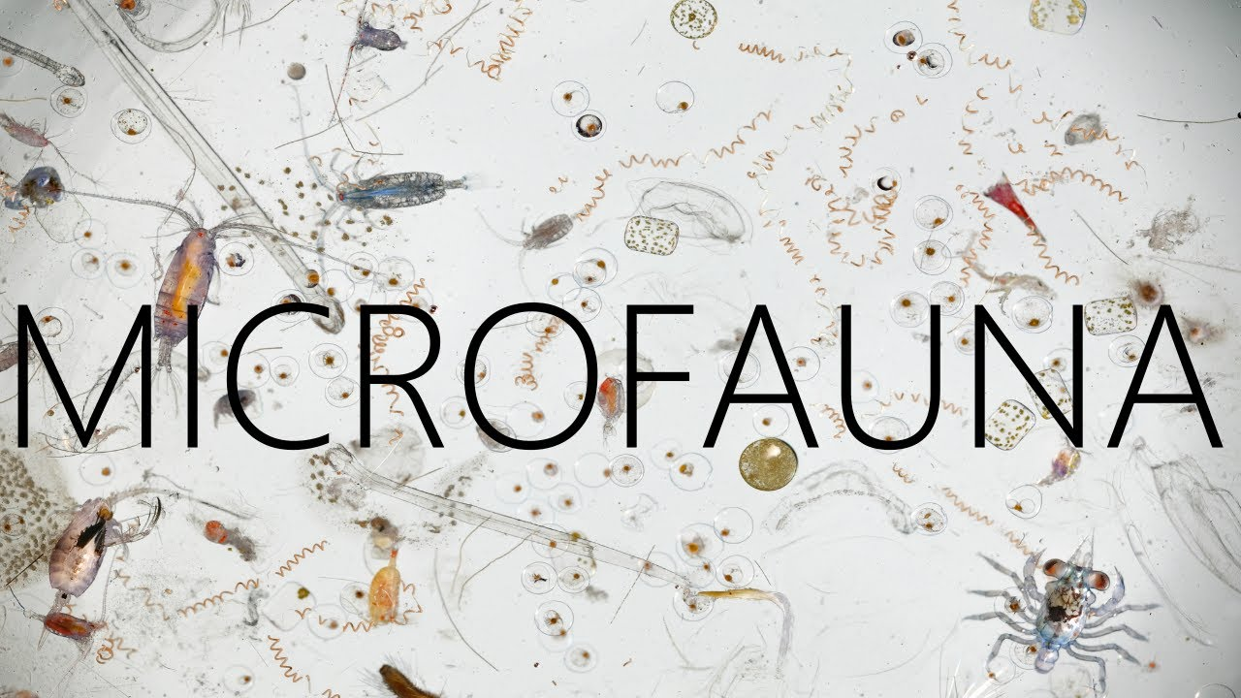
Microfauna
Terrestrial microfauna are small, microscopic animals that inhabit soil
Single-celled protozoans, small nematodes, small unsegmented worms, and tardigrades are the most common. Many live in pore spaces in leaf litter and in the soil, feeding on smaller microorganisms

Slide 3
Background
The conditions of the soil may influence the diversity of terrestrial microfauna.
Things such as different varieties of plant life, herbicide or pesticide use, and general maintenance can change these conditions and affect the diversity of terrestrial microfauna.

Slide 4
Research question/ Hypothesis
Research question- How does the maintenance of a grass field affect the biodiversity of terrestrial microfauna?
Hypothesis- There will be more biodiversity in the unmaintained field than a maintained lawn.

Slide 5
Proposed Methods
A soil auger will be used to extract our soil samples at a depth of 6 inches for each observed area.
Soil samples will be collected from four different sites: two maintained lawns and two unmaintained areas.
The moisture of the soil will be tested as a possible condition affecting the microfauna.

Slide 6
Proposed Methods
A burlese funnel will be used to extract the terrestrial microfauna from our soil sample and will take 2-3 days.
These organisms will be examined and compared to show relative diversity between the sites.

Slide 7
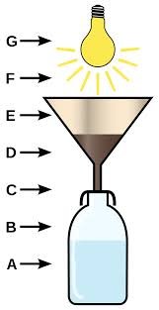
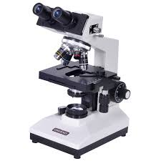
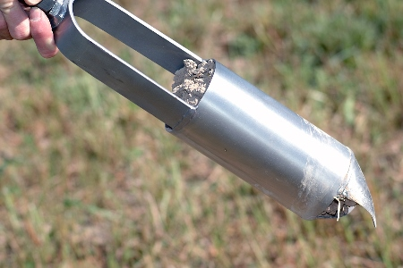
Materials list
Soil auger
Trowel?
Burlese funnel
Microscope
Balance
Identification notebook
Field notebook

Slide 8
Timeline for Completion
Collect soil samples a few days before lab on 09/26/17
Identify organisms filtered through Burlese funnel in lab on 09/26/17
Repeat collection of samples and identification for the next two weeks in lab on 10/03/17 and 10/10/17
Analyze data from identification of organisms after full collection of samples and identification.

