Slide 1
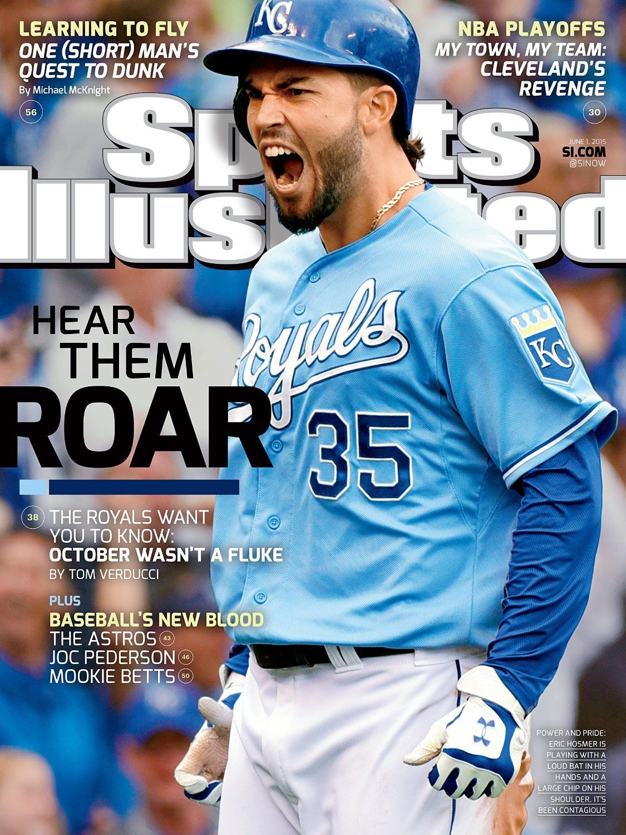
VS

Slide 2
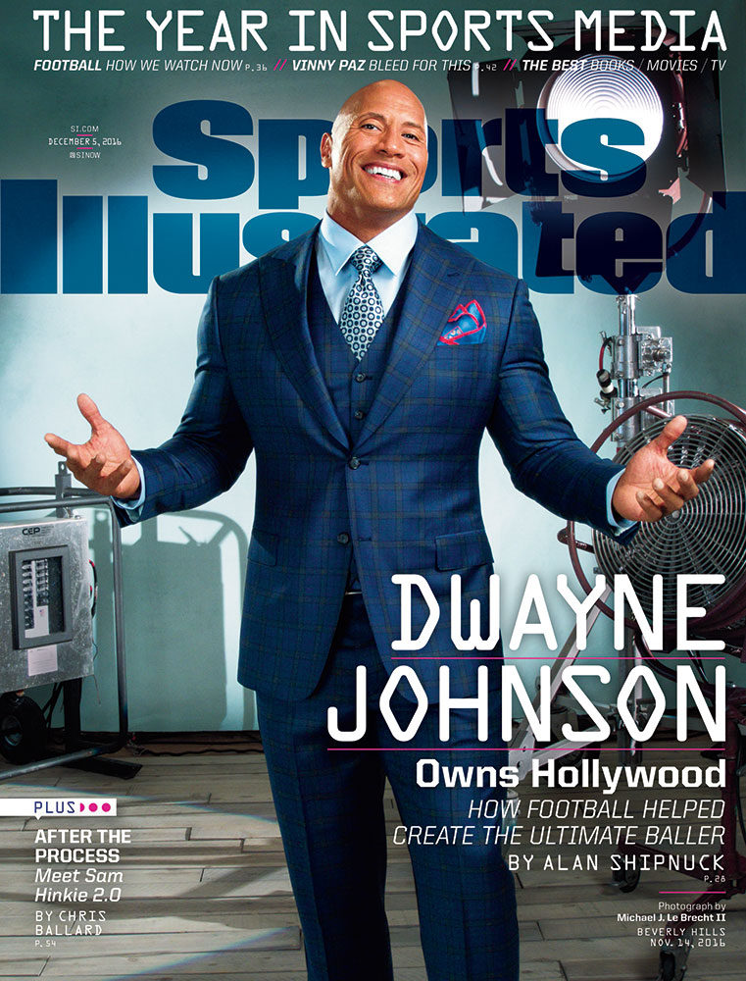
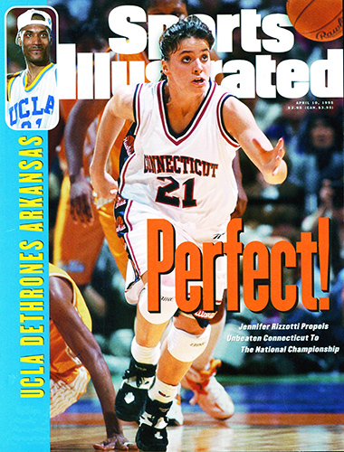
VS

Slide 3
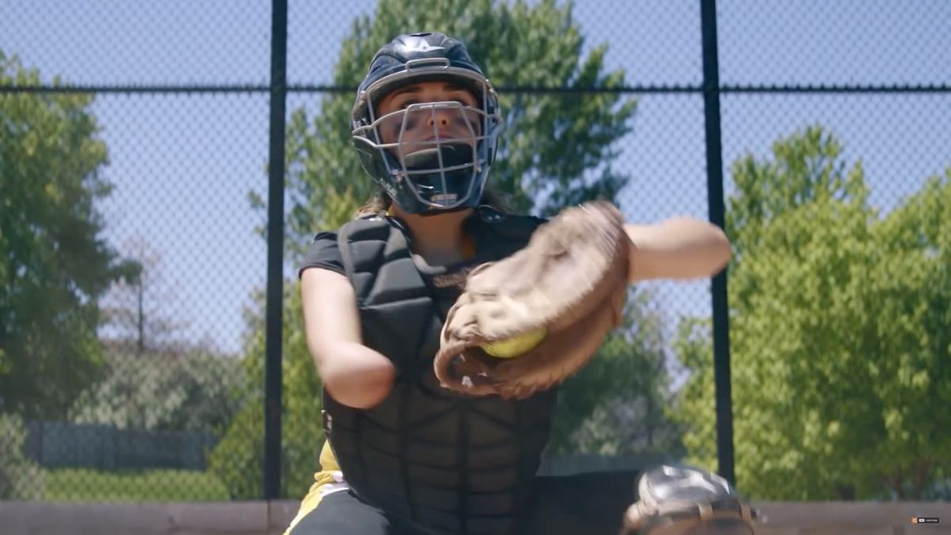

Slide 4
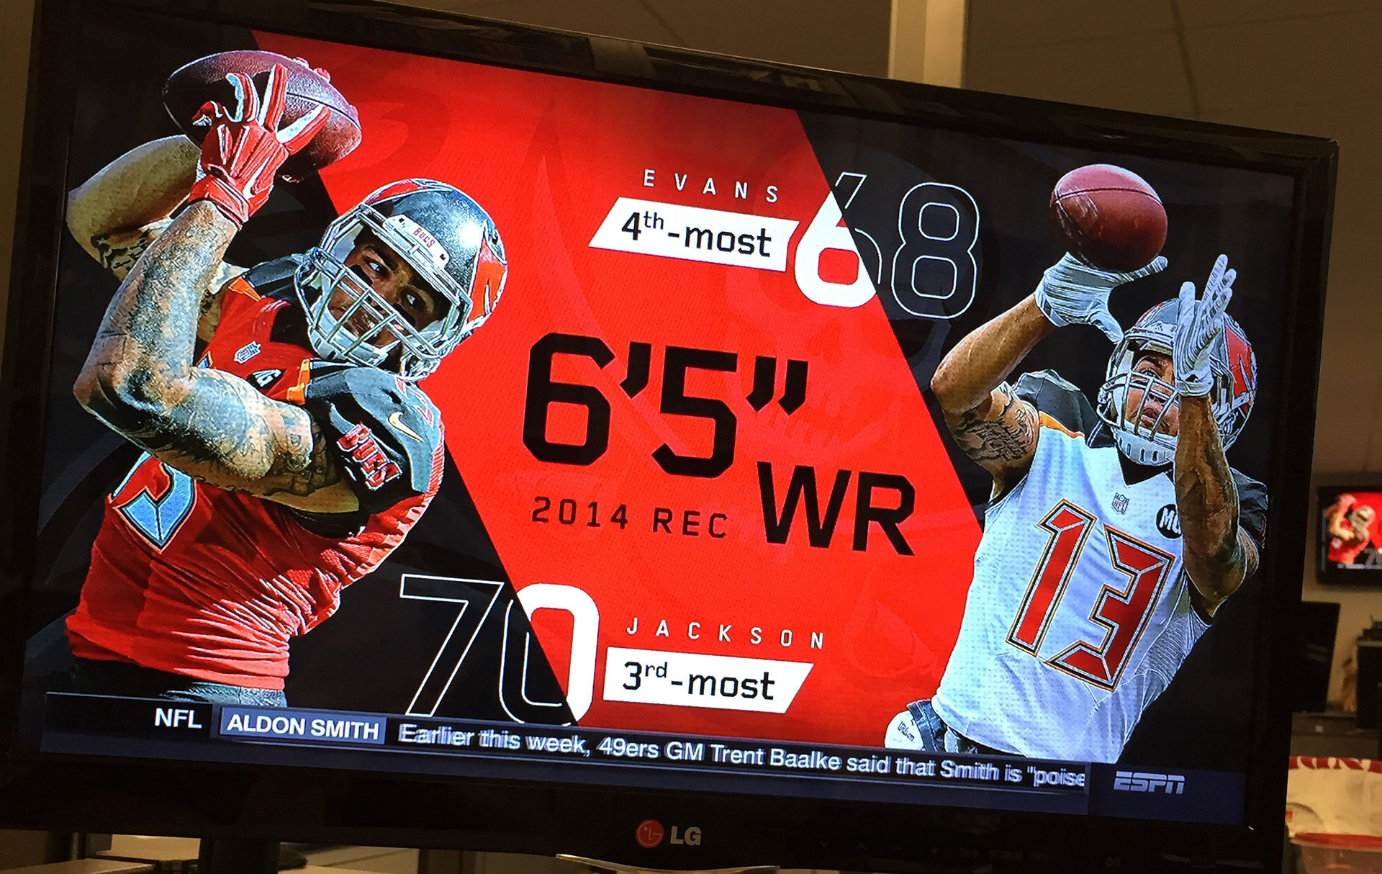
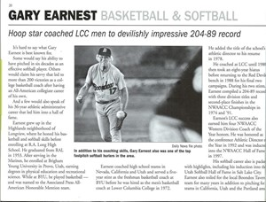
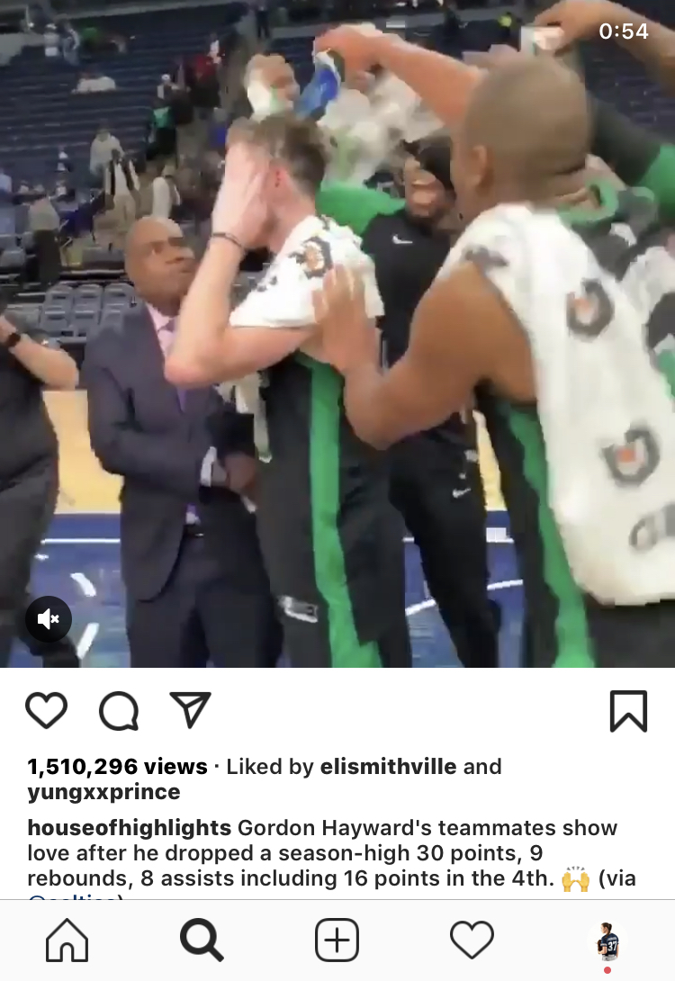
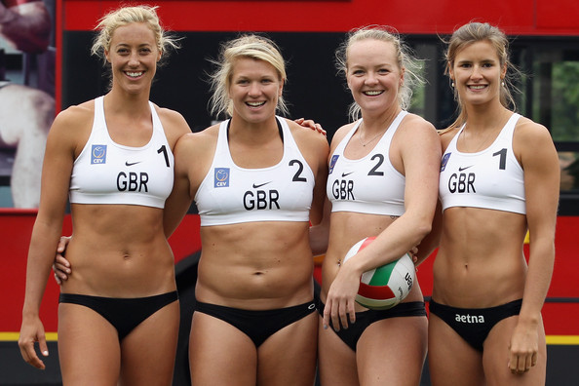
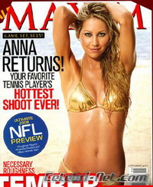
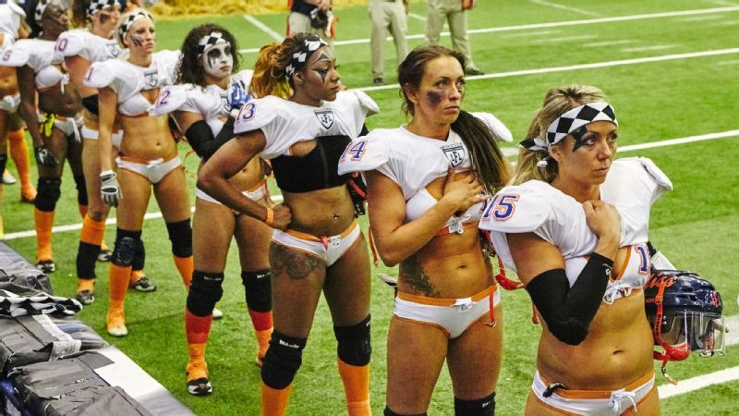
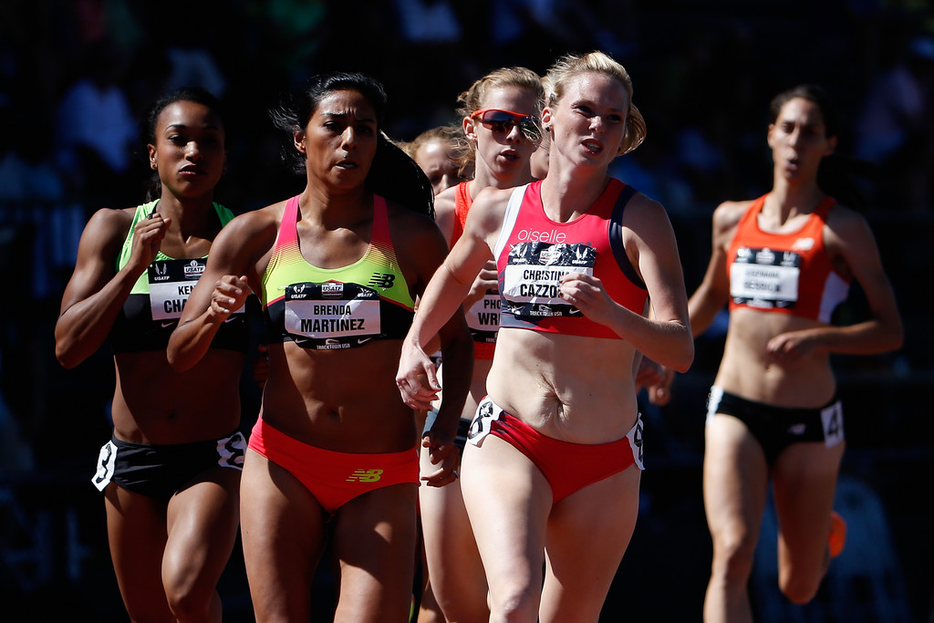
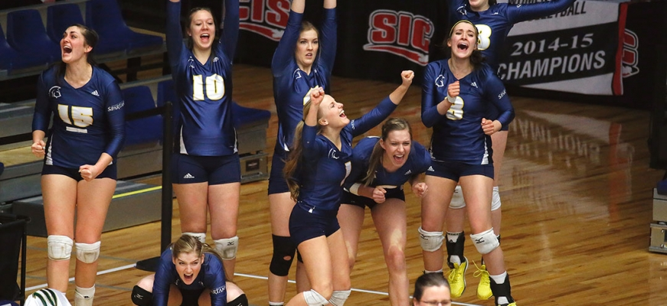
Television
Newspaper
Male Athletes
Social Media
Female Athletes
Being Sexualized

Slide 5
Works Cited
Barkhorn, Eleanor. “9 Ways Women Get on the Cover of 'Sports Illustrated'.” The Atlantic, Atlantic Media Company, 20 July 2011, www.theatlantic.com/entertainment/archive/2011/07/9-ways-women-get-on-the-cover-of-sports-illustrated/242251/.
Dickson, Kaleigh Elizabeth, "Public Perception of Male Athletes Vs. Female Athletes in the Media" (2015). LSU Master's Theses. 3865.
https://digitalcommons.lsu.edu/gradschool_theses/3865

