Slide 1
The importance of health and physical education
Isabella Naccarato

Slide 2
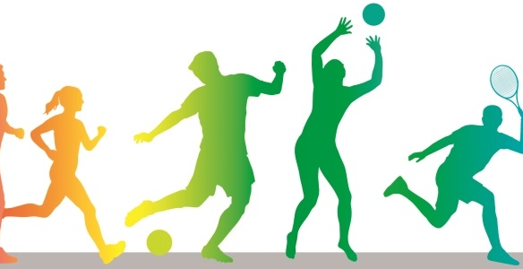
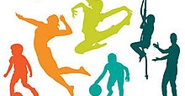
Children
This Photo by Unknown Author is licensed under CC BY-SA-NC
Quality health and physical education programs can be life-changing for today’s young people and, in many cases, already are. Such programs offer students a well-rounded opportunity to develop their bodies and minds to gain skills that will propel them to success in both the physical and academic aspects of education—and life. Good HPE programs provide the structure and discipline that young people need to perform in school effectively, make positive choices in their lives, persevere to see a project through to the end, and earn the respect of their peers. Our society seems to be struggling with these things.
This Photo by Unknown Author is licensed under CC BY-SA

Slide 3
Diet
Our dietary choices aren’t helping, either. The parents of today are the second generation of families raised in a fast-food culture. Many families find that the convenience of fast food, coupled with the opportunity not to make a mess at home, is the quick and easy way to satisfy hunger. However, as we all know, most fast food falls short in providing the healthy nutrition that children need. And the high fat and sugar contents are helping contribute to growing rates of heart disease and diabetes in young people.
Health and PE classes emphasize the importance of eating healthy, watching our intake of toxins, and exercising. These are called the “Big 3”, making this an all-around important lifestyle.
This Photo by Unknown Author is licensed under CC BY-SA

Slide 4
Types of skills/learning styles
Motor: movement and the idea of ways to move
Cognitive: being able to do well on any kind of testing (written, visual, verbal)
Affective: working well with others, sportsmanship, teamwork
Psychomotor: getting from Point A to Point B
Visual: a lot of students need to see things demonstrated before doing this skill; PE helps with visualizing activities and skills then performing them
Audio: being able to hear verbal cues and taking direction from teacher and peers
Hands-on: after seeing or hearing the activity or skill, it is time to test it out!
This Photo by Unknown Author is licensed under CC BY-SA-NC

Slide 5
Overall concepts:
Improved physical fitness Improves children's muscular strength, flexibility, muscular endurance, body composition and cardiovascular endurance.
Skill development Develops motor skills, which allow for safe, successful and satisfying participation in physical activities.
Regular, healthful physical activity Provides a wide-range of developmentally appropriate activities for all children.
Support of other subject areas Reinforces knowledge learned across the curriculum. Serves as a lab for application of content in science, math and social studies.
Self-discipline Facilitates development of student responsibility for health and fitness.
Improved judgment Quality physical education can influence moral development. Students have the opportunity to assume leadership, cooperate with others, question actions and regulations, and accept responsibility for their own behavior.
Stress reduction Physical activity becomes an outlet for releasing tension and anxiety and facilitates emotional stability and resilience.
Strengthened peer relationships Physical education can be a major force in helping children socialize with others successfully and provides opportunities to learn positive people skills. Especially during late childhood and adolescence, being able to participate in dances, games and sports is an important part of peer culture.
Improved self-confidence and self-esteem Physical education instills a stronger sense of self-worth in children based on their mastery of skills and concepts in physical activity. They can become more confident, assertive, independent and self-controlled.
Experience setting goals Gives children the opportunity to set and strive for personal, achievable goals.

