Slide 1
APP REVIEWS
ISABELLA NACCARATO
1/29/19

Slide 2
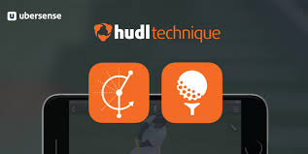
HudlTechnique App:
Athletes and coaches use Hudl Technique to improve through slow motion video analysis. You can use your iPhone, any Android device, or iPad camera to record and break down your technique for instant feedback during a practice, race, or game. Some examples include: analyzing your baseball swing in super slow motion, comparing your tennis serve side-by-side to a pro’s, or studying your long jump frame by frame.

Slide 3
Info:
Application to learning: This app will teach both students and teachers/coaches what to improve on. This will teach them technology skills, as well as psychomotor, cognitive, and affective skills.
Teacher or student app: Both!
Ease of use: Very
How you could utilize the app in health or physical education: Everyone taking out their phones to record their partner do a skill, then run it back and see what needs improving!
Costs involved in the app: Free!

Slide 4
Overall review:
I personally love this app for the use of physical education and regular sports. This app will show players and coaches what needs to be improved on, as well as a discussion to be held about any improvements. This will help with social skills and being able to take constructive criticism and insight. This would effect students well in the physical education system because of being able to partner up and use something their interested in: technology. I would refrain from using it in the elementary and middle school though just because I feel like personally, they wouldn’t stay on track with the assignment given at a young age.

Slide 5
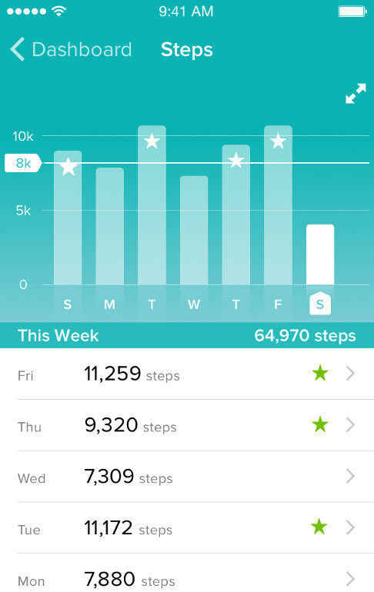
Fitbit Tracker App:
Whoever owns any kind of Fitbit can download this app on their Apple devices and Android devices to keep up with their progress on their actual Fitbit. You can track steps live, see how many steps you get a week, show progress with charts, and more!

Slide 6
Info:
Application to learning: This app will teach both adults and children how to manipulate using their Fitbits for good use.
Teacher or student app: Both!
Ease of use: Very
How you could utilize the app in health or physical education: Whoever has a Fitbit could download this and use it to track steps, heart rates, and overall activities, especially while participating in class.
Costs involved in the app: Free!

Slide 7
Overall review:
I really like to use this app because I’ve done so before and its super easy to maneuver through. Anyone with a Fitbit would agree with me that its so convenient. Like with the Hudl app, I would use this for class but only for high school. Kids and very young teens would not know how to use this especially something more on the pricier side like a Fitbit. Overall though, I would love to se something like this in the PE setting and I think the kids would really like to keep track of their own steps while learning how to use this kind of technology.

