Slide 1
Promotion exercise
Katelyn Housler

Slide 2
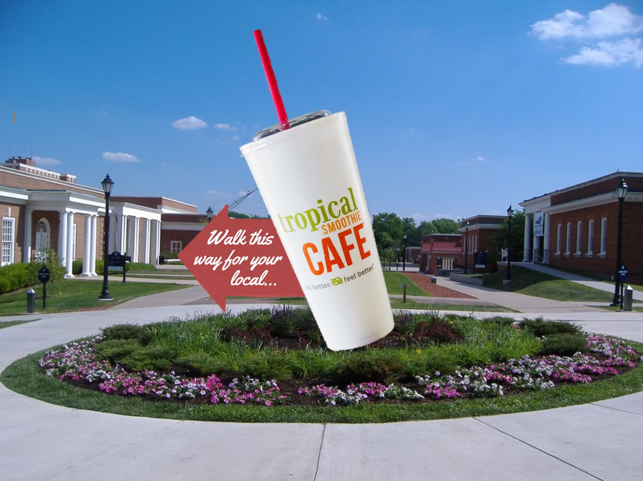
Outdoor Traditional Marketing
Giant 3D Smoothie Cup on Brock Commons
Arrow sticking out of it will point down Iler Hill toward the Longwood Landings where Tropical Smoothie Cafe will be located
Arrow will be placed in the middle of the cup so it will end up saying, “Walk this way for your local… Tropical Smoothie Cafe”

Slide 3
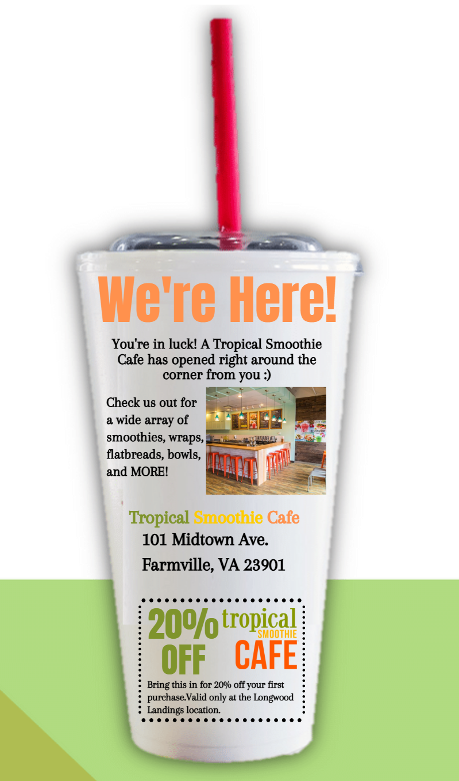
Direct Marketing
Smoothie-shaped Mail Flyers
The direct mail flyers will be sent out directly to Farmville residents and placed on the doors of Longwood dorm rooms
They will include a Coupon for 20% off your first purchase
Front
Back

Slide 4
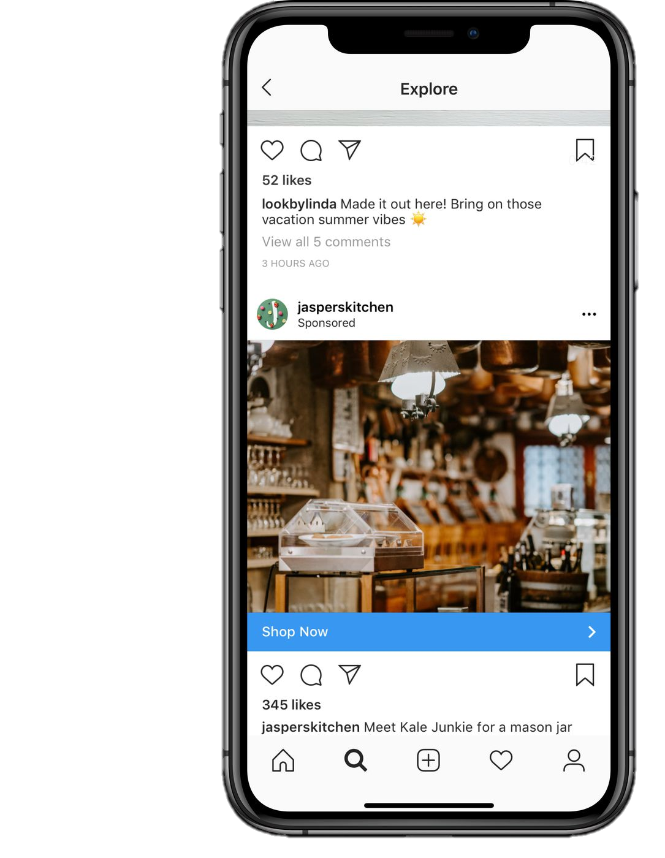
Social Media
Sponsored Social Media Ads
We will pay for sponsored Instagram ads for the first two weeks of the Fall Semester geo-targeting students on the Longwood University campus
This will target students coming back to campus
We will also post this graphic on the Longwood Dining social media pages
Posts will be made once a week about our ‘weekly deal’

