Slide 1
Individual Project Presentation
Katelyn Housler

Slide 2
Study 1:
Parameter Estimation
“We need to do something to slow global warming”

Slide 3
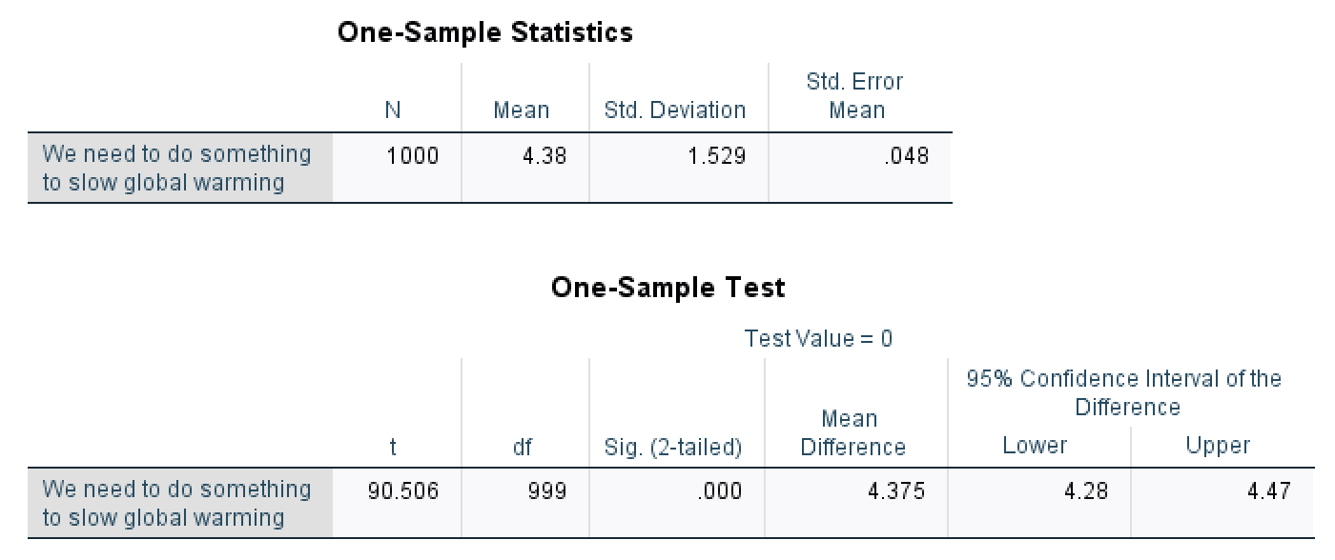
Study 1: Parameter Estimation
Our best estimate is that the average for “We need to do something to slow global warming” is 4.375 (7-point scale, from very strongly disagree to very strongly agree).
We are 95% confident that the true population value falls between 4.28 and 4.47. Therefore, people agree with this statement.

Slide 4
Study 2:
Hypothesis Analysis
“I am worried about global warming”

Slide 5
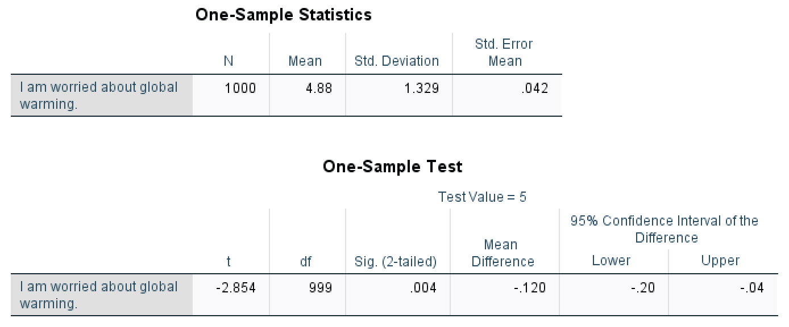
Study 2: Hypothesis Analysis
Hypothesis: ‘Agree’ corresponds to ‘5’ on the 7-point scale
The t-value of -2.854 is less than -1.96, which is below the lower boundary and therefore a part of the tail. Because of this, we will reject the hypothesis. The statement that ‘Agree’ corresponds to ‘5’ on the 7-point scale is incorrect and is not supported by the data.

Slide 6
Study 3:
Difference Analysis
“Male” & “Female” attitudes towards the “1 Seat Motorcycle Electric”

Slide 7
Study 3: Difference Analysis
H0: There is no difference between Male and Female attitudes towards the 1 Seat Motorcycle Electric.
H1: There is significant difference between Male and Female attitudes towards the 1 Seat Motorcycle Electric.

Slide 8
Study 3: Difference Analysis
Since the p-value of 0.130 is greater than 0.05, we will reject the alternative hypothesis and accept the null hypothesis.
There is no significant difference between Males’ and Females’ attitudes towards 1 Seat Motorcycle Electric.

Slide 9
Study 4:
Difference Analysis
“2 Seat Runabout Sport Electric” & “2 Seat Runabout Hatchback Gasoline Hybrid”

Slide 10
Study 4: Difference Analysis
H0: There is no difference in attitude between the 2 Seat Runabout Sport Electric and the 2 Seat Runabout Hatchback Gasoline Hybrid.
H1: There is a significant difference in attitude between the 2 Seat Runabout Sport Electric and the 2 Seat Runabout Hatchback Gasoline Hybrid.

Slide 11
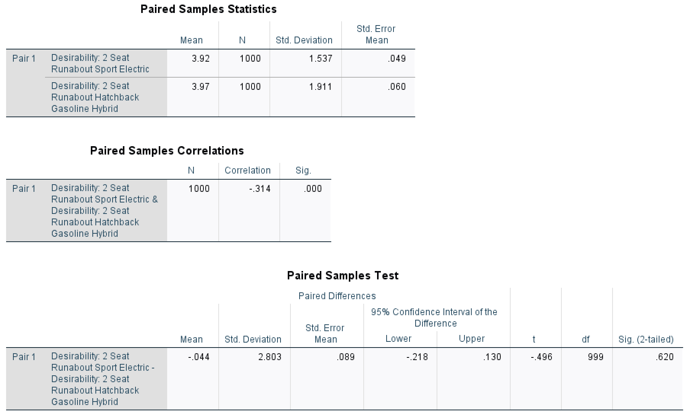
Study 4: Difference Analysis
Since the p-value of 0.620 is greater than 0.05, we will reject the alternative hypothesis and accept the null hypothesis. There is no significant difference between the attitudes towards 2 Seat Runabout Sport Electric and the 2 Seat Runabout Hatchback Gasoline Hybrid.

Slide 12
Study 5:
ANOVA Difference Analysis
“Desireability: 4 Seat Economy Diesel Hybrid” & “Income Category”

Slide 13
Study 5: ANOVA Difference Analysis
H0: There is no difference between the groups ( m1 = m2 = m3 = ….. mi ).
H1: There is at least one group that is significantly different from the other groups ( mi ≠ mj ).

Slide 14
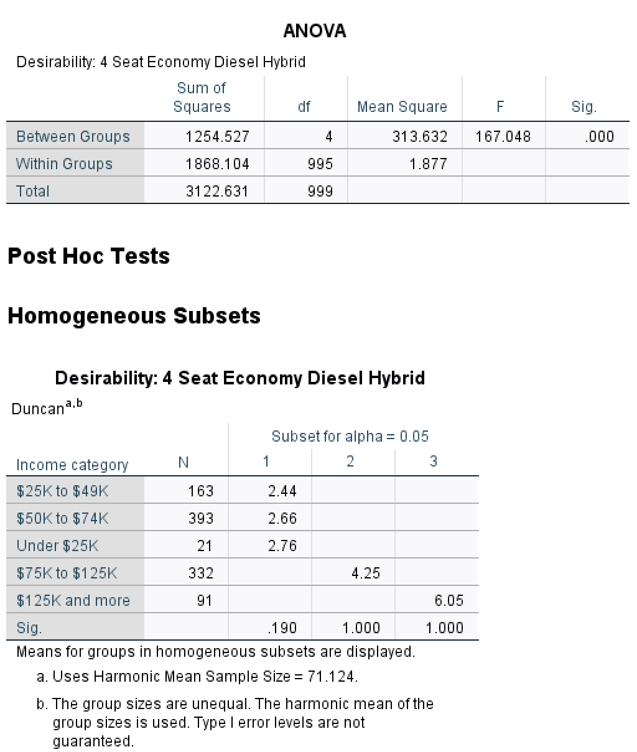
Study 5: ANOVA Difference Analysis
Since the p-value of 0.000 is less than 0.05, we will reject the null hypothesis and accept the alternative hypothesis. At least one of the groups has a significantly different desirability for the 4 Seat Economy Diesel Hybrid. Within groups, there is no significant difference, but between groups there is significant difference.

Slide 15
Study 6:
Chi-Square Test
“Favorite television show types” & “Marital status”

Slide 16
Study 6: Chi-Square Test
H0: There is no relationship between the Favorite Television Show types and the Marital Status.
H1: There is a significant relationship between the Favorite Television Show types and the Marital Status.

Slide 17
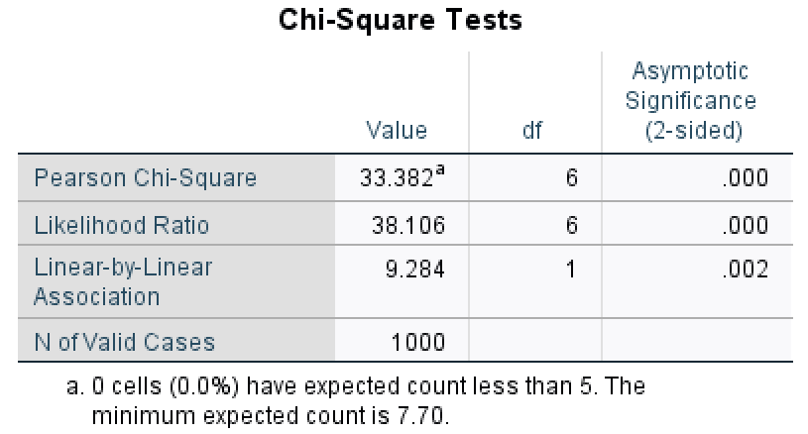
Study 6: Chi-Square Test
Since the p-value of 0.000 is less than 0.05, we will accept the alternative hypothesis and reject the null hypothesis. This means that there is a significant relationship between Favorite Television Show types and Marital Status. The Chi-Square value is 33.382 with 6 degrees of freedom.

Slide 18
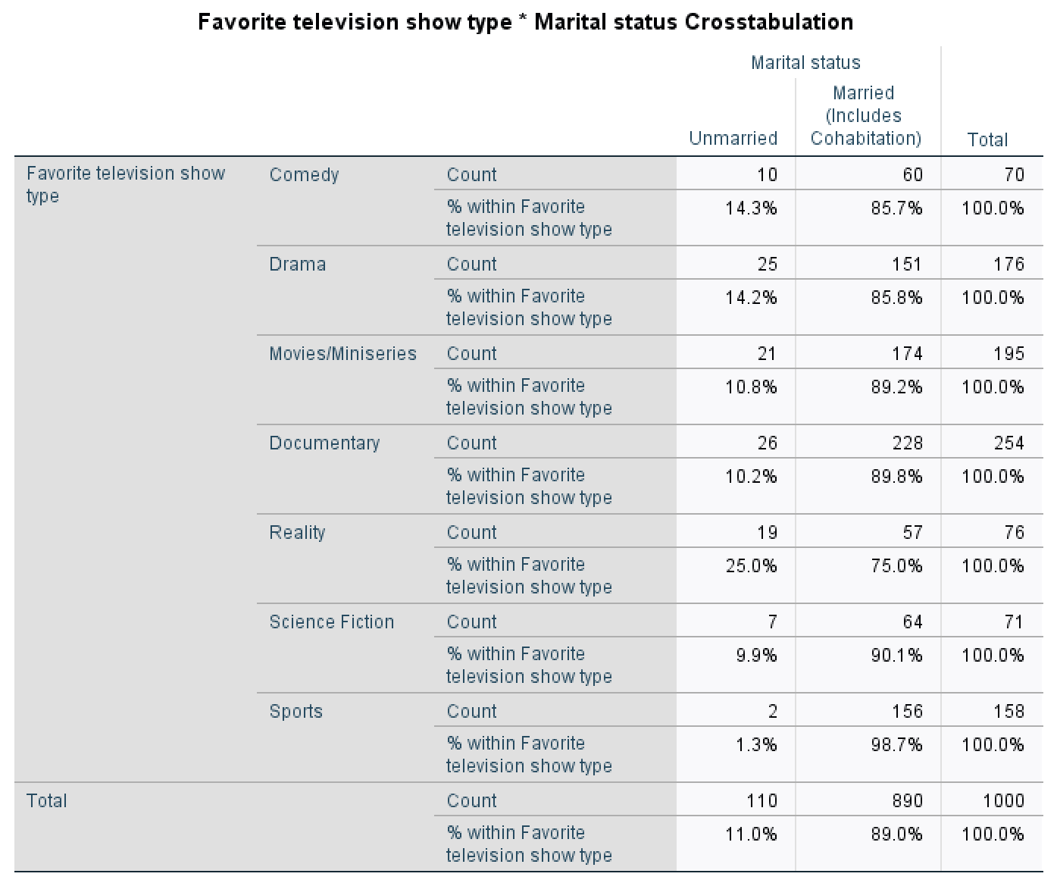
Study 6: Chi-Square Test
Comedy: Married prefer it more than Unmarried
Drama: Married prefer it more than Unmarried
Movies/Miniseries: Married prefer it more than Unmarried
Documentary: Married prefer it more than Unmarried
Reality: Married prefer it more than Unmarried
Science Fiction: Married prefer it more than Unmarried
Sports: Married prefer it more than Unmarried

Slide 19
Study 7:
Correlation Coefficient
Relationship with “Desireability: 4 Seat Economy Diesel Hybrid”

Slide 20
Study 7: Correlation Coefficients
H0: There is no relationship between the desirability of the 4 Seat Economy Diesel Hybrid and the level of agreement with the statement “I am worried about global warming”.
H1: There is a significant relationship between the desirability of the 4 Seat Economy Diesel Hybrid and the level of agreement with the statement “I am worried about global warming”.
H0: There is no relationship between the desirability of the 4 Seat Economy Diesel Hybrid and the level of agreement with the statement “Gasoline emissions contribute to global warming”.
H1: There is a significant relationship between the desirability of the 4 Seat Economy Diesel Hybrid and the level of agreement with the statement “Gasoline emissions contribute to global warming”.
H0: There is no relationship between the desirability of the 4 Seat Economy Diesel Hybrid and the level of agreement with the statement “We need to do something to slow global warming”.
H1: There is a significant relationship between the desirability of the 4 Seat Economy Diesel Hybrid and the level of agreement with the statement “We need to do something to slow global warming”.
H0: There is no relationship between the desirability of the 4 Seat Economy Diesel Hybrid and the level of agreement with the statement “We should be looking for gasoline substitutes”.
H1: There is a significant relationship between the desirability of the 4 Seat Economy Diesel Hybrid and the level of agreement with the statement “We should be looking for gasoline substitutes”.

Slide 21
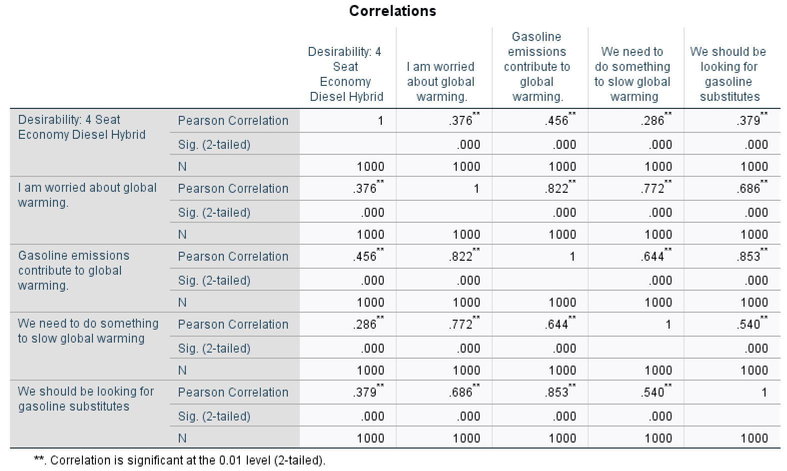
Study 7: Correlation Coefficients
Since the p-value of 0.000 is less than 0.05, we will accept the alternative hypothesis and reject the null hypothesis. This means that there is a significant relationship between the desirability of the 4 Seat Economy Diesel Hybrid and the level of agreement with the statement “I am worried about global warming”. The Pearson Correlation of 0.376 is above the range 0.0 - 0.2, making it a positive and strong relationship.

Slide 22
Study 7: Correlation Coefficients
Since the p-value of 0.000 is less than 0.05, we will accept the alternative hypothesis and reject the null hypothesis. This means that there is a significant relationship between the desirability of the 4 Seat Economy Diesel Hybrid and the level of agreement with the statement “Gasoline emissions contribute to global warming”. The Pearson Correlation of 0.456 is above the range 0.0 - 0.2, making it a positive and strong relationship.

Slide 23
Study 7: Correlation Coefficients
Since the p-value of 0.000 is less than 0.05, we will accept the alternative hypothesis and reject the null hypothesis. This means that there is a significant relationship between the desirability of the 4 Seat Economy Diesel Hybrid and the level of agreement with the statement “We need to do something to slow global warming”. The Pearson Correlation of 0.286 is above the range 0.0 - 0.2, making it a positive and strong relationship.

Slide 24
Study 7: Correlation Coefficients
Since the p-value of 0.000 is less than 0.05, we will accept the alternative hypothesis and reject the null hypothesis. This means that there is a significant relationship between the desirability of the 4 Seat Economy Diesel Hybrid and the level of agreement with the statement “We should be looking for gasoline substitutes”. The Pearson Correlation of 0.379 is above the range 0.0 - 0.2, making it a positive and strong relationship.

Slide 25
Study 8:
Regression Analysis
Independent & Dependent Variables

Slide 26
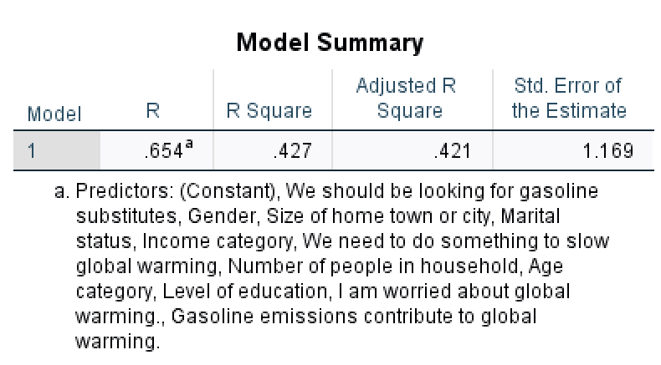
How much of the independent variables can explain the dependent variable?
Using the R-value of 0.654, we can say that the independent variables can explain 65.4% of the dependent variable.

Slide 27
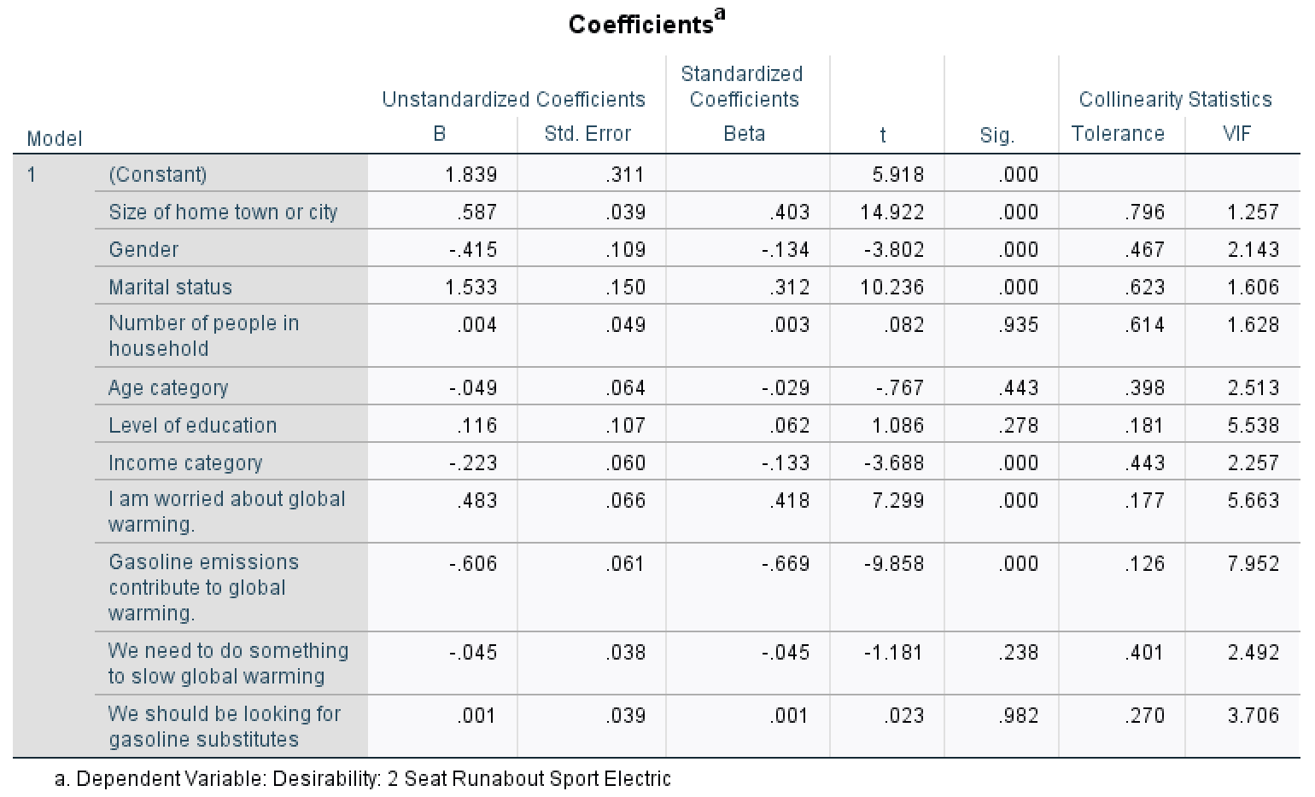
Which independent variables can explain the dependent variable (which is sig.)?
Because ‘Size of home town or city’ has a p-value of 0.000 which is less than 0.05 (making it significant), this independent variable can explain the dependent variable.
Because ‘Gender’ has a p-value of 0.000 which is less than 0.05 (making it significant), this independent variable can explain the dependent variable.

Slide 28
Which independent variables can explain the dependent variable (which is sig.)?
Because ‘Marital status’ has a p-value of 0.000 which is less than 0.05 (making it significant), this independent variable can explain the dependent variable.
Because ‘Number of people in household’ has a p-value of 0.935 which is greater than 0.05 (making it not significant), this independent variable cannot explain the dependent variable.

Slide 29
Which independent variables can explain the dependent variable (which is sig.)?
Because ‘Age category’ has a p-value of 0.443 which is greater than 0.05 (making it not significant), this independent variable cannot explain the dependent variable.
Because ‘Level of education’ has a p-value of 0.278 which is greater than 0.05 (making it not significant), this independent variable cannot explain the dependent variable.

Slide 30
Which independent variables can explain the dependent variable (which is sig.)?
Because ‘Income category’ has a p-value of 0.000 which is less than 0.05 (making it significant), this independent variable can explain the dependent variable.
Because ‘I am worried about global warming’ has a p-value of 0.000 which is less than 0.05 (making it significant), this independent variable can explain the dependent variable.

Slide 31
Which independent variables can explain the dependent variable (which is sig.)?
Because ‘Gasoline emissions contribute to global warming’ has a p-value of 0.000 which is less than 0.05 (making it significant), this independent variable can explain the dependent variable.
Because ‘We need to do something to slow global warming’ has a p-value of 0.238 which is greater than 0.05 (making it not significant), this independent variable cannot explain the dependent variable.

Slide 32
How can each unstandard beta and standard beta interpret?
The independent variables with a significant relationship to the dependent variable are listed below from highest influence (1) to lowest influence (6) according to their Standardized Coefficients Beta:
Marital status
Gasoline emissions contribute to global warming
Size of home town or city
I am worried about global warming
Gender
Income category

Slide 33
How can each unstandard beta and standard beta interpret?
The independent variables with a significant relationship to the dependent variable with negative influences according to their Unstandardized B are:
Gender
Income category
Gasoline emissions contribute to global warming

Slide 34
How can each unstandard beta and standard beta interpret?
The independent variables with a significant relationship to the dependent variable with positive influences according to their Unstandardized B are:
Size of home town or city
Marital status
I am worried about global warming

Slide 35
What is the regression formula?
Y = 1.839 + 0.587 x1 - 0.415 x2 + 1.533 x3 – 0.223 x4 + 0.483 x5 - 0.606 x6
X1 = Size of home town or city
X2 = Gender
X3 = Marital status
X4 = Income category
X5 = I am worried about global warming
X6 = Gasoline emissions contribute to global warming

Slide 36
Study 9:
Descriptive Analysis
“I am worried about global warming”

Slide 37
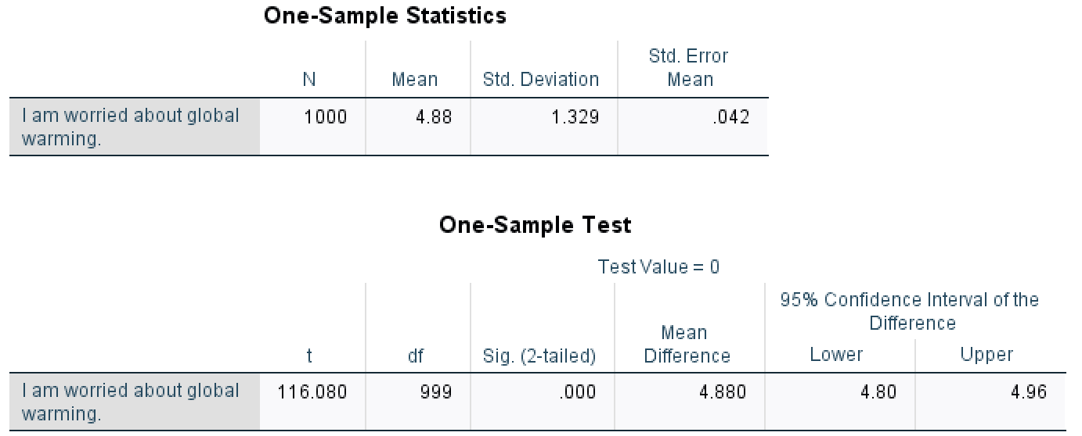
Study 9: Descriptive Analysis
The mean of this study is 4.88, meaning that on a scale from 1 to 7, this is the average answer that respondents gave when asked to rate the statement, “I am worried about global warming.
The standard deviation is 1.329, showing that the values are closer to the mean with not as much variation.

Slide 38
Thank you!
Please let me know if you have any questions!

