Slide 1
Mindless Eating Mini Experiment
By
Bradley Heath

Slide 2
Topic
I conducted a mini experiment on the effect of the number of times students eat junk food in a day and their GPA.

Slide 3
Hypothesis
I had hypothesized that there would be a strong negative correlation between the number of times a student ate snack foods in and their GPA.

Slide 4
Who was studied?
Student 1: Male Longwood student (19 years)
Student 2: Male Longwood student( 20 years)
Student 3:Female Longwood student 20 years)
Student 4: Male Longwood student (19 years)
Student 5: Male Longwood student (19 years)
Student 6: Female Longwood Student (19 Years)
Student 7: Male Longwood Student: (20 years)

Slide 5
Methods
Each participant filled out the following survey: https://docs.google.com/forms/d/e/1FAIpQLSddtRYOkOMjoknQCloMc4DbnQJLwLhSsn2Jv0W2FszXlAzq6Q/viewform?usp=sf_link

Slide 6
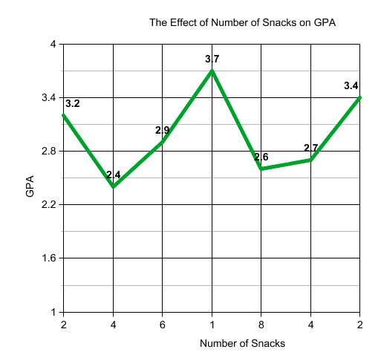
Research Findings
Data: The highest GPA ate the lowest amount of junk food, however, the highest amount of junk food did not have the lowest GPA. However, there was a negative correlation between the two variables.

Slide 7
Why is researching this particular topic and research relevant to the general population?
I believe that this is relevant because it shows the nutritional value of what you eat can make an impact on your academic performance. Eating food with low nutritional value does not give your body adequate energy to think.

Slide 8
Did the findings match the hypothesis? Why or why not?
Yes, the findings matched the hypothesis because the lower the amount of snacks, negatively correlated with a higher GPA.

Slide 9
What observations can you make regarding the results about the Longwood University Population?
Longwood needs to better their food options, because over all it would increase academic performance. If they advocated for better nutrition it would better the entire student population.

Slide 10
How can these results help to change “Mindless Eating”
If students knew how much that junk food actually contributed to their grades, they would try to eat better.

