Slide 1
Live Fast, Die Young:
Using Survivorship Curves to Determine Differences in Death Rates between Sex, Location, and Time Period
Abagail Pack, Cecily Hayek, Jeri Tyler, Sage Church
Biology 251 Independent Research Project

Slide 2
1.Background

Slide 3
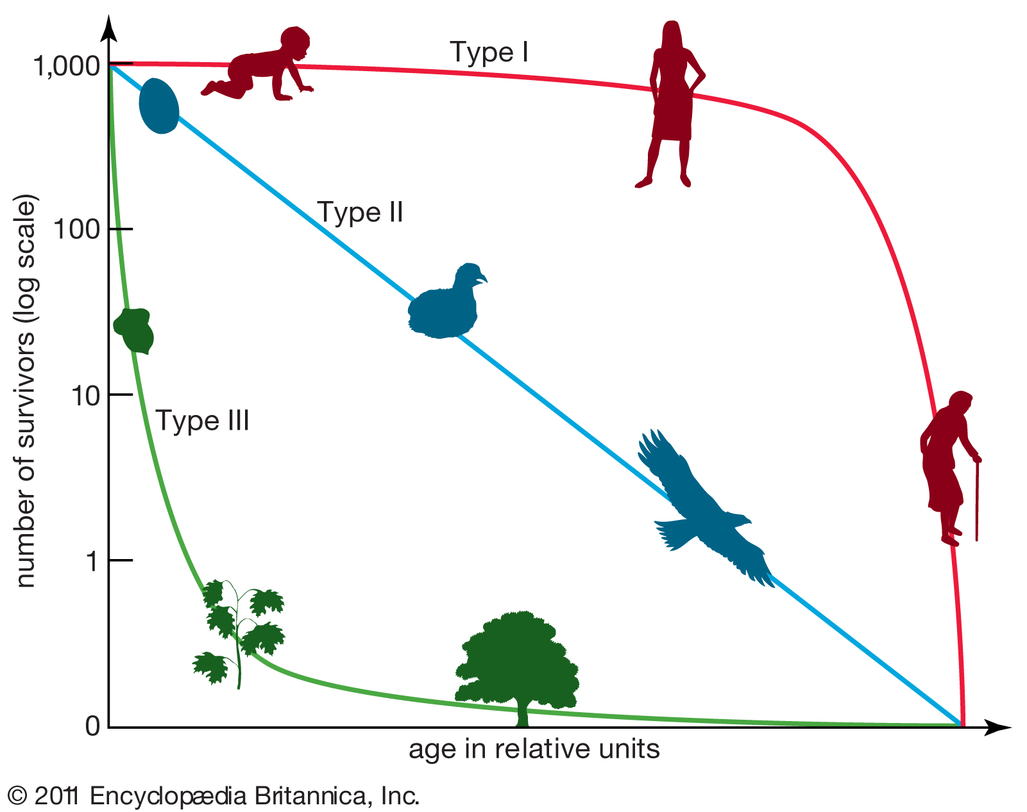
Survivorship curves are graphs that show what percentage of a population survives from one age to the next
(Life tables, survivorship curves, & age-sex structures.)

Slide 5
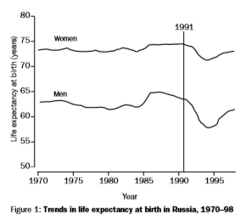
(Shkolnikov et al, 2001)

Slide 6
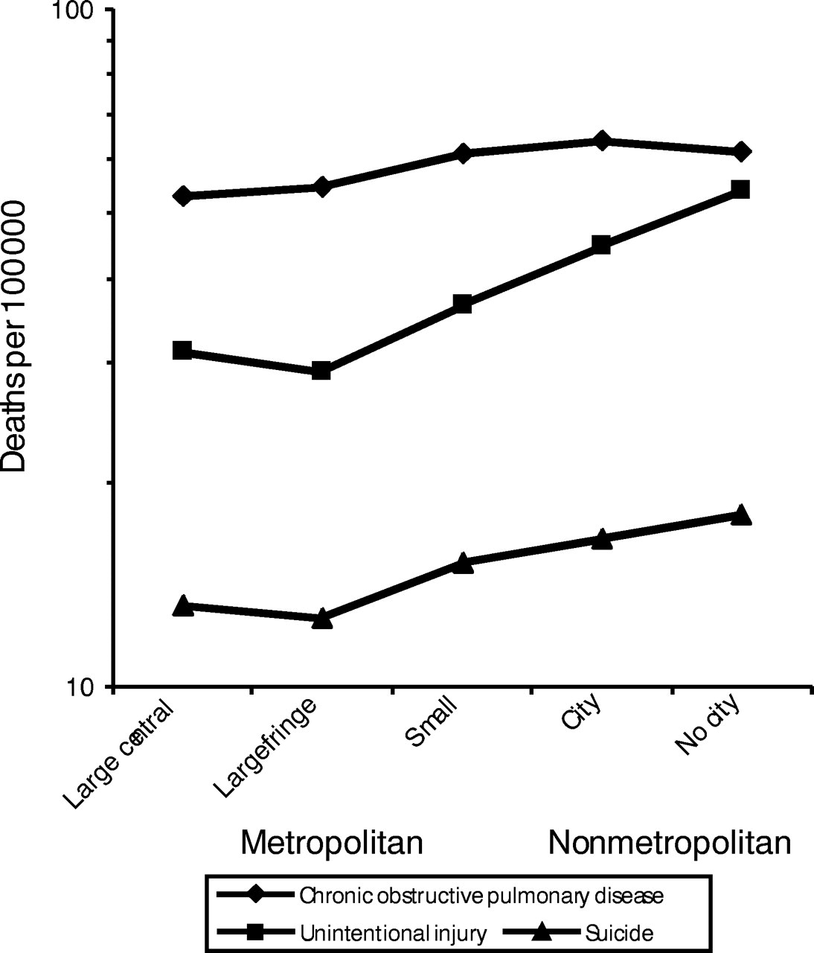
(Eberhardt, Mark S. and Elsie R. Pamuk, 2004.)
Notes:
BE MORE CLEAR JERI

Slide 7
Hypotheses
Null Hypothesis #1: The average age of death from 1950-1980 compared to 1981-present had no significant difference.
Alt. Hypothesis #1: The average age of death from 1950-1980 compared to 1981-now had a significant difference.
Null Hypothesis #2: There will be no difference between the average age of death in males and females from 1950 to the present
Alt. Hypothesis #2: There will be a difference between the average age of death of males and females from 1950 to present day.
Null Hypothesis #3: The average age of death will be the same when comparing people from urban and rural areas
Alt. Hypothesis #3: There will be a difference between the average age of death in urban and rural areas.

Slide 8
Predictions
It is predicted that the average age of death will be higher in the present due to advances in medicine and health care
Men are expected to have a lower average age of death than women which could be attributed to the large number of men that have enlisted in war and some have more physically demanding jobs
People from urban areas are expected to live longer due to the increased availability of resources and relatively safer living conditions

Slide 9
2.Methods

Slide 10
Data was gathered from 6 different cemeteries across the globe
The data was categorized by death year, location, and sex
Graphs were made to compare the average age of death among the three factors
Statistical tests were run to further analyze and compare the data sets
(T-Test and ANOVA)
Notes:
Talk about why we chose the data

Slide 11
Locations of Our Data
Ballymadun, Ireland
Chester Rural, PA
Hollywood Cemetery, VA
Westview, VA
Lowther,
Australia
Odd Fellows, VA

Slide 12
3. Results

Slide 13
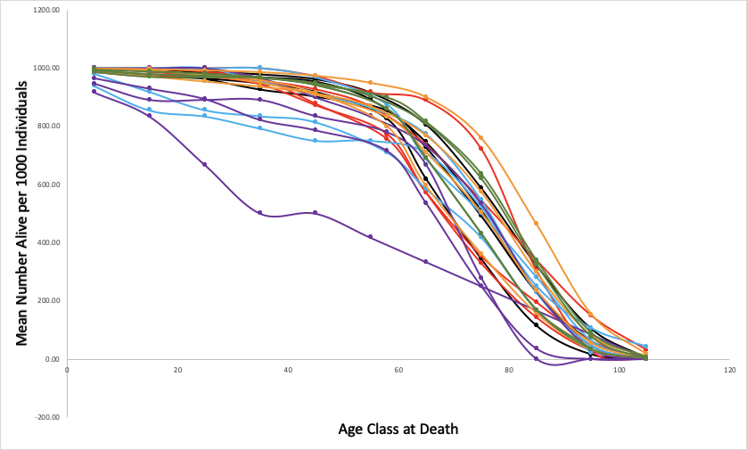
Chester Rural
Odd Fellows
Lowther
Ballymadun
Westview
Hollywood
Figure 1. Survivorship Curves in Six Different Locations. The different locations all showed Type 1 survivorship curves except for females in Ballymadun between the years 1950-1980.

Slide 14
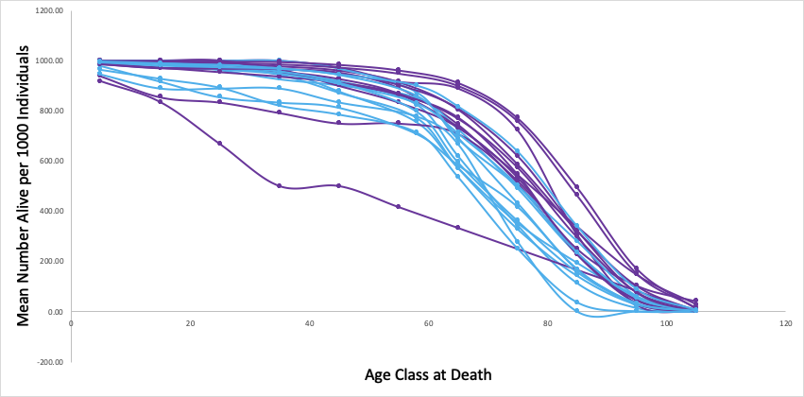
Males
Females
Males
Females
Figure 2. Survivorship Curves of Males Versus Females. The different locations and time periods showed that females are living longer than males.
Notes:
SPLIT THIS GRAPH!!!!!!

Slide 15
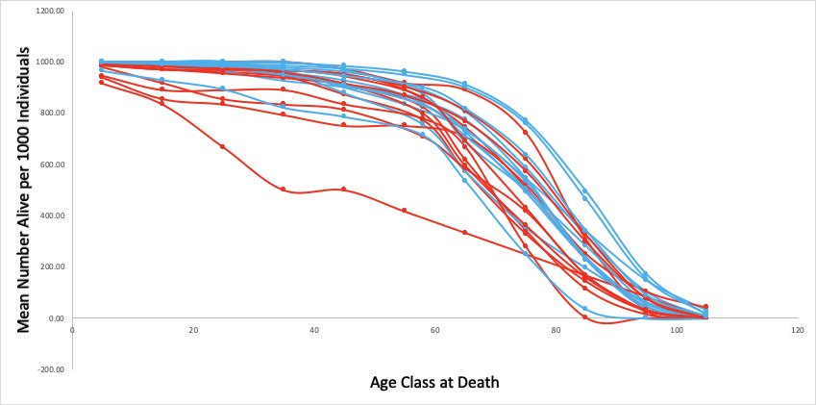
1950-1980
1981-now
Figure 3. Survivorship Curves of 1950-1980 Versus 1981-now. Males and females live longer now than they did before 1980.
Notes:
Specifically how much longer we are living now (and how much longer females live when compared to males)

Slide 16
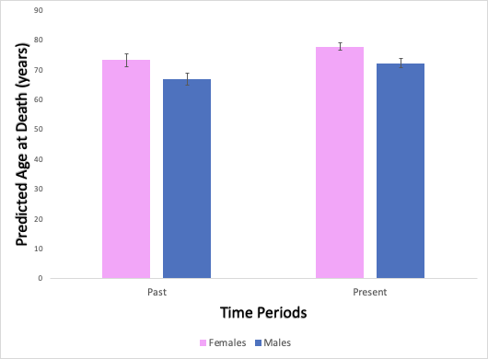
The t-value is 2.69677.
The p-value is .007376.
The result is significant at p < .05.
Figure 4. Predicted Age at Death for Males and Females Past and Present. Males and Females have had increases in their life expectancies, but females live longer than males.
Notes:
Add p-values :)

Slide 17
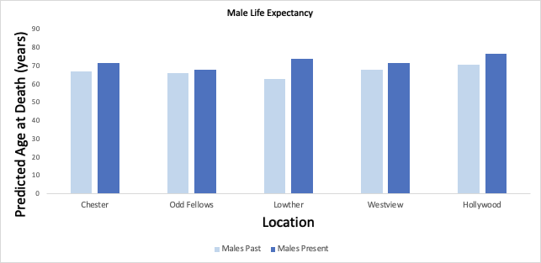
The t-value is 2.23028. The p-value is .028136. The result is significant at p < .05.
Figure 6. Predicted Age at Death for Males in Different Locations. Males live longer now than they did when compared to prior to 1980.
Notes:
SPLIT THIS GRAPH!!!!!!

Slide 18
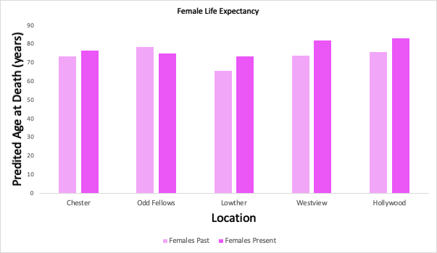
The t-value is 2.57197.
The p-value is .016513.
The result is significant at p < .05.
Figure 5. Predicted Age at Death for Females in Different Locations. Females now live longer than females before 1980, except in Odd Fellows where females are expected to live 4 years less when compared to before 1980.
The t-value is 2.57197. The p-value is .016513. The result is significant at p < .05.

Slide 19
3. Discussion

Slide 20
Connections to Current Literature
A study by Oeppen & Vaupel on female populations in multiple developed countries shows that their longevity has increased throughout the years
As well as studies comparing the life expectancy of males versus females which have found similar results
The general consensus is that:
Females live longer, (Oeppen and Vaupel, 2002)
Life expectancy has increased in recent years, (Fineman and Rice, 2004)
People from urban areas tend to live longer, (Eberhardt and Elsie, 2004)

Slide 21
Interpretations of Analysis
The average death age has:
Increased throughout the years
Except females at Odd Fellows
Females, on average, have a higher life expectancy than males overall
Consistent for all locations and time periods
Except for Ballymadun Cemetery, Ireland during 1950-1980
The type of survivorship curve has:
Been the same, Type 1, for males and females for all locations and time periods
Except for females at Ballymadun Cemetery, Ireland during 1950-1980
Type 2

Slide 22
Suggestions for Improvement
Access to more data
Third-world countries
A better program to compare data
Need more databases
Need causations
Need sufficient amounts of data

Slide 23
References
Brown DC, Lariscy JT, Kalousova L. Comparability of Mortality Estimates from Social Surveys and Vital Statistics Data in the United States. 2019.
Eberhardt, Mark. S. and Elsie R. Pamuk. The importance of place of residence: examining health in rural and nonrural areas. American Journal of Public Health. 2011; 94 (10): 1682-1686.
Fineman, N. and Rice, D. Economic Implications of Increased Longevity in the United States. Annual Review of Public Health. 2004; 25: 457-473.
Life tables, survivorship curves, & age-sex structure. Khan Academy. https://www.khanacademy.org/science/biology/ecology/population-ecology/a/life-tables-survivorship-age-sex-structure.
Oeppen J, Vaupel J. Broken limits to life expectancy. Science 2002;296:1029-1031
Shkolnikov, V, McKee, M, ad Leon, D. Changes in life expectancy in Russia in the mid-1990’s. The Lancet. 2001. 357: 917-921

Slide 24
Questions?

