Slide 1
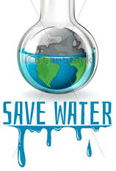
Water Bottle-Fill Stations on Longwood Campus
By Faith Harris and Phil Anderson

Slide 2
The Question
How can we increase student and faculty awareness of the issues with unsustainable bottle habits as well as promote the usage of current water bottle-fill stations, and the addition of more?
We wanted to know how far we would have to push so that we could have an awareness of the bottle habits
But we have concluded that the only way to push for the awareness of the bottle habit's and the for the placement of the water bottle fill stations is to get the students and the staff to be a part of it. To bring awareness through the clubs, sororities, and other organizations. A big thing would to make a club to focuses on this issue completely

Slide 3
The Research
Duke community members are trading in disposable plastic water bottles for reusable ones, highlighting a growing effort to “take back the tap.
With the help of water refilling stations across the university, Duke students, faculty and staff last year saved about 400,000 plastic bottles by filling up their own reusable containers. That’s enough bottles to stretch from West Campus to Greensboro.
Since January 2014, Duke has installed 50 water bottle filling stations in athletic and academic buildings throughout campus
“We’ve had students promoting reduced water use since 2009 through national campaigns like ‘Take Back the Tap’,” said Casey Roe, outreach coordinator for Sustainable Duke.
In partnership with the Nicholas School of the Environment, Sustainable Duke provides every first-year student with a reusable water bottle.

Slide 4
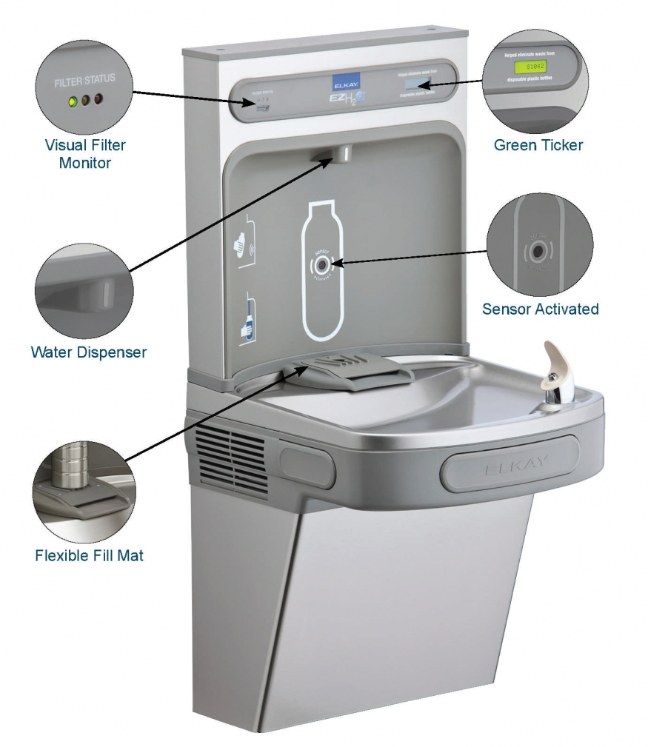
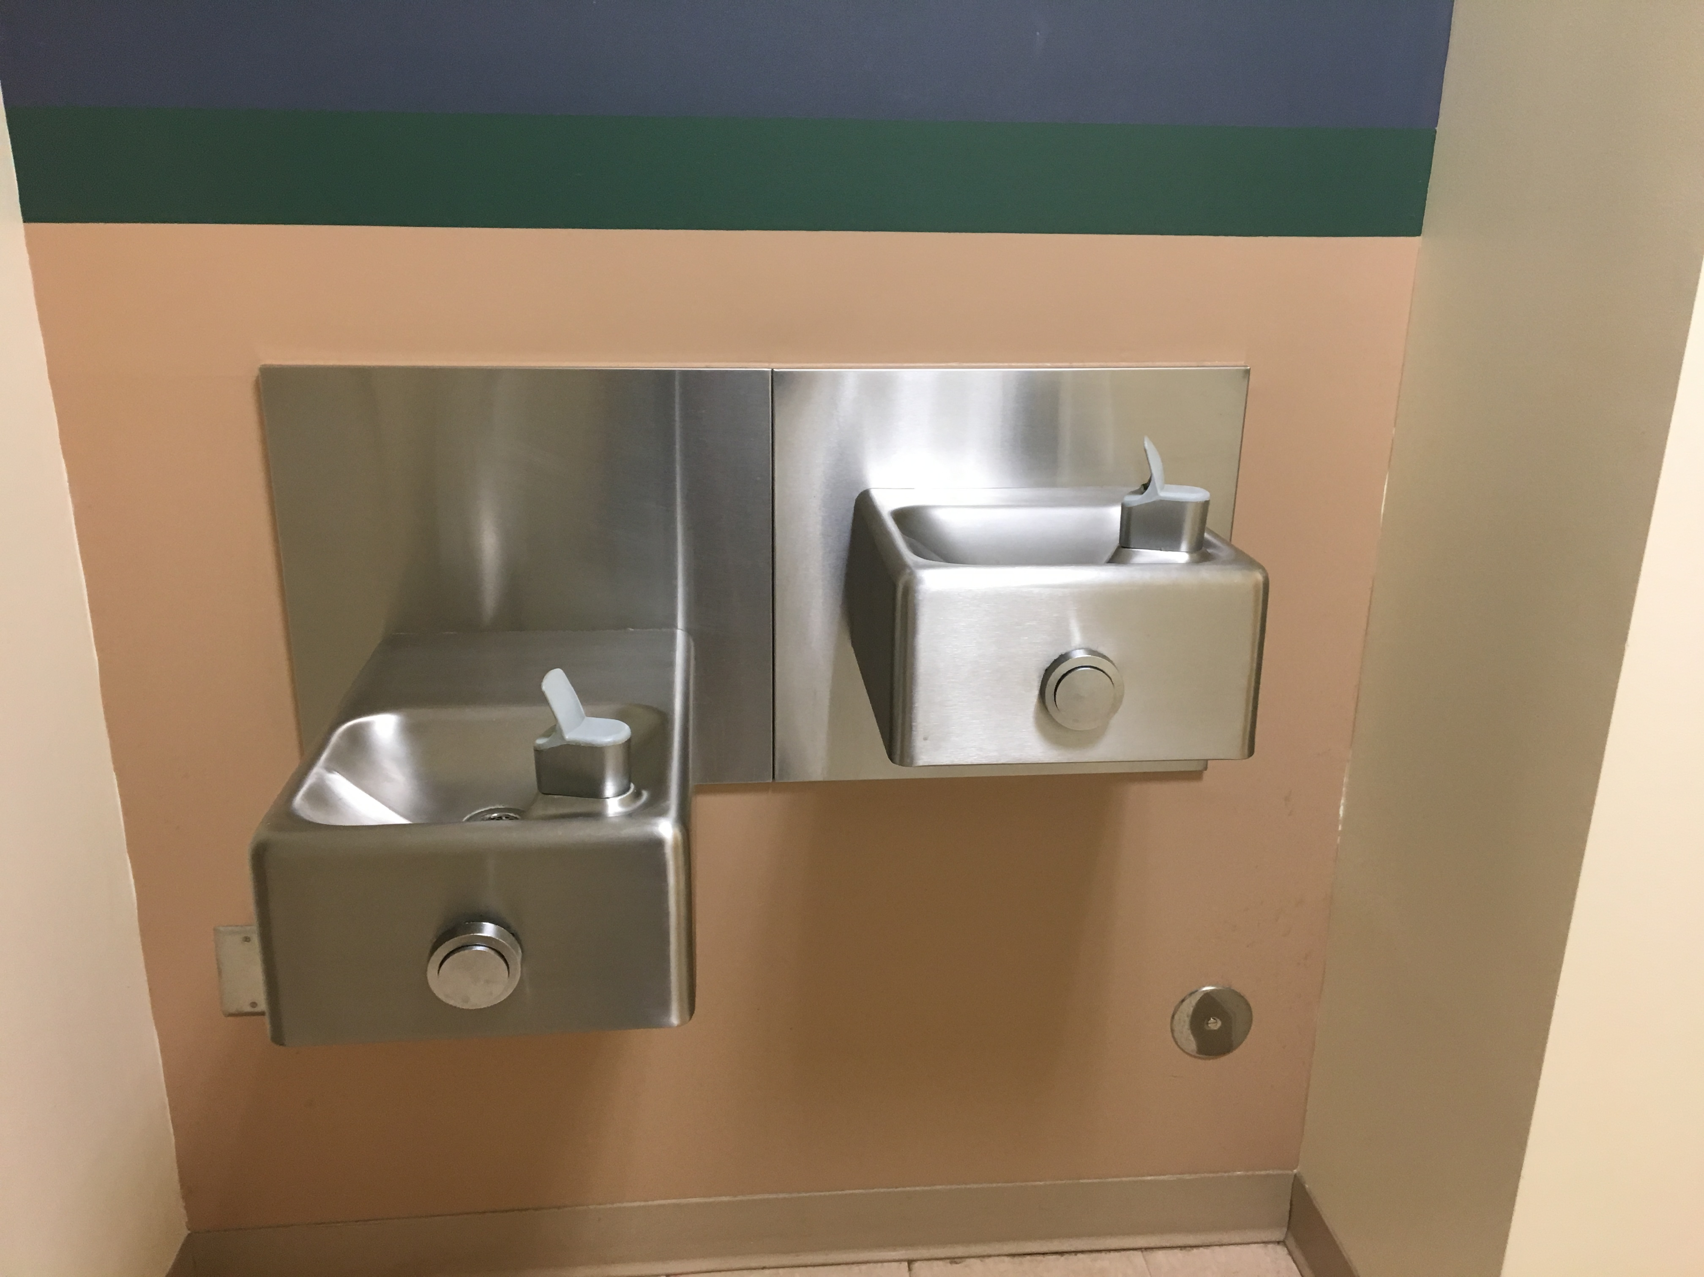
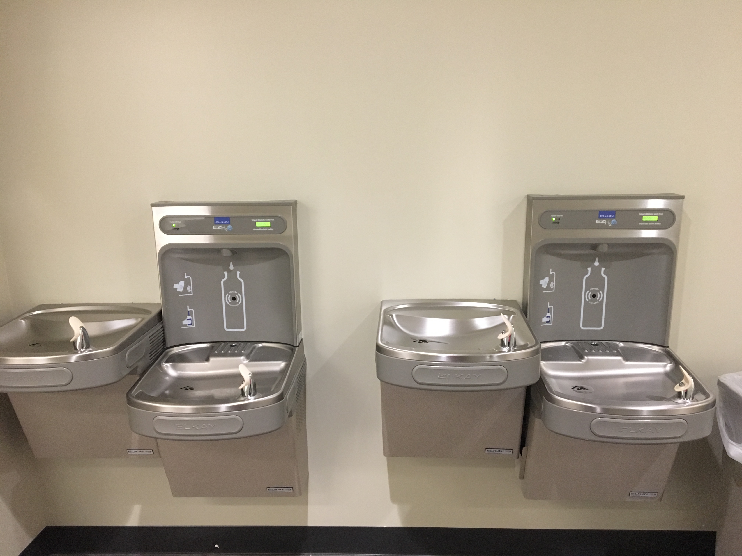
The Observation
The Cost Difference is high with water fountains that only cost $500, including installation, and hydration stations that are approximately $1100.
The benefits and potential impacts is that Water Bottle-Fill stations have greatly outweigh the few costs they bring. They’re quick and easy while being cleaner than a conventional fountain and tasting better at the same time! Most importantly, these stations can encourage positive and sustainable water use habits for people with the use of reusable water
The Buildings | 25
Water Bottle-Fill Stations | 28 | 20%
Water Fountains | 111 | 80%

Slide 5
The Inquiry
We had the chance to interview Mr. Ben Myers the Facilities Operation Director and the Facilities Management Department, to try to answer are question, his email is myersab@longwood.edu
Mr. Myers put a lot of insight on what happens behind the scenes and the placement of the water bottle fill stations.
Each building once renovated gets a water bottle-fill station in it but if a department wants to raise the money for their own, they can.
They have a university standard book that they give it to the construction team, they have a philosophy on how everything should be and how it works, they try to keep everything the same. they must use more than one source to gather materials, so they have different filters and Water bottle fill stations, but they try to keep it in a small number of companies.
We wish that we would have been able to see more than side of the issue

Slide 6
The Impact
The Difference is small, The Impact is Real- Water fountains are becoming old school technology with all the benefits of Hydration Stations. Along with critical environmental impacts and possible changes in unsustainable drinking habits, these stations are generally appealing and usher in a new age of public water sources.
The Importance of the Impacts- The negative environmental impacts of creating and using plastic water bottles go far beyond the fact that they are one of numerous single-use plastics overwhelmingly polluting the Earth. Using reusable bottles in favor of any plastic bottles can save energy for production, oil for transportation, and just saving money spent on plastic bottled products.

Slide 7
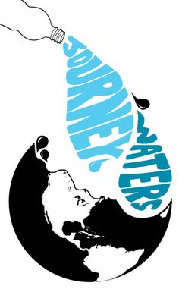
The future steps
Here on our campus, we want to encourage a change in water use habits and having more Water Bottle-Fill stations will allow for a more natural change so each year we should push for the addition of these stations in buildings/locations on campus.
Potential change here at LU- These Water Bottle-Fill stations on campus encourage students and faculty to have more sustainable and healthy water use habits by promoting the use of refillable water bottles over buying cases of plastic water bottles or single-use plastic bottle products. Longwood even encourages departments to fundraise for their own Water Bottle-Fill Station.
We want the students to know that the spread of the water bottle fill stations is in their hands and if they really want a change they must push and educate their peers on it

Slide 8
The Summary
Water sustainability and water use habits extend far beyond the implications that bottle-fill stations have, but overall, we've learned, and informed others, about these stations' outstanding benefits and rippling effects towards personal and collective water usage. Through researching online about general studies, national campaigns, and other universities' initiatives we've built an understanding of why bottle-fill stations are preferable over water fountains and most importantly the impacts that they bring. Along with an interview with Ben Meyers on campus we were able to relate our research to a local level, as well as receive valuable data and insight from an official. From our interview that supported by our research, we have been able to finalize and realize the future steps and potential that bottle-fill stations have on our campus. First students and faculty should be better engaged and informed to then raise a voice for having additional stations each year, in the most useful and high traffic areas.

Slide 9
Work Citied
https://today.duke.edu/2015/10/hydrationstations
Ben Meyers the Facilities Operation Director and the Facilities Management Department
https://www.google.com/search?q=clip+art+about+saving+water+on+earth&rlz=1C1DLBX_enUS815US815&source=lnms&tbm=isch&sa=X&ved=0ahUKEwjpud6mloXfAhXP1VkKHZToBtcQ_AUIDigB&biw=1366&bih=657#imgrc=QEYiUu1kcC3-XM:

