Slide 1
Global Warming and its Possible Effects on Cloud Formation
By Adam Gyori

Slide 2
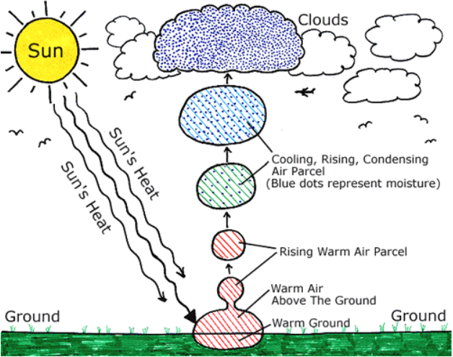
Background Information
Cloud formation
Warm air rises
Cools in the atmosphere
Clouds form
Notes:
North Carolina Climate Office. “Cloud Formation”. https://climate.ncsu.edu/edu/CloudFormation

Slide 3
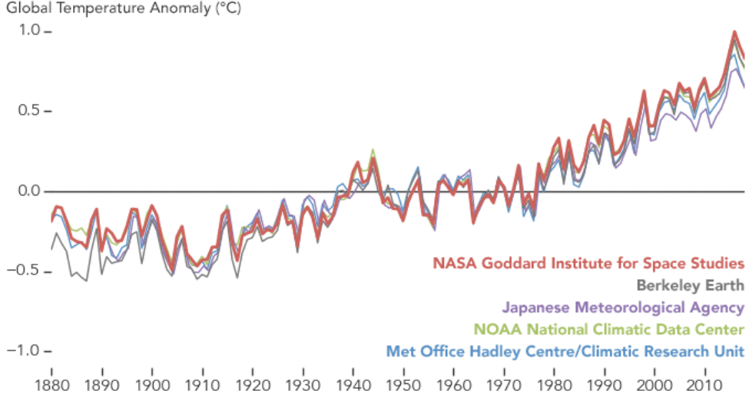
Global Warming
Average temperatures per year shown to be consistently increasing from 1880-2018
Caused by the increase in the amount of greenhouse gases being put into the atmosphere.
Gases include: Carbon Dioxide, Water Vapor, Methane, Nitrous Oxide, and Chlorofluorocarbons.
Notes:
NASA. “2018 fourth warmest year in continued warming trend, according to NASA, NOAA”. Feb. 2019. https://climate.nasa.gov/news/2841/2018-fourth-warmest-year-in-continued-warming-trend-according-to-nasa-noaa/
NASA. “The Causes of Climate Change”. 2018. https://climate.nasa.gov/causes/

Slide 4
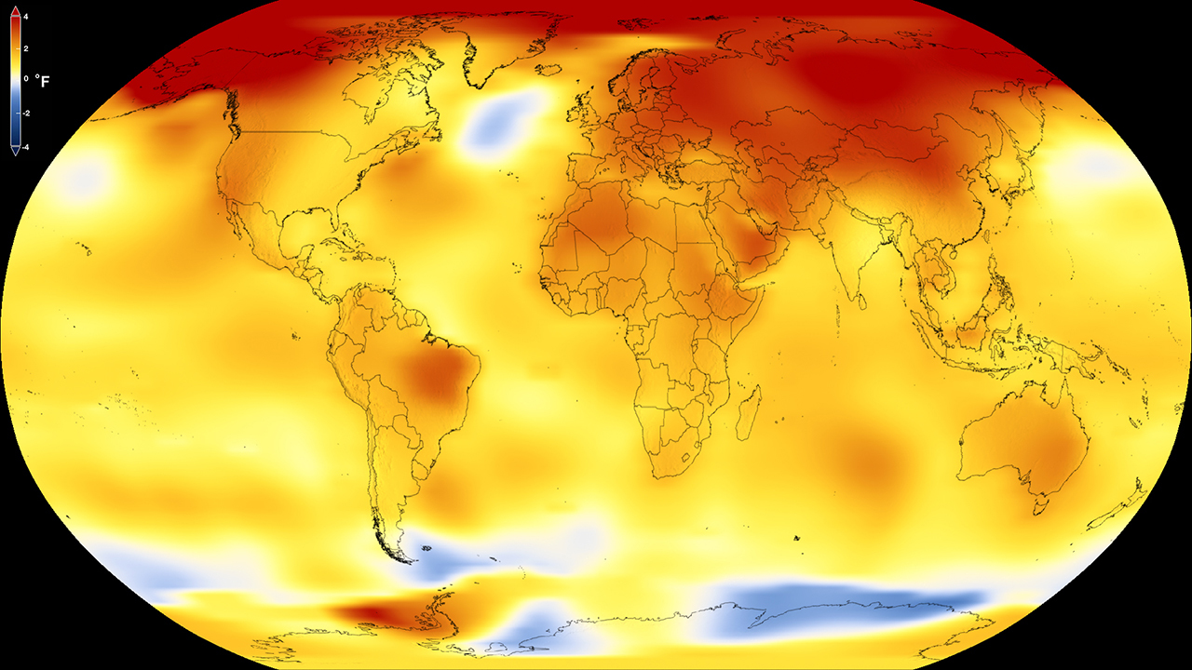
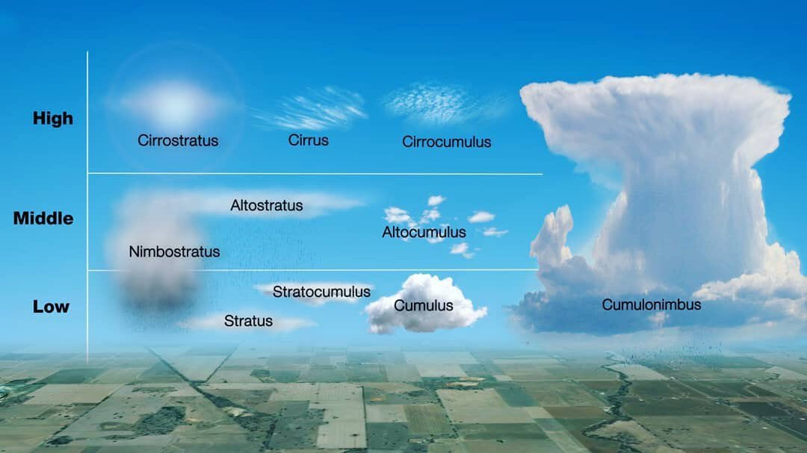
Synthesis
Cloud Formation is Being Affected due to Increased Evaporation Rates and Increased Temperatures.

Slide 5
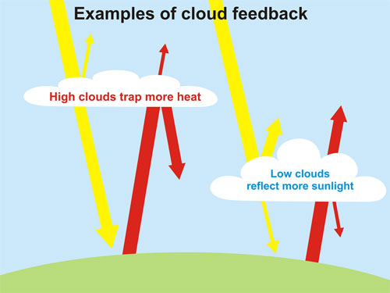
Why Should we Care About This?
We don’t know how clouds are reacting to
Global warming
Clouds provide a feedback loop that’s both
beneficial and harmful
Notes:
Ceppi, Paulo. et. al. “Cloud feedback mechanisms and their representation in global climate models“. 2017.

Slide 6
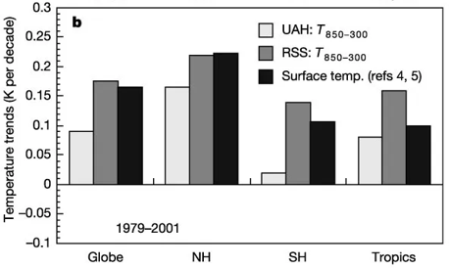
Tropospheric Temperature
Tropospheric temperature varies from the surface temperature
Notes:
Fu, Qiang. et. al. “Contribution of stratospheric cooling to satellite-inferred tropospheric temperature trends”. Nature. pp 55-58. May. 2004. https://www.nature.com/articles/nature02524#citeas

Slide 7
Evaporation with Global Warming
Global warming does increase evaporation
Notes:
Climate Central. “Warmer Air Means More Evaporation and Precipitation”. Sept. 2017. https://www.climatecentral.org/gallery/graphics/warmer-air-means-more-evaporation-and-precipitation

Slide 8
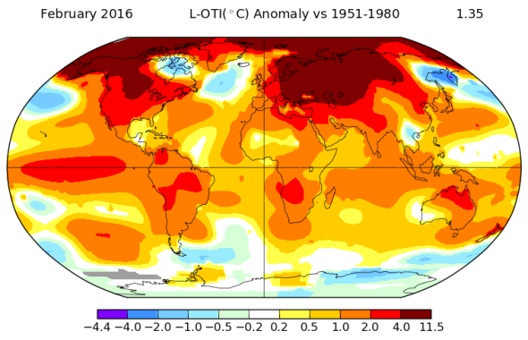
Conclusion
Is Global Warming affecting Cloud formation?
Notes:
Leminic, Michael. “The Effect of Clouds on Climate: A Key Mystery for Researchers”. Yale Environment. Aug. 2010. https://e360.yale.edu/features/the_effect_of_clouds_on_climate_a_key_mystery_for_researchers

