Slide 1
Animal Testing
Sandra Gillum

Slide 2
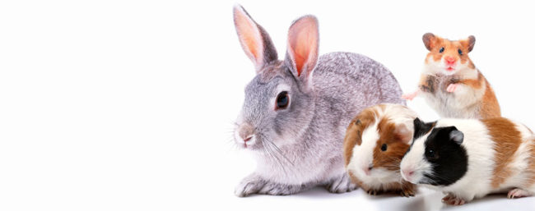
Who has had a pet rabbit, guinea pig, mouse, or rat?
Notes:
I ask that you think about them throughout this presentation

Slide 3
The problem
Animals are being tested on to determine the safety of new ingredients in cosmetics and is both unnecessary and inaccurate.
Results from animal tests vary and are therefore are unreliable and ineffective

Slide 4
The background
These animals are put through eye irritation tests
Force-feedings lasting weeks-months
And lethal dose tests
Notes:
Laboratory-bred rats and mice are not included in official statistics and have no protection from Animal Welfare Act.

Slide 5
Where it occurs
Animal testing is not legally required for cosmetics sold in the United States
Notes:
The European Union has banned animal testing in the year 2013 and since then India, Israel, Norway, and Switzerland

Slide 6
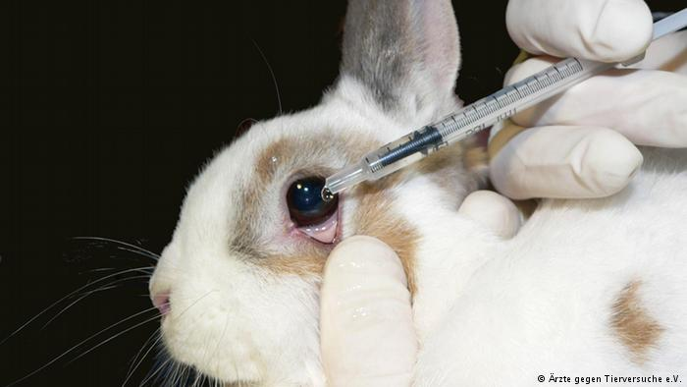
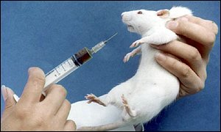
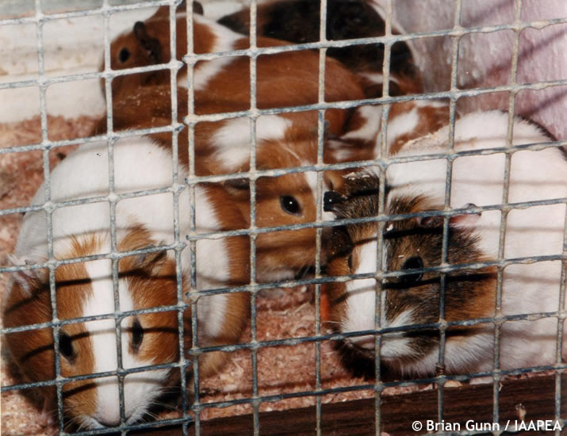
For whom it is a problem
Mice, Rats, rabbits, guinea pigs and people

Slide 7
Why is it a problem (its significance)
At the end of experiments animals are killed normally by asphyxiation, neck-breaking, or decapitation. With no pain relief

Slide 8
solution
Legislative and policy initiatives such as “The Humane Cosmetics Act” if enacted would put the ban on animal testing in cosmetics
Shop for cruelty- free cosmetics
Human cell-based tests and sophisticated computer models (hours or days) instead of (weeks or months)
Notes:
There are nearly 50 non-animal tests that have been validated for use with more in development
(efficient and cost-effective)
-Lush, The Body Shop, Tarte, Pacifica

Slide 9
Cites
“Cosmetics Testing FAQ.” The Humane Society of the United States, 2019, www.humanesociety.org/resources/cosmetics-testing-faq#products.
“Animal Testing 101” “People for the Ethical Treatment of Animals”. PETA, https://www.peta.org/issues/animals-used-for-experimentation/animal-testing-101/

