Slide 1
Positive Relationships
Rose Gerena
Comm-101-04

Slide 2
Key to Success
Research suggests that long term romantic partnerships display a particular ratio of five positive interactions for every one negative interaction.
Negative moments are more impactful and memorable so we need many positive moments to counteract them.
Making positive relationship deposits a regular habit strengthens relationships and will boost overall positive emotions.

Slide 3
Relationships = Bank Accounts
Everyday we make deposits and withdrawals
with each person in our lives.
Just like with banking, in order to keep an
overall positive balance,
we must make regular deposits.

Slide 4
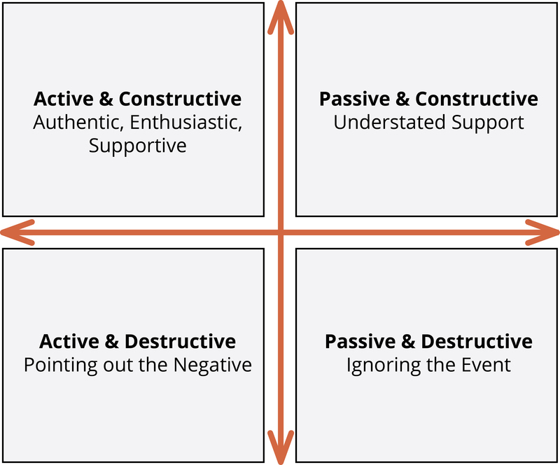
Ways to Deposit
Capitalization
Active-Constructive Responding
Gratitude
Forgiveness
Quality Time

Slide 5
Benefits
Being pleasant and making deposits can change the nature of conflict.
Builds intimacy, commitment, and other positive emotions.
You will enjoy each other’s company more and be better equipped to endure inevitable, occasional conflicts.

Slide 6
References
Lambert, N. M. (2019). Positive relationships. In R. Biswas-Diener & E. Diener (Eds), Noba textbook series: Psychology. Champaign, IL: DEF publishers. Retrieved from http://noba.to/z7bf68n5
Covey, S. R. (1989). The seven habits of highly effective people. New York, NY: Simon and Schuster.
Baumeister, R. F., Bratslavsky, E., Finkenauer, C., & Vohs, K. D. (2001). Bad is stronger than good. Review of General Psychology, 5, 323-370.

