Slide 1
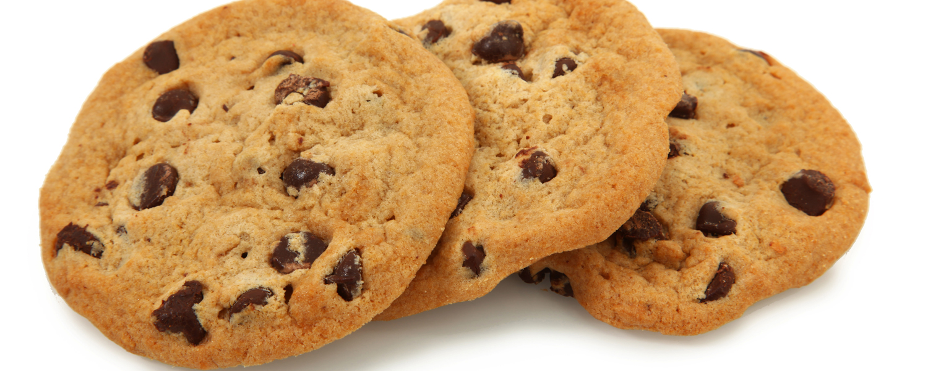
Mindless Eating Mini Experiment
By: Kendra Fetty
This Photo by Unknown Author is licensed under CC BY-SA-NC

Slide 2
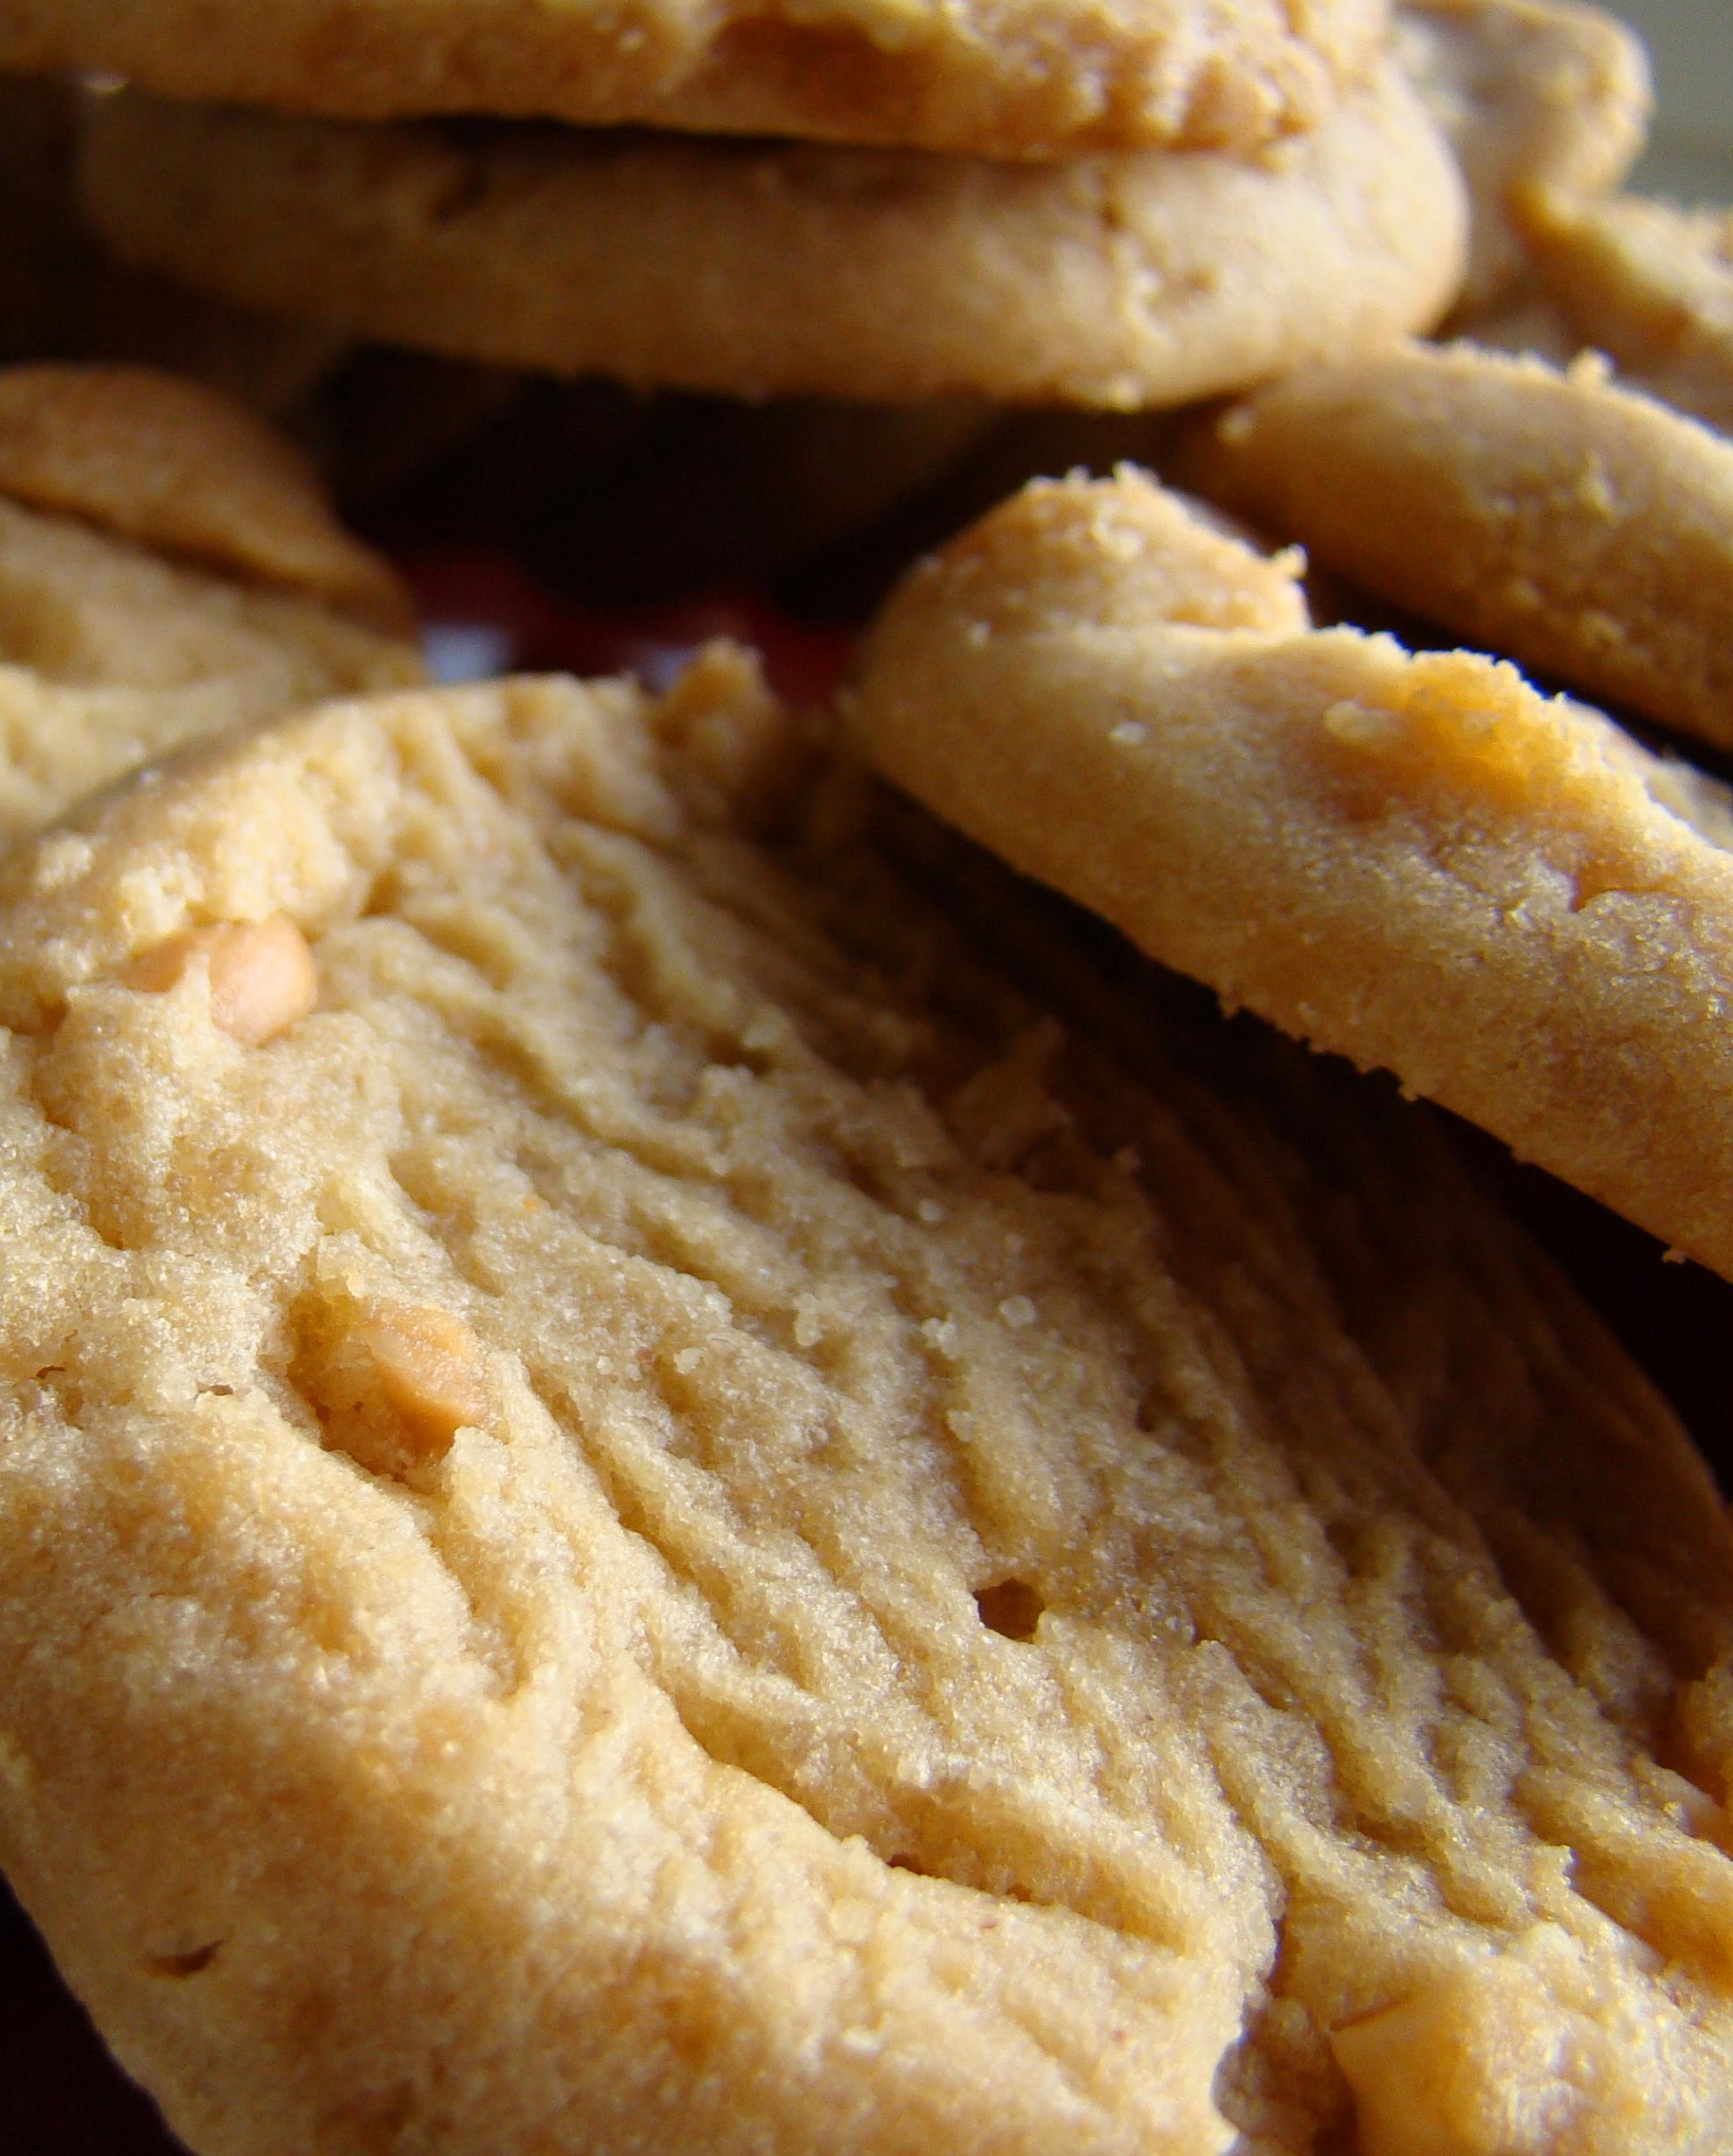
1. Describe the topic and methods of the mini research study.
I chose the topic of whether people make decisions on what food to eat based upon whether or not it has low-fat in the name/description of the food.
I did a survey mini experiment at Longwood University with the first five students I encountered.
I asked each person to choose a cookie they would eat from a list of five different cookie recipes. I did not show the calorie count or any other information about the cookies. Only the names of the cookies were shown to the students.
After they made their decision I recorded their answer on a piece of paper.
This Photo by Unknown Author is licensed under CC BY-SA

Slide 3
2. Why is researching this particular topic and research relevant to the general population?
I think this topic is relevant today as many try to eat healthier and choose foods that are better for their body; however, they do not always make informed decisions. Just because a food has the words “low fat” in the description/title does not mean it is any healthier than a food lacking those words. I think it is important for people to realize that low fat does not mean the same as low calorie as there are many factors to be accounted for in choosing food.

Slide 4
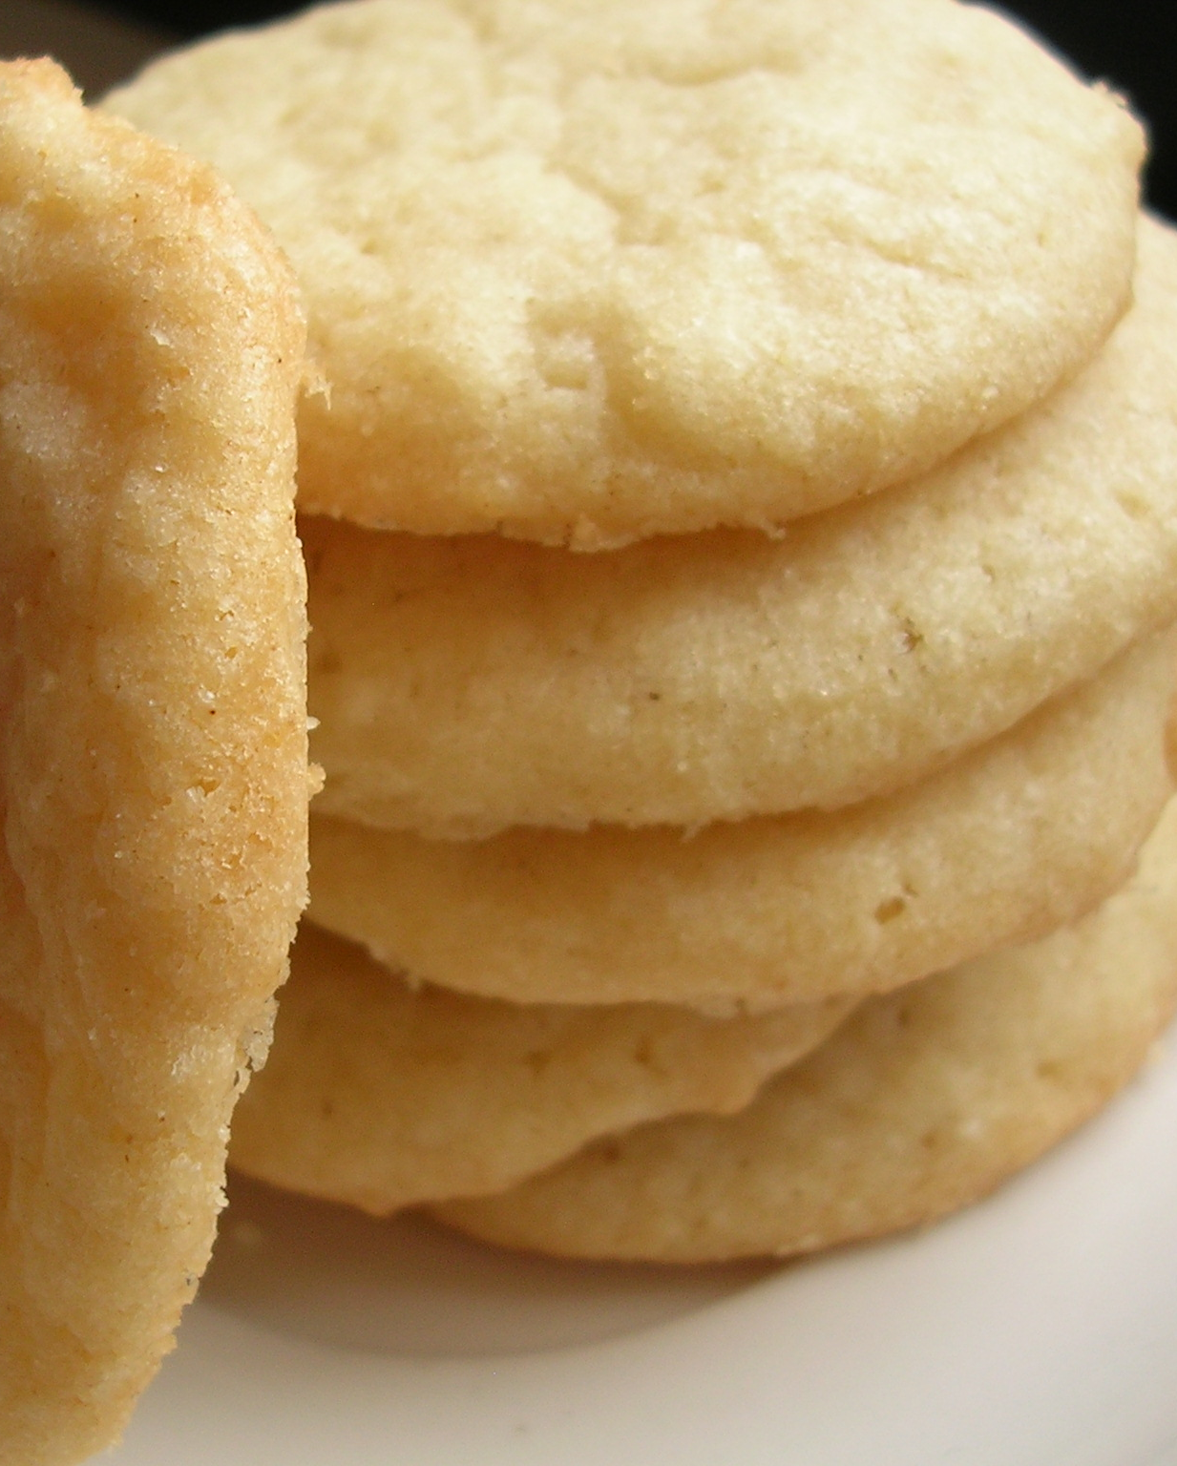
3. Who was studied?
Subject #1: Male student
Subject #2: Female student
Subject #3: Female student
Subject #4: Female student
Subject #5: Male student
All were college students ranging from 19-21 in age.
This Photo by Unknown Author is licensed under CC BY-SA-NC

Slide 5
4. What was the hypothesis?
If students are given a cookie option with the words “low fat” in the title, then they will choose that cookie over the others as it contains the words “low fat.”

Slide 6
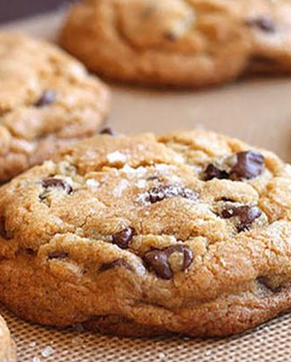
5. State the study’s methods.
First, I approached the first five college students I encountered to participate in my experiment and made sure they were okay with me using them for the experiment.
Second, I told them to choose one cookie from the list that they would like and I made sure to choose my words carefully so I did not influence their answer.
The list of cookies was as follows:
Low Fat Double Chocolate Chip Cookies (51 calories) http://www.kitchme.com/recipes/low-fat-double-chocolate-chip-cookies-weight-watchers
Cream Cheese Sugar Cookies (53 calories) http://www.kitchme.com/recipes/cream-cheese-sugar-cookies
Low Fat Peanut Butter Cookies (66 calories) https://www.tasteofhome.com/recipes/low-fat-peanut-butter-cookies/
Chocolate Lava Cookies (60 calories) https://recipes.sparkpeople.com/recipe-detail.asp?recipe=194666
Chocolate Chip Cream Cheese Cookies (40 calories) https://chocolatecoveredkatie.com/2015/02/10/chocolate-chip-cream-cheese-cookies/
Third, I recorded their answer and gender before going to the next student.
This Photo by Unknown Author is licensed under CC BY

Slide 7
6a. What were the findings of the research?
Subject #1: Male student: Chocolate Lava Cookies
1
Subject #2: Female student: Low Fat Double Chocolate Chip Cookies
2
Subject #3: Female student: Cream Cheese Sugar Cookies
3
Subject #4: Female student: Chocolate Lava Cookies
4
Subject #5: Male student: Low Fat Peanut Butter Cookies
5

Slide 8
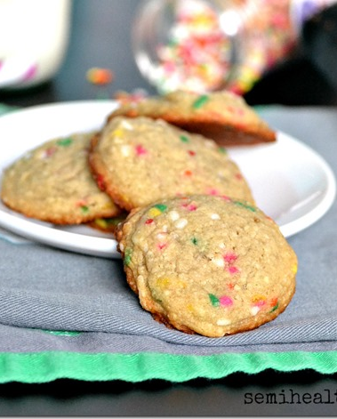
6b. Were the results similar throughout the subjects tested?
Results were similar as most chose a cookie that did not have “low fat” in the title. I think they were similar based upon the fact that they each chose a cookie they said they liked, so rather than looking at whether it was low fat or not they chose based upon which cookie they liked.
This Photo by Unknown Author is licensed under CC BY-NC-ND

Slide 9
6c. Did the findings match the hypothesis?
I found that most people did not choose based upon whether the name of the cookie had the words “low fat” in their title. These findings disprove my hypothesis as I thought most of the students would choose the low fat option thinking it would have the least calories.
I could have gotten these results based upon a variety of factors, like personal preference, whether they had just eaten, time of day, or a number of other influences.

Slide 10
6d. What observations can you make regarding the results and the Longwood University population?
I can say based on the findings of my experiment that most students choose what they eat based upon whether or not they like the food, not whether it says low fat or other dietary words.

Slide 11
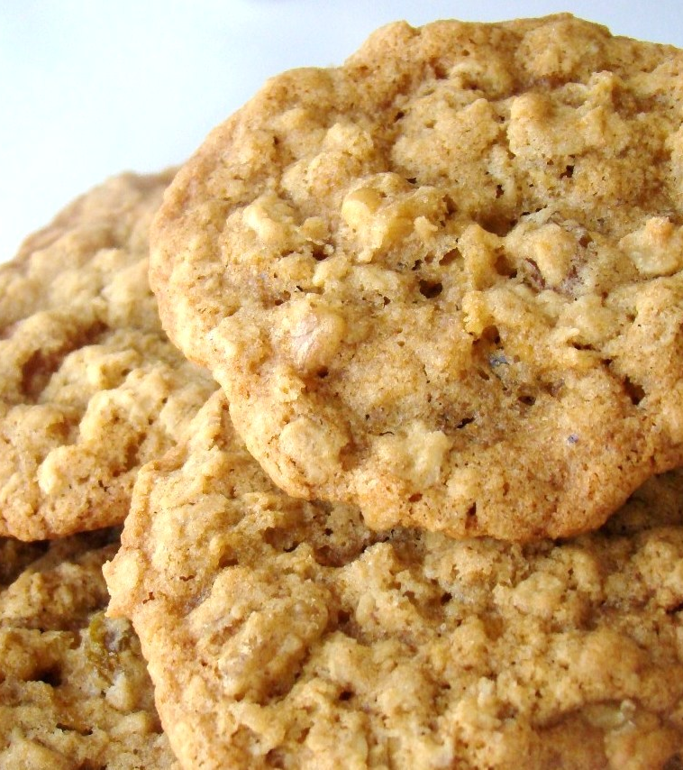
6e. How can these results help to change “Mindless Eating?”
These results show that students choose food based upon their preference rather than the words that are contained within a food’s title.
This distinction students make can be good as they are eating what they like, but it can be bad as people should not rely solely on their instinct as to what they should eat as they might end up eating more than they should/intake more calories than they need.
These results can help show what students look for when choosing food and a major I found was rather than looking for dietary words, students look for familiarity of foods.
This Photo by Unknown Author is licensed under CC BY-NC-ND

