Slide 1
What is a Better Mental Boost than Caffeine?

Slide 2
Problems with Lack of Sleep

Slide 3
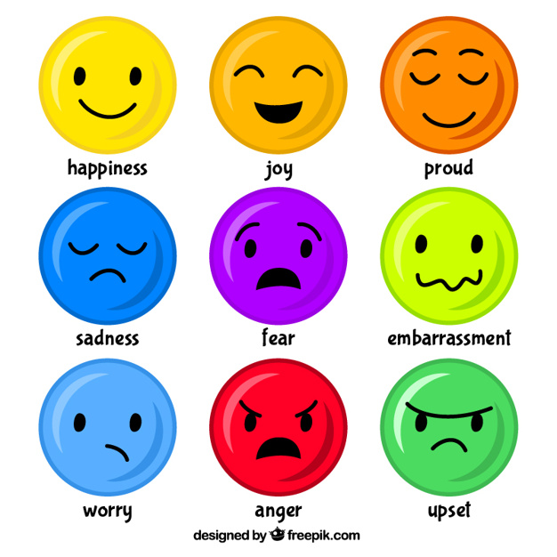
Problems with Lack of Sleep for College Students

Slide 4
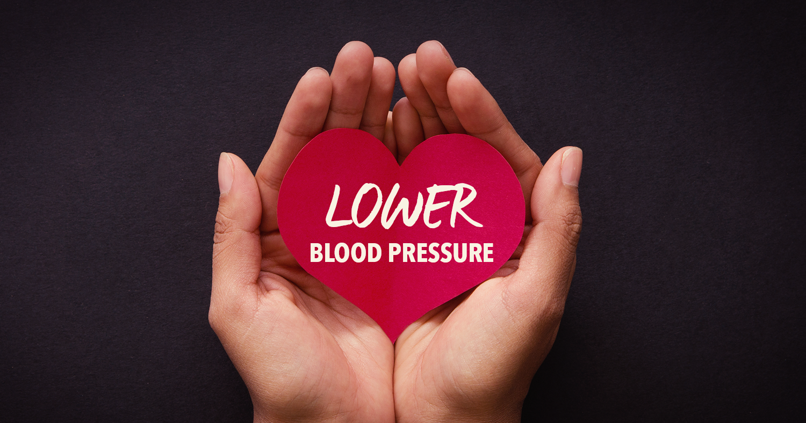
Benefits of Naps

