Slide 1
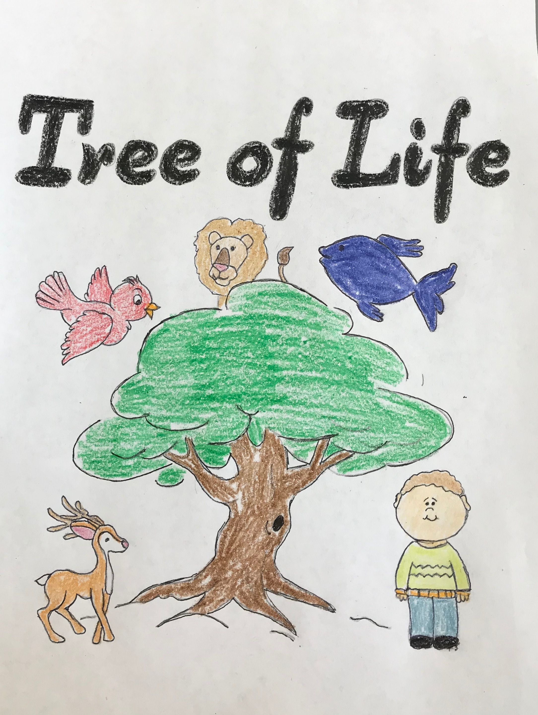
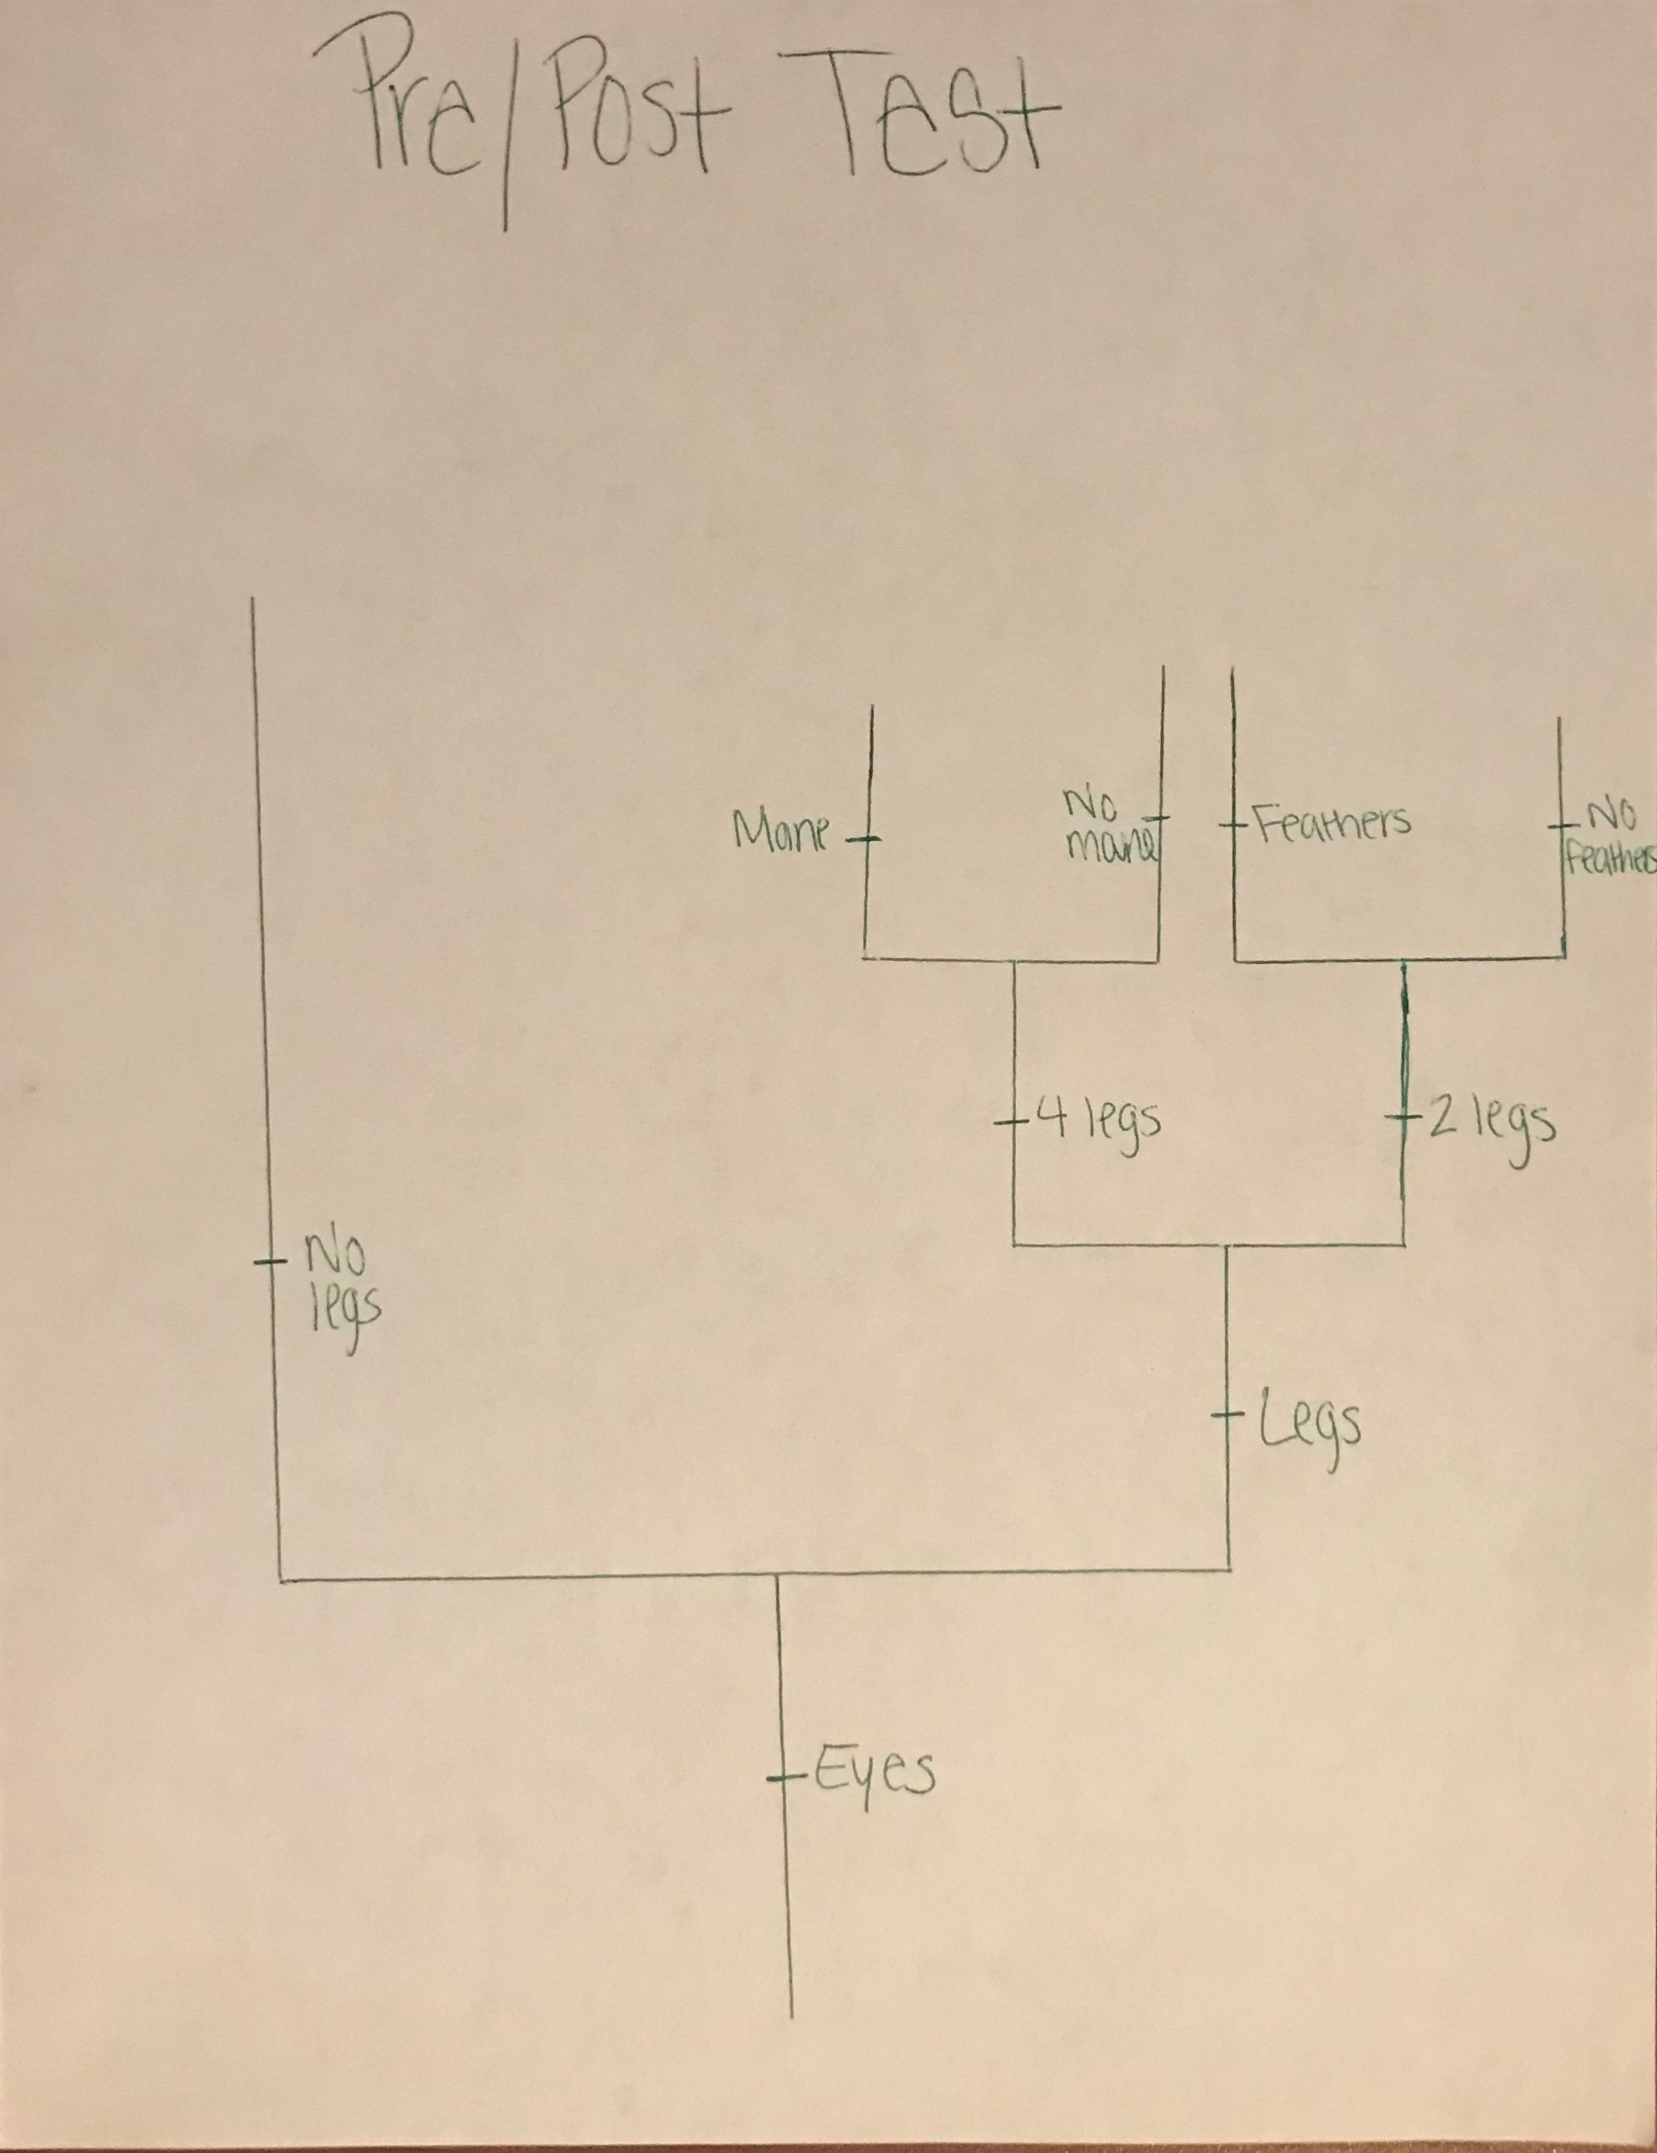
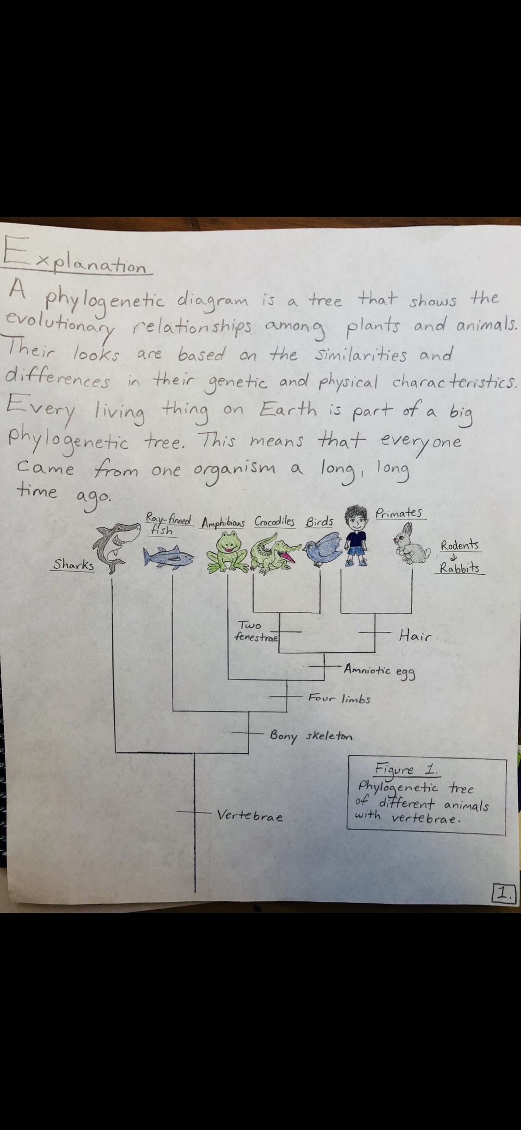
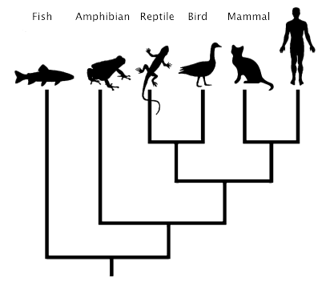
Tree of Life Cynthia Castillo, Rana Haboush, Sam Kane, Angelica Romero Department of Biological and Environmental Sciences Longwood University
Introduction
Methodology
Target Audience
4-5th Grade Elementary School Students
Why did we choose 4-5th grade?
They don’t have preconceived notions, thus they are more easily accepting of new ideas and willing to learn.
If we start with this small easy to understand concept the children will be more willing to accept evolution as a whole.
If evolution is taught at an early age with age appropriate examples then it will be less likely for students to reach high school with misconceptions
Evolution isn't taught until upper elementary.
Lesson:
Children’s Book
Why did we choose a children's Book?
A book is easy to follow along with.
If a child wants to come back and refresh themselves on the topic they can.
If everyone has a book in front of them, they are more likely to pay attention to the lesson.
Pre/Post-Test:
Show toys based off of the book with morphological features
Have kids group animals on morphological features, then try and create a phylogenetic tree.
Specific Aim
Goals of our project
Teaching the kids to successfully build a phylogenetic tree based on morphological factors.
Why?
We believe phylogenetic trees are one of the easier concepts of evolution to grasp.
Phylogenetic trees are one of the least controversial concepts of evolution, due to being able to see traits on animals and understand that these animals are obviously related. People like to have evidence that they can see and not just trust in an idea.
Potential Pitfalls
We are only giving a visual presentation on how to make a phylogenetic tree, but not really explaining how animals have evolved morphological traits.
Parents could disapprove of this project due to different views, such as religious beliefs.
Future Direction
After teaching children about phylogenetic trees, we could begin teaching them how features evolved on animals, leading into adaptation and natural selection
We could do a hands on activity to engage children in learning about Evolution.
Ex.
Figure 1. Sample Phylogenetic Tree.

