Slide 1
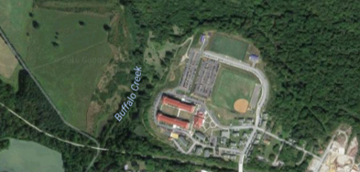
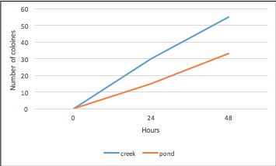
Microbial Diversity between a creek and a pond
Samuel Kane
Longwood University
Microbial Diversity between Buffalo Creek and a Retention Pond
Renee Fargo and Samuel Kane
Biology and Environmental Science, Longwood University
Background
Results
Lancer Park - Environmental Education Center
Buffalo Creek
Retention Pond
Microbes account for most of the diversity of life on our planet. adapted to nearly every environment on earth. Ponds have a wide variety of microbial life. Average of 184.5 different types of microbes.
Retention Pond had more colorful bacteria colonies
Retention Pond had less colonies than Buffalo Creek
Objectives
Compare the pond and creek’s microbial concentration
We hypothesized that the retention pond would have more bacteria than Buffalo Creek
Ultimately test for the type of bacteria found within Buffalo Creek and the retention pond
Figure 1. Abundance of Color in Bacterial Colonies. The outside represents the pond and show 0% purple, 7% orange, 36% yellow and 57% white. The inside represents the creek and shows 0% purple, 0% orange, 18% yellow, and 57% white. Each color may display a different type or strain of bacteria within the lake.
Methods
Collection of Samples
Genomic DNA Isolation and PCR for 16s rRNA
Electrophoresis
DNA
Sequencing
BLAST Analysis
DNA Culturing
Figure 2. Number of colonies over time. The blue line represents the creek the orange represents the pond. At 24 hours the number of colonies the creek had was 30 colonies. The number of colonies in the pond was 15. At 48 hours the number in the creek increased to 55 colonies and in the pond increased to 33 colonies.
.
Name | Identity | Gap
Aquasprilillum articum | 97%(420/432) | 0/432
Janthinobacterium | 97% (420/432) | 0/432
Janthinobacterium sp. clone A315 | 97% (419/430) | 0/430
Janthinobacterium sp. LM6 | 97%(419/432) | (0/432
Janthinobacterium sp. LM6 | 97% (418/432 ) | 0/432
Conclusions
Hypothesis was disproven
Greater abundance of bacteria within the creek than the pond
Bacteria sample tested most related to Aqua spirillum
Li, X., Guo, J., Dai, S., Ouyang, Y., Wu, H., Sun, W., Wang, G. (2009). Exploring and exploiting microbial diversity through metagenomics for natural product drug discovery. Current Topics in Medicinal Chemistry, 9(16), 1525-1535. Review.
Burnett,
Celesty. Where Do Microbes Live? Summer 2005. 25 August 2008.
<http://www.mercer.edu/camps/message/summer2000/summer2000-microbes.htm>.
References
Table 1. Potential Identifications of our Bacteria. Top 5 hits of BLAST
Aquasprillium was our top hit. Other bacteria were a close match.

