Slide 1
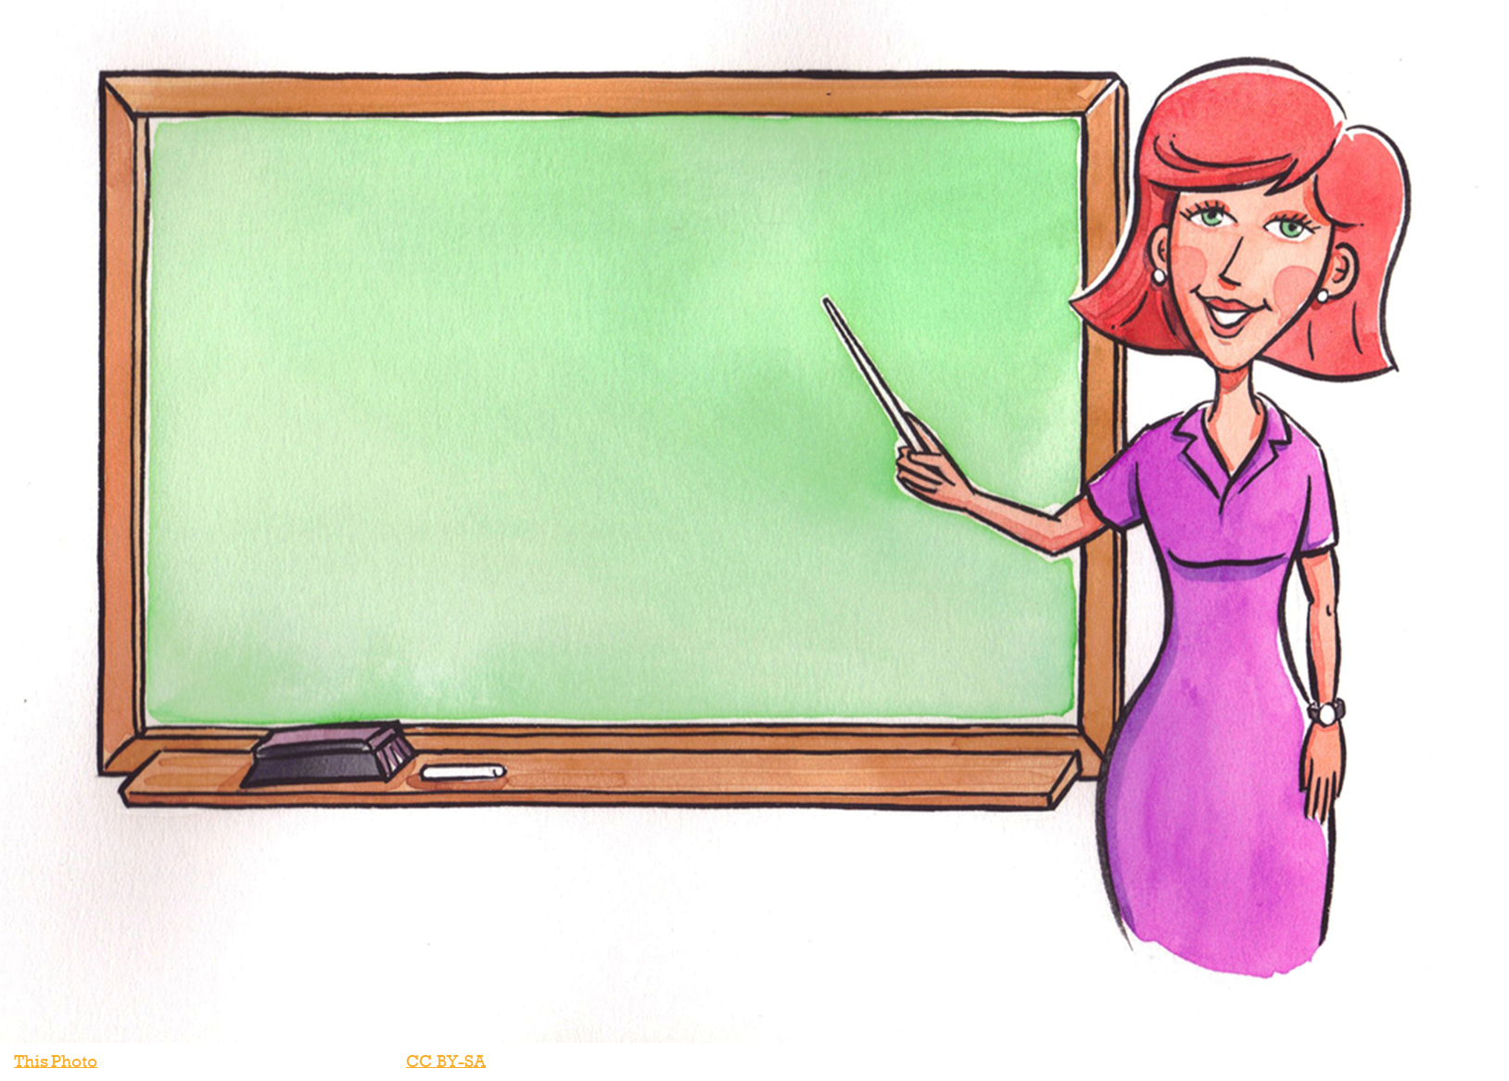
My Teaching Philosophy
By Abby Souder

Slide 2
A Little About me
Elementary and Middle School license with English Concentration
Children’s Literature Minor
Kappa Delta Pi (teaching honor society) member
Director of Jobs for Big Event
This Photo by Unknown Author is licensed under CC BY-SA

Slide 3
Why I chose to be a teacher?
I believe it’s a teachers job to inspire and guide students to be the best they can be in life. My teachers did that for me growing up, so I want to inspire children and help them through life.
I want to children to become excited to learn and be in school, to reach for their dreams and always have a passion for knowledge.

Slide 4
What is a teaching philosophy?
A teaching philosophy defines a teacher persons beliefs and ideas about the role of education and a teacher in a students life
Philosophy is important to teachers because it helps them understand everything that influences schools and grow more professionally as an educator.
Teachers need to always be think about what is best for their students and how they can benefit them.

Slide 5
My Teaching statement
I believe teachers need to do what benefits their students individually and not what is best for the school board. Learning occurs best when students feel comfortable with their teacher and feel they can express themselves freely. I would take a existentialist and progressivist approach by allowing students to make their own individual choices and focus on students more so than the subject. The goals I have for my future students are a passion for learning, engage with their peers, and strive to be their best.

Slide 6
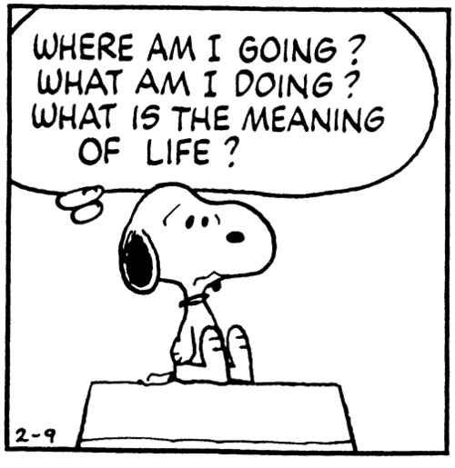
Educational Philosophies
Existentialism- education should be focused on individual choice and enriching students lives. It wants to take away from the importance of rational theories, history and social institutions.
Progressivism – education should be more about the student and less on the subject material or the teacher

Slide 7
Examples of existentialism in the classroom
Having more project-based learning which allows students to express them creatively and draw from their own experiences to make the project.
Children are often forced to believe that college is the only option after graduation and is unachievable for most students. However, as teachers we need to respect their individual choices and help them in whatever they decide.

Slide 8
Examples of progressivism in the classroom
Dividing the room in activities centers caters to students individual needs as some students are interested in different subjects and like working in different settings.
For students who may have behavior issues and can’t sit still or have trouble focusing, create an environment just for them. Such as creating corner for them to work in or give them a different chair like a yoga ball or moveable chair.

Slide 9
Importance of Diversity
Having a diverse classroom means there are multiple learning styles and a representation of all types of students and area.
Its important to have a diverse classroom because it allows students to experience different cultures and lifestyles, as well as for teachers. Because society is so diverse, teachers need to make sure students are treated equally and are given the same access to knowledge as other students.
Applying a progressivist approach means allowing students to express their culture or lifestyle in their schoolwork.
Applying a existentialist approach means students should draw from their own experiences to connect with the lesson.

Slide 10
Importance of Technology in classroom
In todays time, technology is becoming a more prominent feature in society and are slowly working their way into the classrooms.
It benefits the students by appealing to different learning styles, makes students become familiar with technology they might use in the future, and guides more critical thinking.
Students are prepared for the future, as many careers will be more technology based, opening the job market.
Using a progressivism philosophy would be making sure all students have the access or materials to use the technology.
Using a existentialism approach would be allowing students to express themselves freely by creating discussion boards or make research projects to think more critically.

Slide 11
Thank you for your listening!
Work Cited
Parkay, F. W. (2014). Becoming a teacher. (10th ed.). Boston: Pearson.
http://clipartix.com/school-clipart-image-50393/
https://www.pinterest.com/BelleReveur/existentialism/
https://www.emaze.com/@AIFRZTIQ

