Slide 1
LANGUAGE DEVELOPMENT
Pronunciation:
Phonemes: units of sound (j, v, th, zh come later)
Decoding sentences is difficult when the meaning depends on intonation: tone of voice
EX: “George gave a book to David, and he gave one to Bill” then “George gave a book to David and David gave a different book to Bill” BUT IF “George gave a book to David, and he gave one to Bill” then “George gave a book to David and George also gave a book to Bill”
Grammar:
Passive voice
EX: “The dog was walked by John”
Conditional sentences
EX: “If Sarah will set the table, I will wash the dishes”
Syntax: the rules that indicate how words and phrases can be combined to form sentences
Vocabulary:
Average 6 year old has a vocabulary of 8,000-14,000 words
Grows by another 5,000 words between the age of 9-11
Conversational skills:
Pragmatics: the rules governing the use of language to communicate in a social setting
Metalinguistic awareness: an understanding of one’s own use of language
Growing sophistication of their language help middle childhood children control their behavior
The Marshmallow Experiment Watch me!

Slide 2
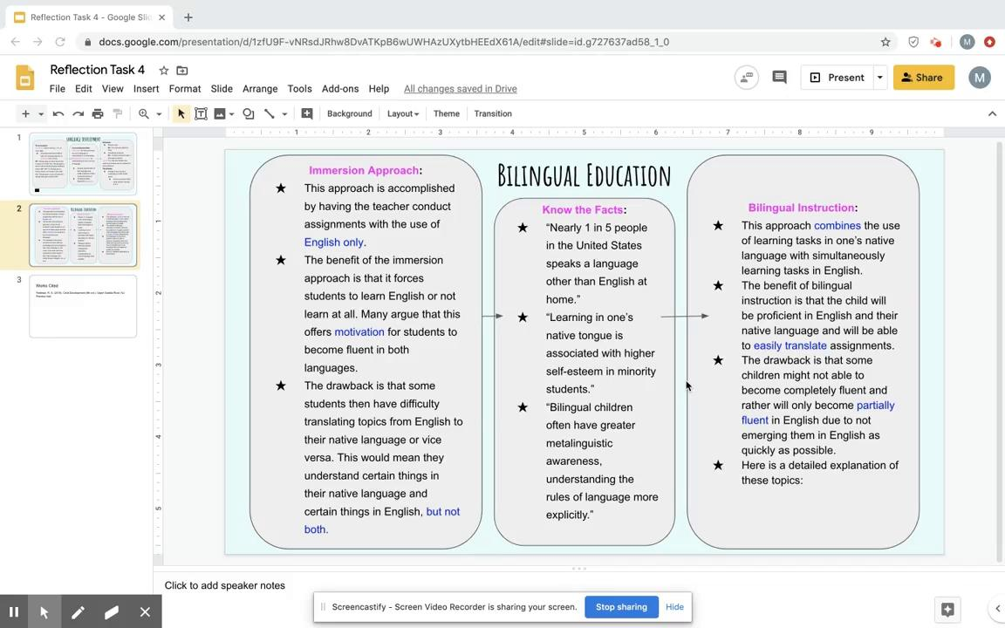
Bilingual Education
Immersion Approach:
This approach is accomplished by having the teacher conduct assignments with the use of English only.
The benefit of the immersion approach is that it forces students to learn English or not learn at all. Many argue that this offers motivation for students to become fluent in both languages.
The drawback is that some students then have difficulty translating topics from English to their native language or vice versa. This would mean they understand certain things in their native language and certain things in English, but not both.
Bilingual Instruction:
This approach combines the use of learning tasks in one’s native language with simultaneously learning tasks in English.
The benefit of bilingual instruction is that the child will be proficient in English and their native language and will be able to easily translate assignments.
The drawback is that some children might not able to become completely fluent and rather will only become partially fluent in English due to not emerging them in English as quickly as possible.
Here is a detailed explanation of these topics:
Know the Facts:
“Nearly 1 in 5 people in the United States speaks a language other than English at home.”
“Learning in one’s native tongue is associated with higher self-esteem in minority students.”
“Bilingual children often have greater metalinguistic awareness, understanding the rules of language more explicitly.”

Slide 3
Works Cited
Feldman, R. S. (2018). Child Development (8th ed.). Upper Saddle River, NJ: Prentice Hall.

