Slide 1
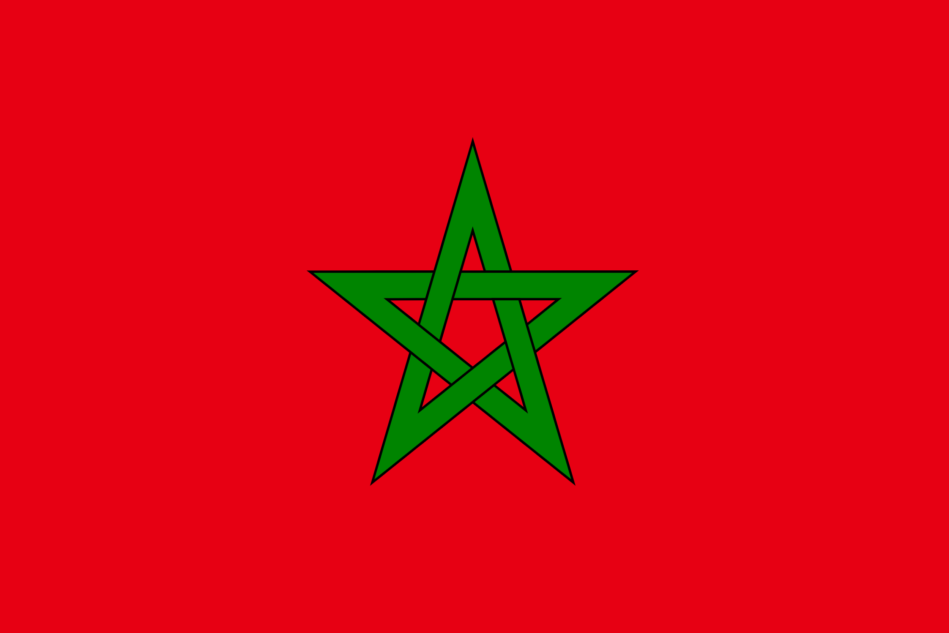
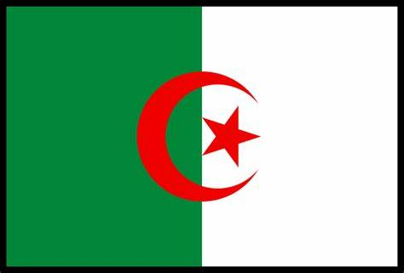
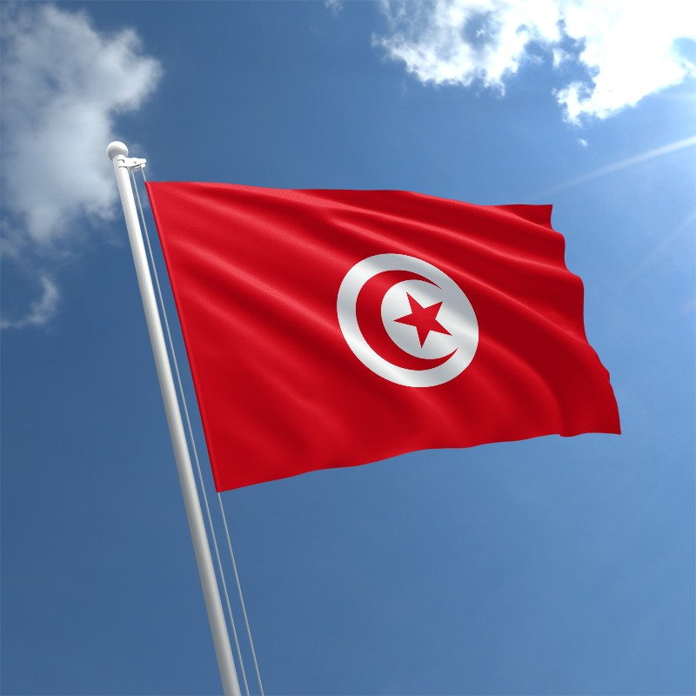
L’Algérie, Le Maroc,
La Tunisie
Marisa Raetano & Molly Desque

Slide 2
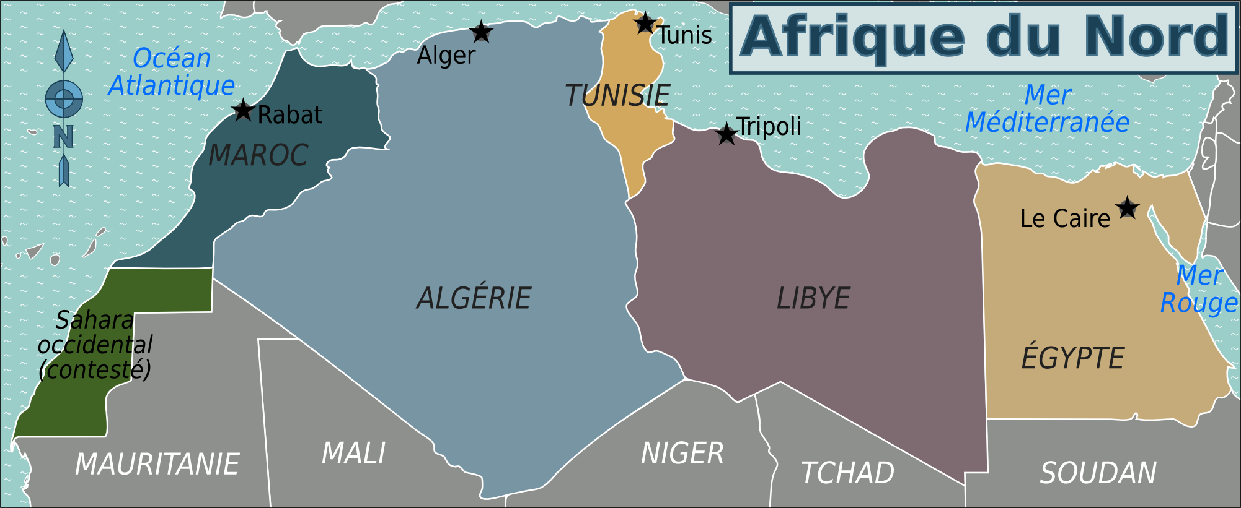

Slide 3
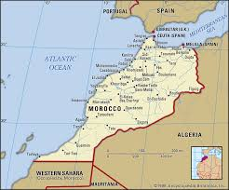
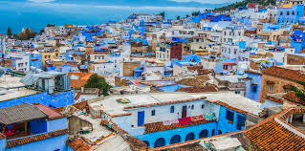
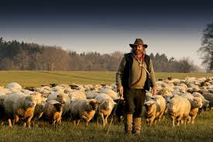
Le Maroc
A crossroad between Europe and Africa
Arabic and French are the official languages
Villages in the highland of Rif and Atlas practice transhumance
Transhumance - migrating with their flocks or herds

Slide 4
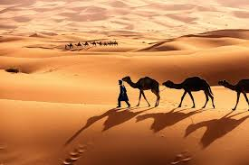
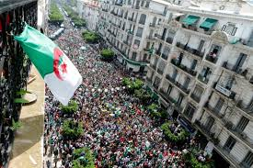
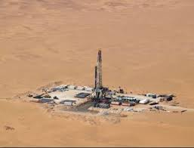
L'Algerie
Has the Sahara desert, where the Earth’s hottest surface temperatures have been recorded there.
A revolutionary war with France lead to their independence
Development of oil and natural gas (has many natural resources including petroleum)

Slide 5
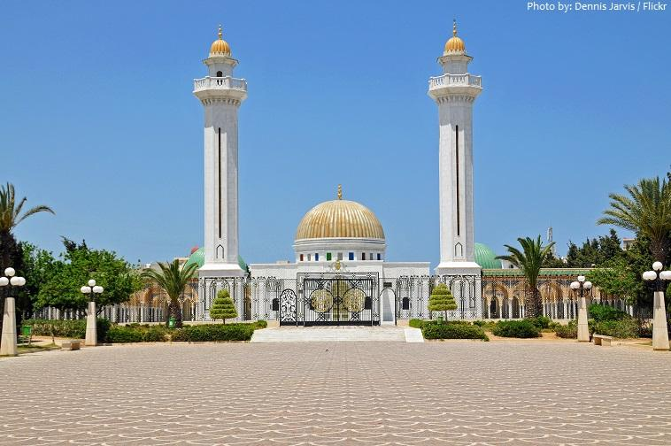
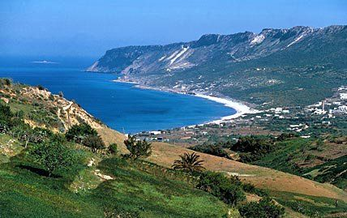
La Tunisie
Main language = Arabic
French influence due to colonization
French is widely used in the culture (News, Education, and Politics)
Located on the Mediterranean made it very susceptible to being conquered
Bardo National Museum

Slide 6
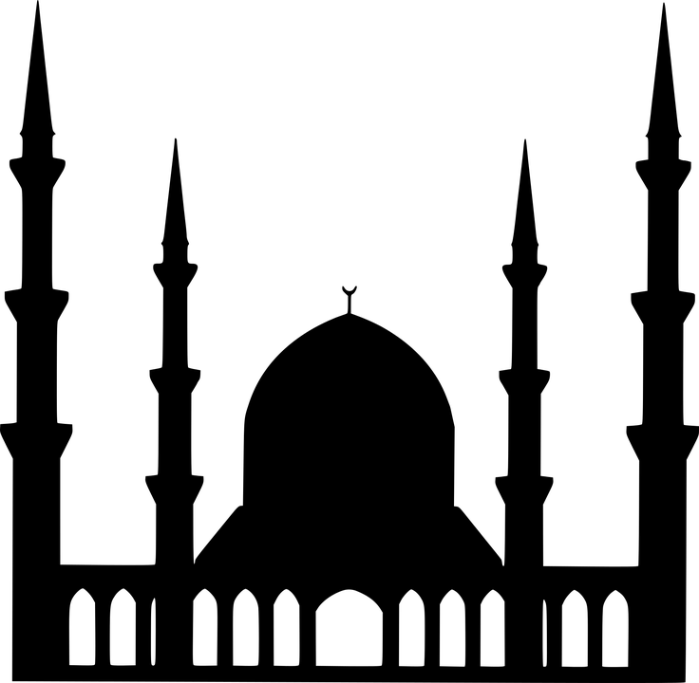
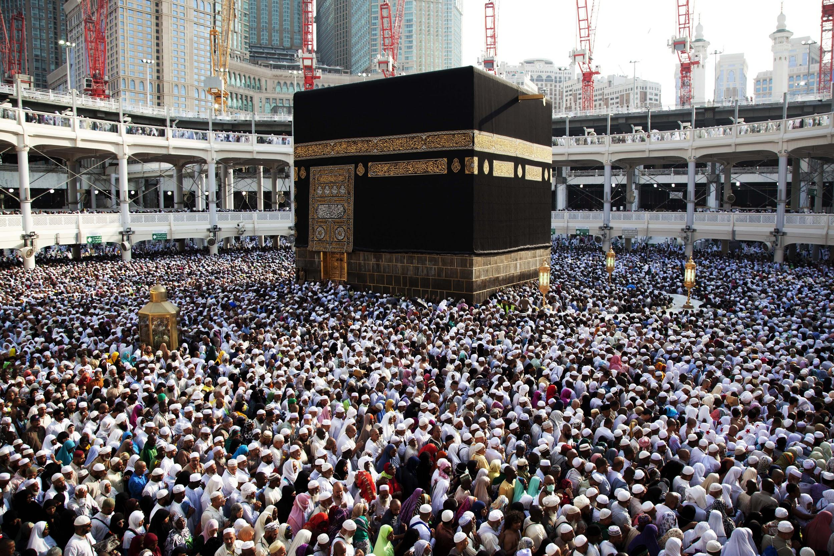
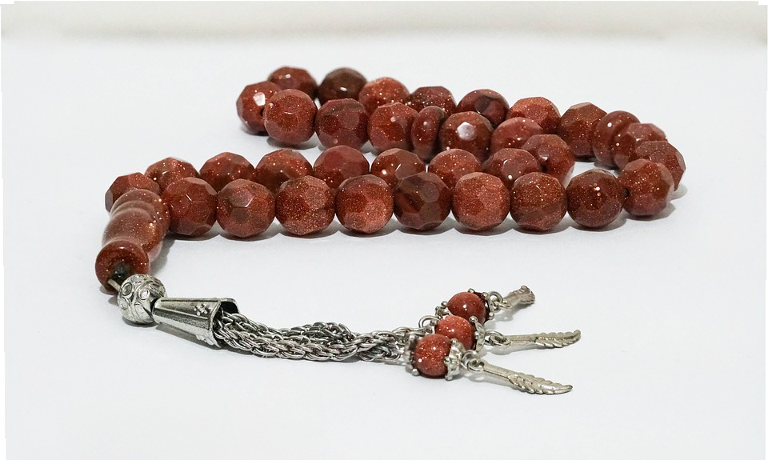
Islam k
The majority of people in all three countries practice the Islamic religion
Has five main pillars: to declares one’s faith, pray five times a day, to give to those in need, to fast during ramadan, and participate in a pilgrimage to Mecca
Different branches of Islam

Slide 7
Citations
Clark, J. I., & Murphy, E. (2019, July 25). Languages. Retrieved October 6, 2019, from https://www.britannica.com/place/Tunisia/Languages.
History.com Editors, H. E. (2018, January 5). Islam. Retrieved October 6, 2019, from https://www.history.com/topics/religion/islam.
Visitmorocco.com. (2019). Moroccan traditions and modernity | Moroccan National Tourist Office. [online] Available at: https://www.visitmorocco.com/en/morocco/modern-society [Accessed 6 Oct. 2019].
Morocco - Settlement patterns. (2019). In: Encyclopædia Britannica. [online] Available at: https://www.britannica.com/place/Morocco/Settlement-patterns [Accessed 6 Oct. 2019].
Algeria | Facts, History, & Geography. (2019). In: Encyclopædia Britannica. [online] Available at: https://www.britannica.com/place/Algeria [Accessed 6 Oct. 2019].

