Slide 1
Three Ages Project
By: Barbara Daniels

Slide 2
Tiffany Questions Overview
Cognitive
She enjoys verbal learning
Working in groups
Gets nervous before and during tests
Favorite part about school is hanging with friends

Slide 3
Carol Questions Overview
Cognitive
Learns better with verbal teaching
Gets a little nervous with tests
Likes to work by herself
Favorite part of school is when they go outside for P.E.

Slide 4
Seth Questions Overview
Cognitive
Learns better with hands on activities
Does not get nervous before tests
Enjoys group work, more brains and opinions
Favorite part of school is meeting new people

Slide 5
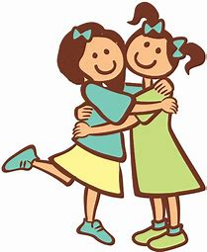
Tiffany Questions Overview
Social/Emotional
Enjoys making new friends
Social in the way she makes friends
Enjoys talking with friends but rather stay in the house when with her friends
Happy/Angry
Writing stories makes her happy, angry if she gets in fights with her friends

Slide 6
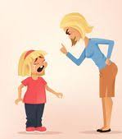
Carol Questions Overview
Social/Emotional
She enjoys making new friends
Goes up and says hi when making new friends
Enjoys playing freeze tag with friends
Happy/Angry
Hanging out with friends
Mom gets angry at her sister or herself

Slide 7
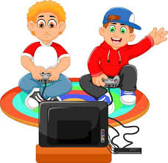
Seth Questions Overview
Social/Emotional
Stays with the same group of friends but enjoys meeting new people
Enjoys going outside with friends or playing video games
Happy/Angry
Hanging out with his friends
Ignorant people

Slide 8
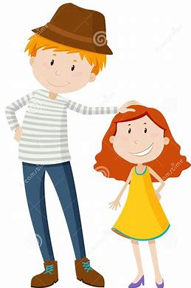
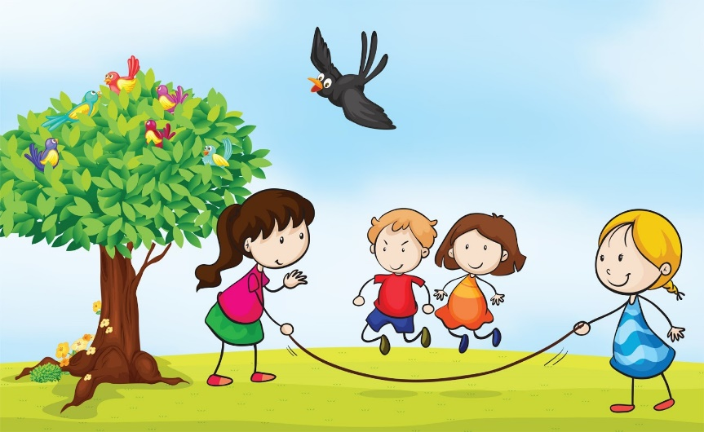
Tiffany Questions Overview
Physical
She enjoys playing outside but does not play any sports
Shorter than most of her friends
Bedtime is at eight

Slide 9
Carol Questions Overview
Physical
Enjoys being outside
Used to do gymnastics
Shorter than most of her friends
Goes to bed around eight

Slide 10
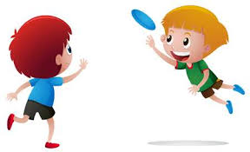
Seth Questions Overview
Physical
Rather be outside
Taller than most
Plays ultimate frisbee/baseball

Slide 11
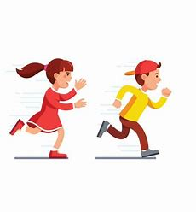
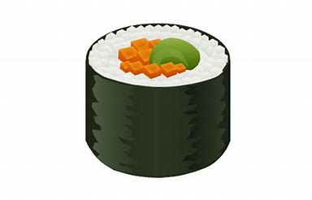
Tiffany Questions Overview
Interests
Wants to go to New York
Favorite food is Sushi
Enjoys playing freeze tag

Slide 12
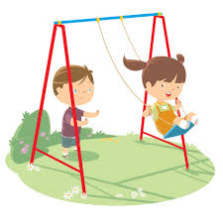
Carol Questions Overview
Interests
Wants to go to Florida
Favorite food is Panda Express
Favorite outdoor activity is playing on her swing set

Slide 13
Seth Questions Interview
Interests
Wants to go to Naples, Italy
Favorite food is mashed potato's and gravy
Favorite outside activity is ultimate frisbee

Slide 14
Overview of Each Interviewee
Tiffany, Carol, Seth
Social Cognitive Learning Theory
Formal Operations Stage

Slide 15
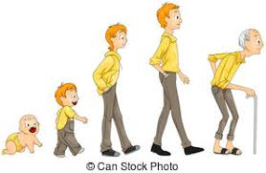
Erickson's Psychosocial Theory Stages
Tiffany represents the stage of industry vs inferiority
She will either learn the tasks of society or develops a sense of inadequacy
Carol represents the initiative versus guilt
She either exhibits exuberant activity or overcontrol
Seth represents identity versus role confusion
Integrates previous experiences to form an identity or feels confusion about his or her role in society

